Slide 1
Unlocking Financial Insights with AlgoFabric
Advanced AI Solutions for Manufacturing Excellence

Slide 2
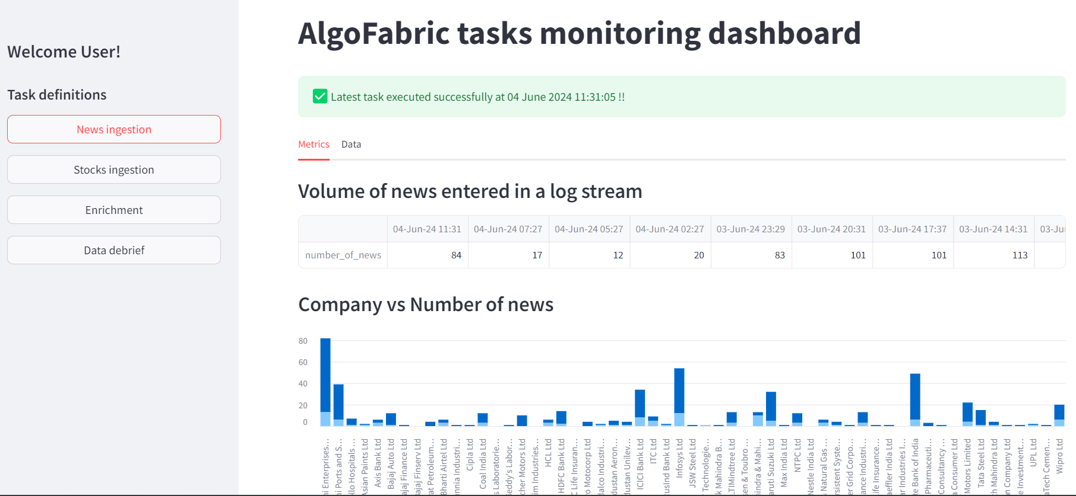
Overview of AlgoFabric
▸ AI-powered financial insights platform designed for stock research and analysis.
▸ Utilizes advanced natural language processing (NLP) and numerical data analysis.
▸ Offers a comprehensive view of market trends, news sentiments, and stock performance.
2/6

Slide 3
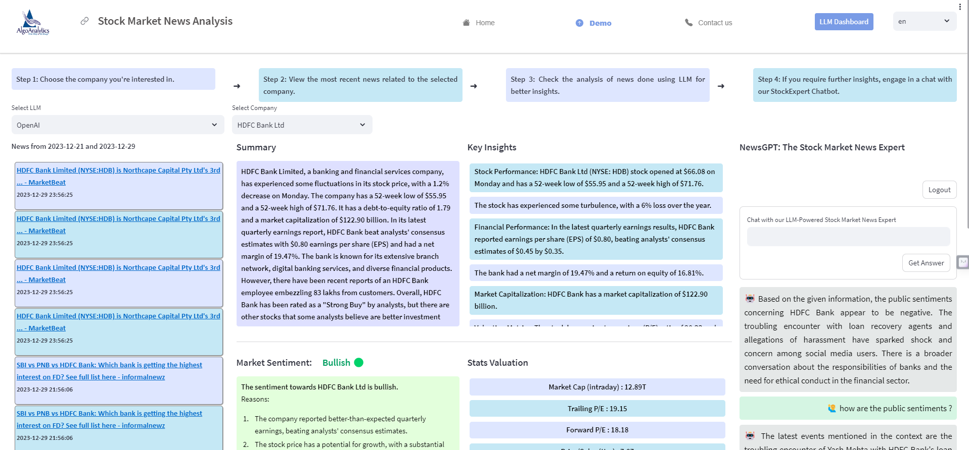
Key Features and Functionalities
▸ Real-time news aggregation and sentiment analysis for informed decision-making.
▸ Dashboard for monitoring backend tasks, enhancing operational efficiency.
▸ Stock picking and recommendation capabilities based on historical performance and market trends.
3/6

Slide 4
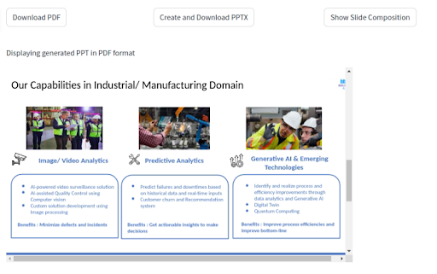
Generalization and Adaptability
▸ Designed to be adaptable across various domains, including sports, politics, and technology.
▸ Feature extraction techniques applicable to diverse datasets for broader insights.
▸ User interface components can be customized for different industry needs.
4/6

Slide 5
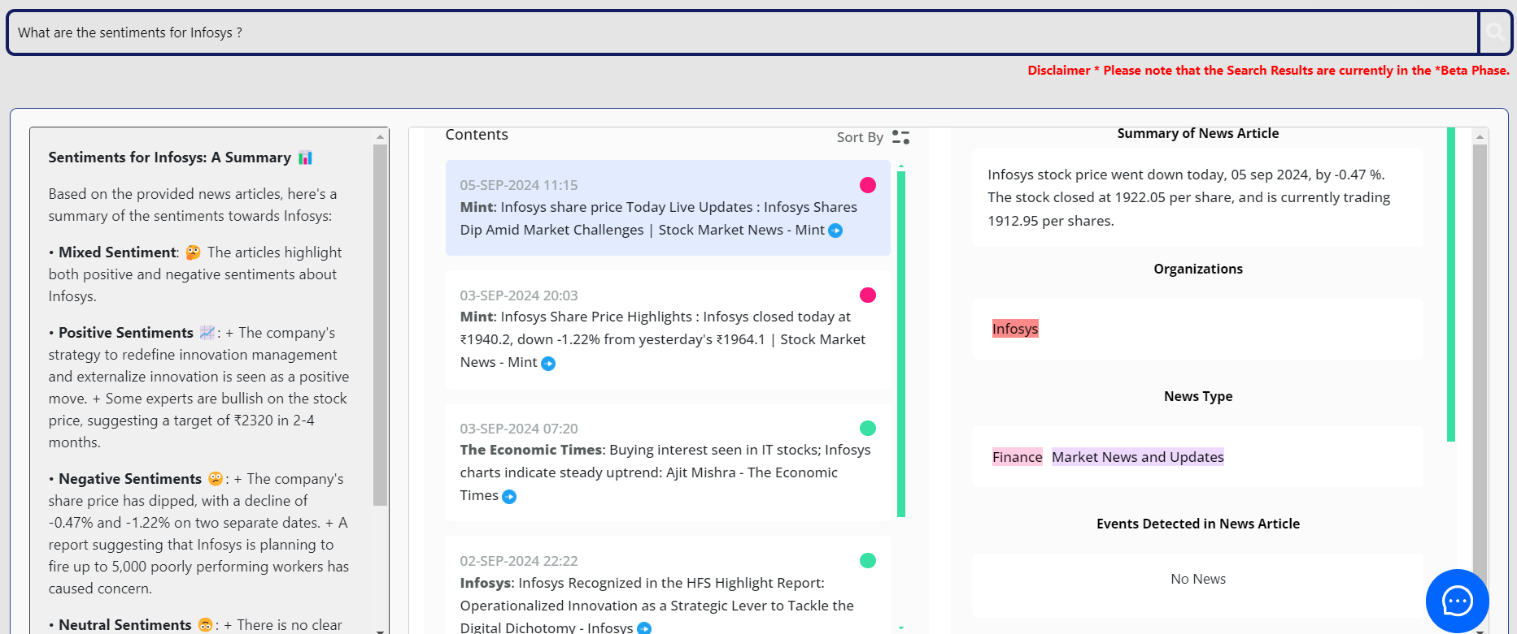
Upcoming Enhancements
▸ Introduction of a 'What's Trending' tab for quick identification of market movers.
▸ Enhanced mutual fund investment composition display for better asset management insights.
▸ Integration of small language models for faster and more specialized task handling.
5/6

Slide 6
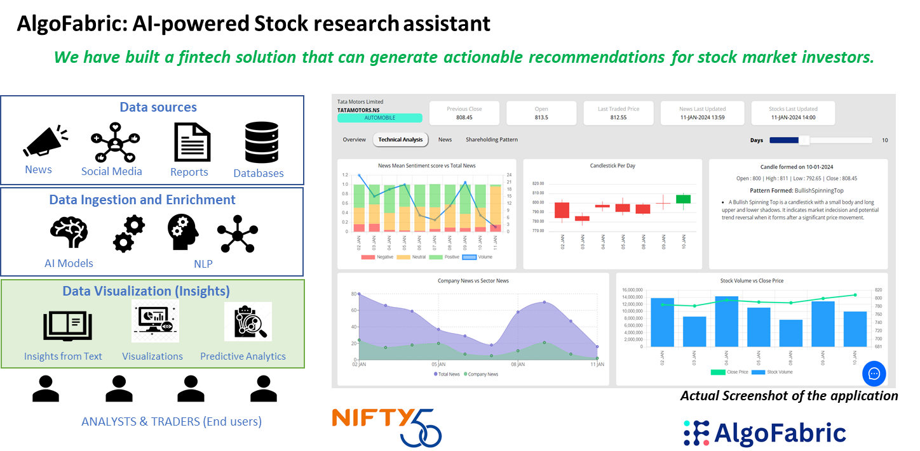
Business Value and Impact
▸ Empowers traders and investors with actionable insights and AI-based recommendations.
▸ Facilitates a 360-degree view of investment opportunities and risks.
▸ Aims to improve portfolio performance through data-driven strategies and insights.
6/6

