Slide 1
Introduction to Aksha
Advanced AI Solutions for Manufacturing Excellence

Slide 2

What is Aksha?
▸ Aksha is an intelligent surveillance system designed for automated monitoring.
▸ Utilizes advanced technologies including Computer Vision, Artificial Intelligence, and Gen AI.
▸ Capable of detecting objects and unusual situations with minimal human intervention.
2/10

Slide 3
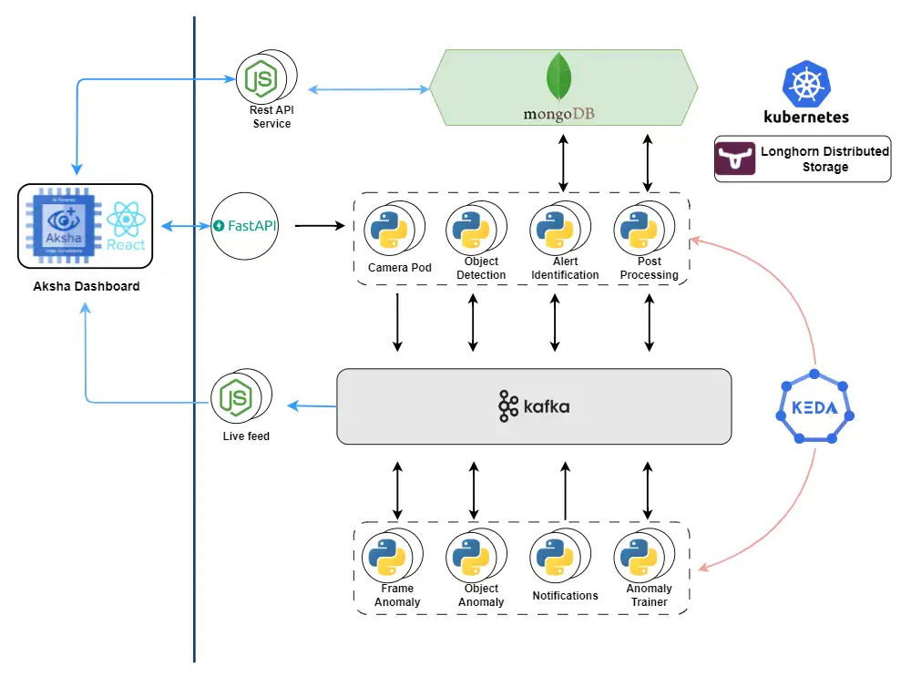
Key Features of Aksha
▸ Live recording and real-time data processing for immediate insights.
▸ Advanced object detection capabilities, identifying various objects and anomalies.
▸ Customizable alerts that allow users to respond quickly to incidents.
3/10

Slide 4
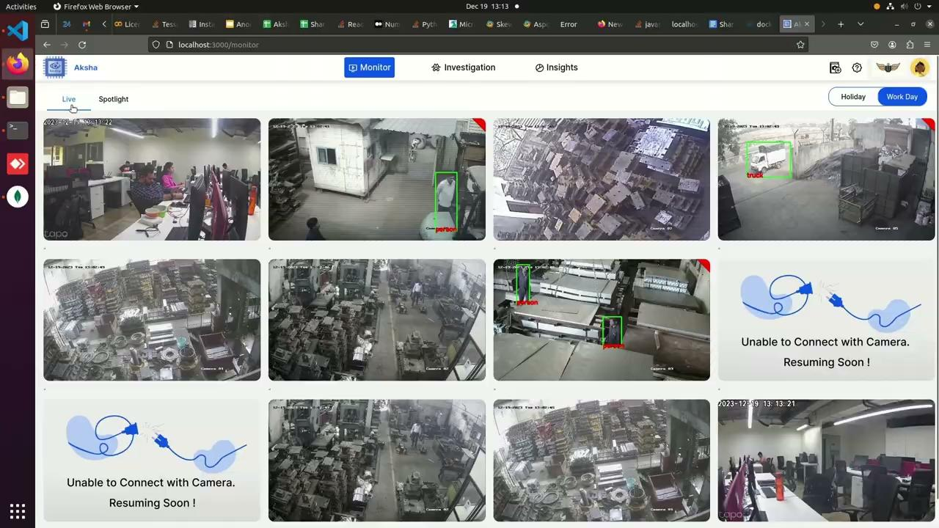
Architectural Approaches
▸ Multiple deployment options including Aksha on Edge and Cloud.
▸ Flexible architecture with UI and backend options tailored to business needs.
▸ Supports both on-premise and cloud-based solutions for scalability.
4/10

Slide 5
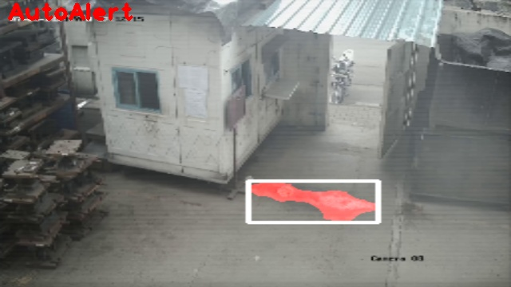
Collaboration with NDIL
▸ Customized version of Aksha developed for worker safety in collaboration with NDIL.
▸ Integration of Edge + Cloud architecture for enhanced performance.
▸ Phased development approach with continuous support and optimization.
5/10

Slide 6
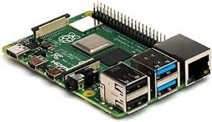
Phased Development Overview
▸ Phase I: Initial deployment on Raspberry Pi 4B with dual OS support.
▸ Phase II: Enhanced features using Gen AI and improved cloud architecture.
▸ Phase III: Final optimizations and advanced features for better user experience.
6/10

Slide 7
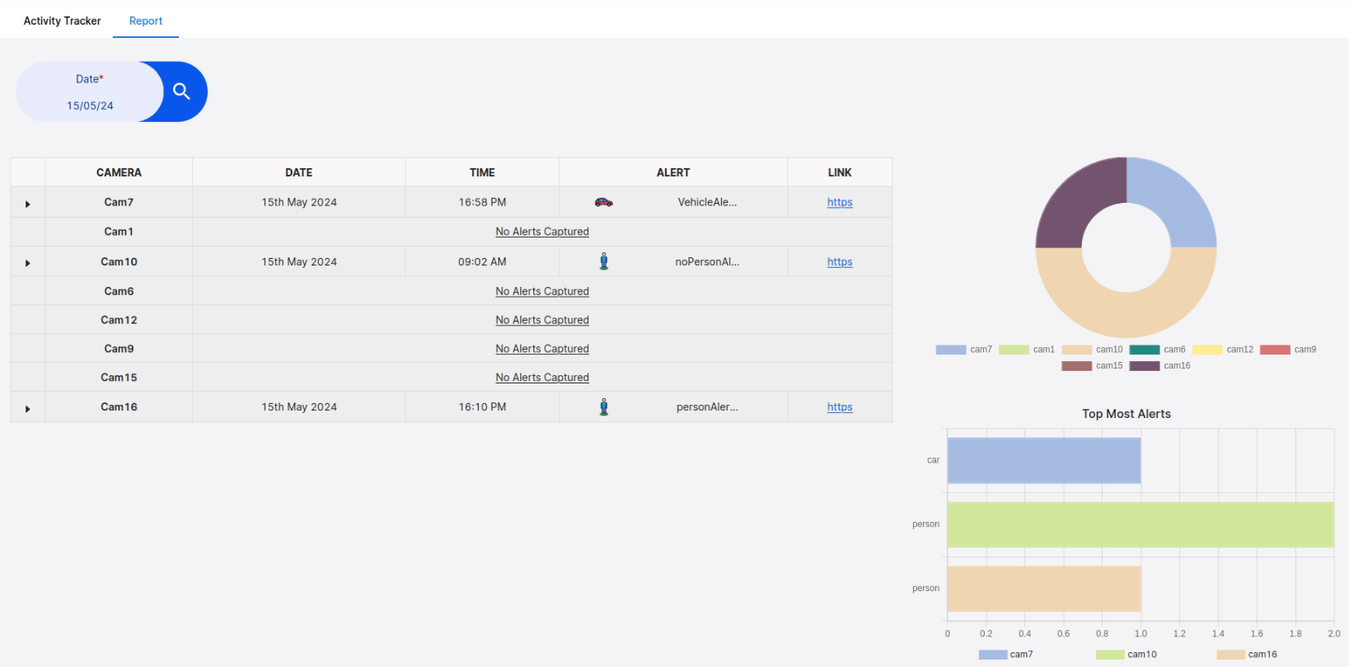
Business Value of Aksha
▸ Enhances employee safety by providing real-time monitoring and alerts.
▸ Reduces operational risks through automated anomaly detection.
▸ Improves decision-making with insightful report generation and analysis.
7/10

Slide 8
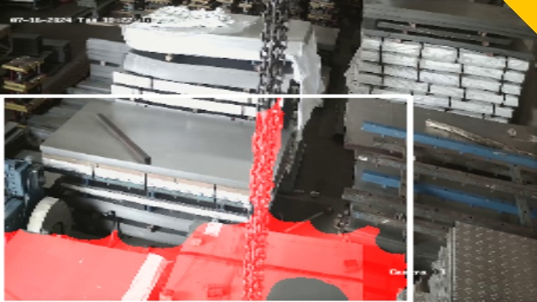
Practical Applications
▸ Ideal for businesses prioritizing workplace safety and security.
▸ Applicable in various sectors including manufacturing, logistics, and retail.
▸ Supports compliance with safety regulations through continuous monitoring.
8/10

Slide 9
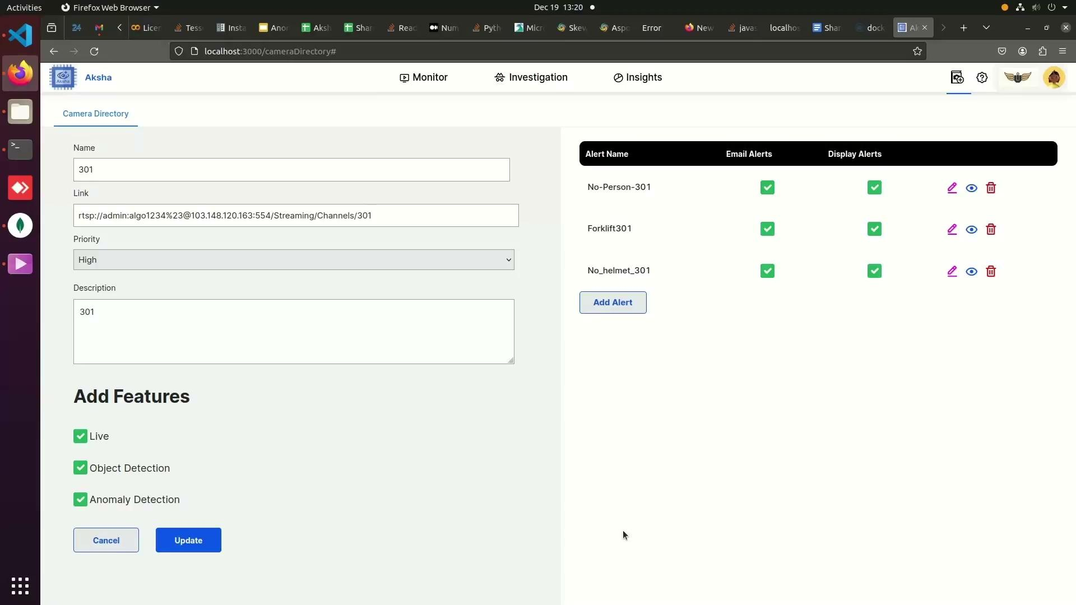
Contact Information
▸ For more information, visit: https://aksha.algoanalytics.com/
▸ Contact us at: aksha@algoanalytics.com
▸ Office Location: Alacrity India Innovation Centre, Pune.
9/10

Slide 10
Conclusion
▸ Aksha represents a significant advancement in intelligent surveillance technology.
▸ Combines AI and Gen AI to provide a robust solution for modern business challenges.
▸ Investing in Aksha enhances safety, efficiency, and operational excellence.
10/10

