Slide 1

Intro to Autonomy of Cars and GPU Units
AI-Powered Solution

Slide 2
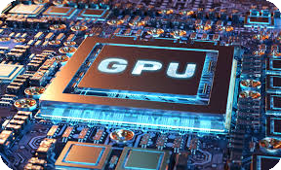
The Evolution of GPUs
• Transition from specialized 3D rendering units to general-purpose parallel processors.
• Optimized for massive parallel processing, enabling efficient data-intensive tasks.
• Core architecture supports high-performance computing, scientific simulations, and AI applications.
AI Presentation
2

Slide 3
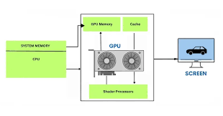
GPU's Role in AI and Deep Learning
• Accelerates time-to-discovery in complex computational science.
• Essential for training large neural networks, particularly in deep learning.
• High core density and memory bandwidth support rapid model iteration and optimization.
AI Presentation
3

Slide 4
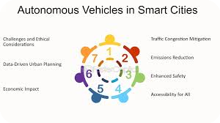
Autonomous Vehicles: A Disruptive Technology
• Promises reduced traffic congestion and optimized fuel efficiency.
• Aims to significantly lower accident rates caused by human error.
• Challenges include technical, legal, and ethical hurdles in achieving Level 5 autonomy.
AI Presentation
4

Slide 5
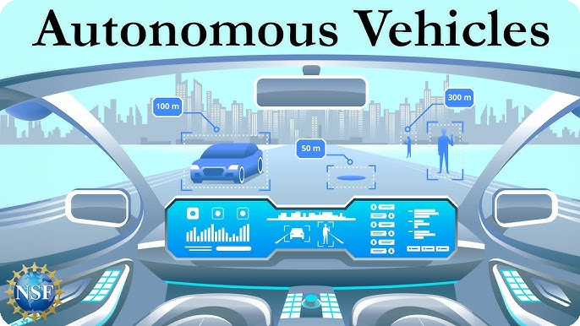
Sensor Fusion and Perception in AVs
• Relies on advanced sensors like LiDAR, radar, and high-resolution cameras.
• Accurate environmental perception is critical for safe navigation.
• Integration of sensor data is essential for real-time decision-making.
AI Presentation
5

Slide 6
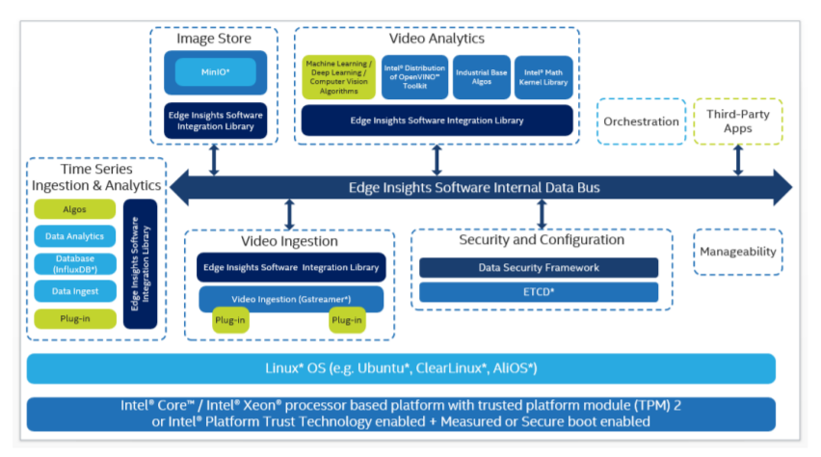
GPU Architecture and Its Impact on AV Technology
• Specialized hardware like Tensor Cores enhances deep learning capabilities.
• Parallel architecture allows for processing of multiple data streams simultaneously.
• Critical for real-time processing requirements in autonomous driving systems.
AI Presentation
6

Slide 7
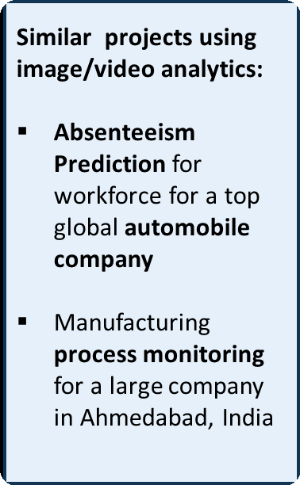
Business Value of Autonomous Vehicles and GPUs
• Potential for significant cost savings through improved efficiency and safety.
• Market growth driven by advancements in AI and GPU technology.
• Investment in AV technology can lead to competitive advantages in transportation and logistics.
AI Presentation
7

Slide 8
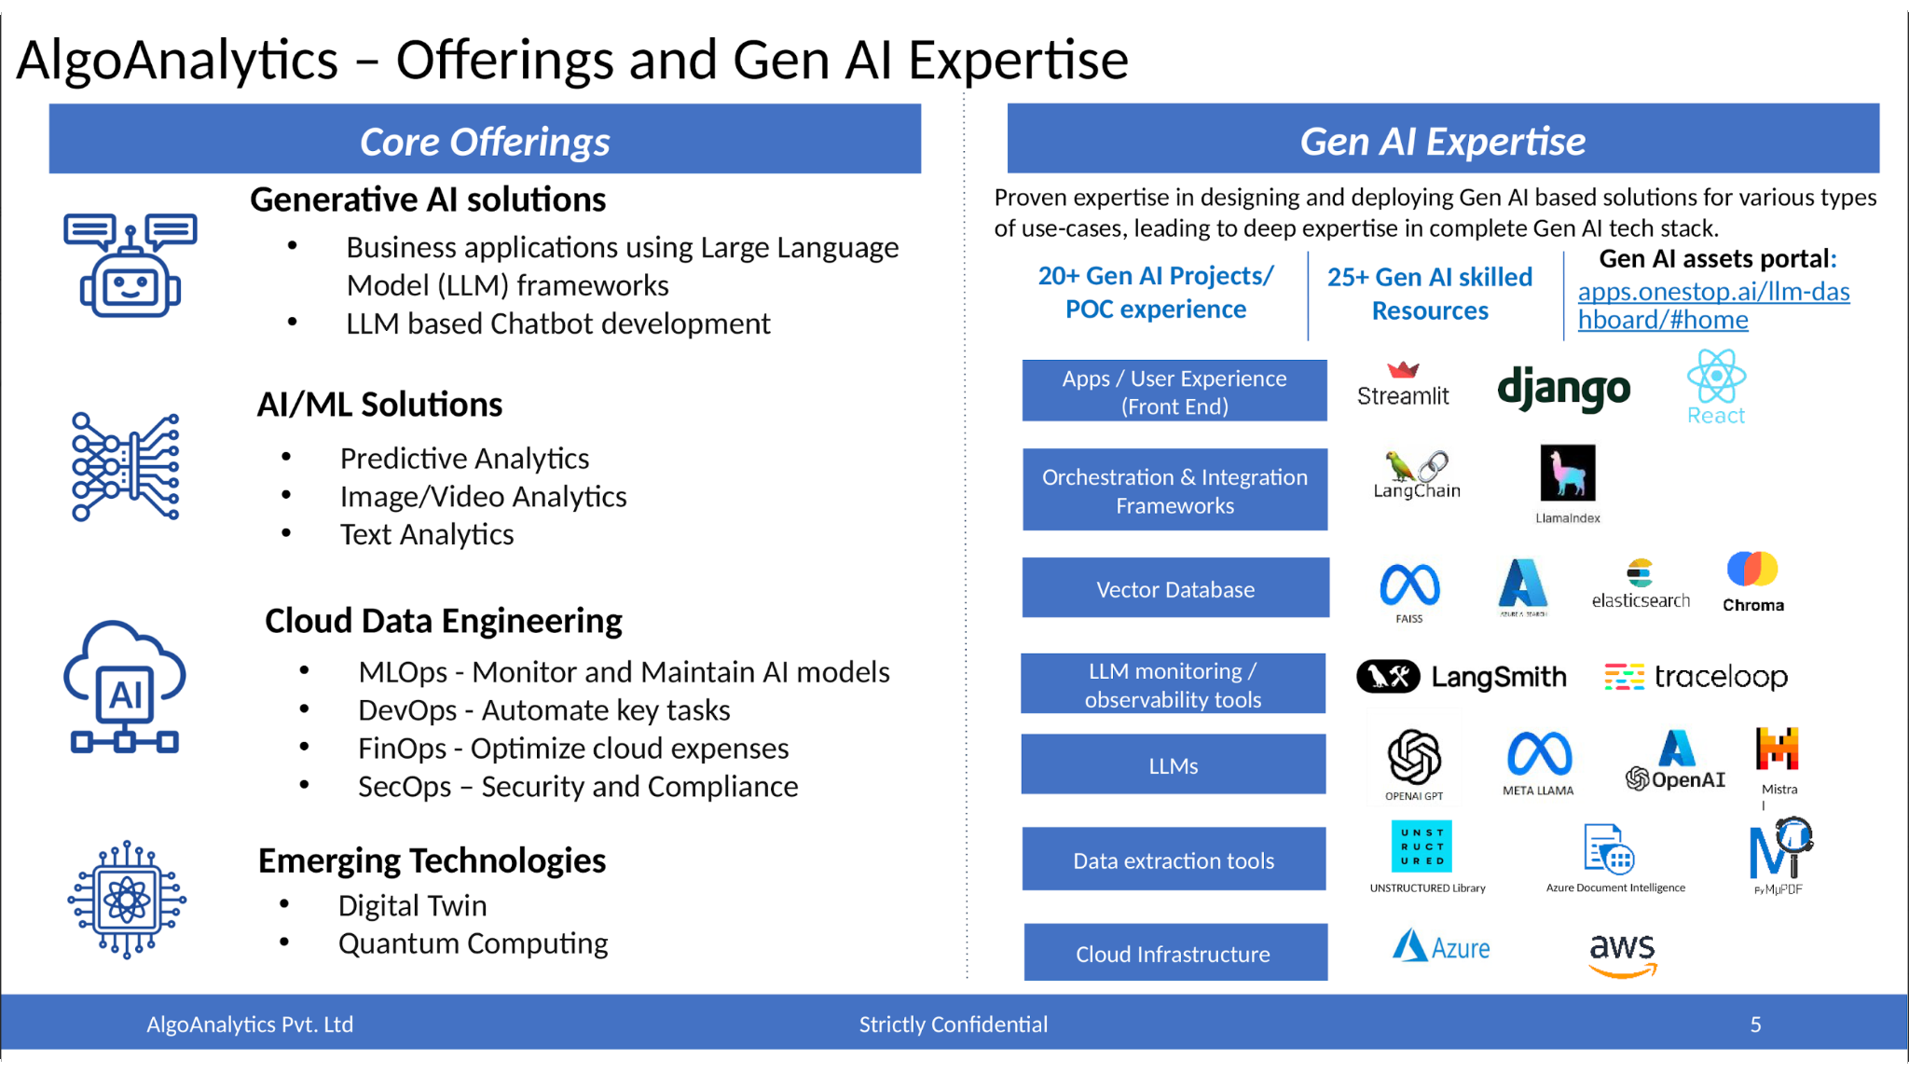
Future Trends and Considerations
• Continued evolution of GPU capabilities will enhance AV performance.
• Ethical and regulatory frameworks will shape the deployment of autonomous vehicles.
• Collaboration between tech and automotive industries is essential for innovation.
AI Presentation
8

