Slide 1
Introduction to Aksha
Advanced AI Solutions for Manufacturing Excellence

Slide 2

What is Aksha?
▸ • Aksha is an intelligent surveillance system designed for automated monitoring with minimal human intervention.
▸ • Utilizes advanced technologies such as Computer Vision, Artificial Intelligence, and Generative AI to enhance monitoring capabilities.
▸ • Key functionalities include object detection, anomaly detection, and real-time analysis of unusual situations.
This is a logo for "Aksha," featuring a stylized blue eye with a plus sign, symbolizing health or medical care. The background is a lighter blue square, and the brand name "Aksha" is displayed prominently below the eye design
2/7

Slide 3
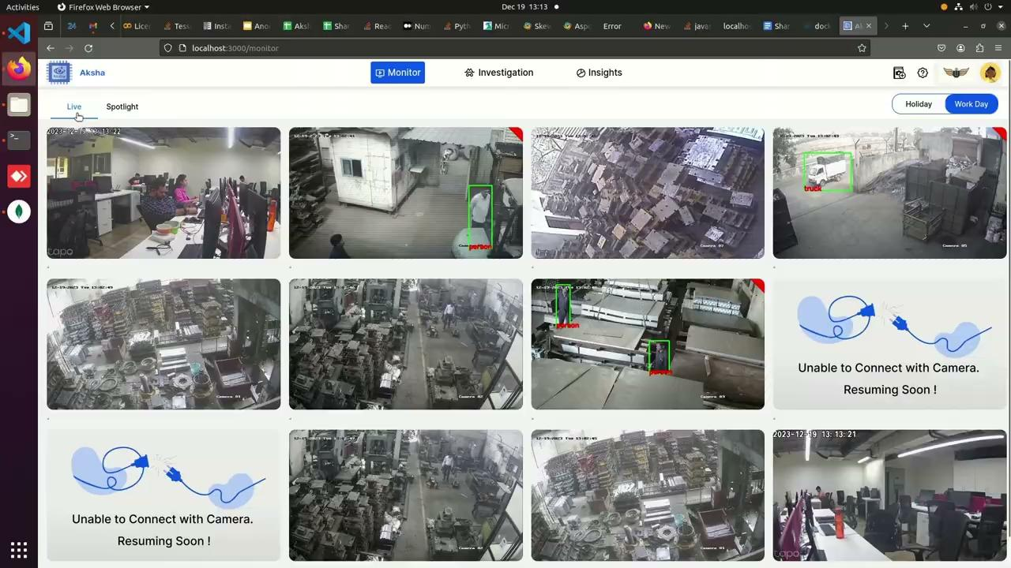
Architectural Approaches
▸ • Offers multiple architectural configurations: On-Premise, Edge, and Cloud solutions.
▸ • Supports seamless integration with existing CCTV infrastructure using standard RTSP links.
▸ • Decoupled architecture enhances fault tolerance and allows independent service development.
This is a screenshot of a surveillance monitoring interface displaying multiple camera feeds. The layout features several video thumbnails showing various indoor and outdoor scenes, including people and vehicles. Some thumbnails have green bounding boxes identifying detected objects like "person" and "truck." The
3/7

Slide 4
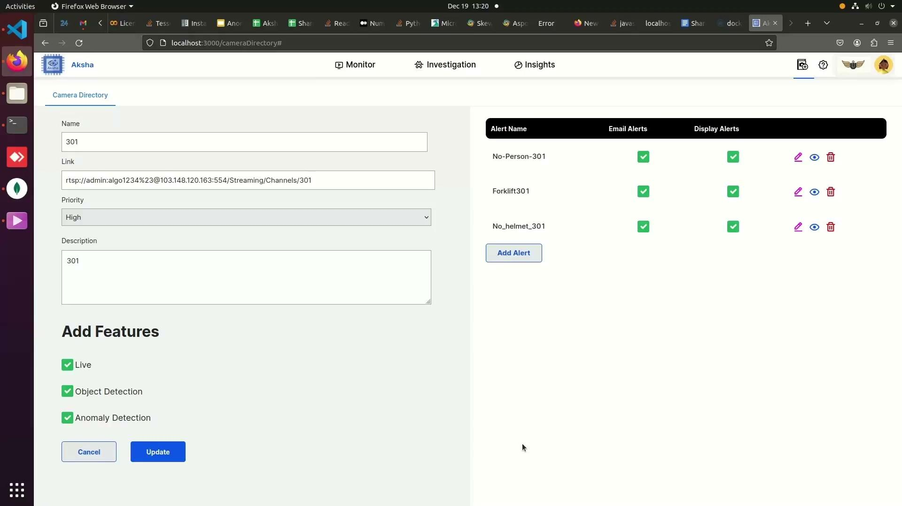
Key Features of Aksha
▸ • Live recording and processing of video data for immediate insights.
▸ • Advanced object detection capabilities, identifying various entities like vehicles, personnel, and anomalies.
▸ • Customizable alerts enable users to receive notifications tailored to specific scenarios.
This is a screenshot of a web application interface, specifically a camera directory management system. It displays fields for camera name, link, priority, and description, along with options to add features like live monitoring and object detection. On the right, alert settings
4/7

Slide 5
Customer Success Stories
▸ • Clients report significant reductions in human monitoring efforts and enhanced detection of unforeseen events.
▸ • Positive feedback highlights the system's ability to provide actionable insights and improve safety protocols.
▸ • Ongoing updates and innovations are anticipated to further enhance system capabilities.
5/7

Slide 6
Scalability and Performance
▸ • Effortless scalability through Kubernetes for managing microservices and high message volumes.
▸ • Real-time data processing ensures timely insights and actions, critical for operational efficiency.
▸ • High availability maintained through distributed messaging systems like Kafka.
6/7

Slide 7
Getting Started with Aksha
▸ • Installation requires connecting to the same network as existing DVR/NVR systems.
▸ • Compatible with any standard CCTV camera that supports RTSP links.
▸ • Comprehensive support and documentation available for seamless implementation.
7/7

