Slide 1
Introduction to Aksha

Slide 2

What is Aksha?
• Aksha is an intelligent surveillance system designed for automated monitoring with minimal human intervention.
• Utilizes advanced technologies such as Computer Vision, Artificial Intelligence, and Generative AI.
• Capable of detecting objects and unusual situations, enabling proactive responses.

Slide 3

Key Features of Aksha
• Live recording and real-time data processing for immediate insights.
• Advanced object detection capabilities, including monitoring for safety gear and unusual activities.
• Customizable alerts allow users to set specific notifications based on detected anomalies.

Slide 4
Architectural Approaches
• Flexible deployment options: Aksha can operate on-premise, in the cloud, or in hybrid configurations.
• Supports microservices architecture for scalability and resilience using Kubernetes.
• Real-time data streaming facilitated by Kafka for timely insights and actions.

Slide 5
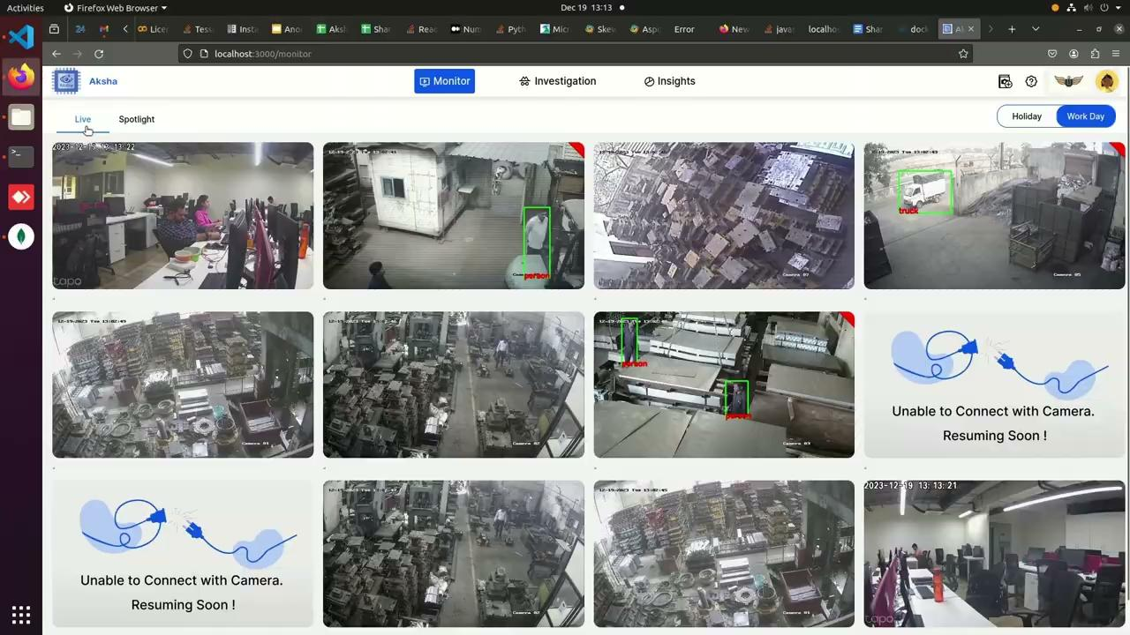
Client Success Stories
• Clients report significant reductions in human monitoring efforts and improved event detection.
• Positive feedback highlights Aksha's ability to transform traditional CCTV usage into proactive safety management.
• Ongoing updates and innovations are anticipated to enhance system capabilities further.

Slide 6
Installation and Compatibility
• Easy installation process: Requires connection to standard CCTV cameras providing RTSP links.
• Compatible with a wide range of CCTV systems, ensuring flexibility in deployment.
• Installation can be conducted on edge devices within the same network as DVR/NVR.

Slide 7
Future of Aksha
• Continuous enhancements through collaboration with industry partners like NDIL.
• Integration of Generative AI to improve anomaly detection and reporting capabilities.
• Commitment to scalability and performance improvements to meet growing market demands.

