Slide 1
Introduction to Aksha
Advanced AI Solutions for Manufacturing Excellence

Slide 2

Overview of Aksha
▸ Aksha is an intelligent surveillance system designed for automated environment monitoring.
▸ Utilizes advanced technologies such as Computer Vision, Artificial Intelligence, and Generative AI.
▸ Aims to minimize human intervention while enhancing security and operational efficiency.
2/7

Slide 3
Architectural Approaches
▸ Offers multiple deployment models: Aksha on Edge, Aksha UI & Backend on Edge, and Aksha on Cloud.
▸ Supports hybrid configurations for flexibility in resource management.
▸ Designed for scalability and ease of integration with existing systems.
3/7

Slide 4
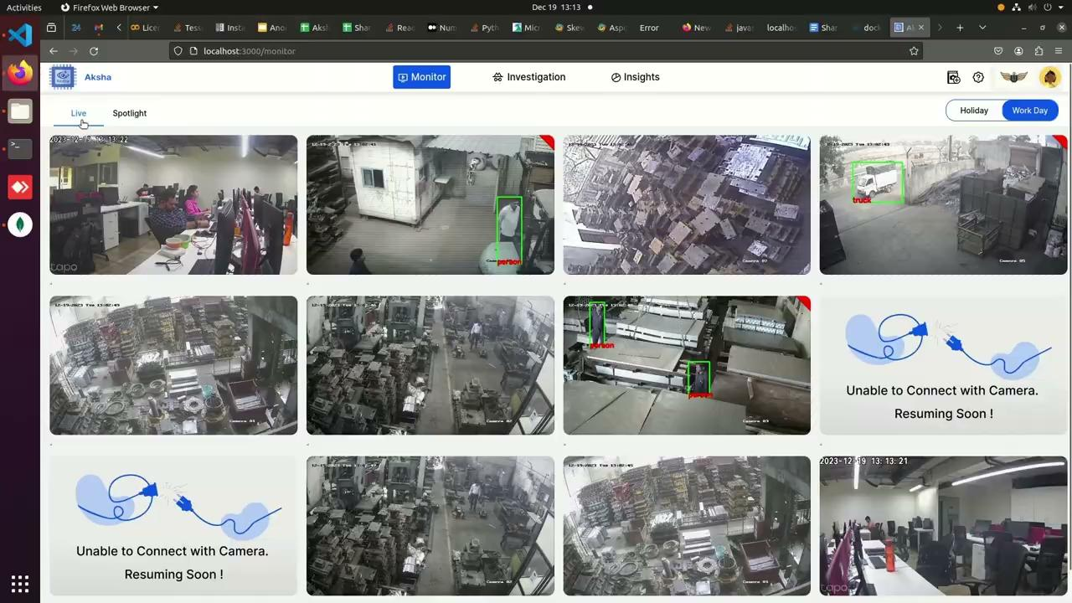
Key Features of Aksha
▸ Real-time object detection and anomaly identification using AI.
▸ Customizable alerts for various scenarios, enhancing user responsiveness.
▸ Generates insightful reports and analytics to support decision-making.
4/7

Slide 5
Collaboration and Customization
▸ Collaboration with NDIL led to the development of 'Aksha for Workers Safety'.
▸ Implemented a robust Edge + Cloud architecture for enhanced performance.
▸ Continuous improvements through phases, including Gen AI integration for better feature sets.
5/7

Slide 6
Customer Testimonials
▸ Clients report significant reductions in human monitoring efforts.
▸ Enhanced ability to detect and respond to abnormal events, improving safety.
▸ Positive feedback on the innovative use of CCTV technology for proactive security measures.
6/7

Slide 7
Scalability and Future Prospects
▸ Utilizes Kubernetes for effortless scalability and microservices management.
▸ Real-time data processing capabilities ensure timely insights and actions.
▸ Future developments aim to further enhance Aksha’s features and user experience.
7/7

