Slide 1
Introduction to Aksha
Advanced AI Solutions for Manufacturing Excellence

Slide 2

Overview of Aksha
KEY POINTS
▸ • Aksha is an intelligent surveillance system designed for automated monitoring with minimal human intervention.
▸ • Utilizes advanced technologies such as Computer Vision, Artificial Intelligence, and Generative AI for real-time analysis.
▸ • Capabilities include object detection, anomaly identification, and actionable insights for enhanced security.
2/6

Slide 3
Architectural Approaches
KEY POINTS
▸ • Flexible deployment options: Aksha can operate on Edge, Cloud, or a hybrid of both, catering to diverse business needs.
▸ • Supports microservices architecture for improved scalability and fault tolerance.
▸ • Real-time data processing capabilities ensure timely insights and proactive responses.
🖼️
Visual Content
3/6

Slide 4
Collaboration and Customization
KEY POINTS
▸ • In collaboration with NDIL, Aksha has been customized for worker safety, enhancing operational efficiency.
▸ • Phased development approach: Continuous improvements through Gen AI integration and architectural optimizations.
▸ • Successful implementation on Raspberry Pi 4B, demonstrating versatility and cost-effectiveness.
🖼️
Visual Content
4/6

Slide 5
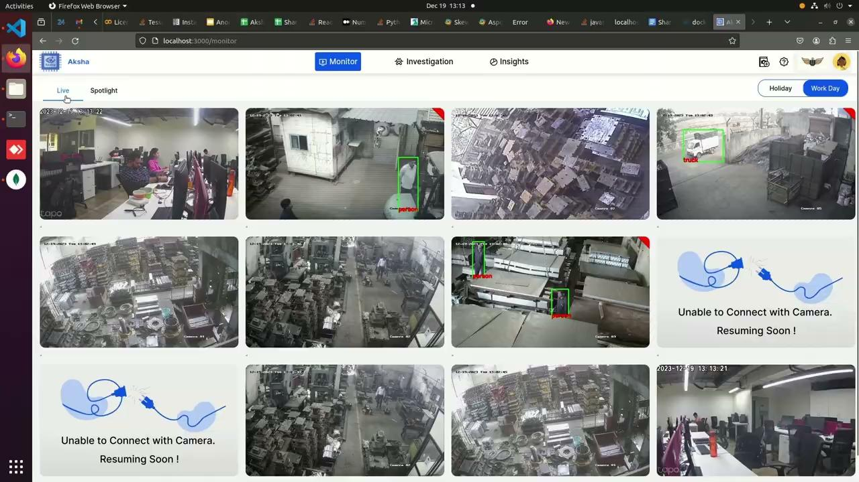
Customer Testimonials
KEY POINTS
▸ • Clients report significant reductions in human monitoring efforts and enhanced detection of unforeseen events.
▸ • Positive feedback highlights Aksha's ability to provide actionable insights, improving overall security posture.
▸ • Customers express eagerness for future updates and innovations, showcasing trust in Aksha's evolving capabilities.
5/6

Slide 6

Installation and Compatibility
KEY POINTS
▸ • Aksha is compatible with any standard CCTV camera that supports RTSP links, ensuring broad applicability.
▸ • Installation involves straightforward steps, making it accessible for various operational environments.
▸ • Customizable alerts and live data processing enhance user experience and operational responsiveness.
6/6

