Slide 1
Introduction to Aksha
Advanced AI Solutions for Manufacturing Excellence

Slide 2

Overview of Aksha
▸ Aksha is an intelligent surveillance system designed for automatic monitoring with minimal human intervention.
▸ Utilizes advanced technologies such as Computer Vision, Artificial Intelligence, and Generative AI.
▸ Key functionalities include object detection, anomaly detection, and real-time analysis.
2/7

Slide 3
Architectural Approaches
▸ Multiple deployment options: Aksha on Edge, Aksha UI & Backend on Edge, and Aksha on Cloud.
▸ Flexible architecture allows for integration with existing systems and scalability.
▸ Supports real-time data processing and high availability through Kubernetes and Kafka.
3/7

Slide 4
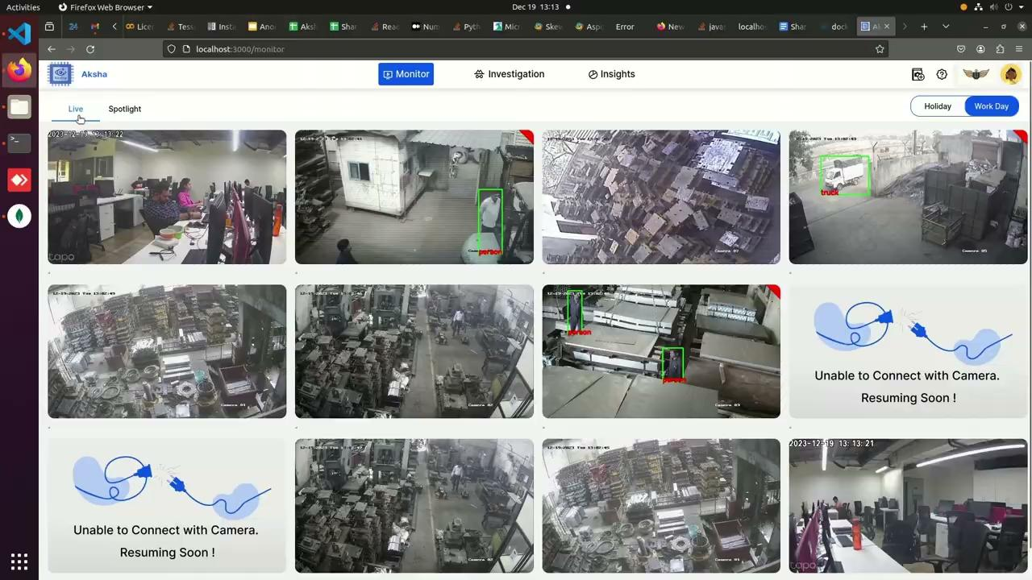
Key Features of Aksha
▸ Live recording and processing of surveillance data for immediate insights.
▸ Advanced object detection capabilities, including identification of personnel, vehicles, and unusual behaviors.
▸ Customizable alerts and reporting features, enabling users to tailor notifications to specific needs.
4/7

Slide 5
Collaboration and Customization
▸ Collaboration with NDIL to customize Aksha for worker safety, enhancing its utility in industrial settings.
▸ Implemented a phased approach to development, integrating Generative AI for improved functionality.
▸ Successful proof of concept on Raspberry Pi 4B, demonstrating versatility and cost-effectiveness.
5/7

Slide 6
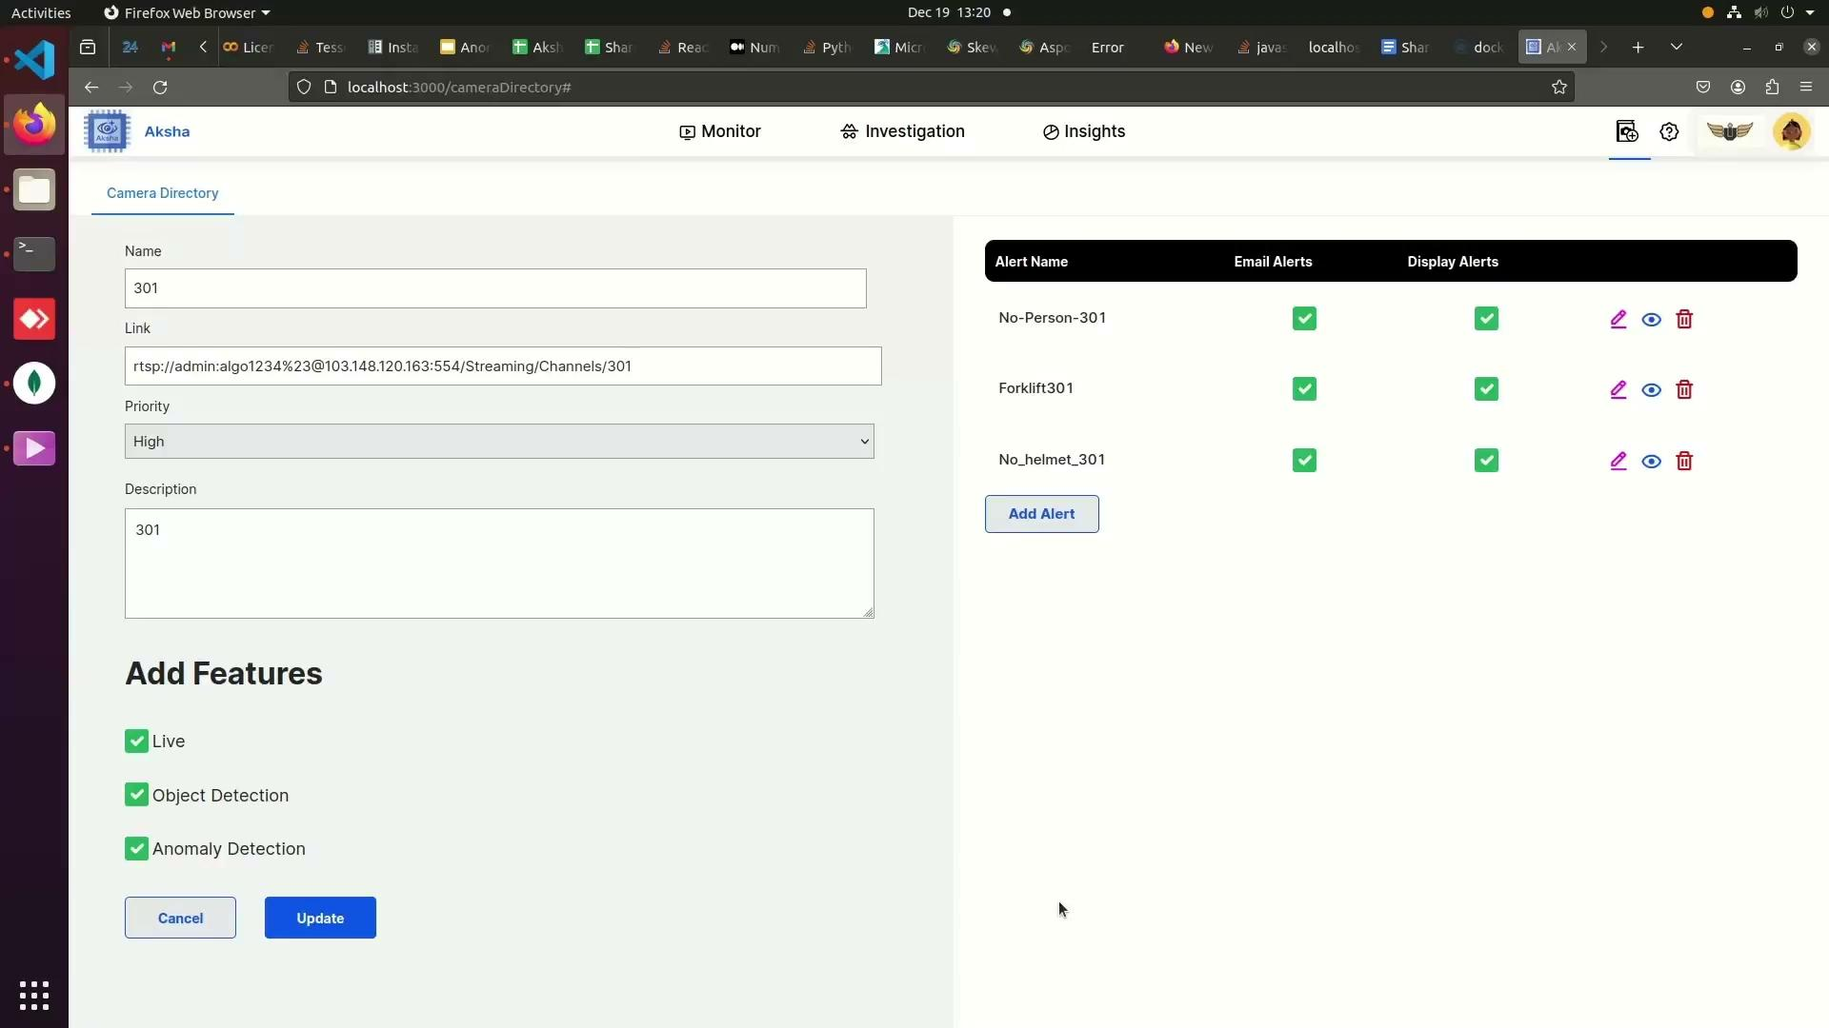
Customer Testimonials
▸ Clients report significant reductions in human monitoring efforts and enhanced detection of abnormal events.
▸ Positive feedback on the system's ability to provide actionable insights and improve safety measures.
▸ Customers express eagerness for future updates and innovations from Aksha.
6/7

Slide 7
Scalability and Future Prospects
▸ Effortless scalability through microservices architecture, enabling easy adaptation to growing needs.
▸ Real-time data processing capabilities ensure timely responses to security incidents.
▸ Commitment to continuous improvement and innovation in AI-powered surveillance solutions.
7/7

