Slide 1
Unlocking Business Potential with Agentic AI and AI Agents

Slide 2
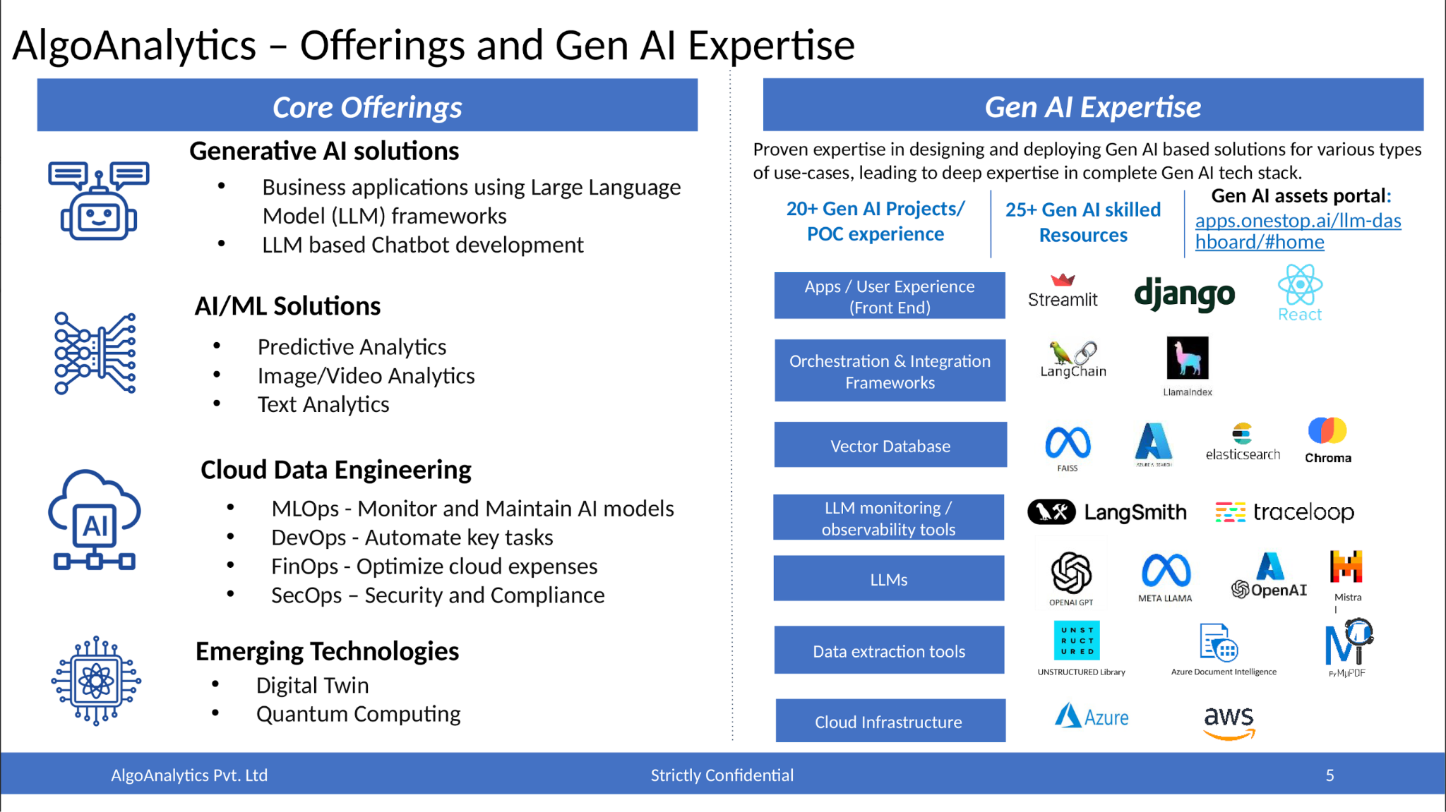
Introduction to Agentic AI
• Agentic AI leverages advanced algorithms to create intelligent agents capable of autonomous decision-making.
• Focuses on implementing 11 distinct Agentic Patterns to enhance operational efficiency.
• Supports various industries by automating processes and improving user interactions.

Slide 3
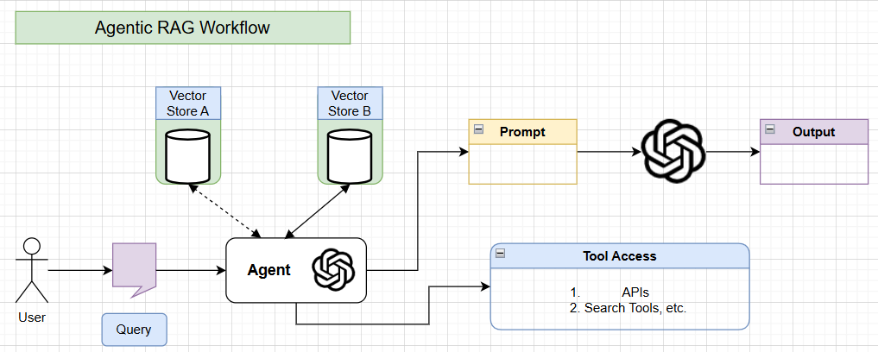
Key Features of Agentic AI
• Adaptive Processing: Dynamic workflow optimization to enhance productivity.
• Multi-Agent Collaboration: Seamless interaction between specialized agents for complex tasks.
• Intelligent Routing: Smart query distribution to ensure optimal agent selection.

Slide 4
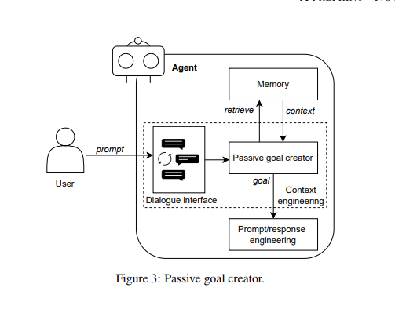
The 11 Agentic Patterns
• Passive and Proactive Goal Creators to align agent actions with business objectives.
• Prompt/Response Optimizer and Retrieval-Augmented Generation (RAG) for enhanced information retrieval.
• Human Reflection and Multimodal Guardrails to ensure user-centric design and safety.

Slide 5
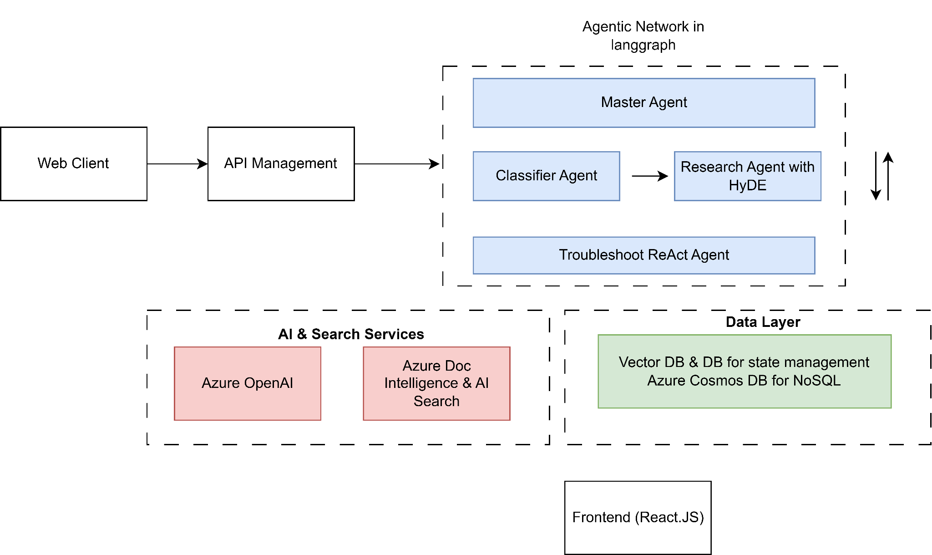
Implementation Strategy
• Phased implementation over three months, focusing on research and practical applications.
• Utilization of the Dify platform for deploying individual agents and multi-agent systems.
• Integration of all agents into a single user interface for streamlined operations.

Slide 6
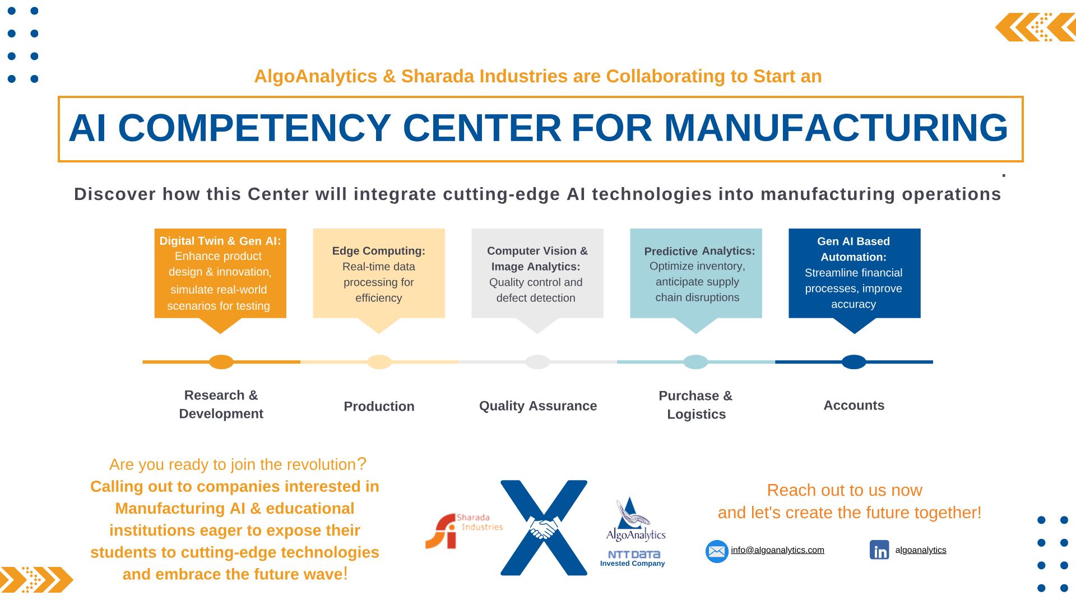
Business Value of Agentic AI
• Increases operational efficiency by automating routine tasks and decision-making.
• Enhances customer engagement through personalized interactions and timely responses.
• Facilitates data-driven insights for strategic decision-making and market analysis.

Slide 7
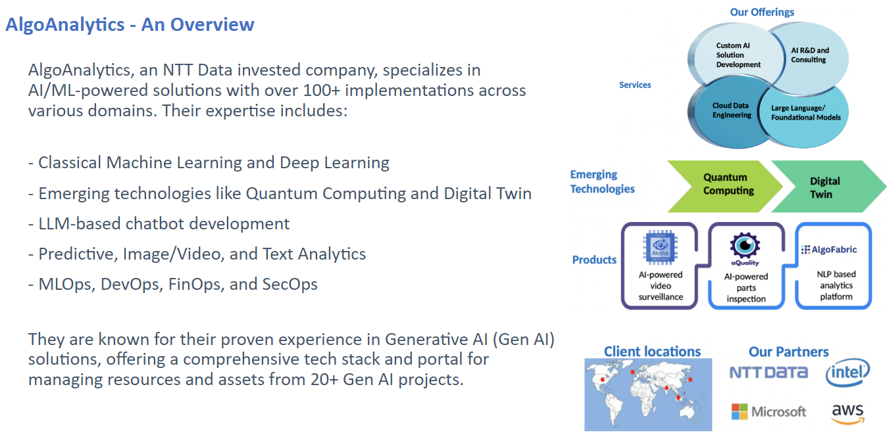
Practical Applications
• Market Research Assistant: Multi-agent collaboration for comprehensive data analysis.
• Customer Support: AI agents providing 24/7 assistance and query resolution.
• Sales Optimization: Automated lead generation and follow-up processes.

Slide 8
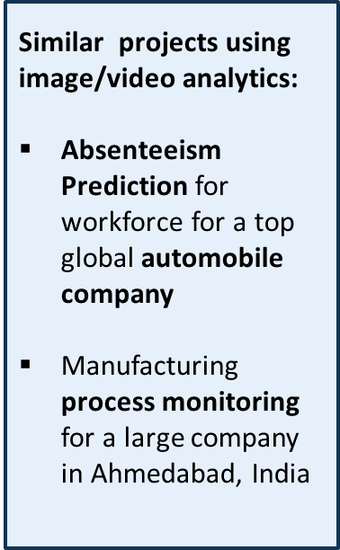
Case Studies and Success Stories
• Showcase of successful implementations across various sectors, including finance and retail.
• Demonstrated ROI through increased efficiency and reduced operational costs.
• Testimonials from clients highlighting improved customer satisfaction and engagement.

Slide 9
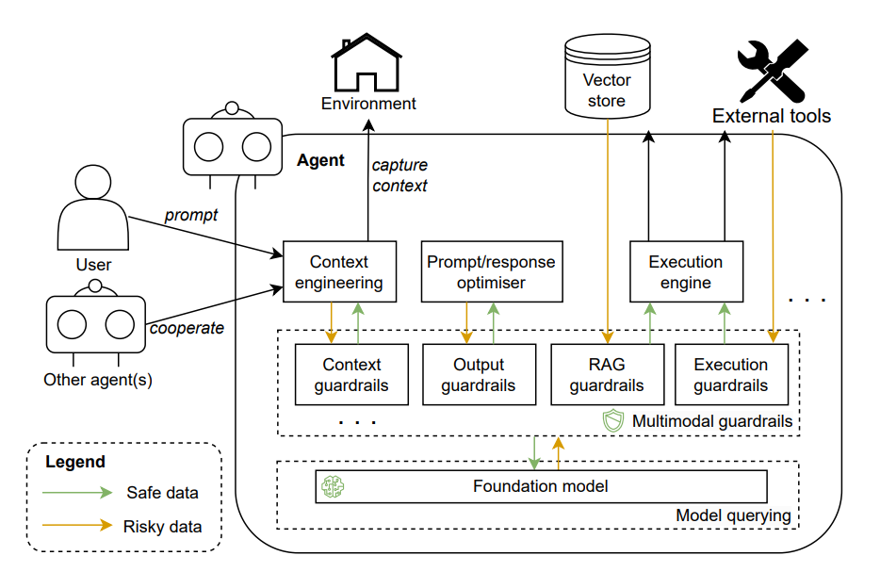
Future of Agentic AI
• Ongoing research and development to refine agent capabilities and expand use cases.
• Potential for integration with emerging technologies like IoT and blockchain.
• Vision for a fully autonomous agent ecosystem that adapts to business needs.

Slide 10
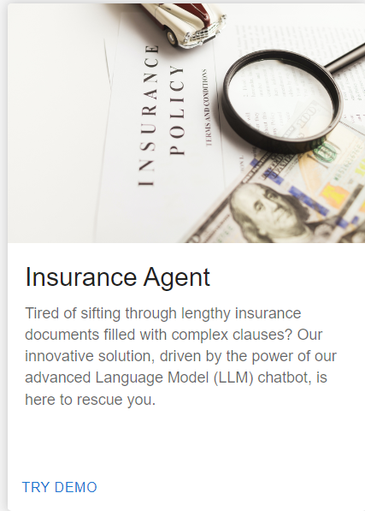
Call to Action
• Explore how Agentic AI can transform your business operations.
• Schedule a consultation to discuss tailored solutions for your organization.
• Join the forefront of AI innovation and drive your business to new heights.

