Slide 1
Intro to Autonomy of Cars

Slide 2
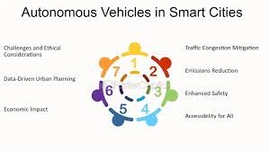
Understanding Autonomous Vehicles
• Definition of Autonomous Vehicles (AVs) and their classification levels.
• Overview of the technology driving AVs, including AI and machine learning.
• Potential impact on transportation systems and urban planning.

Slide 3
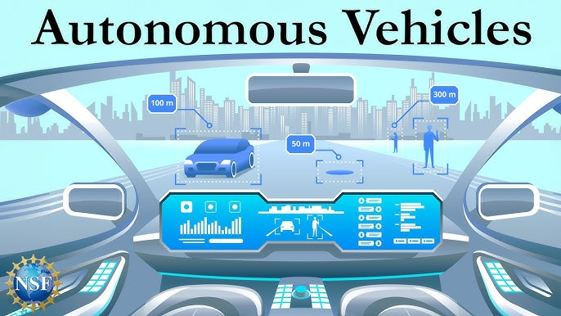
Business Value of Autonomous Vehicles
• Reduction in traffic congestion leading to increased productivity.
• Significant decrease in accident rates, lowering insurance costs.
• Potential for new revenue streams through ride-sharing and delivery services.

Slide 4
Technical Challenges in AV Development
• Complexity of sensor fusion and the need for accurate environmental perception.
• Challenges in navigating unpredictable real-world scenarios.
• Integration of advanced sensors like LiDAR, radar, and cameras for reliable operation.

Slide 5
Ethical and Legal Considerations
• Addressing liability in the event of accidents involving AVs.
• Navigating regulatory frameworks and compliance for deployment.
• Ethical implications of decision-making algorithms in critical situations.

Slide 6
Current Market Landscape
• Overview of key players in the autonomous vehicle industry.
• Recent advancements and pilot programs in various regions.
• Investment trends and market forecasts for AV technology.

Slide 7
Future Trends in Autonomous Vehicles
• Emerging technologies that will enhance AV capabilities.
• Predictions for the timeline of achieving Level 5 autonomy.
• Potential societal changes driven by widespread AV adoption.

Slide 8
Conclusion and Call to Action
• Recap of the transformative potential of autonomous vehicles.
• Encouragement for stakeholders to engage in AV initiatives.
• Invitation for collaboration in addressing challenges and leveraging opportunities.

