Slide 1
Generative AI in Fintech

Slide 2
The Rise of Generative AI
• Generative AI is transforming the Fintech landscape by enabling innovative solutions.
• The market is projected to grow at a CAGR of 36.1% from 2023 to 2030, reaching $10 billion.
• Key applications include compliance, fraud detection, and customer service enhancements.

Slide 3
Applications Across Fintech Segments
• Generative AI is utilized in risk management, credit scoring, and wealth management.
• Synthetic data generation aids in compliance and fraud detection, reducing false positives.
• Customer behavior analytics powered by AI enhances personalized financial services.

Slide 4
Adoption by Industry Leaders
• Capital One and JPMorgan Chase leverage Generative AI for fraud detection, improving accuracy and customer satisfaction.
• Morgan Stanley utilizes OpenAI to provide insights for financial advisors, enhancing decision-making.
• Wells Fargo focuses on automating document processing and scaling virtual assistant capabilities.

Slide 5
Market Trends and Insights
• Compliance and fraud detection dominated applications in 2022, accounting for 19.1% of the market.
• Investment banking remains a significant segment for Generative AI deployment.
• North America led revenue share in 2022, with a focus on on-premise solutions.

Slide 6
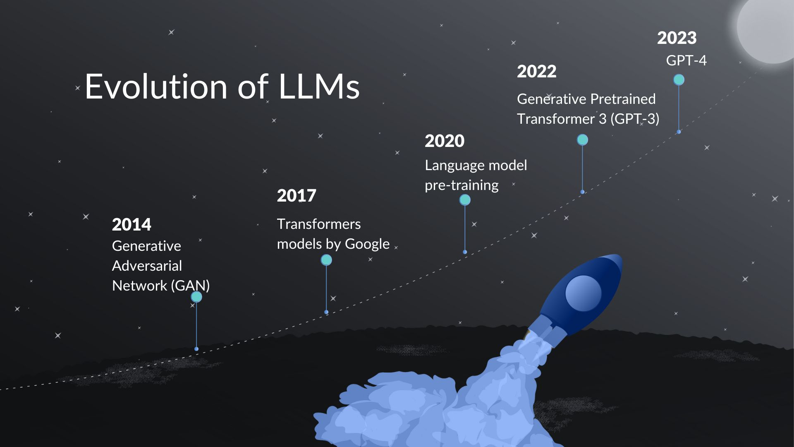
Future of Generative AI in Fintech
• The evolution of Large Language Models (LLMs) is driving the Generative AI boom.
• Emergence of vector databases enhances data processing capabilities for financial applications.
• A shift towards explainable AI (XAI) is crucial for regulatory compliance and trust.

Slide 7
Case Studies and Success Stories
• Goldman Sachs and Citadel explore Generative AI for internal software development and analytics.
• Successful implementation of AI-driven solutions leads to significant cost reductions.
• Real-world applications demonstrate improved operational efficiency and customer engagement.

Slide 8
Our Journey and Future Directions
• At AlgoAnalytics, we are committed to exploring diverse applications of Generative AI.
• Our approach involves using advanced ML frameworks to create customizable technology solutions.
• We aim to lead the Fintech sector in innovative AI-driven transformations.

