Slide 1
Harnessing the Power of GPUs for Business Innovation
Advanced AI Solutions for Manufacturing Excellence

Slide 2
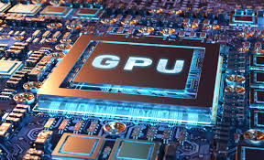
Understanding the GPU Evolution
▸ Originally designed for 3D graphics rendering in gaming, GPUs have evolved into essential tools for data processing.
▸ Transitioned from specialized circuits to general-purpose parallel processors, enabling diverse applications.
▸ Key differentiator: GPUs are optimized for massive parallel processing, unlike CPUs which focus on sequential task execution.
2/7

Slide 3
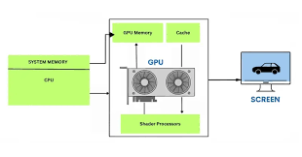
Architectural Advantages of GPUs
▸ Utilize thousands of smaller cores for high throughput, allowing simultaneous execution of multiple threads.
▸ Ideal for 'embarrassingly parallel' problems, significantly outperforming CPUs in data-intensive tasks.
▸ High-speed matrix multiplications across cores enable rapid processing for complex computations.
3/7

Slide 4
GPU Applications in AI and Deep Learning
▸ Critical for training large neural networks, reducing time for model training significantly.
▸ Supports complex linear algebra operations essential for natural language processing and computer vision.
▸ Facilitates real-time data processing, enhancing decision-making capabilities in business environments.
4/7

Slide 5
Impact on High-Performance Computing (HPC)
▸ Empowers scientific simulations in fields like molecular dynamics, astrophysics, and financial modeling.
▸ GPU clusters enable unprecedented scales and resolutions in simulations, driving innovation in research.
▸ Accelerates time-to-discovery, making complex computational science faster and more energy-efficient.
5/7

Slide 6
Business Value of GPU Technology
▸ Enhances operational efficiency by enabling faster data processing and analysis.
▸ Supports the development of AI-driven solutions, providing a competitive edge in the market.
▸ Reduces costs associated with computational resources through energy-efficient processing.
6/7

Slide 7
Future Trends and Considerations
▸ As AI models grow in complexity, GPUs will remain central to technological advancements.
▸ Investment in GPU technology is crucial for businesses aiming to leverage big data and AI.
▸ Continuous evolution in GPU architecture will drive further innovations across various industries.
7/7

