Slide 1

Unlocking Financial Insights with Algofabric
AI-Powered Solution

Slide 2
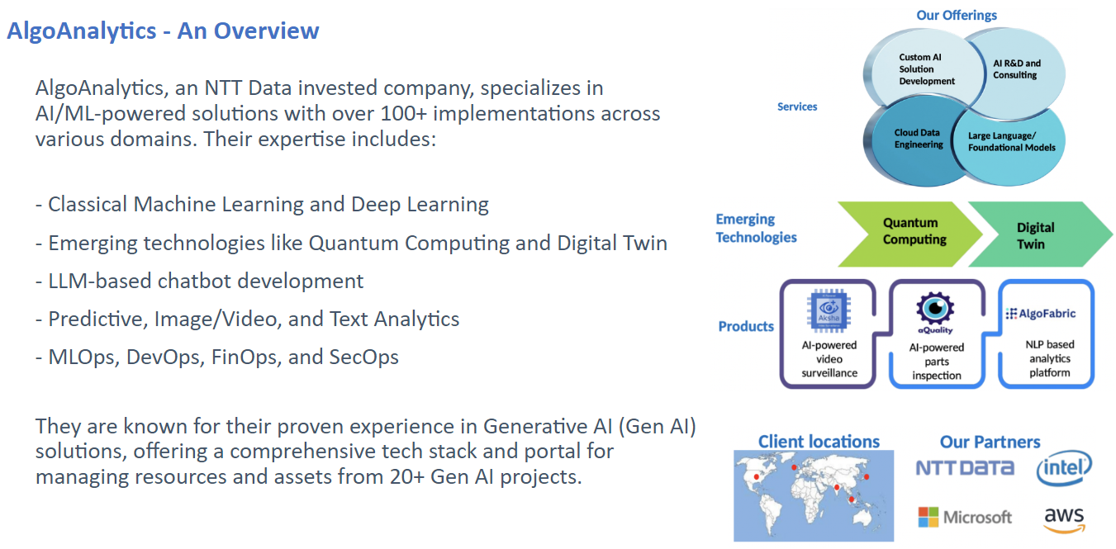
Introduction to Algofabric
• AI-powered stock research assistant designed for financial professionals.
• Integrates advanced Natural Language Processing (NLP) with numerical data analysis.
• Provides actionable insights and recommendations for investment strategies.
AI Presentation
2

Slide 3
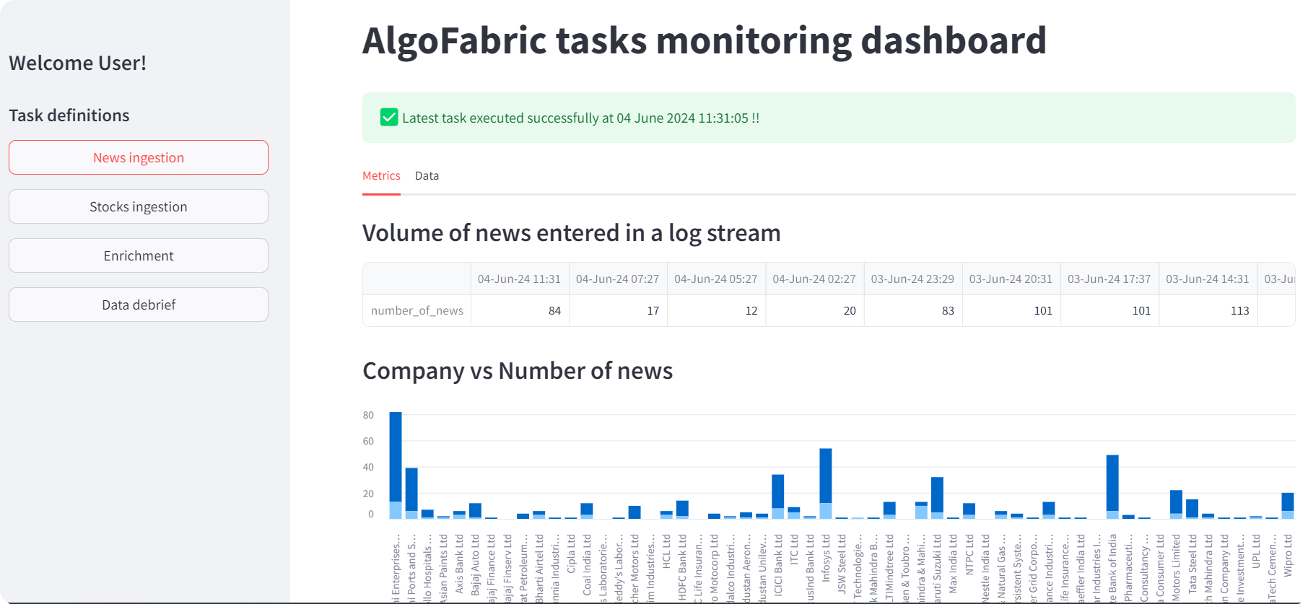
Key Features of Algofabric
• Data-driven insights from unstructured data sources such as news articles.
• Real-time sentiment analysis and trending topics for informed decision-making.
• Personalized information digest tailored to user preferences and interests.
AI Presentation
3

Slide 4
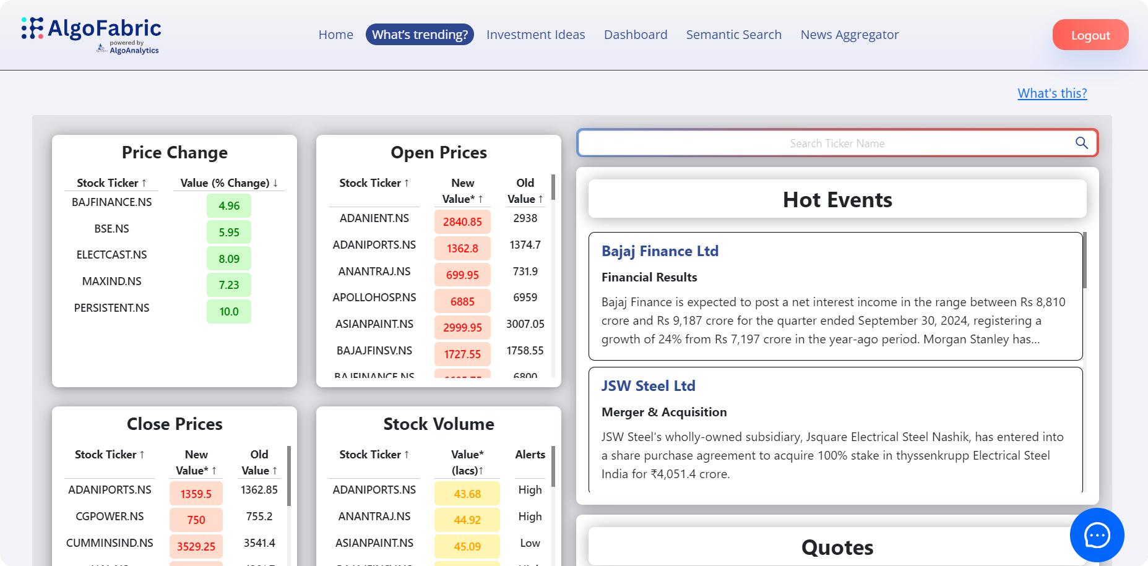
Platformification of Algofabric
• Transitioning to a SaaS platform for enhanced accessibility and scalability.
• Facilitates integration with various financial tools and applications.
• Supports a wide range of domains, including sports, politics, and technology.
AI Presentation
4

Slide 5
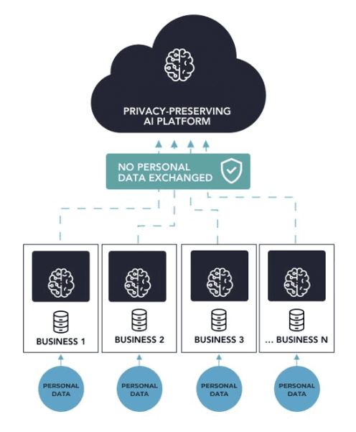
Business Value Proposition
• Empowers users with a 360-degree view of market dynamics.
• Enhances competitive edge through timely and relevant insights.
• Streamlines decision-making processes with AI-driven recommendations.
AI Presentation
5

Slide 6
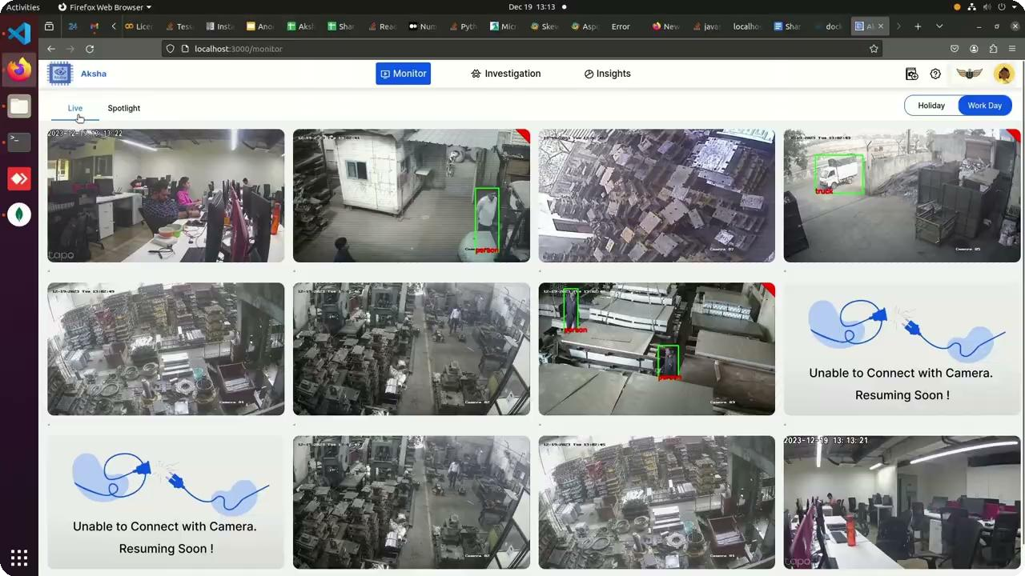
User Experience and Interface
• Intuitive user interface designed for ease of navigation and usability.
• Customizable UI components to cater to diverse user needs.
• Incorporates LLM-powered chatbot for interactive user support.
AI Presentation
6

Slide 7
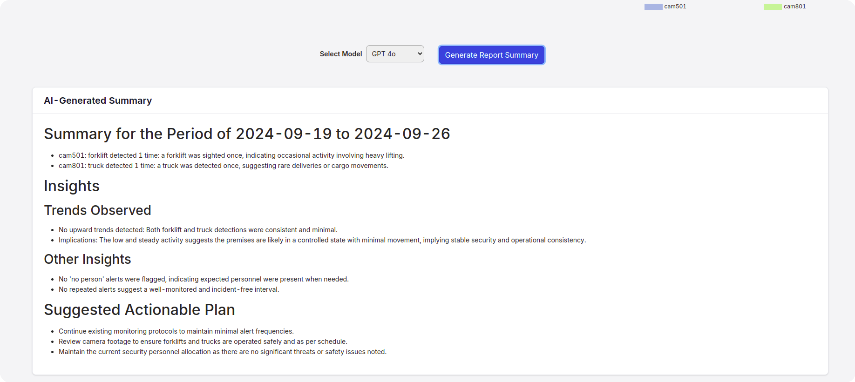
Future Developments and Roadmap
• Expansion of data ingestion capabilities beyond news articles.
• Generalization of features for applicability across various sectors.
• Continuous updates and enhancements based on user feedback and market trends.
AI Presentation
7

Slide 8
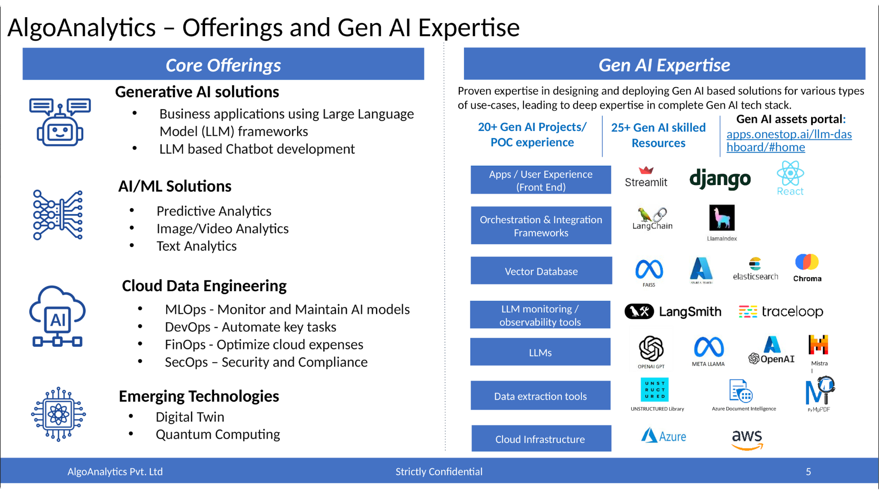
Conclusion and Call to Action
• Algofabric represents a transformative approach to financial analysis.
• Encourages stakeholders to leverage AI for improved investment outcomes.
• For more information, visit: https://algofabric.algoanalytics.com/
AI Presentation
8

