Slide 1

Unlocking Business Potential with GenAI and LLM Technologies
AI-Powered Solution

Slide 2
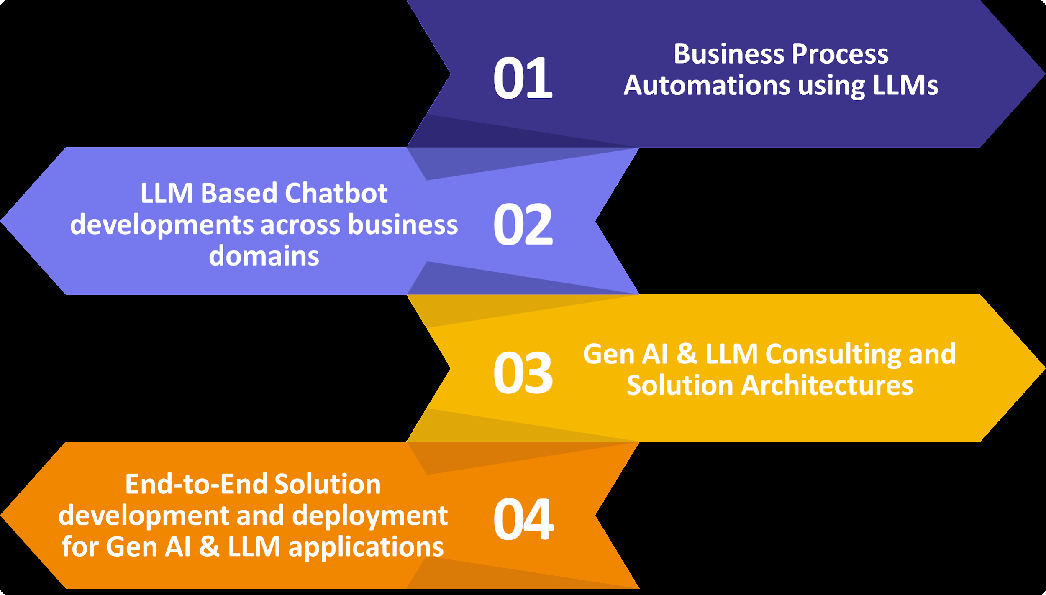
The Power of Generative AI and LLMs
• Generative AI (GenAI) and Large Language Models (LLMs) are transforming business operations across industries.
• LLMs enhance capabilities in document summarization, customer service automation, and data retrieval.
• Key applications include chatbots, personalized assistants, and dynamic content generation.
AI Presentation
2

Slide 3

Innovative Use Cases and Applications
• Utilizing LLMs for autonomous agents and advanced document reading to streamline workflows.
• Deployment of AI-driven chatbots for customer service, travel consultation, and insurance FAQs.
• Integration of LLMs in financial decision-making tools, enhancing accuracy and efficiency.
AI Presentation
3

Slide 4

Customization and Flexibility with Open Source LLMs
• Open-source LLMs like Meta's Llama 2 provide businesses with control, transparency, and customization options.
• Self-hosting capabilities enhance data security and privacy, crucial for sensitive business operations.
• Cost-effective solutions allow for scalable implementations tailored to specific business needs.
AI Presentation
4

Slide 5
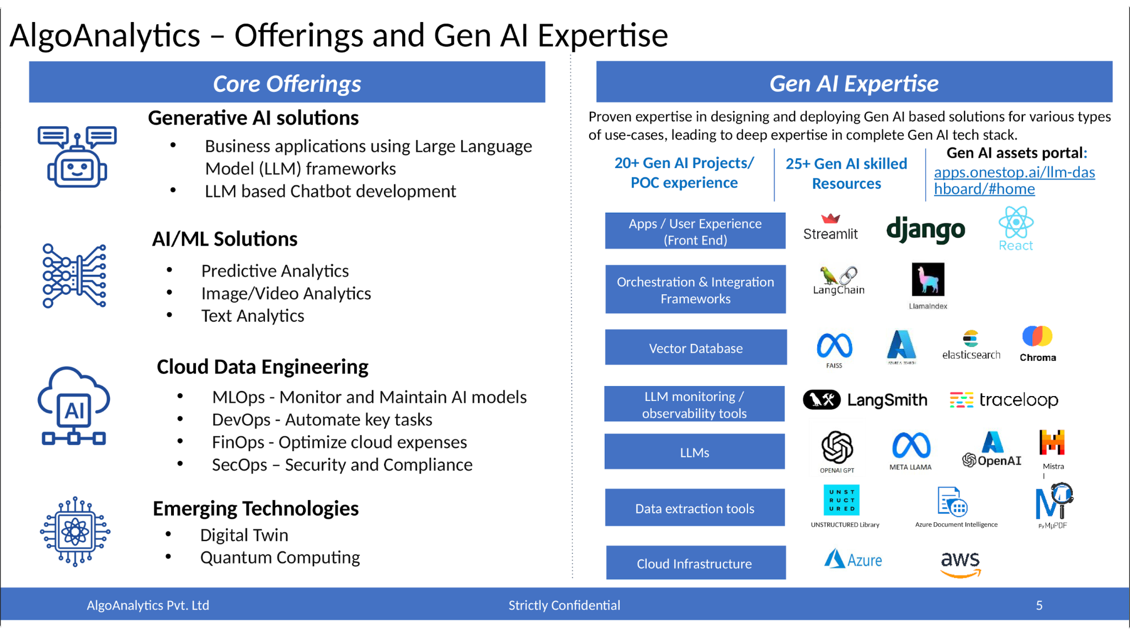
Future Trends in Generative AI and LLMs
• Emerging trends include specialized models for industry-specific applications and multimodal capabilities.
• Integration with classical machine learning models will enhance the robustness of AI solutions.
• Addressing ethical concerns and data privacy will be paramount as LLMs evolve.
AI Presentation
5

Slide 6
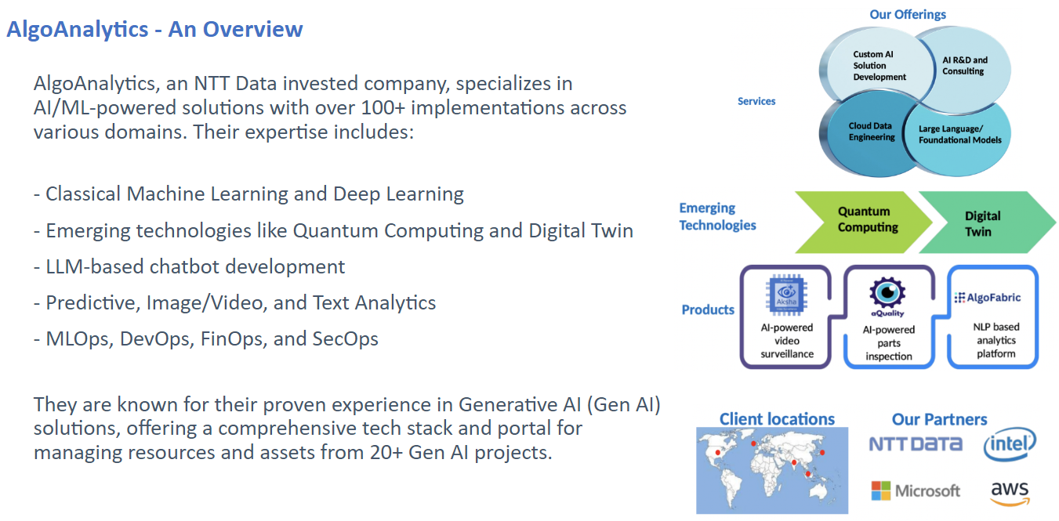
Partnering for Success with GenAI Solutions
• Our expertise in GenAI and LLM frameworks positions us to deliver innovative solutions tailored to your business.
• End-to-end solution development ensures seamless integration into existing workflows.
• Join us in leveraging the transformative power of GenAI to drive efficiency and growth in your organization.
AI Presentation
6

