Slide 1
Insurance Fraud Detection
Advanced AI Solutions for Manufacturing Excellence

Slide 2
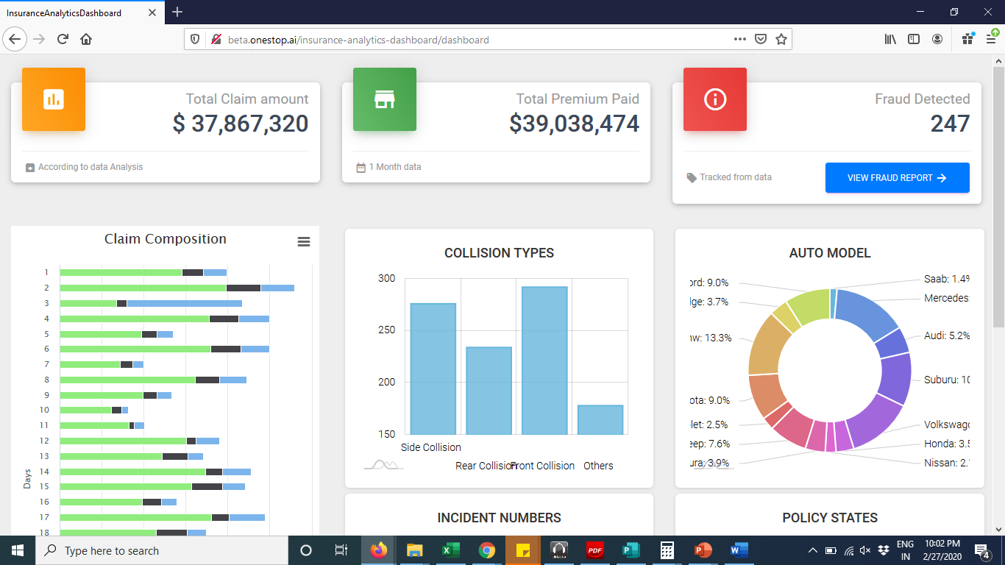
Understanding Insurance Fraud
• • Insurance fraud involves deceiving companies for illegitimate benefits, including false and exaggerated claims.
• • Healthcare fraud includes billing for services not rendered and upcoding for higher reimbursements.
• • Identity fraud entails using someone else's personal information to file insurance claims.
• • Payment fraud utilizes stolen or counterfeit payment methods, impacting transaction integrity.
• • The financial impact of fraud includes significant losses, increased operational costs, and reputational damage.
This is a screenshot of an insurance analytics dashboard, displaying various data visualizations. Key elements include total claim amount ($37,867,320), total premium paid ($39,038,474), and fraud detected (247). It features bar graphs for
2/6

Slide 3
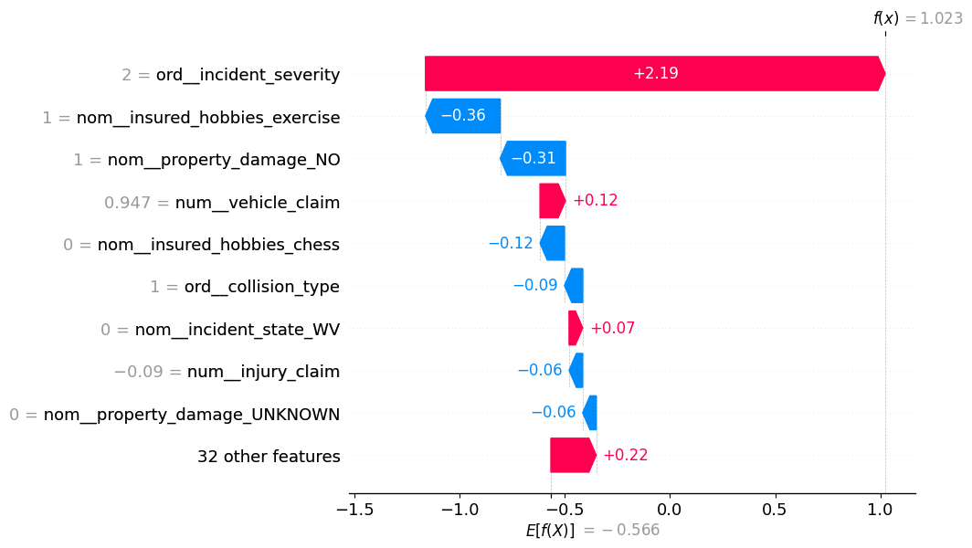
Data Insights for Fraud Detection
• • Utilizing a synthetic vehicle insurance dataset with 1000 data points to analyze fraud patterns.
• • Key features include claim amounts, policy details, and incident characteristics to identify fraudulent behavior.
• • Fraudulent claims (24.
• 7% of dataset) often show discrepancies between claimed amounts and actual damages.
• • Feature selection focuses on injury, property, and vehicle claims to enhance detection accuracy.
• • Understanding customer demographics and incident types aids in predicting potential fraud.
This is a diagram illustrating feature importance in a predictive model, likely related to insurance claims. It displays various features along the vertical axis, with corresponding values indicating their impact on the model's output. Positive values are shown in pink and negative values in blue
3/6

Slide 4
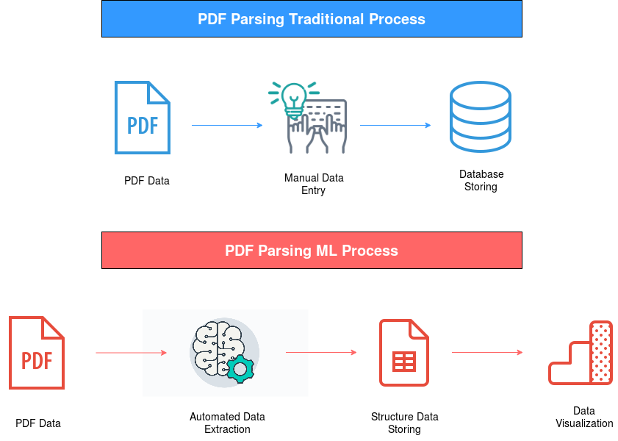
Machine Learning Techniques
• • Employing unsupervised learning methods like clustering to identify outlier transactions indicative of fraud.
• • Algorithms such as k-means clustering help separate normal transactions from potential fraud cases.
• • Feature importance analysis reveals critical indicators for fraud, including incident severity and property damage.
• • Machine learning models can predict the likelihood of claims based on customer data, improving risk assessment.
• • Continuous refinement of algorithms enhances detection capabilities and reduces false positives.
This is an illustration comparing two PDF parsing processes: traditional and machine learning (ML). The top section, in blue, outlines the traditional method involving manual data entry and database storage. The bottom section, in red, depicts the ML process with automated data
4/6

Slide 5
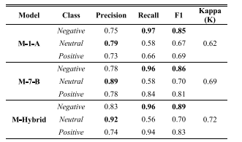
Model Performance and Business Value
• • The CatBoost model achieves an F1 score of 0.
• 81, balancing recall (0.
• 95) and precision (0.
• 71).
• • High recall ensures most fraudulent cases are identified, minimizing financial losses for insurers.
• • Moderate precision indicates some false positives, necessitating further investigation but enhancing overall fraud detection.
This is a diagram presenting a performance comparison of various models in a classification task. It features a table with columns labeled "Model," "Class," "Precision," "Recall," "F1," and "Kappa (K)." Each row lists model
5/6

Slide 6
Conclusion and Future Directions
• • Investing in advanced fraud detection technologies mitigates risks and enhances operational efficiency.
• • Continuous data analysis and model training are essential for adapting to evolving fraud tactics.
• • Collaboration across departments can improve data sharing and enhance fraud detection strategies.
• • Future improvements may include integrating real-world data for better model accuracy and reliability.
• • A robust fraud detection framework not only protects assets but also strengthens customer relationships.
6/6

