Slide 1
Introduction to Aksha
Advanced AI Solutions for Manufacturing Excellence

Slide 2

What is Aksha?
KEY POINTS
▸ • Aksha is an intelligent surveillance system designed for automated monitoring with minimal human intervention.
▸ • Utilizes advanced technologies such as Computer Vision, Artificial Intelligence, and Generative AI for real-time analysis.
▸ • Capable of detecting objects and unusual situations, enhancing situational awareness and security.
2/7

Slide 3
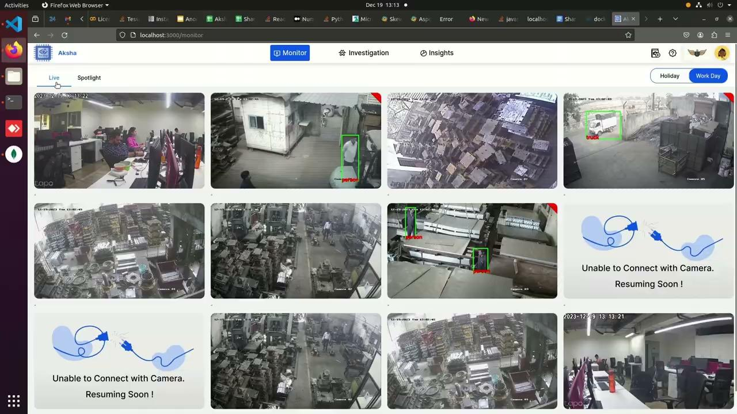
Key Features of Aksha
KEY POINTS
▸ • Live recording and processing of surveillance data for immediate insights.
▸ • Advanced object detection capabilities, including identifying people, vehicles, and specific anomalies.
▸ • Customizable alerts that empower users to respond promptly to critical events.
3/7

Slide 4
Architectural Approaches
KEY POINTS
▸ • Supports multiple deployment architectures: On-Premise, Edge, and Cloud solutions.
▸ • Decoupled architecture enhances fault tolerance and maintainability.
▸ • Effortless scalability through microservices and real-time data processing capabilities.
🖼️
Visual Content
4/7

Slide 5
Collaboration and Customization
KEY POINTS
▸ • Collaboration with NDIL led to the development of 'Aksha for Workers Safety' with enhanced features.
▸ • Implemented Generative AI to improve anomaly detection and reporting capabilities.
▸ • Successful deployment on Raspberry Pi 4B, demonstrating flexibility and cost-effectiveness.
🖼️
Visual Content
5/7

Slide 6
Customer Testimonials
KEY POINTS
▸ • Clients report significant reductions in human monitoring efforts and enhanced detection of abnormal events.
▸ • Positive feedback highlights the system's ability to provide actionable insights and improve safety.
▸ • Customers express eagerness for ongoing updates and innovations from Aksha.
🖼️
Visual Content
6/7

Slide 7
Getting Started with Aksha
KEY POINTS
▸ • Installation is straightforward: Requires camera RTSP links and an Edge device within the same network.
▸ • Compatible with any standard CCTV camera that supports RTSP, ensuring broad applicability.
▸ • Support and resources available for seamless integration and deployment.
🖼️
Visual Content
7/7

