Slide 1
Introduction to Aksha

Slide 2

Overview of Aksha
• Aksha is an intelligent surveillance system designed for automated monitoring with minimal human intervention.
• Utilizes advanced technologies like Computer Vision, Artificial Intelligence, and Generative AI for real-time analysis.
• Key functionalities include object detection, anomaly detection, and automated alert generation.

Slide 3
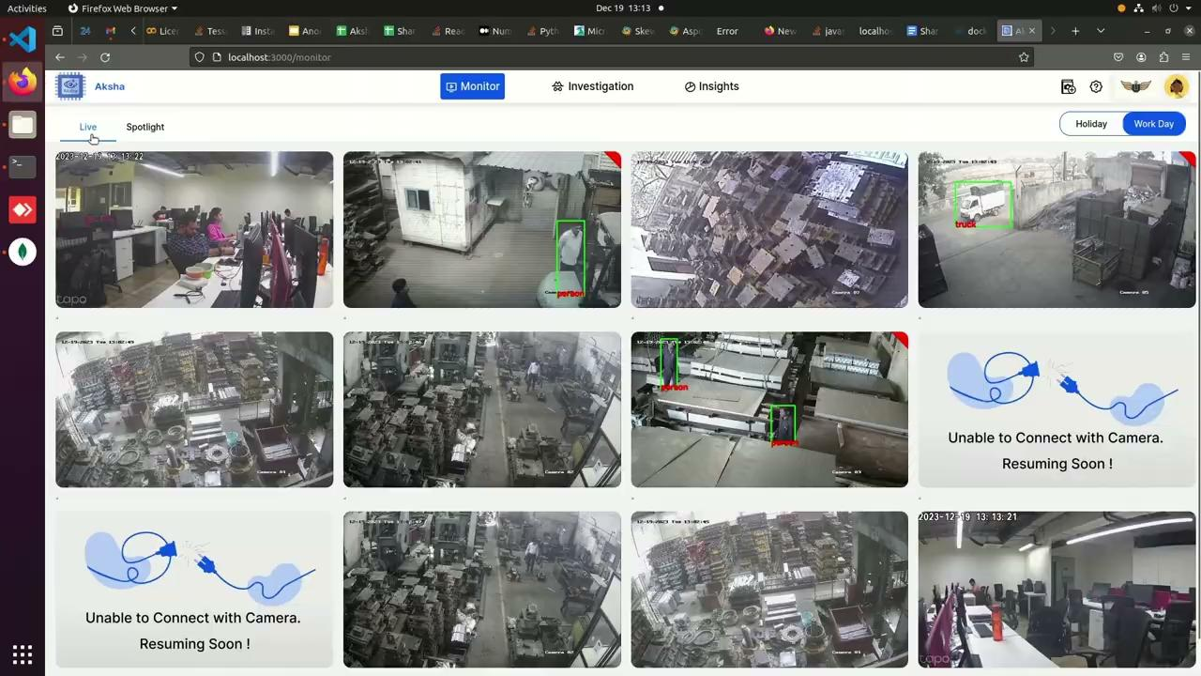
Architectural Approaches
• Offers multiple deployment architectures: On-Premise, Edge, and Cloud solutions.
• Flexibility in UI and backend configurations to suit various operational needs.
• Supports seamless integration with existing infrastructure for enhanced scalability.

Slide 4
Collaboration and Customization
• Collaboration with NDIL led to the development of a customized version focused on worker safety.
• Implemented a three-phase customization process incorporating Generative AI for enhanced features.
• Successful proof of concept demonstrated on Raspberry Pi 4B with dual OS support.

Slide 5
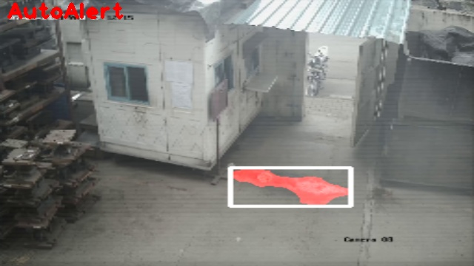
Key Features of Aksha
• Live recording and processing capabilities for real-time surveillance.
• Advanced object detection for various entities including vehicles, personnel, and safety gear compliance.
• Customizable alerts and insights generated using Generative AI for proactive management.

Slide 6
Customer Testimonials
• Clients report significant reductions in human monitoring efforts and enhanced event detection.
• Positive feedback highlights the system's ability to identify abnormal events effectively.
• Users appreciate the cost-effective nature of Aksha in enhancing existing CCTV setups.

Slide 7
Scalability and Performance
• Effortless scalability through microservices architecture using Kubernetes.
• Real-time data processing capabilities ensure timely insights and actions.
• High availability and fault tolerance achieved through decoupled architecture and distributed messaging with Kafka.

