Slide 1
Harnessing GPU Power with FastAPI for High-Performance Applications

Slide 2
Introduction to FastAPI
• Built on Starlette and Uvicorn, FastAPI achieves performance comparable to compiled languages.
• Utilizes asynchronous programming with 'async' and 'await' for efficient handling of I/O-bound tasks.
• Ideal for microservices and real-time applications due to low latency and high concurrency capabilities.

Slide 3
FastAPI's Competitive Advantages
• Revolutionizes API development with standardized Python type hints, enhancing code quality and developer experience.
• Automatically generates interactive API documentation using OpenAPI, simplifying client integration and testing.
• Addresses historical performance constraints in Python web development, making it a preferred choice for modern applications.

Slide 4
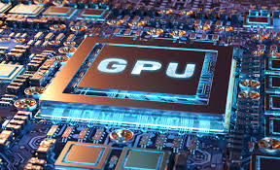
Understanding GPU Architecture
• GPUs are designed for massive parallelism, enabling simultaneous processing of thousands of data streams.
• Critical for deep learning and AI, leveraging high-speed matrix multiplications across numerous cores.
• Transitioned from graphics rendering to essential components in HPC and scientific modeling.

Slide 5
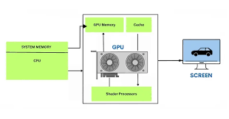
Business Value of GPUs
• Accelerate time-to-discovery in complex computational tasks, enhancing productivity and innovation.
• Support real-time data processing, crucial for applications in finance, healthcare, and autonomous systems.
• Enable large-scale simulations and deep learning model training, driving advancements in AI technologies.

Slide 6
Integrating FastAPI with GPU Capabilities
• FastAPI can efficiently handle requests for GPU-accelerated applications, optimizing resource utilization.
• Supports data validation and serialization through Pydantic, ensuring safe and reliable API interactions.
• Facilitates rapid development cycles, allowing businesses to quickly deploy AI-driven solutions.

Slide 7
Practical Applications of FastAPI and GPU
• Ideal for deploying machine learning models in production, providing low-latency API endpoints.
• Enhances real-time analytics capabilities in sectors like e-commerce and finance.
• Supports complex simulations in scientific research, improving accuracy and efficiency.

Slide 8
Conclusion and Future Outlook
• FastAPI and GPUs together represent a powerful combination for modern application development.
• Their integration can significantly reduce operational costs while improving performance and scalability.
• As AI and data processing demands grow, leveraging these technologies will be critical for competitive advantage.

