Slide 1
Unlocking Financial Insights with AlgoFabric

Slide 2
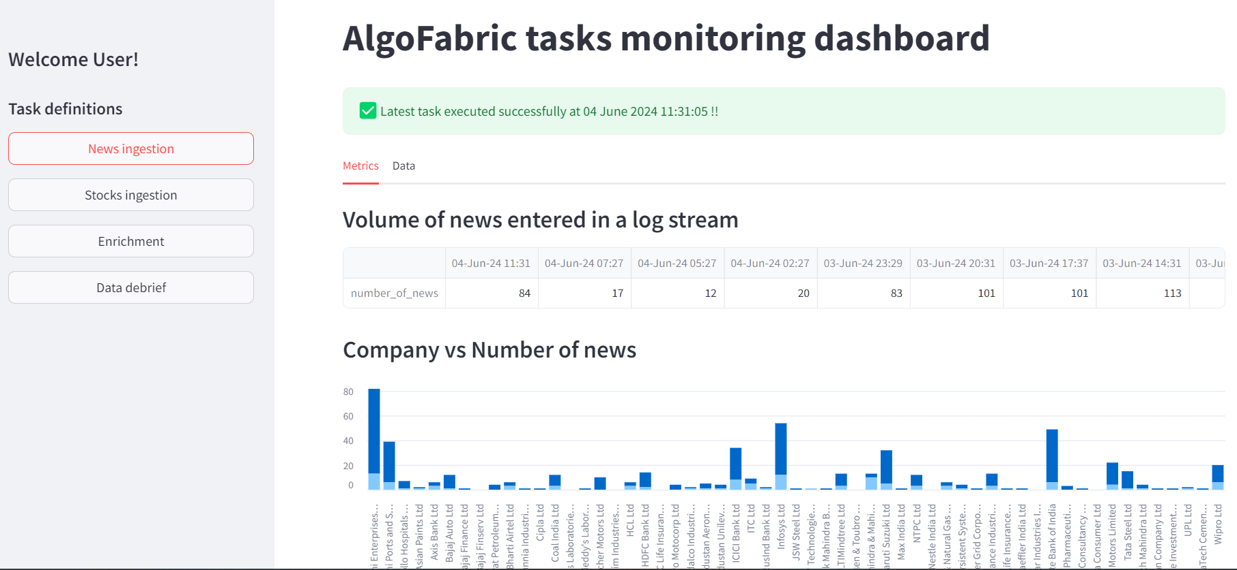
Overview of AlgoFabric
• AI-powered financial insights platform designed for stock research and analysis.
• Combines advanced Natural Language Processing (NLP) with numerical data analytics.
• Offers a comprehensive view of market trends, public sentiment, and risk analysis.

Slide 3
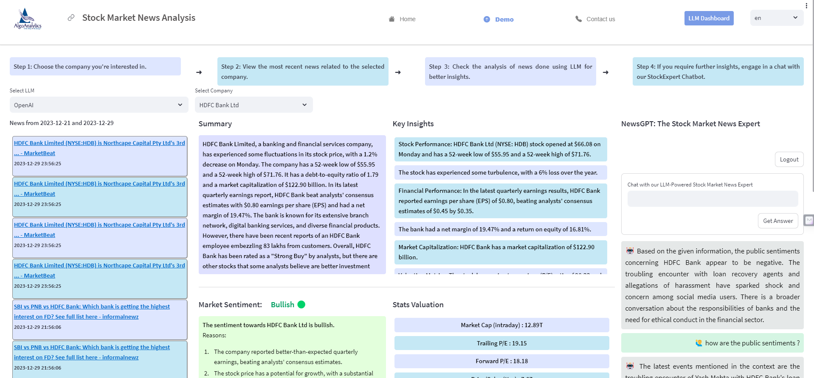
Key Features and Functionalities
• Real-time news aggregation and sentiment analysis to inform trading decisions.
• Dashboard for monitoring backend tasks, enhancing operational efficiency.
• Stock picking and recommendation strategies based on historical performance and market trends.

Slide 4
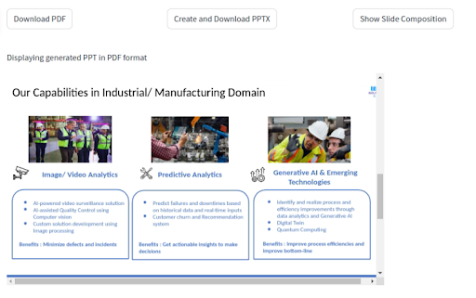
Generalization and Adaptability
• Designed to be adaptable across various domains such as sports, politics, and education.
• Feature engineering techniques applicable to diverse datasets for broader insights.
• User interface components can be customized for different user needs and contexts.

Slide 5
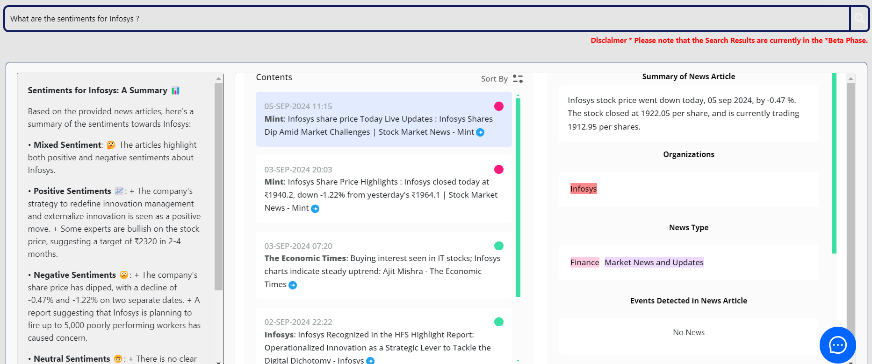
Upcoming Enhancements
• Introduction of a 'What's Trending' tab for tracking market movers and news.
• Enhanced mutual fund investment composition display for better asset management.
• Integration of small language models for faster and more efficient insights generation.

Slide 6
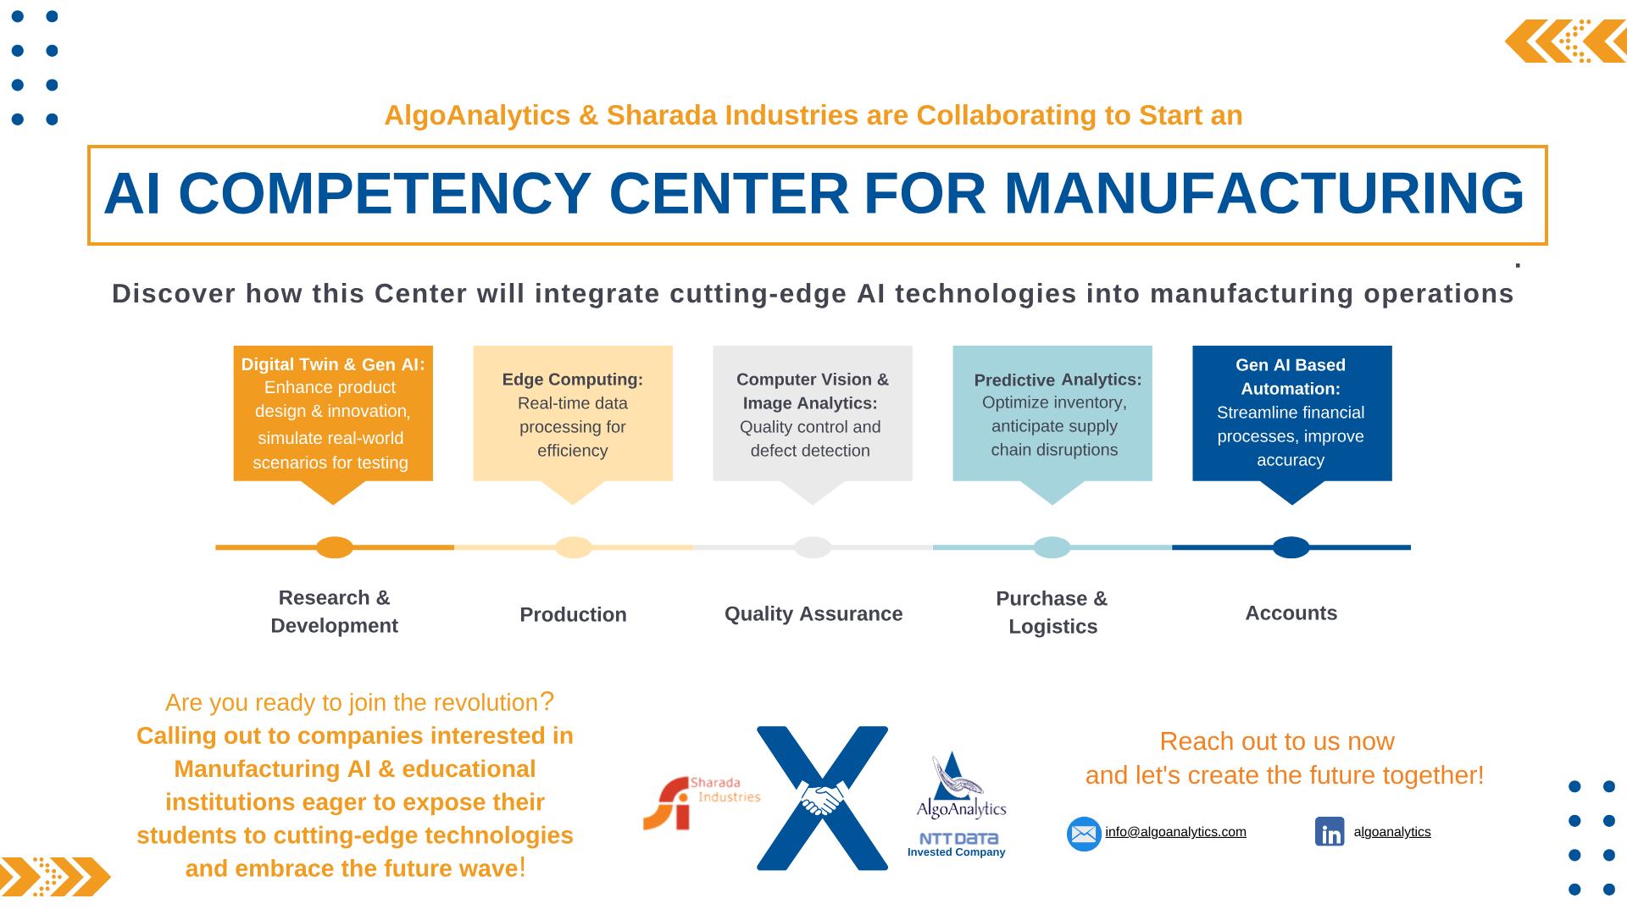
Business Value and Impact
• Empowers traders with actionable insights, improving decision-making and portfolio performance.
• Facilitates a 360-degree view of investments with timely updates and personalized information.
• Positions businesses to leverage AI-driven analytics for competitive advantage in the financial market.

