Slide 1
Our Two Projects: AlgoFabric and Aksha
Advanced AI Solutions for Manufacturing Excellence

Slide 2
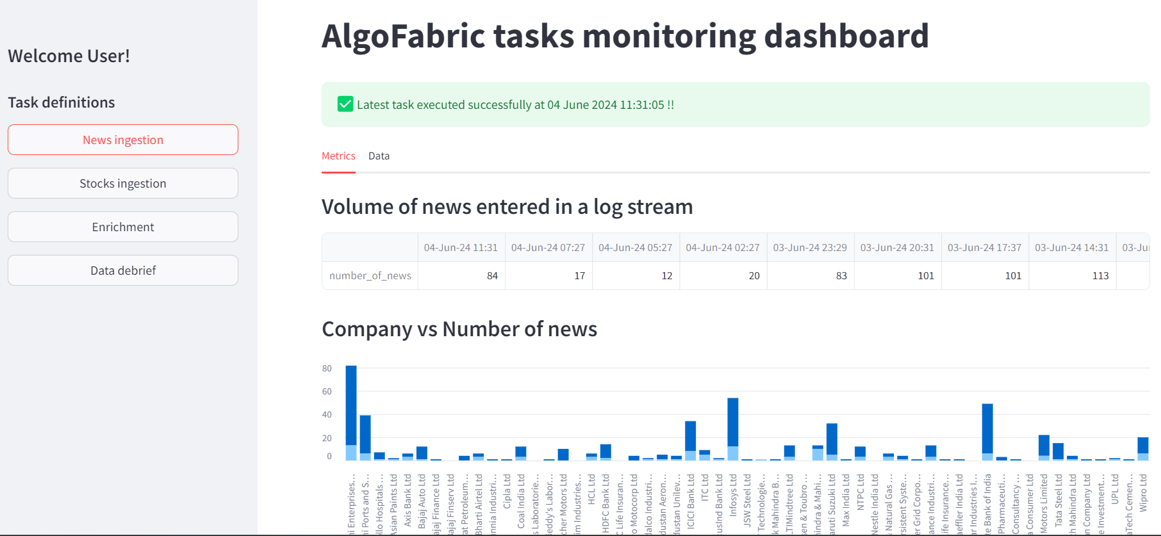
Overview of AlgoFabric
▸ AlgoFabric is a SaaS platform designed to provide AI-powered financial insights.
▸ Utilizes state-of-the-art NLP models combined with numerical data analysis.
▸ Offers features like news aggregation, sentiment analysis, and risk assessment.
▸ Provides a 360-degree view of companies with daily updates on stock performance.
▸ Integrates a user-friendly LLM-powered chatbot for enhanced user interaction.
2/8

Slide 3
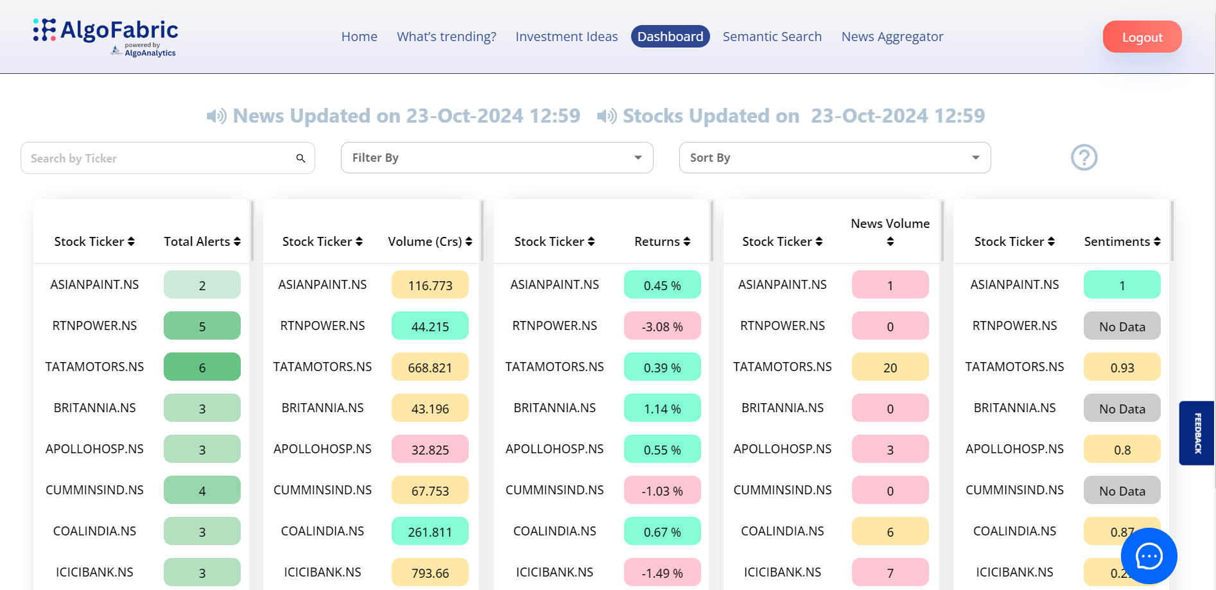
Key Features of AlgoFabric
▸ Real-time dashboard for monitoring backend task performance and debugging.
▸ Displays mutual fund investment compositions for selected stocks.
▸ Generates insights from news articles using small language models for faster processing.
▸ Expanding portfolio by incorporating additional companies based on stock recommendations.
▸ Personalized information digest tailored to user preferences.
3/8

Slide 4
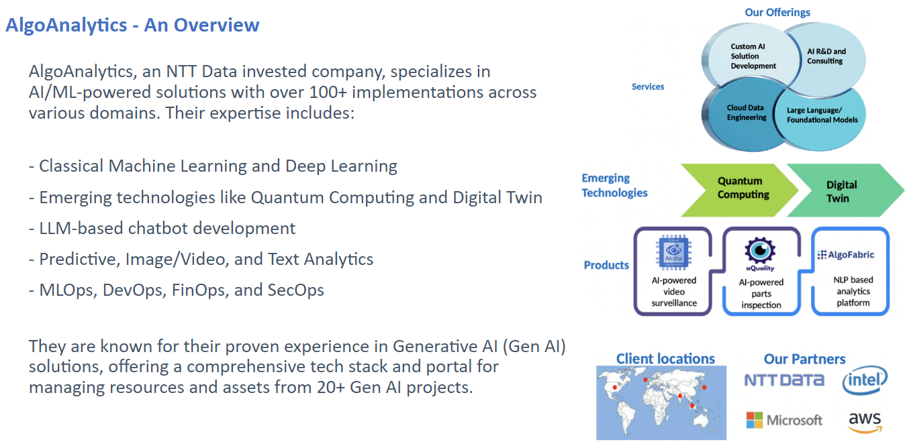
Business Value of AlgoFabric
▸ Enhances decision-making with data-driven insights and timely information.
▸ Provides a competitive edge through comprehensive market analysis.
▸ Facilitates risk management with predictive analytics and sentiment trends.
▸ Improves user understanding and engagement with personalized features.
▸ Supports strategic investment decisions with detailed shareholding patterns.
4/8

Slide 5

Introduction to Aksha
▸ Aksha is a customized solution for worker safety developed in collaboration with NDIL.
▸ Runs on an Edge + Cloud architecture, enhancing operational efficiency.
▸ Incorporates Gen AI features for improved functionality and user experience.
▸ Successfully completed three phases of customization, focusing on real-time safety monitoring.
▸ Utilizes Raspberry Pi 4B for effective deployment in various environments.
5/8

Slide 6
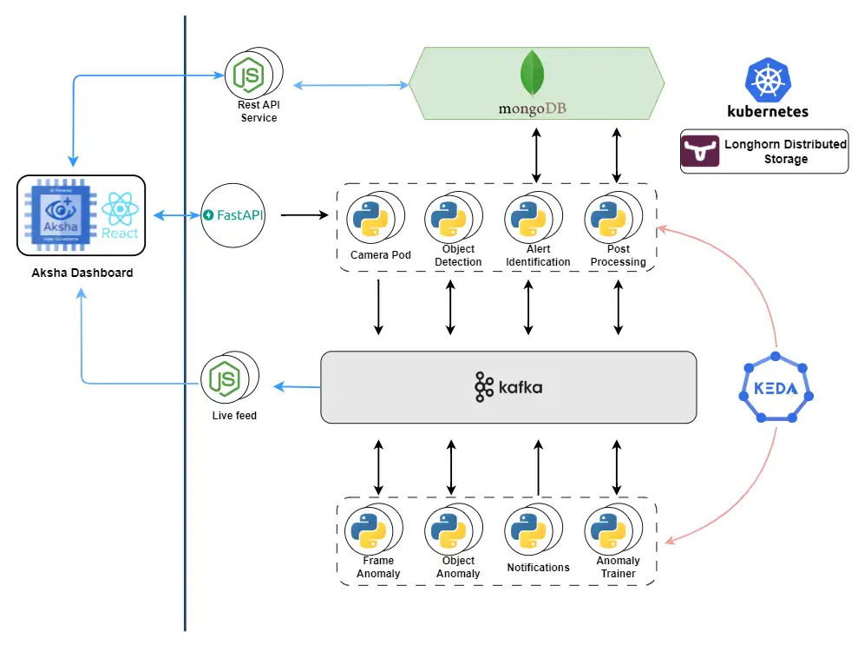
Aksha Customization Phases
▸ Phase I: Initial deployment on Raspberry Pi with OS support for Linux and SPECTRA.
▸ Phase II: Enhanced features using Gen AI and image prompt engineering.
▸ Phase III: Architectural improvements for better performance and cloud integration.
▸ Continuous support provided to NDIL for operational efficiency.
▸ Focus on optimizing code for better frame rates and notification systems.
6/8

Slide 7
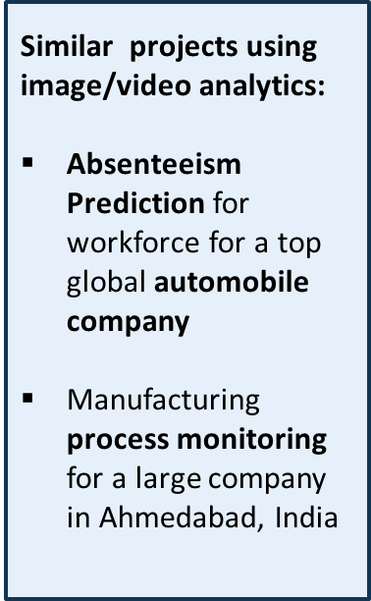
Business Value of Aksha
▸ Enhances workplace safety through real-time monitoring and alerts.
▸ Reduces operational risks with advanced AI-driven analytics.
▸ Improves compliance with safety regulations and standards.
▸ Facilitates data-driven decision-making in safety management.
▸ Supports scalability and adaptability across various operational contexts.
7/8

Slide 8
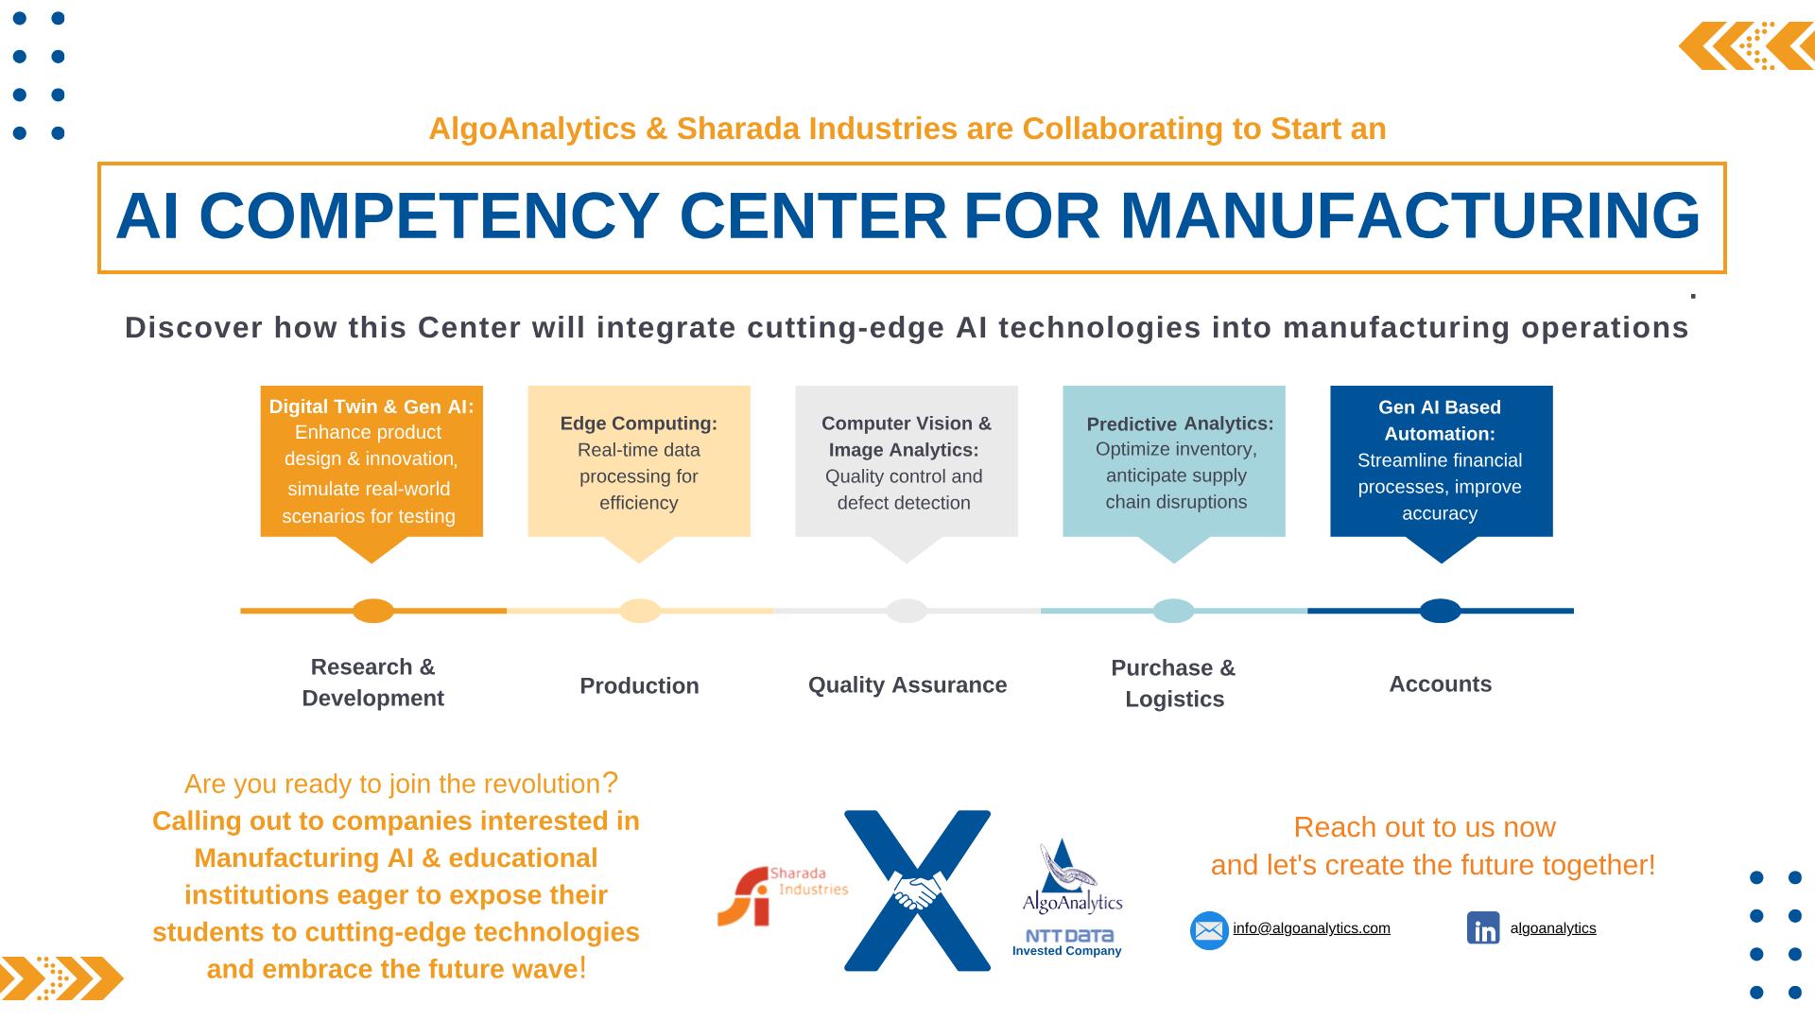
Conclusion and Next Steps
▸ Both AlgoFabric and Aksha represent significant advancements in their respective fields.
▸ Continued investment in AI and data analytics will drive further innovation.
▸ Engagement with stakeholders is crucial for successful implementation and feedback.
▸ Explore opportunities for collaboration and integration across platforms.
▸ For more information, visit our websites or contact us directly.
8/8

