Slide 1
Introduction to Aksha
Advanced AI Solutions for Manufacturing Excellence

Slide 2

Overview of Aksha
▸ • Aksha is an intelligent surveillance system designed for automatic environment monitoring.
▸ • Utilizes advanced technologies such as Computer Vision, Artificial Intelligence, and Gen AI.
▸ • Capable of detecting objects and unusual situations with minimal human intervention.
This is a logo for Aksha, featuring a stylized blue eye symbol with a plus sign, indicating a focus on vision or healthcare. The logo is set against a light blue background, framed by alternating blue and white stripes. The text "Ak
2/7

Slide 3
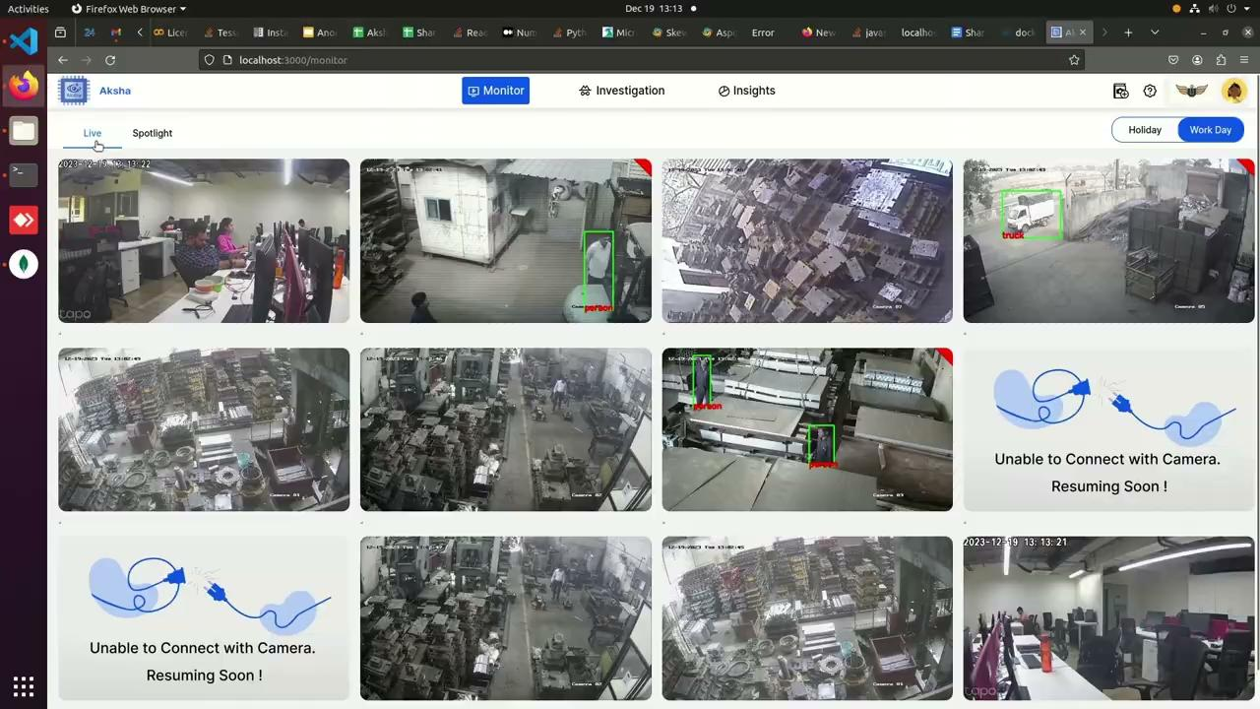
Architectural Approaches
▸ • Offers multiple deployment options: On-Premise, Edge, and Cloud configurations.
▸ • Supports seamless integration with existing infrastructure for enhanced flexibility.
▸ • Architectural designs ensure scalability and adaptability to various business needs.
This is a screenshot of a surveillance monitoring interface displaying multiple camera feeds. It features a grid layout with live video streams, including office scenes and industrial settings. Some frames highlight detected objects, such as a "person" and a "truck," marked with
3/7

Slide 4
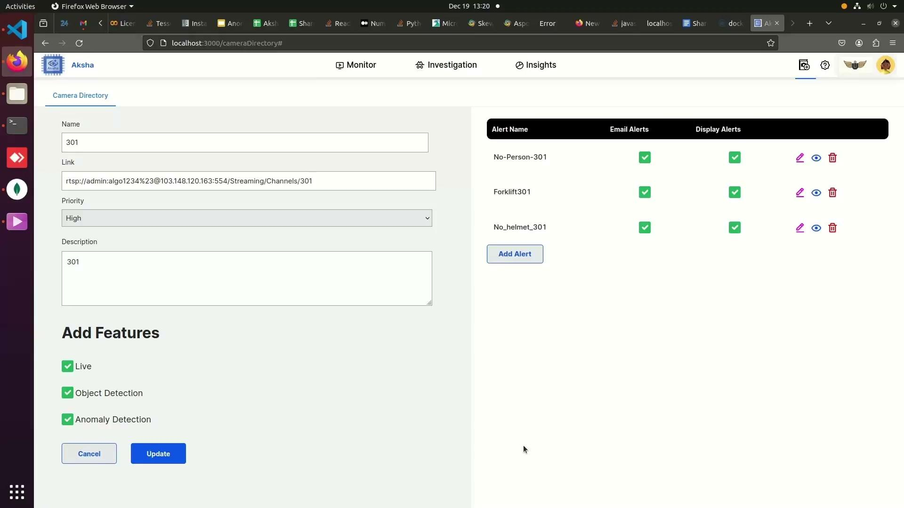
Key Features of Aksha
▸ • Live recording and real-time data processing for immediate insights.
▸ • Advanced object detection capabilities including various entities like vehicles and personnel.
▸ • Customizable alerts and anomaly detection powered by Gen AI for proactive safety measures.
This is a screenshot of a web application interface, specifically a camera directory management system. It displays fields for camera name, link, priority, and description, along with options to add features like live streaming and object detection. On the right, alert settings
4/7

Slide 5
Client Success Stories
▸ • Clients report significant reductions in human monitoring efforts and enhanced CCTV utility.
▸ • Positive feedback on the ability to detect and highlight abnormal events effectively.
▸ • Ongoing interest in future updates and innovations, showcasing client trust and satisfaction.
5/7

Slide 6
Scalability and Performance
▸ • Effortless scalability through Kubernetes for managing microservices and high message volumes.
▸ • Decoupled architecture enhances fault tolerance and simplifies maintenance.
▸ • Real-time data processing capabilities ensure timely insights and actions for businesses.
6/7

Slide 7
Getting Started with Aksha
▸ • Installation requires connecting to the same network as the CCTV cameras.
▸ • Compatible with any standard CCTV camera that provides RTSP links.
▸ • Simple setup process ensures quick deployment and integration into existing systems.
7/7

