Slide 1
Introduction to Aksha
Advanced AI Solutions for Manufacturing Excellence

Slide 2

Overview of Aksha
▸ Aksha is an intelligent surveillance system designed for automated monitoring with minimal human intervention.
▸ Utilizes advanced technologies such as Computer Vision, Artificial Intelligence, and Generative AI for real-time analysis.
▸ Key functionalities include object detection, anomaly identification, and automated response mechanisms.
2/7

Slide 3
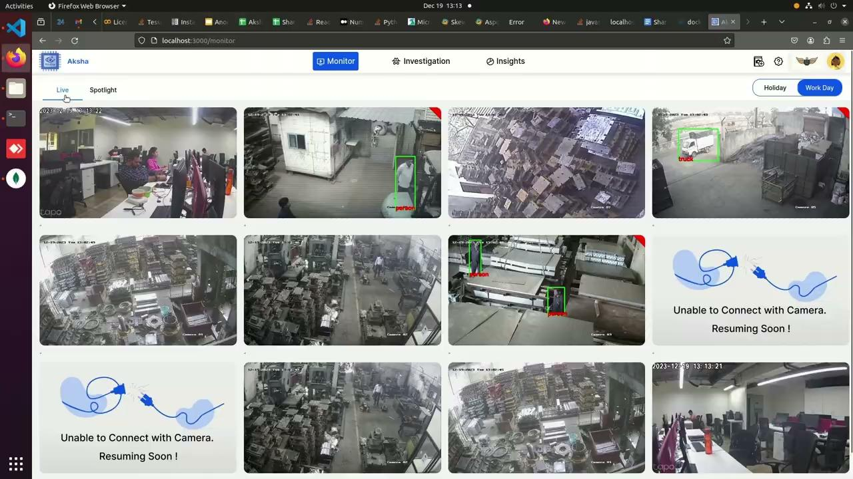
Architectural Approaches
▸ Multiple deployment models: Aksha on Edge (On-Premise), Aksha UI & Backend on Edge, and hybrid models combining Edge & Cloud.
▸ Supports seamless integration with existing CCTV systems through standard RTSP links.
▸ Decoupled architecture enhances maintainability and fault tolerance, allowing for independent service development.
3/7

Slide 4
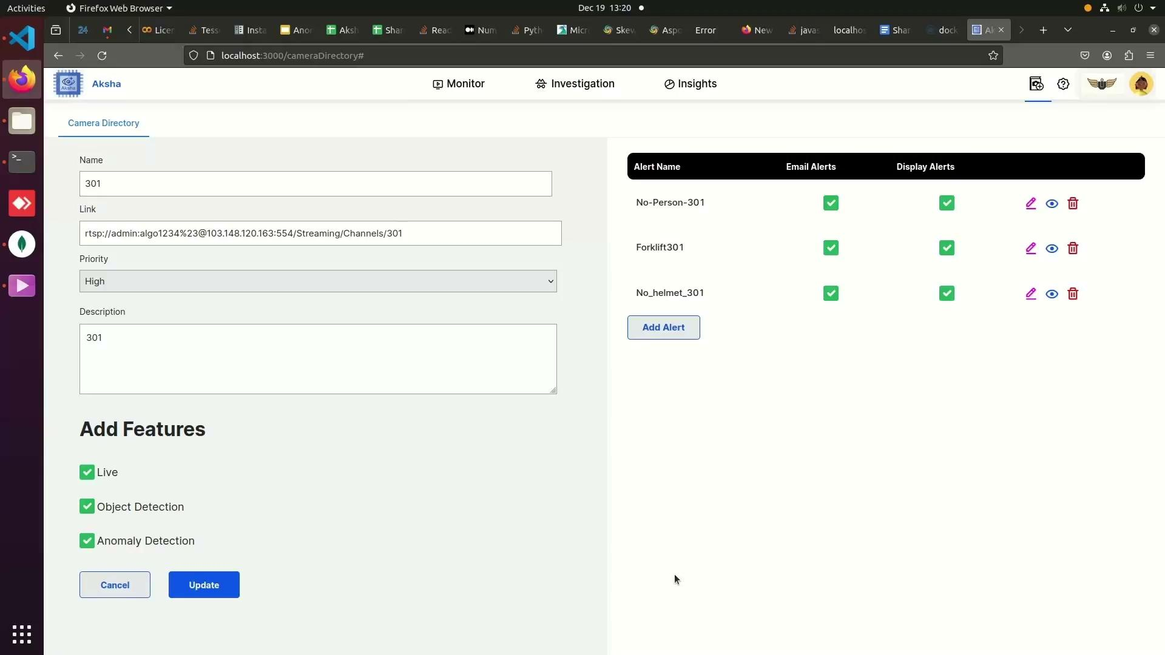
Key Features of Aksha
▸ Live recording and processing capabilities for immediate data access.
▸ Advanced object detection including various categories such as vehicles, personnel, and safety gear compliance.
▸ Customizable alerts enable users to set specific notifications based on detected anomalies.
4/7

Slide 5
Collaboration and Customization
▸ Partnership with NDIL to enhance Aksha for worker safety, integrating Edge + Cloud solutions.
▸ Phased development approach, with significant enhancements in Gen AI capabilities for improved anomaly detection.
▸ Successful proof of concept executed on Raspberry Pi 4B, showcasing versatility and cost-effectiveness.
5/7

Slide 6
Customer Testimonials
▸ Clients report significant reductions in human monitoring efforts and improved detection of unforeseen events.
▸ Positive feedback highlights Aksha's ability to transform traditional CCTV usage into proactive safety management.
▸ Ongoing interest in future updates and innovations, indicating strong customer engagement and satisfaction.
6/7

Slide 7
Scalability and Performance
▸ Effortless scalability achieved through microservices architecture and Kubernetes orchestration.
▸ Real-time data processing capabilities ensure timely insights and actions for enhanced operational efficiency.
▸ High availability maintained through distributed messaging systems like Kafka, ensuring reliable performance.
7/7

