Slide 1
Harnessing the Power of GPU Units: The NVIDIA Advantage
Advanced AI Solutions for Manufacturing Excellence

Slide 2
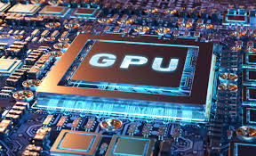
Evolution of GPU Technology
▸ Transitioned from specialized graphics rendering to general-purpose parallel processing.
▸ Essential for High-Performance Computing (HPC) and scientific simulations.
▸ Optimized architecture for massive parallelism enhances efficiency in data-intensive tasks.
2/6

Slide 3
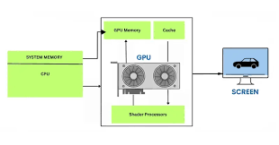
Architectural Advantages of GPUs
▸ Thousands of smaller cores (e.g., NVIDIA's CUDA cores) designed for throughput.
▸ Superior performance in 'embarrassingly parallel' tasks compared to traditional CPUs.
▸ Critical for executing high-speed matrix multiplications, essential for AI and deep learning.
3/6

Slide 4
Business Applications of GPUs
▸ Accelerate time-to-discovery in complex computational science.
▸ Enable real-time data processing for AI models, enhancing decision-making capabilities.
▸ Support diverse applications from financial risk analysis to weather forecasting.
4/6

Slide 5
NVIDIA's Role in GPU Innovation
▸ Pioneered CUDA programming model, unlocking GPU potential for various industries.
▸ Continues to lead in developing high-bandwidth memory (HBM) technologies.
▸ Drives advancements in AI, machine learning, and scientific research through powerful GPU clusters.
5/6

Slide 6
Future Outlook: The GPU Landscape
▸ Growing demand for real-time processing and complex AI models will sustain GPU relevance.
▸ Potential for GPUs to revolutionize sectors like healthcare, finance, and autonomous systems.
▸ Ongoing innovations will further enhance energy efficiency and computational capabilities.
6/6

