Slide 1
Unlocking Financial Insights with AlgoFabric
Advanced AI Solutions for Manufacturing Excellence

Slide 2
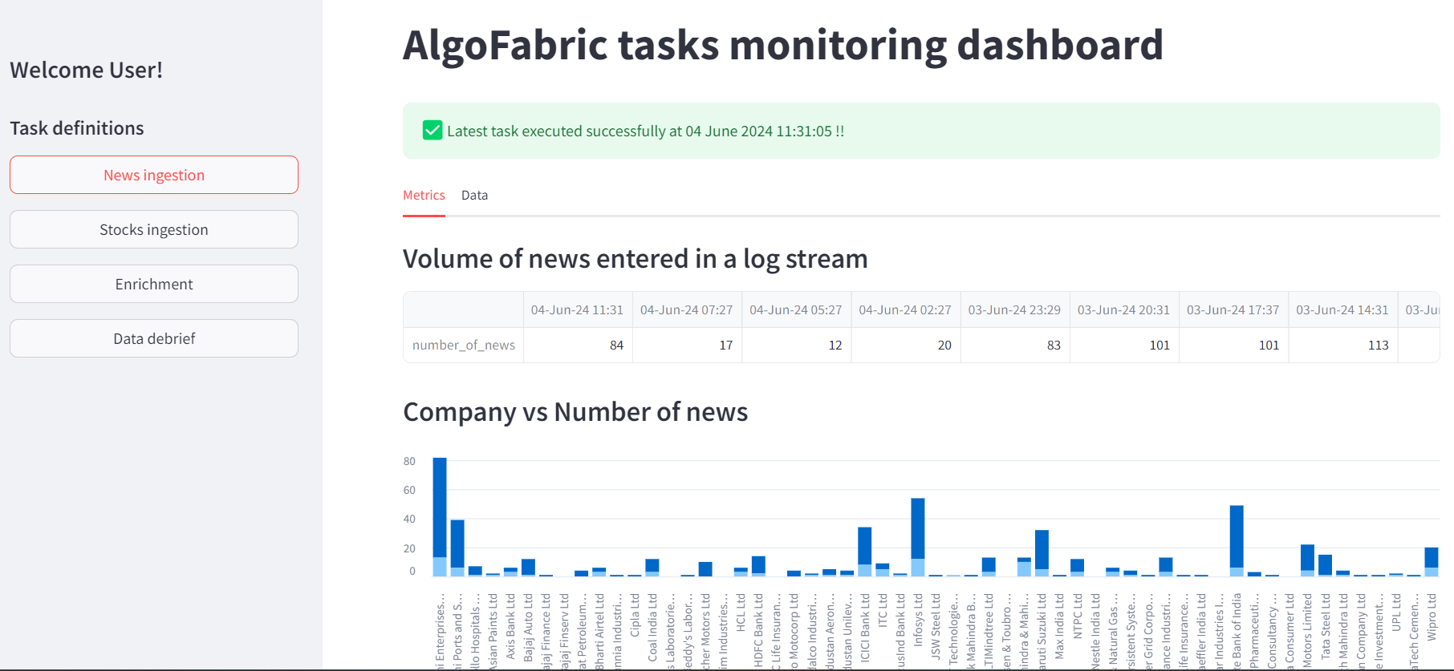
Overview of AlgoFabric
▸ AI-powered financial insights platform designed for stock research and analysis.
▸ Combines advanced NLP models with numerical data for comprehensive insights.
▸ Facilitates real-time access to diverse data types, including news and social media.
2/6

Slide 3
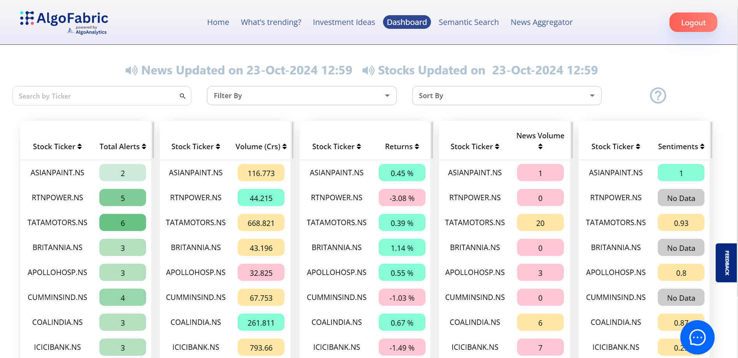
Key Features of AlgoFabric
▸ Dashboard for monitoring backend tasks, enabling quick debugging and issue resolution.
▸ Real-time news aggregation and sentiment analysis for informed decision-making.
▸ Stock picking and recommendation strategies based on historical performance and market trends.
3/6

Slide 4
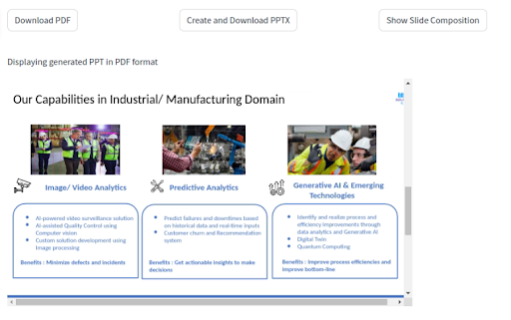
Generalization and Adaptability
▸ Designed for adaptability across various domains: finance, sports, politics, and education.
▸ Feature engineering techniques applicable to diverse datasets enhance generalizability.
▸ User interface components can be customized for different applications and user needs.
4/6

Slide 5
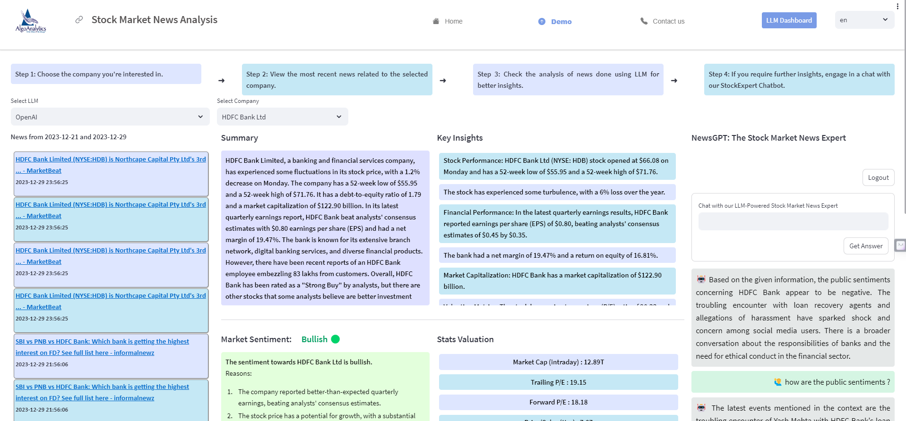
Upcoming Features and Enhancements
▸ Integration of mutual fund investment composition for comprehensive asset management.
▸ Expansion of stock portfolio to align with evolving stock picking strategies.
▸ Deployment of small language models for faster insights generation from news articles.
5/6

Slide 6
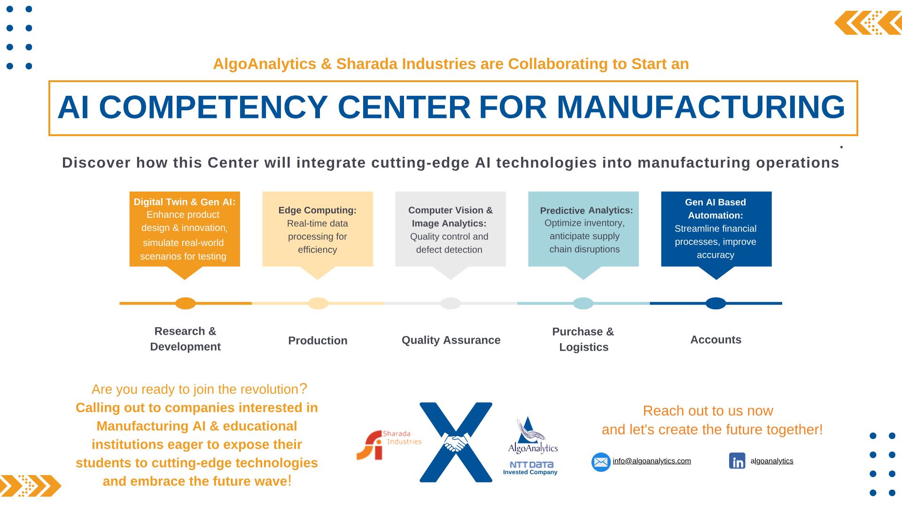
Business Value and Strategic Impact
▸ Empowers traders with intelligent insights, enhancing decision-making capabilities.
▸ Provides a competitive edge through timely information and personalized updates.
▸ Facilitates risk analysis and trend detection, supporting strategic investment decisions.
6/6

