Slide 1
Revolutionizing Transportation: Autonomous Cars and Generative AI
Advanced AI Solutions for Manufacturing Excellence

Slide 2
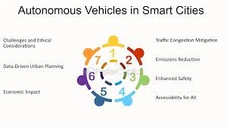
The Promise of Autonomous Vehicles
▸ Autonomous vehicles (AVs) aim to redefine transportation, enhancing safety and efficiency.
▸ Potential to drastically reduce traffic congestion and fuel consumption.
▸ Significant reduction in accident rates due to the elimination of human error.
▸ Challenges include achieving Level 5 autonomy amidst technical, legal, and ethical hurdles.
2/9

Slide 3
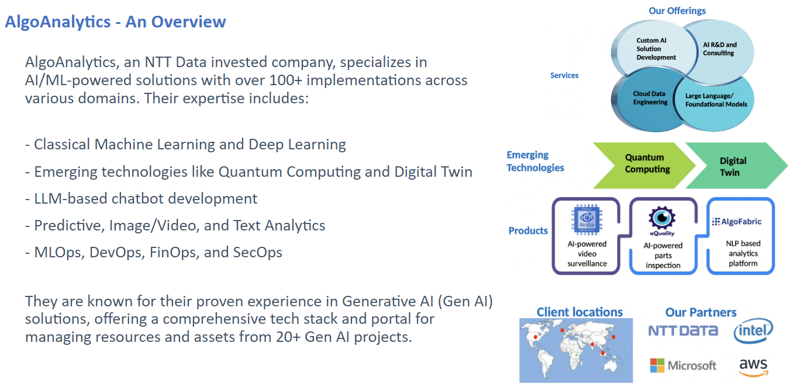
Technical Foundations of AVs
▸ AVs rely on advanced sensors like LiDAR, radar, and high-resolution cameras for environment perception.
▸ Sensor fusion is critical for accurate navigation and decision-making in complex scenarios.
▸ Continuous improvement in AI algorithms enhances the reliability of AV systems.
▸ Collaboration with tech partners is essential for overcoming engineering challenges.
3/9

Slide 4
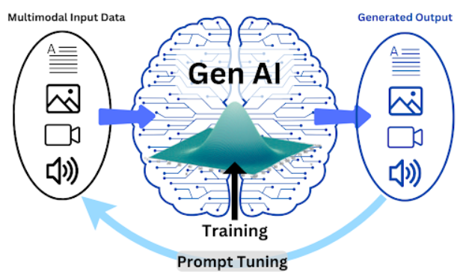
Generative AI: Transforming Industries
▸ Generative AI (Gen AI) enables innovative solutions across various sectors, including automotive.
▸ Applications include intelligent assistants, automated insight generation, and smart documentation management.
▸ Gen AI enhances business process automation, improving operational efficiency and decision-making.
▸ Proven expertise in developing LLM-based solutions tailored to industry needs.
4/9

Slide 5
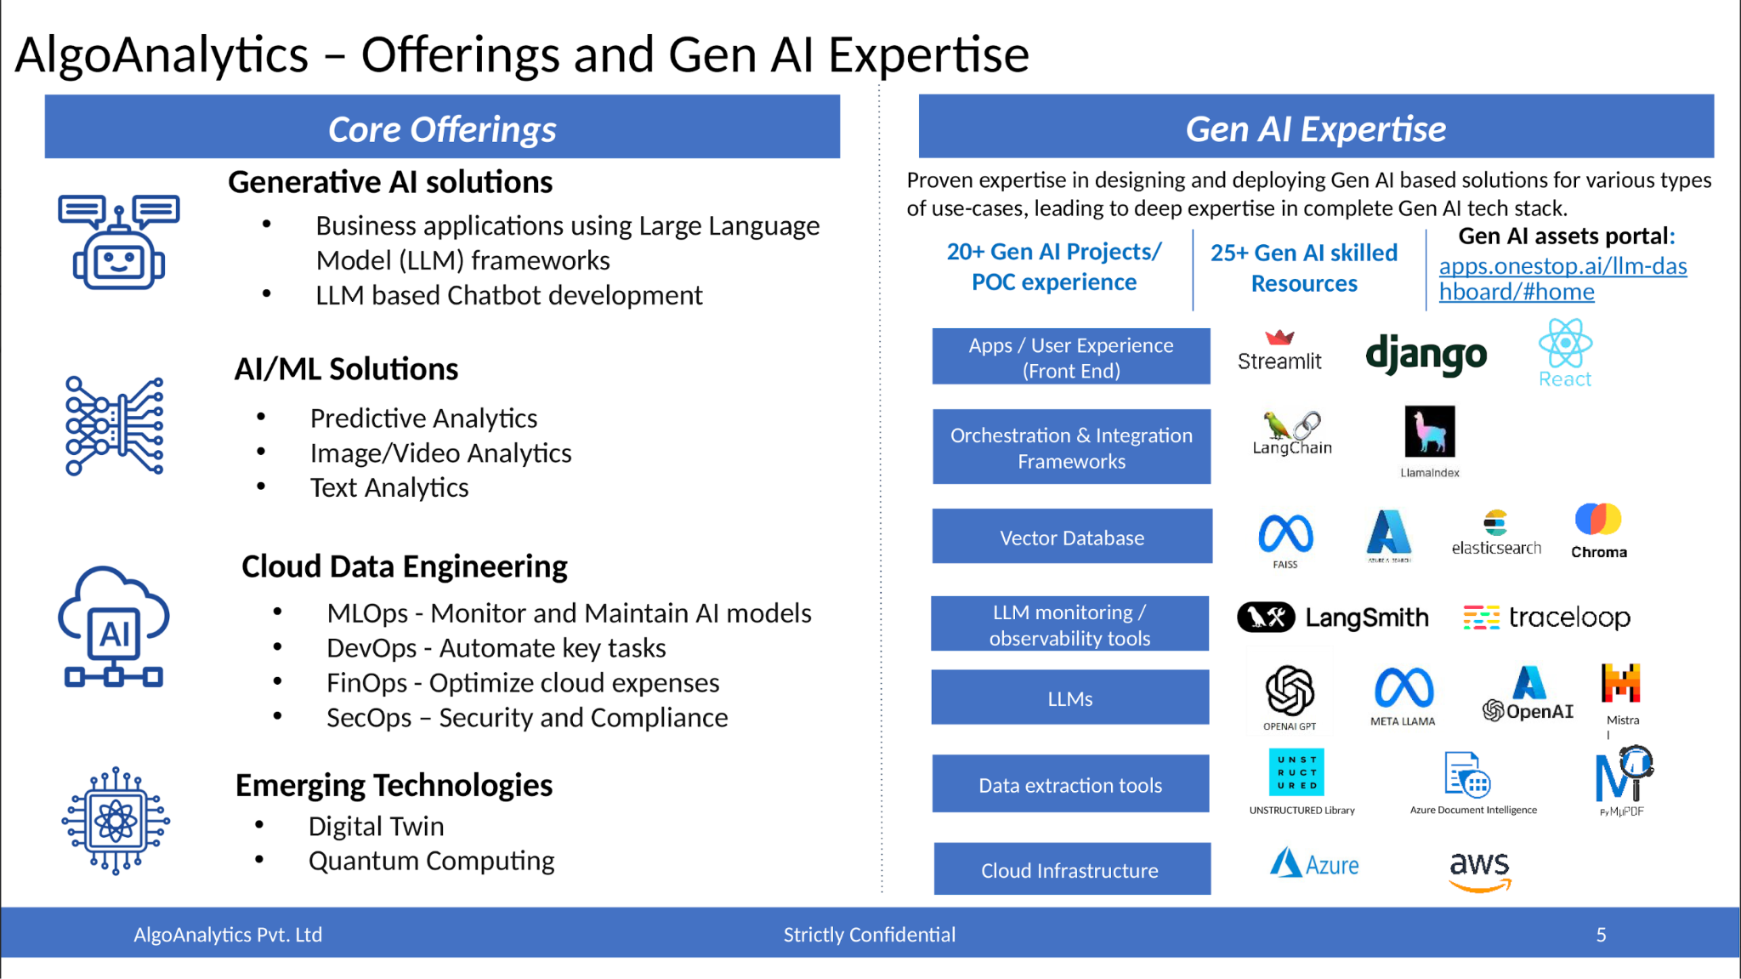
Gen AI in the Automotive Sector
▸ Gen AI solutions for automotive were recognized as top finalists in industry hackathons.
▸ Applications include dynamic RFP response generation and enterprise document summarization.
▸ LLM-powered chatbots enhance customer engagement and streamline service processes.
▸ Collaboration with automotive leaders is key to driving innovation and adoption.
5/9

Slide 6
Business Value of Autonomous Cars
▸ AVs can lead to significant cost savings for businesses through reduced liability and insurance costs.
▸ Enhanced logistics and supply chain efficiency through autonomous delivery systems.
▸ Potential for new revenue streams via ride-sharing and mobility-as-a-service models.
▸ Improved customer satisfaction through enhanced safety and convenience.
6/9

Slide 7
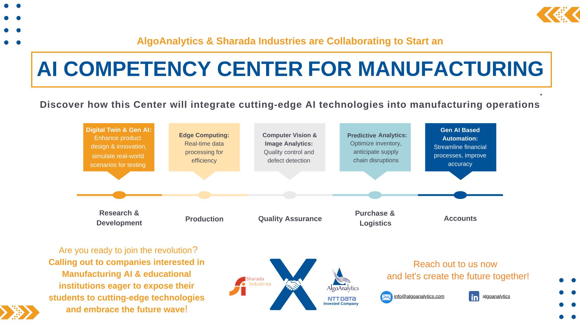
Challenges and Considerations
▸ Navigating regulatory frameworks and public acceptance is critical for AV deployment.
▸ Addressing ethical concerns surrounding AI decision-making in critical situations.
▸ Investment in infrastructure to support AV technology is necessary for widespread adoption.
▸ Ongoing research and development are essential to overcome technical barriers.
7/9

Slide 8
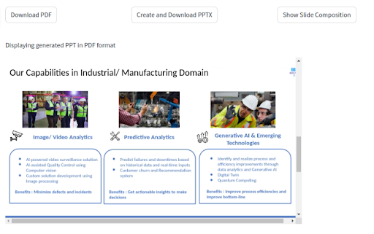
Future Outlook and Opportunities
▸ The convergence of AVs and Gen AI presents unique opportunities for innovation.
▸ Potential for partnerships between tech companies and automotive manufacturers.
▸ Emerging markets for AV technology in urban planning and smart city initiatives.
▸ Continuous evolution of AI capabilities will drive further advancements in autonomous systems.
8/9

Slide 9
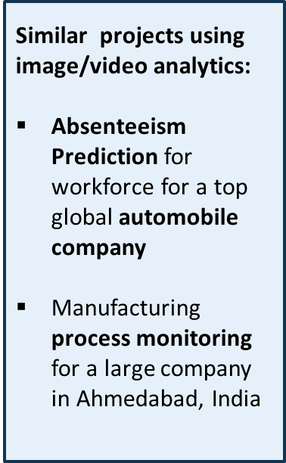
Call to Action
▸ Invest in partnerships that leverage Gen AI for enhancing AV capabilities.
▸ Engage in pilot programs to test and validate autonomous solutions.
▸ Stay informed on regulatory changes and technological advancements in the AV space.
▸ Join the movement towards a safer, more efficient future in transportation.
9/9

