Slide 1
Unlocking Financial Insights with AlgoFabric
Advanced AI Solutions for Manufacturing Excellence

Slide 2
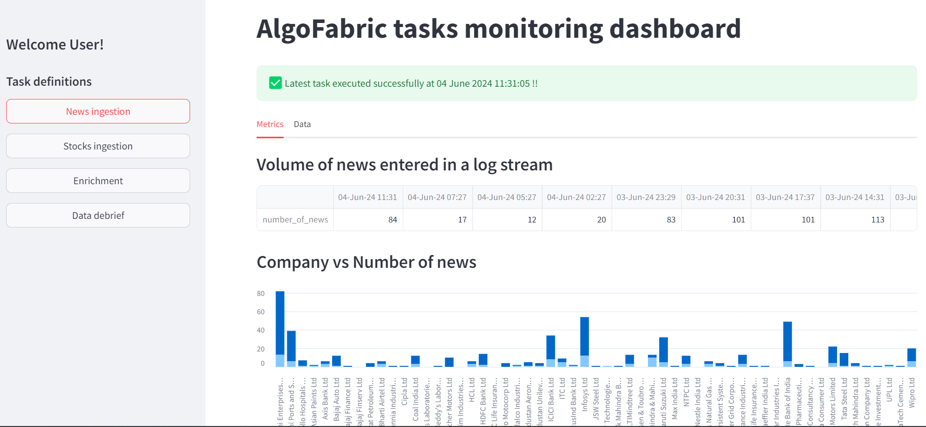
Overview of AlgoFabric
▸ AlgoFabric is an AI-powered financial insights platform designed to transform unstructured data into actionable intelligence.
▸ Combines advanced Natural Language Processing (NLP) with numerical data analysis for comprehensive stock research.
▸ Offers a SaaS model, enabling easy integration and scalability for various business needs.
2/8

Slide 3
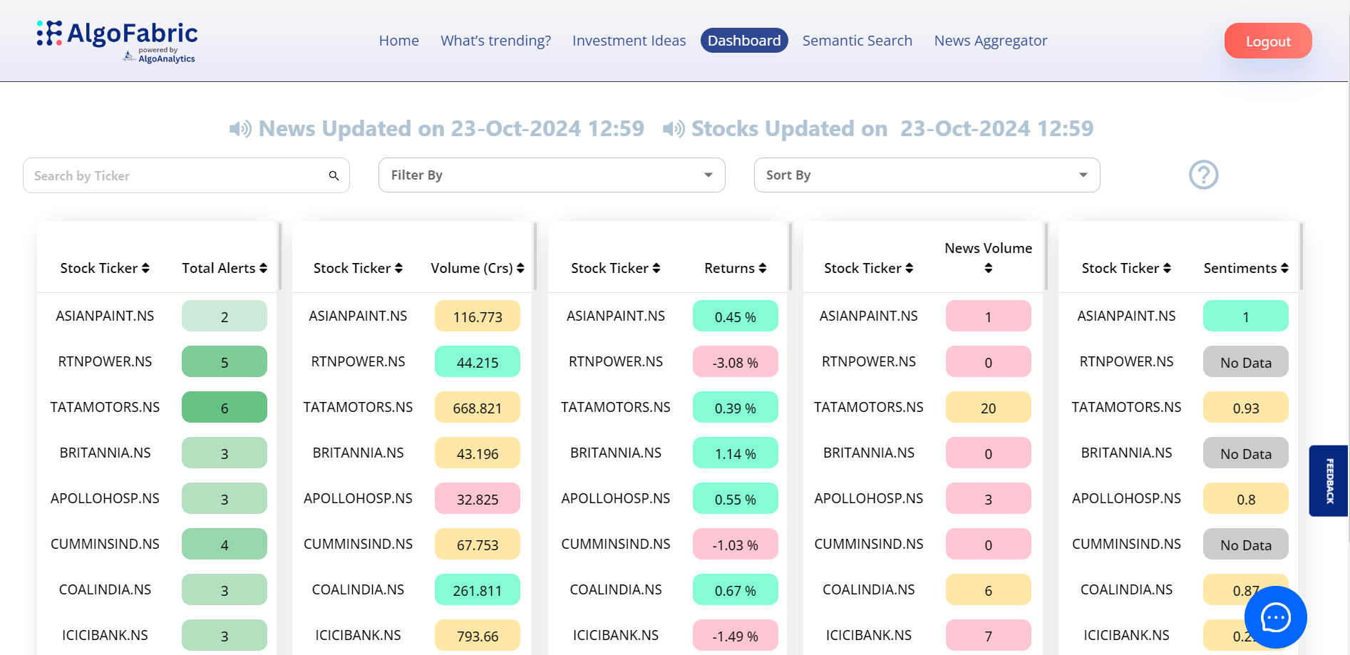
Key Features of AlgoFabric
▸ Real-time news aggregation and sentiment analysis to keep users informed of market movements.
▸ AI-driven recommendations and insights tailored to individual stock interests.
▸ User-friendly dashboard for monitoring performance and debugging backend tasks efficiently.
3/8

Slide 4
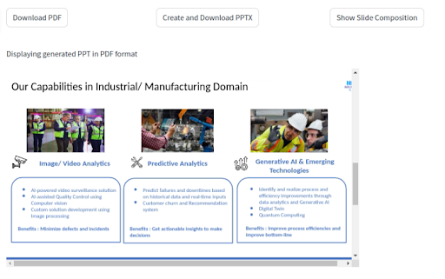
Generalization and Adaptability
▸ Designed to be adaptable across various domains, including sports, politics, and technology.
▸ Feature extraction techniques applicable to diverse datasets, enhancing versatility.
▸ User interface components can be customized for different sectors, ensuring relevance.
4/8

Slide 5
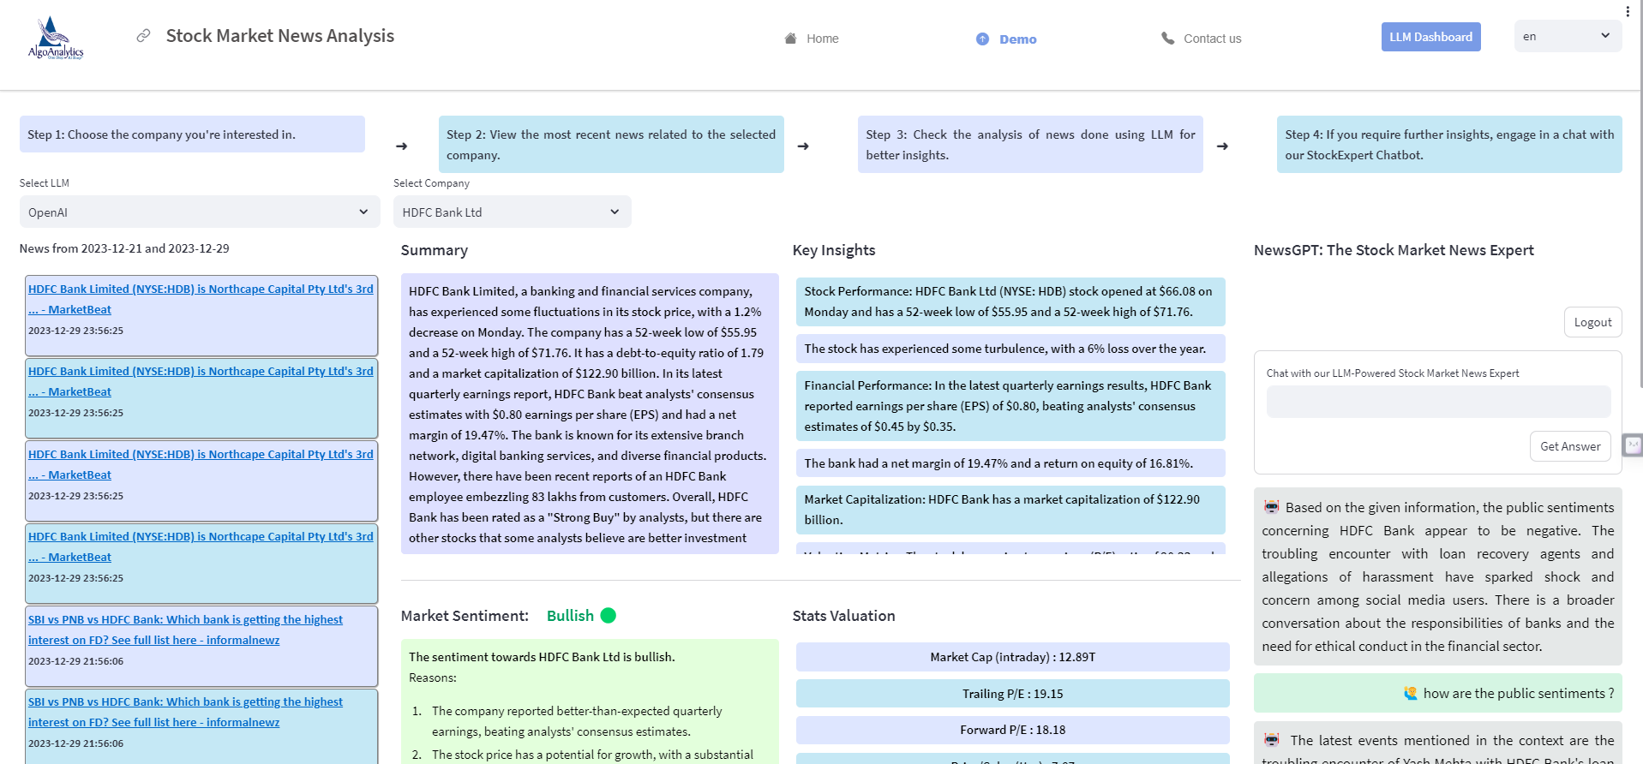
Upcoming Features and Enhancements
▸ Introduction of a Mutual Fund Investment Composition feature to visualize asset allocation.
▸ Integration of small language models for faster insights generation from news articles.
▸ Expansion of stock coverage in alignment with our recommendation strategy.
5/8

Slide 6
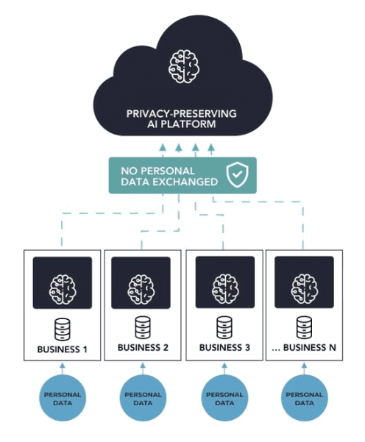
Business Value Proposition
▸ Empowers traders with intelligent insights, enhancing decision-making capabilities.
▸ Provides a competitive edge through timely, personalized information and risk analysis.
▸ Facilitates a 360-degree view of investment opportunities, improving strategic planning.
6/8

Slide 7
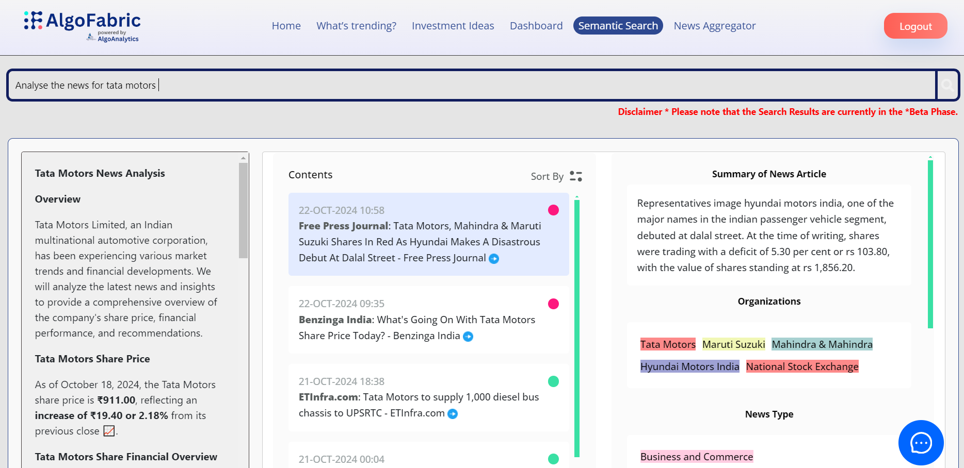
Practical Applications of AlgoFabric
▸ Ideal for financial analysts seeking to streamline stock research processes.
▸ Supports portfolio managers in making informed investment decisions based on real-time data.
▸ Utilized by corporate strategists for market trend analysis and competitive positioning.
7/8

Slide 8
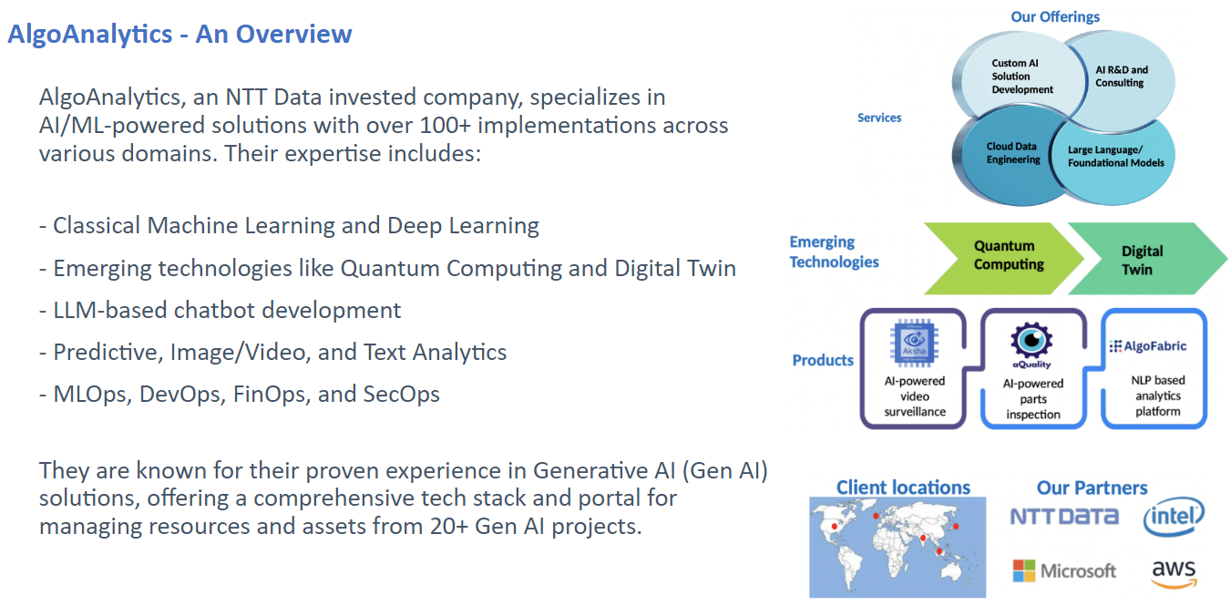
Conclusion and Next Steps
▸ AlgoFabric is positioned to redefine financial insights through AI and data analytics.
▸ Encouraging stakeholders to explore the platform for enhanced investment strategies.
▸ For more information, visit: https://algofabric.algoanalytics.com/
8/8

