Slide 1
Unlocking Financial Insights with Algofabric
Advanced AI Solutions for Manufacturing Excellence

Slide 2
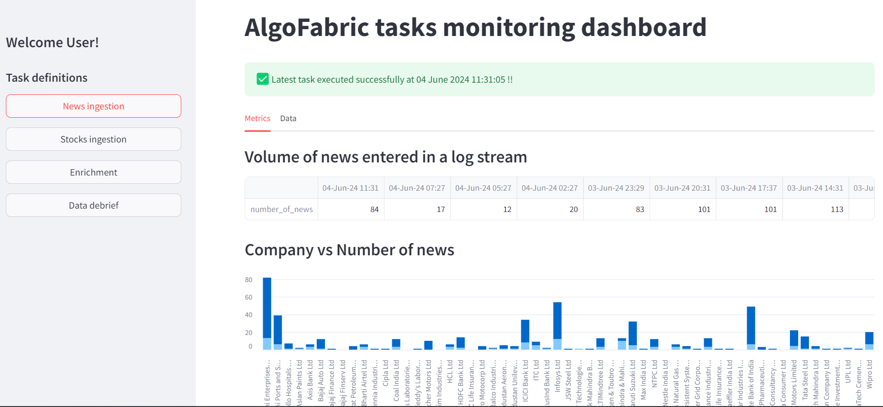
Introduction to Algofabric
▸ AI-powered Stock Research Assistant designed for financial professionals.
▸ Integrates state-of-the-art NLP models with numerical data analysis.
▸ Provides actionable insights and recommendations for investment strategies.
2/7

Slide 3
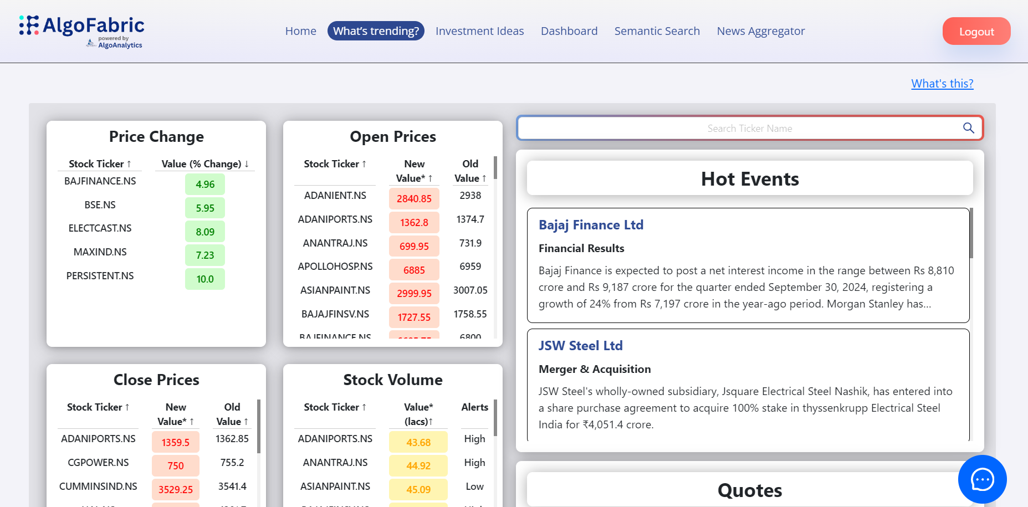
Platformification of Algofabric
▸ Transforms Algofabric into a comprehensive SaaS platform for financial insights.
▸ Facilitates seamless integration of diverse data sources including news and social media.
▸ Enhances user experience through personalized information delivery and insights.
3/7

Slide 4
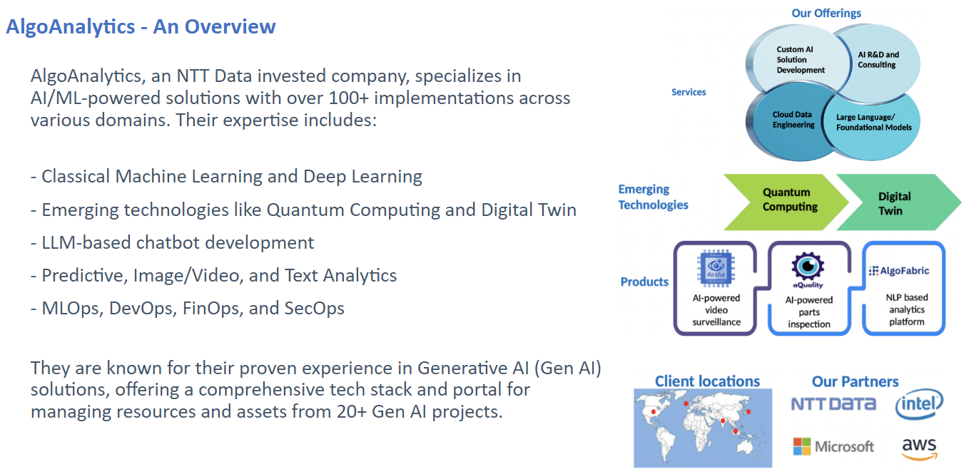
Key Features of Algofabric
▸ Data-driven insights from unstructured data, enabling informed decision-making.
▸ Real-time sentiment analysis and trending topics to gauge market sentiment.
▸ LLM-powered ChatBot for enhanced user interaction and support.
4/7

Slide 5
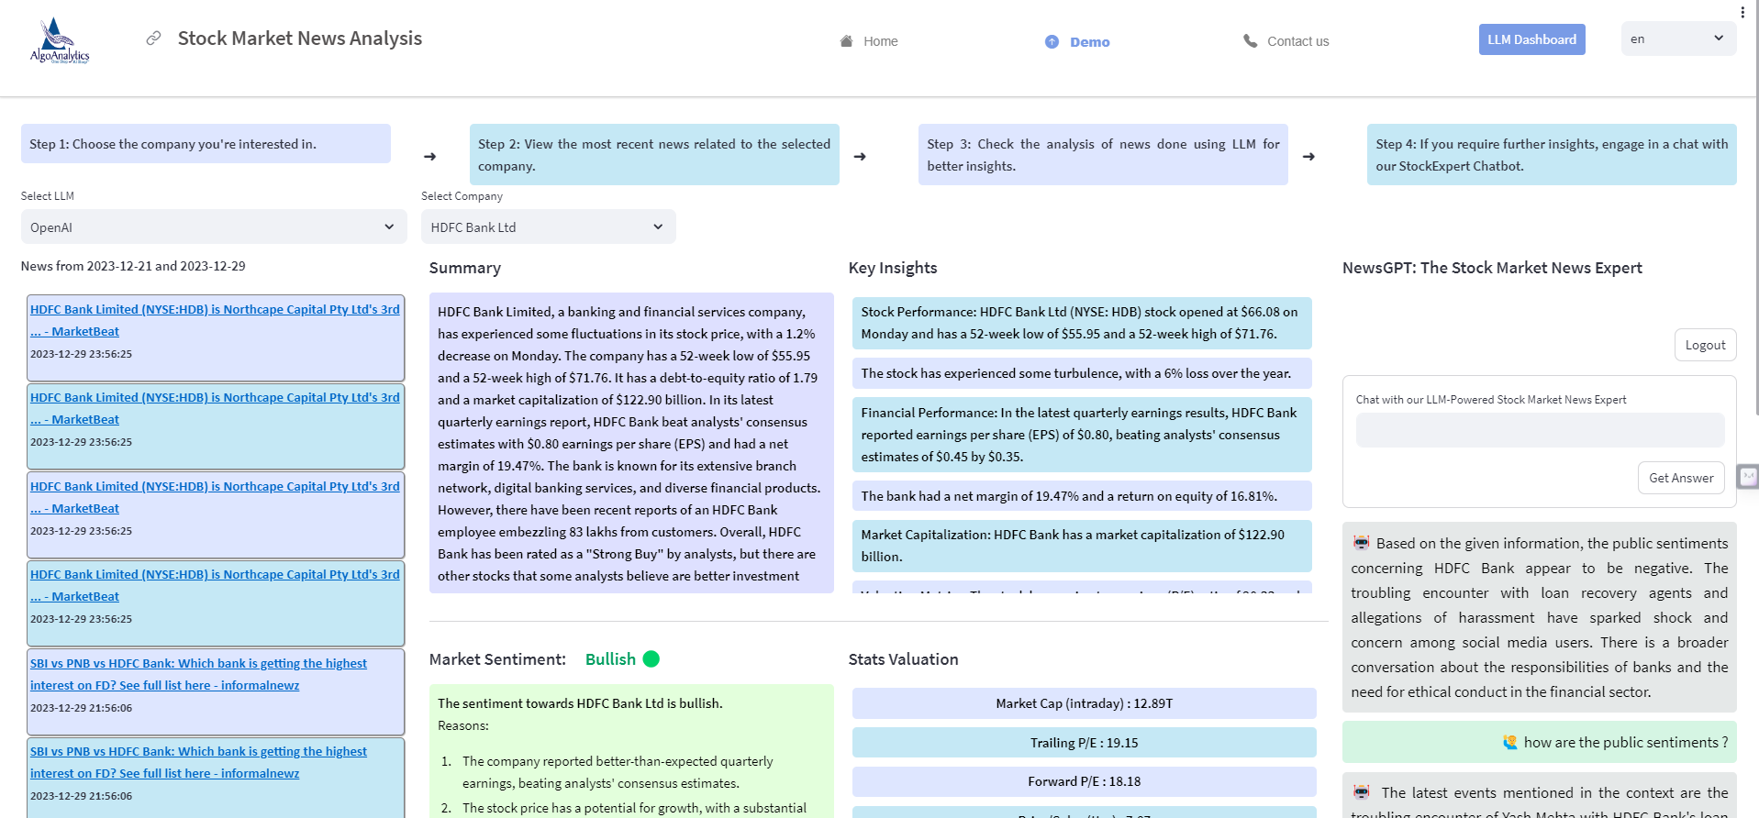
Business Value Proposition
▸ Provides a 360-degree view of companies with daily updates on stock interests.
▸ Offers timely and convenient information digest tailored to user preferences.
▸ Equips users with a competitive edge through comprehensive risk analysis and insights.
5/7

Slide 6
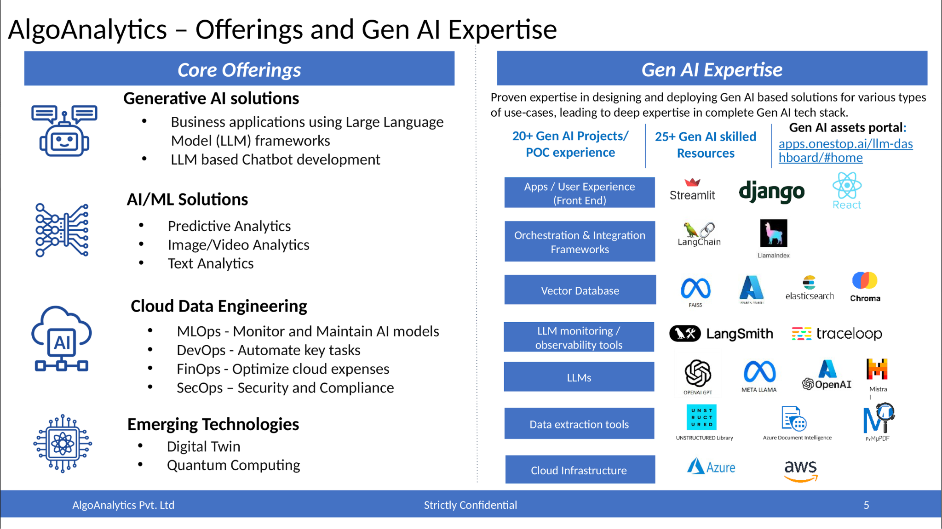
Generalization and Future Applications
▸ Objective to generalize Algofabric for diverse domains beyond finance.
▸ Potential applications in sports, politics, technology, and education sectors.
▸ Focus on adaptable architecture and feature extraction techniques for various datasets.
6/7

Slide 7
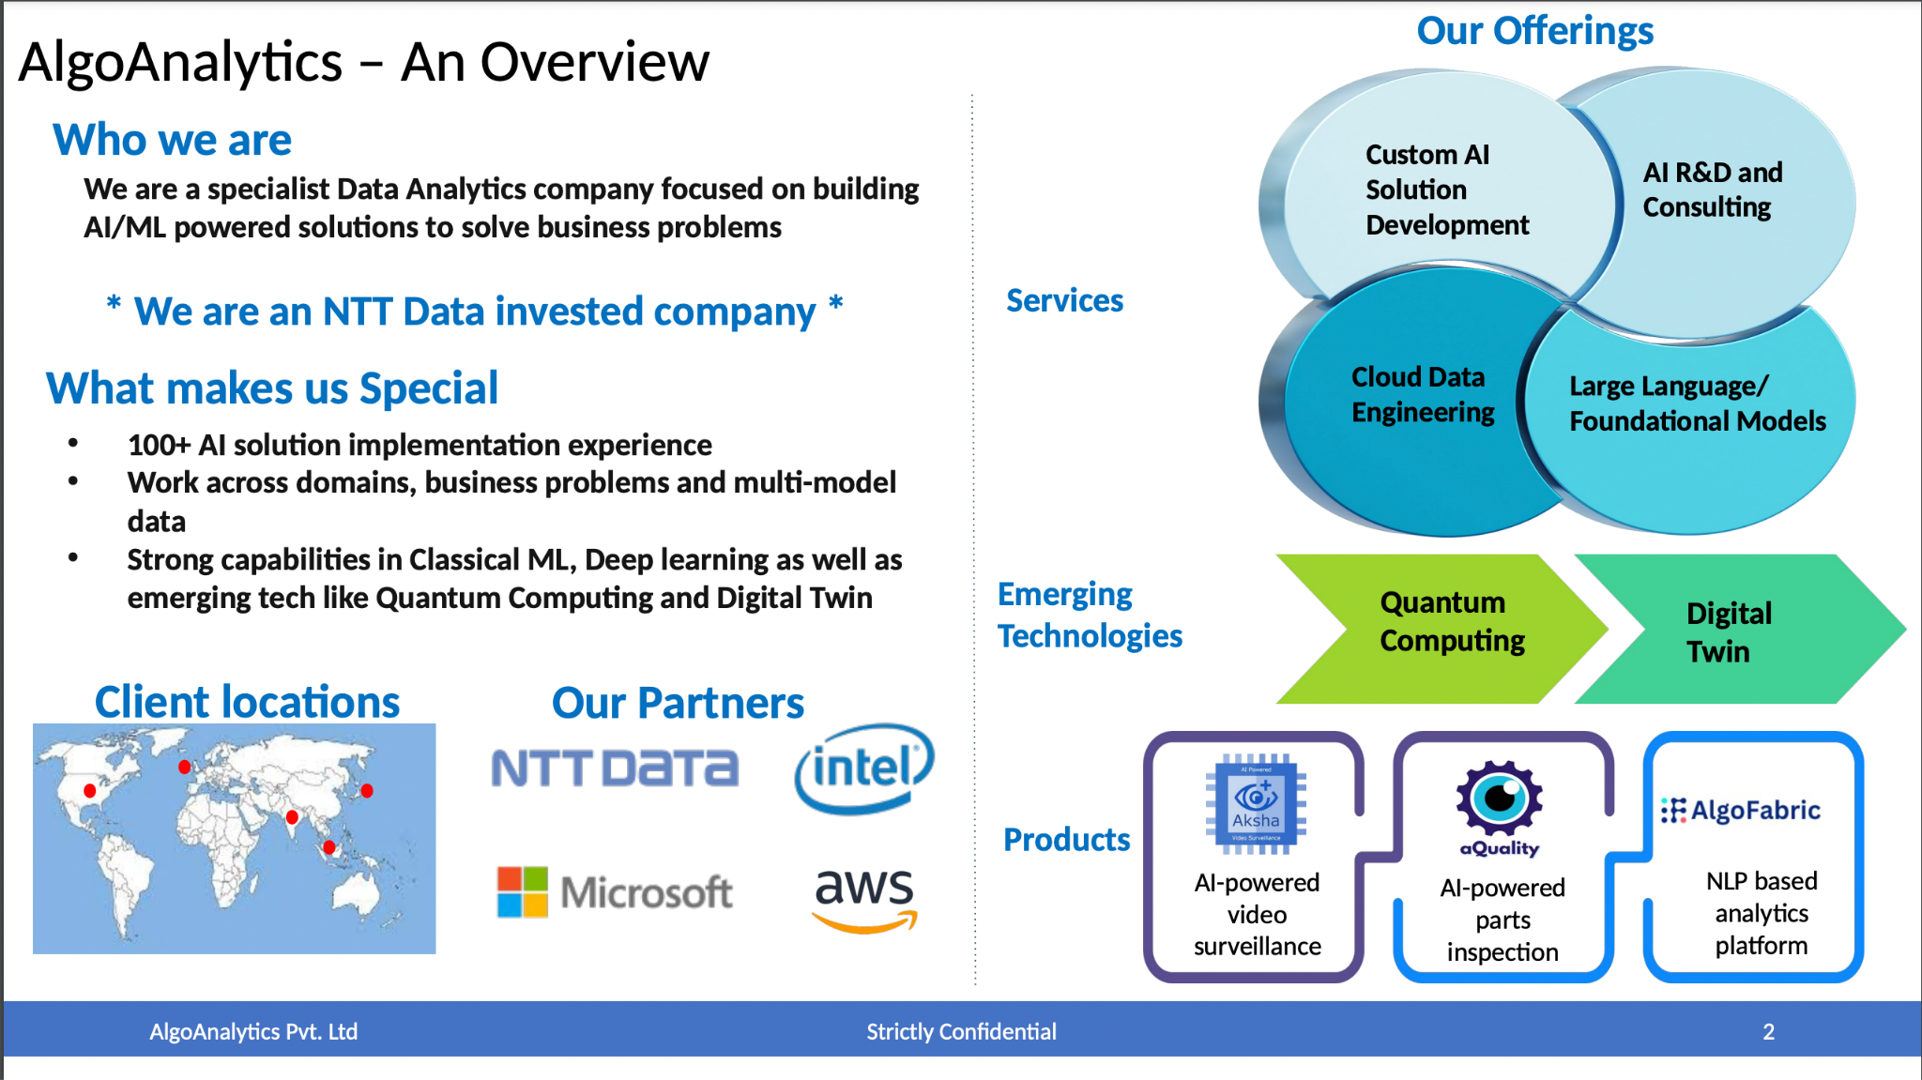
Conclusion and Next Steps
▸ Algofabric stands at the forefront of AI-driven financial insights.
▸ Encourages decision-makers to leverage its capabilities for strategic advantage.
▸ For further information, visit: https://algofabric.algoanalytics.com/
7/7

