Slide 1
Introduction to Aksha Surveillance System
Advanced AI Solutions for Manufacturing Excellence

Slide 2

Overview of Aksha
• Aksha is an intelligent surveillance system designed for automatic monitoring with minimal human intervention.
• Utilizes advanced technologies such as Computer Vision, Artificial Intelligence, and Gen AI.
• Capable of detecting objects and unusual situations, enabling proactive responses.
2/8

Slide 3
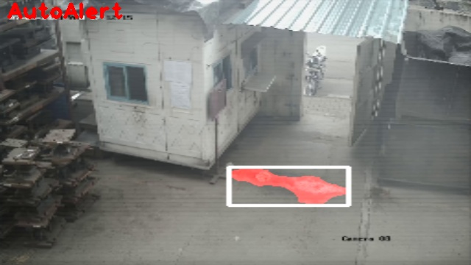
Key Features of Aksha
• Live recording and real-time data processing for immediate insights.
• Advanced object detection capabilities including various entities like vehicles, personnel, and anomalies.
• Customizable alert system allowing users to set specific notifications at their fingertips.
3/8

Slide 4
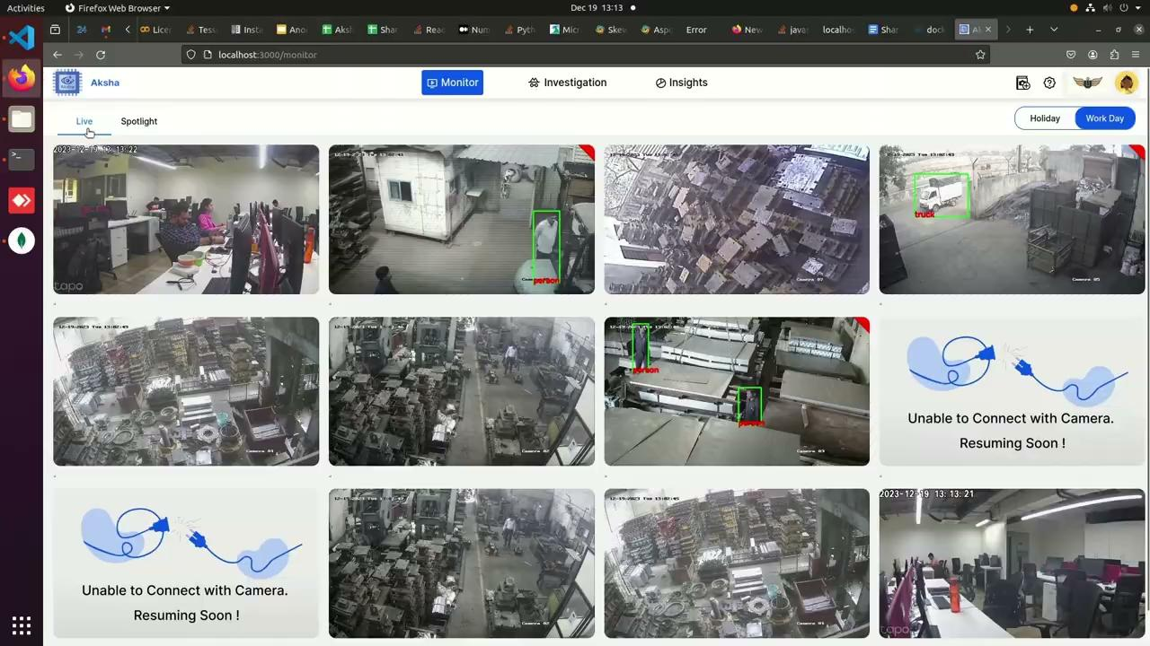
Customer Testimonials
• Clients report significant reductions in human monitoring efforts and improved detection of unforeseen events.
• Positive feedback highlights the system's ability to enhance CCTV utility and operational safety.
• Ongoing anticipation for future updates and innovations from Aksha.
4/8

Slide 5
Installation and Compatibility
• Aksha can be installed on any standard CCTV camera that supports RTSP links.
• Installation involves connecting to an edge device within the same network as the DVR/NVR.
• Compatible with a variety of camera types, ensuring flexibility in deployment.
5/8

Slide 6
Technological Advancements
• Collaboration with NDIL has led to the development of a customized version of Aksha for worker safety.
• Integration of Gen AI to enhance features and improve anomaly detection capabilities.
• Architectural improvements for better performance and scalability, including cloud and edge computing solutions.
6/8

Slide 7
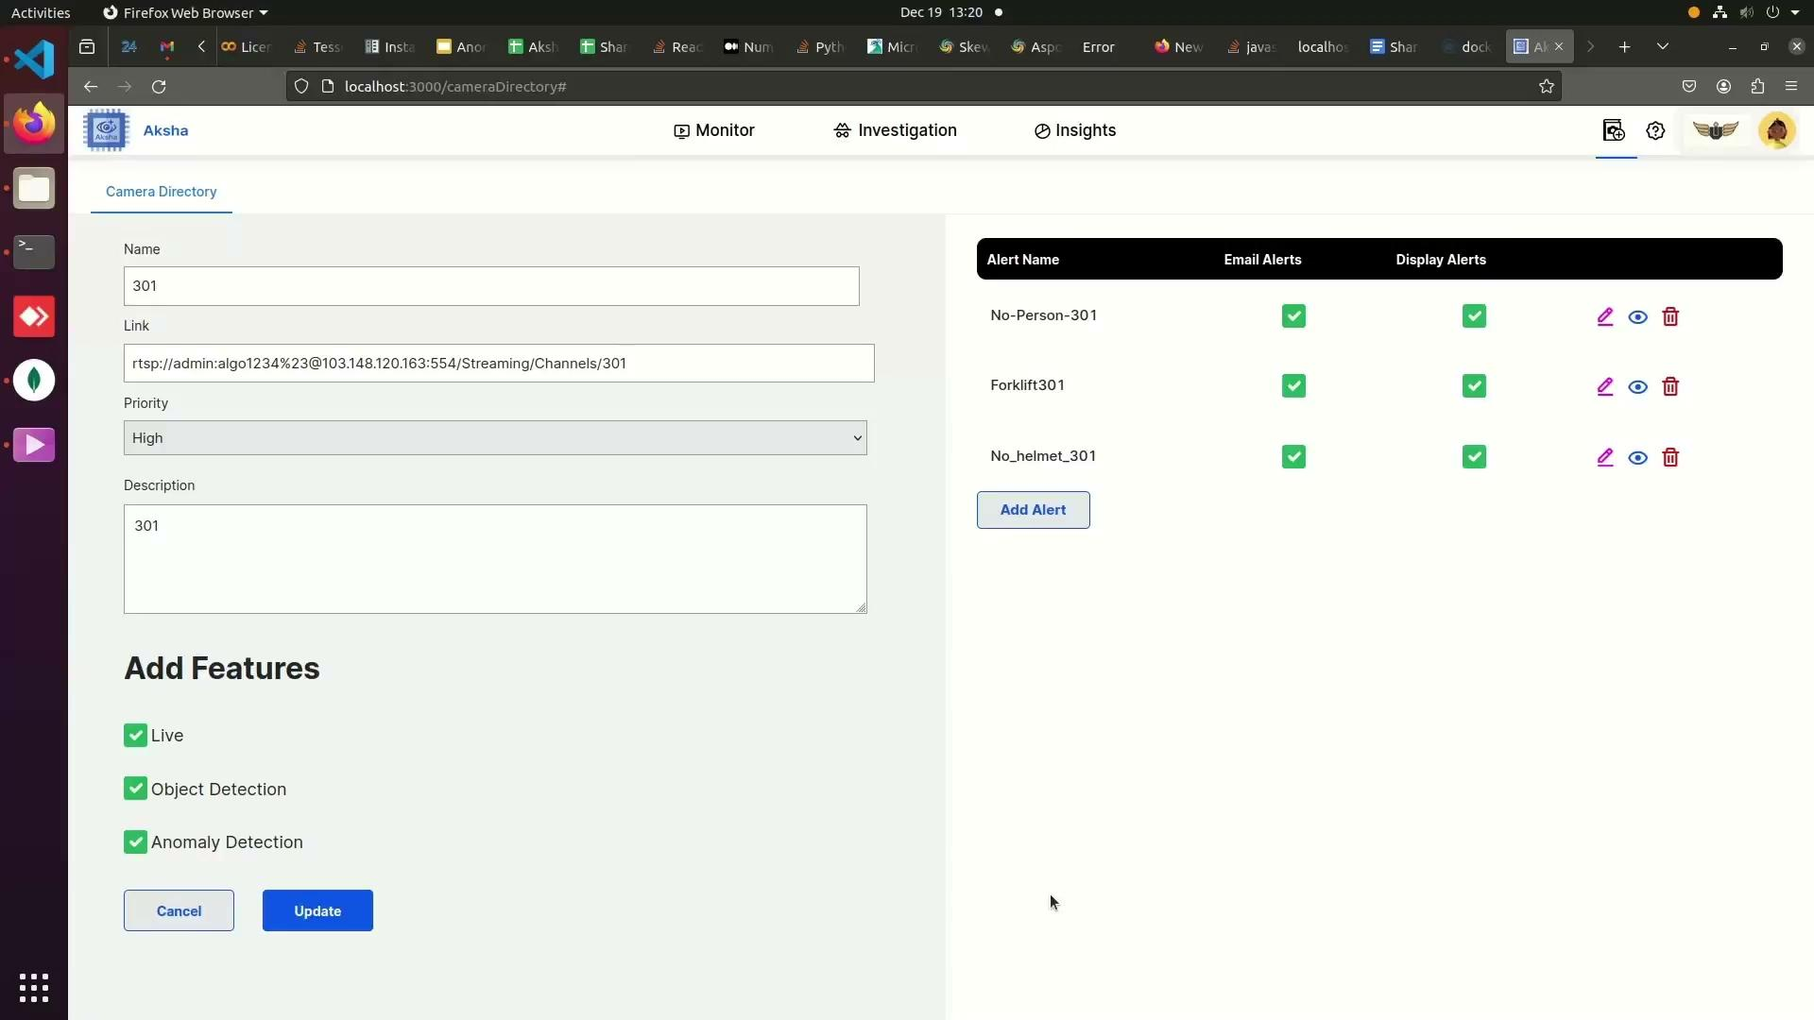
Current Developments and Future Directions
• Ongoing enhancements to support multi-edge architecture for improved camera management.
• Centralized GUI for monitoring multiple cameras running on different hardware devices.
• Future plans include expanding functionalities and optimizing user experience.
7/8

Slide 8
Contact Information
• For more information, visit: https://aksha.algoanalytics.com/
• Contact us at: aksha@algoanalytics.com
• Office Location: Alacrity India Innovation Centre, Pune, India.
8/8

