Slide 1
Aksha Surveillance System and Digital Twin Project
Advanced AI Solutions for Manufacturing Excellence

Slide 2
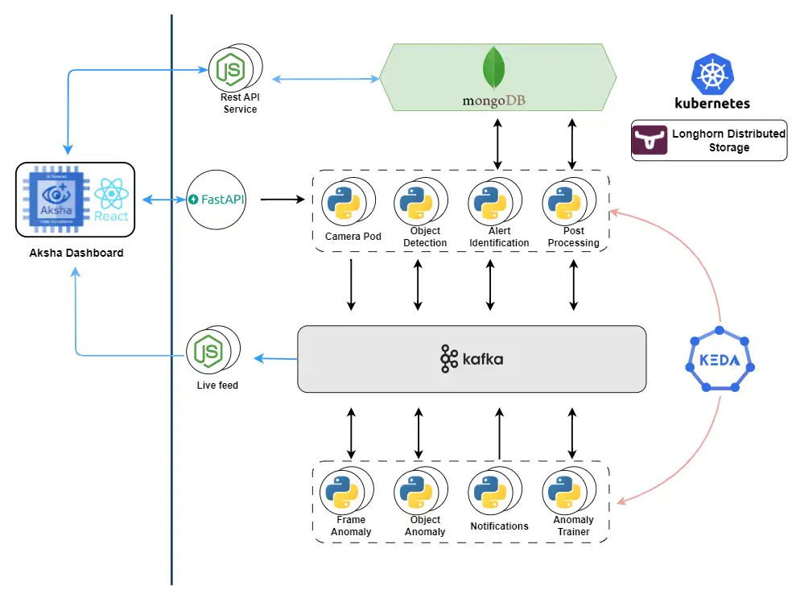
Introduction to Aksha
▸ Aksha is an intelligent surveillance system designed for automated monitoring with minimal human intervention.
▸ Utilizes advanced technologies such as Computer Vision, Artificial Intelligence, and Gen AI.
▸ Focuses on real-time object detection and anomaly identification to enhance safety and security.
2/10

Slide 3

Core Features of Aksha
▸ 24/7 monitoring capabilities with live recording and data processing.
▸ Advanced object detection for various entities including vehicles, people, and unusual behaviors.
▸ Customizable alert systems that allow users to set specific notifications based on detected anomalies.
3/10

Slide 4
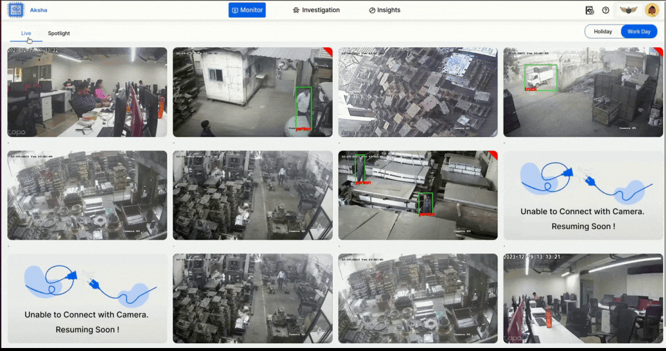
Business Value Proposition
▸ Transforms traditional CCTV setups into smart surveillance systems, enhancing operational efficiency.
▸ Reduces human monitoring efforts, allowing businesses to allocate resources more effectively.
▸ Low capital expenditure (CapEx) with SaaS-based pricing models, making it accessible for various industries.
4/10

Slide 5
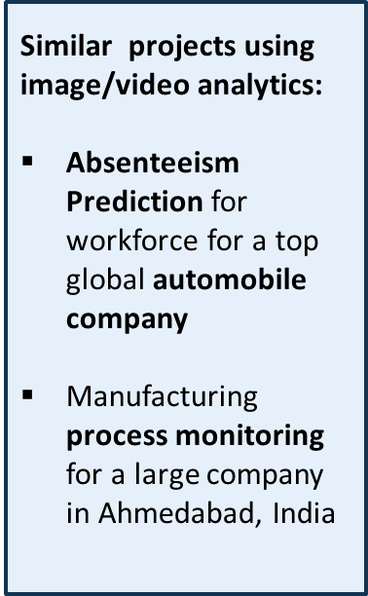
Applications in Industrial Settings
▸ Customized solutions for worker safety monitoring in construction and industrial environments.
▸ Real-time insights into worker activities and safety compliance through advanced video analytics.
▸ Seamless integration with existing infrastructure, ensuring minimal disruption during implementation.
5/10

Slide 6
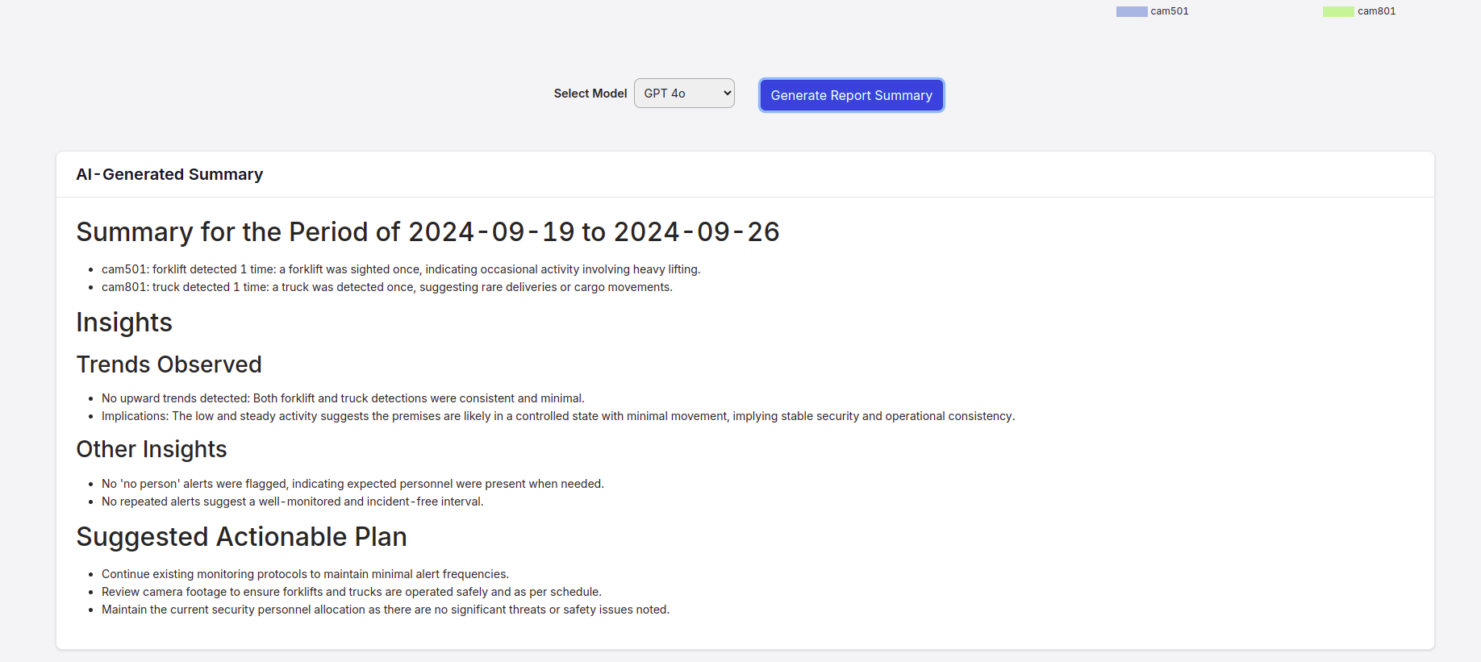
Case Study: Worker Safety
▸ Development of a video analytics solution specifically for monitoring worker safety at construction sites.
▸ Utilized Aksha's capabilities to address challenges in real-time monitoring and anomaly detection.
▸ Phased implementation approach tailored to client needs, enhancing adaptability and effectiveness.
6/10

Slide 7
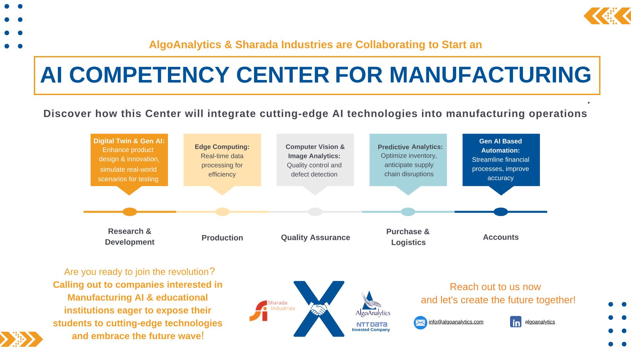
Collaborative Development Efforts
▸ Collaboration with NDIL to customize Aksha for enhanced worker safety features.
▸ Successful integration of Gen AI to improve detection accuracy and reporting capabilities.
▸ Phased development approach with continuous support to optimize performance on edge devices.
7/10

Slide 8
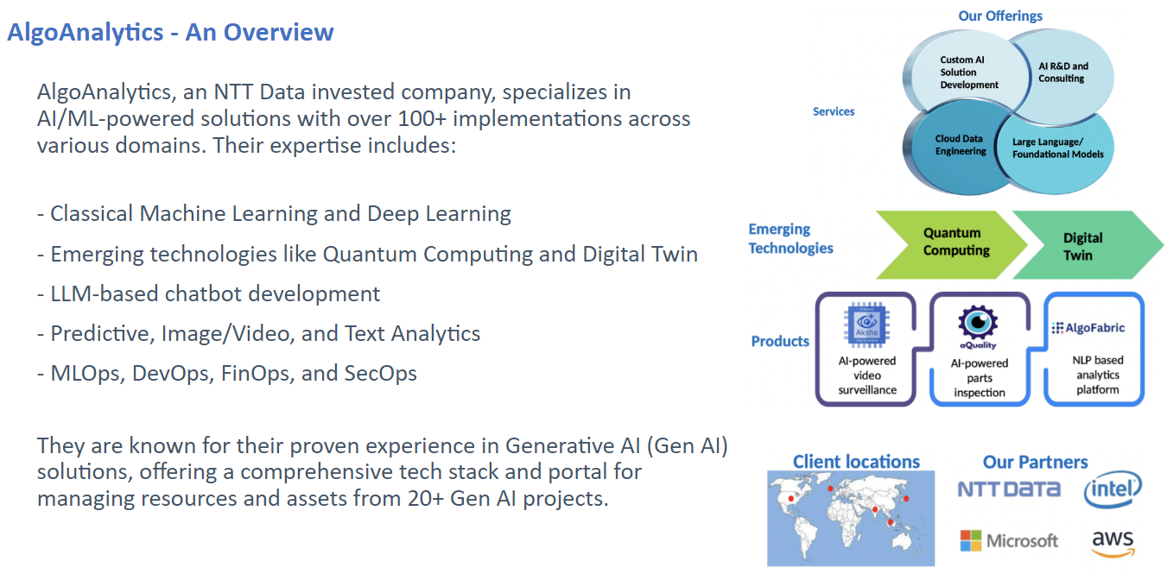
Customer Testimonials
▸ Positive feedback highlighting the reduction in human monitoring efforts and improved anomaly detection.
▸ Clients appreciate the flexibility and customization options that Aksha provides.
▸ Recognition of Aksha's role in transforming traditional surveillance into proactive safety management.
8/10

Slide 9
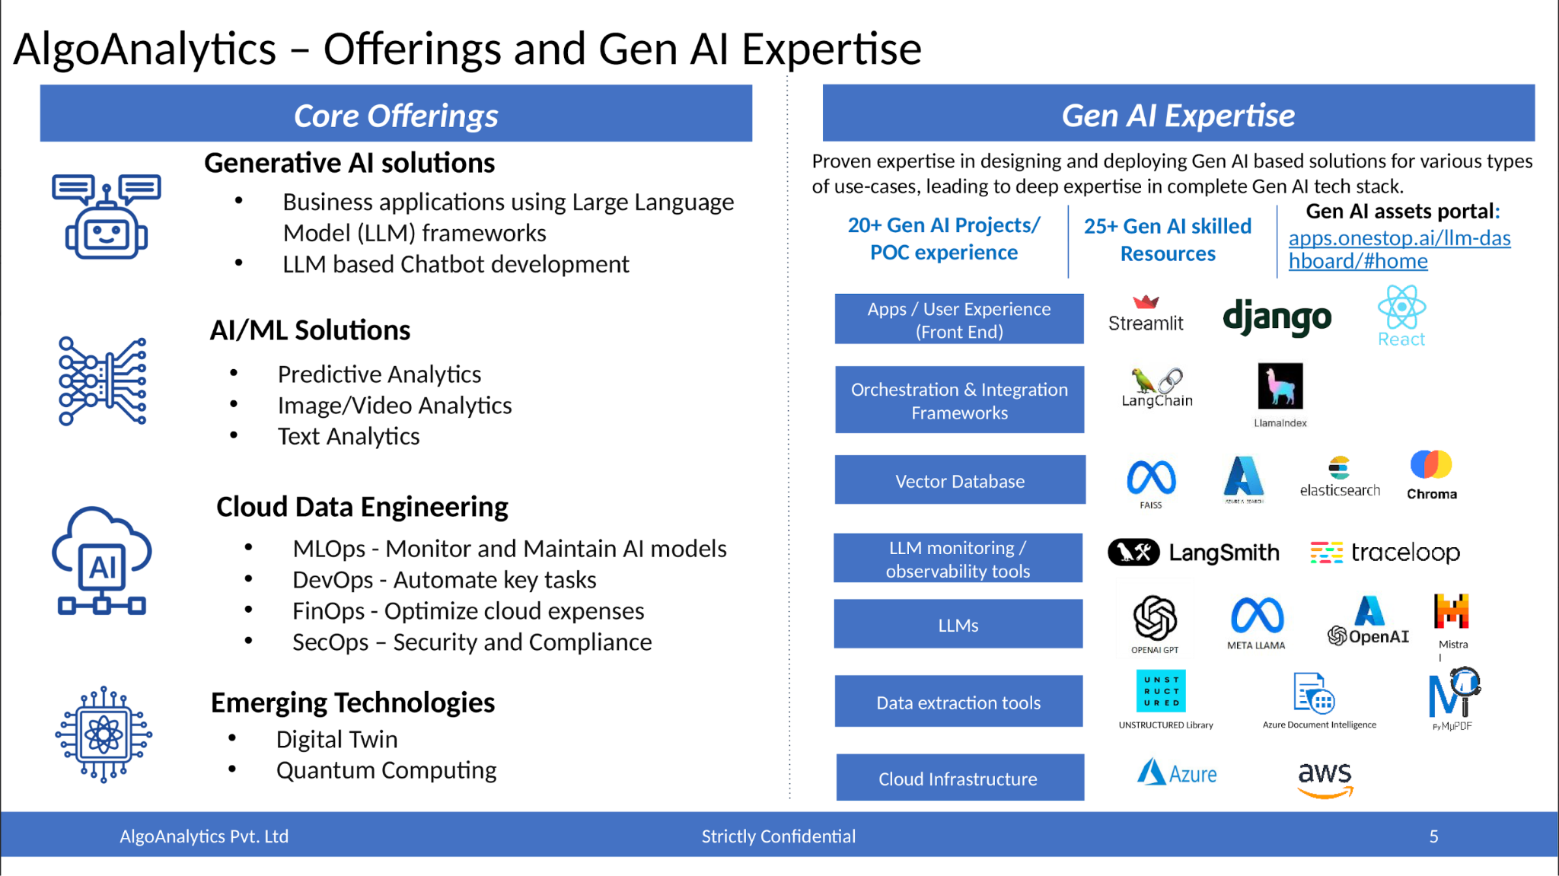
Future Innovations and Updates
▸ Ongoing enhancements to Aksha's features, including further integration of Gen AI capabilities.
▸ Plans for expanding applications across various sectors beyond construction and industrial domains.
▸ Commitment to continuous improvement based on client feedback and technological advancements.
9/10

Slide 10
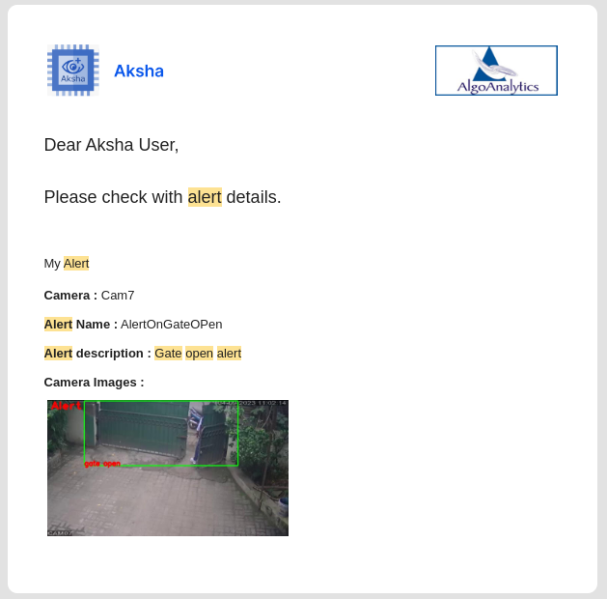
Conclusion and Call to Action
▸ Aksha represents a significant advancement in surveillance technology, prioritizing safety and efficiency.
▸ Encouragement for stakeholders to explore Aksha's capabilities for their specific business needs.
▸ Invitation for further discussions on implementation strategies and potential collaborations.
10/10

