Slide 1
Harnessing the Power of NVIDIA GPUs for Business Innovation
Advanced AI Solutions for Manufacturing Excellence

Slide 2
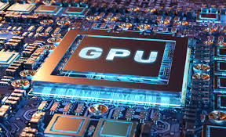
The Evolution of GPUs
▸ Transitioned from specialized graphics rendering to general-purpose parallel processors.
▸ Optimized architecture for massive parallelism enables efficient data-intensive tasks.
▸ Critical in High-Performance Computing (HPC) and scientific simulations.
2/6

Slide 3
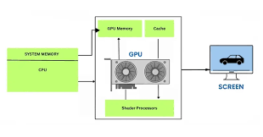
Architectural Advantages
▸ Thousands of cores designed for high-throughput, enabling simultaneous processing of multiple data streams.
▸ Superior performance in 'embarrassingly parallel' problems compared to traditional CPUs.
▸ Key enabler of deep learning and AI, significantly reducing model training time.
3/6

Slide 4
Business Applications of NVIDIA GPUs
▸ Accelerate complex simulations in fields like finance, weather forecasting, and molecular dynamics.
▸ Enhance capabilities in natural language processing and computer vision applications.
▸ Drive innovation in autonomous systems through rapid data processing and analysis.
4/6

Slide 5
Energy Efficiency and Time-to-Discovery
▸ GPUs deliver faster results with lower energy consumption compared to traditional computing methods.
▸ Accelerate time-to-discovery in scientific research and business insights.
▸ Support real-time data processing needs, essential for modern business operations.
5/6

Slide 6
Future of GPUs in Business
▸ As AI models grow, GPUs will remain central to technological advancements in various sectors.
▸ Continued evolution of GPU technology will drive efficiency and innovation in business processes.
▸ Investment in GPU capabilities is critical for organizations aiming to leverage big data and AI.
6/6

