Slide 1
Harnessing FastAPI, GPU, and AlgoAnalytics for High-Performance Solutions
Advanced AI Solutions for Manufacturing Excellence

Slide 2
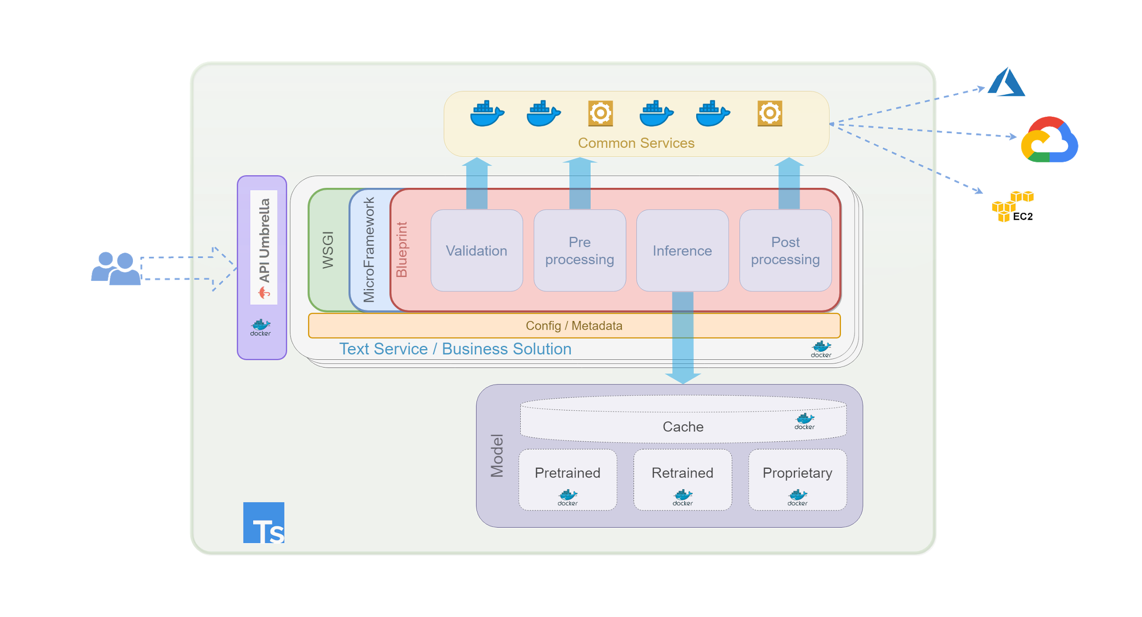
Introduction to FastAPI
▸ Built on Starlette and Uvicorn, FastAPI offers performance that rivals compiled languages.
▸ Utilizes asynchronous programming for efficient handling of concurrent requests, ideal for I/O-bound tasks.
▸ Enhances developer experience with standard Python type hints and automatic generation of OpenAPI documentation.
2/8

Slide 3
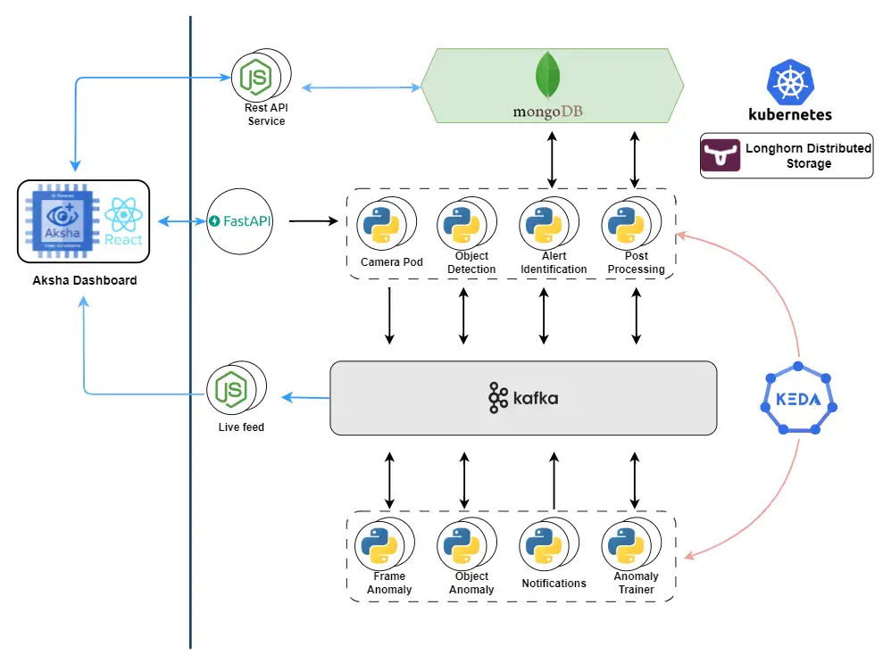
The Business Value of FastAPI
▸ FastAPI bridges the gap between Python's data-centric strengths and the demands of modern web infrastructure.
▸ Enables rapid development of microservices and real-time applications with low latency.
▸ Facilitates seamless integration with external APIs, enhancing operational efficiency.
3/8

Slide 4
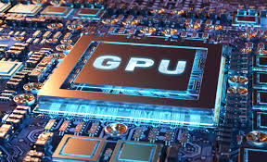
Understanding GPU Capabilities
▸ GPUs excel in processing thousands of data streams simultaneously, outperforming CPUs in parallel tasks.
▸ Critical for deep learning, enabling rapid training of large neural networks through high-speed matrix operations.
▸ Supports real-time data processing, essential for applications in AI and machine learning.
4/8

Slide 5
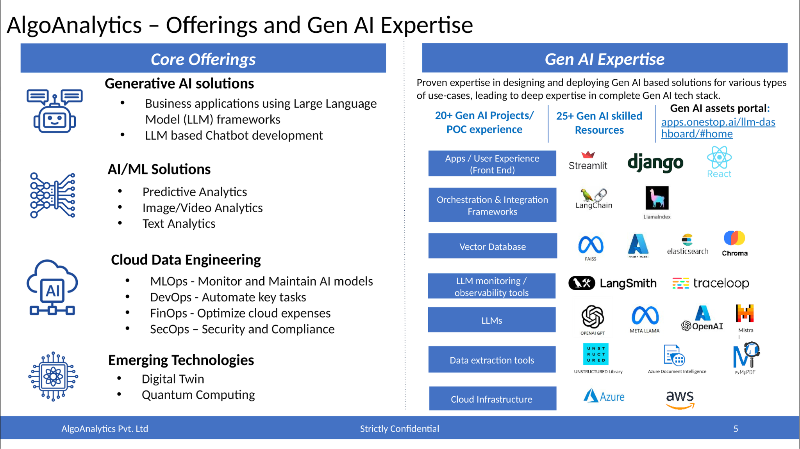
AlgoAnalytics: Driving Innovation
▸ Offers a comprehensive Gen AI tech stack, including orchestration frameworks and vector databases.
▸ Expertise in deploying AI solutions across various industries, enhancing operational capabilities.
▸ Provides tools for data extraction, model fine-tuning, and infrastructure provisioning.
5/8

Slide 6
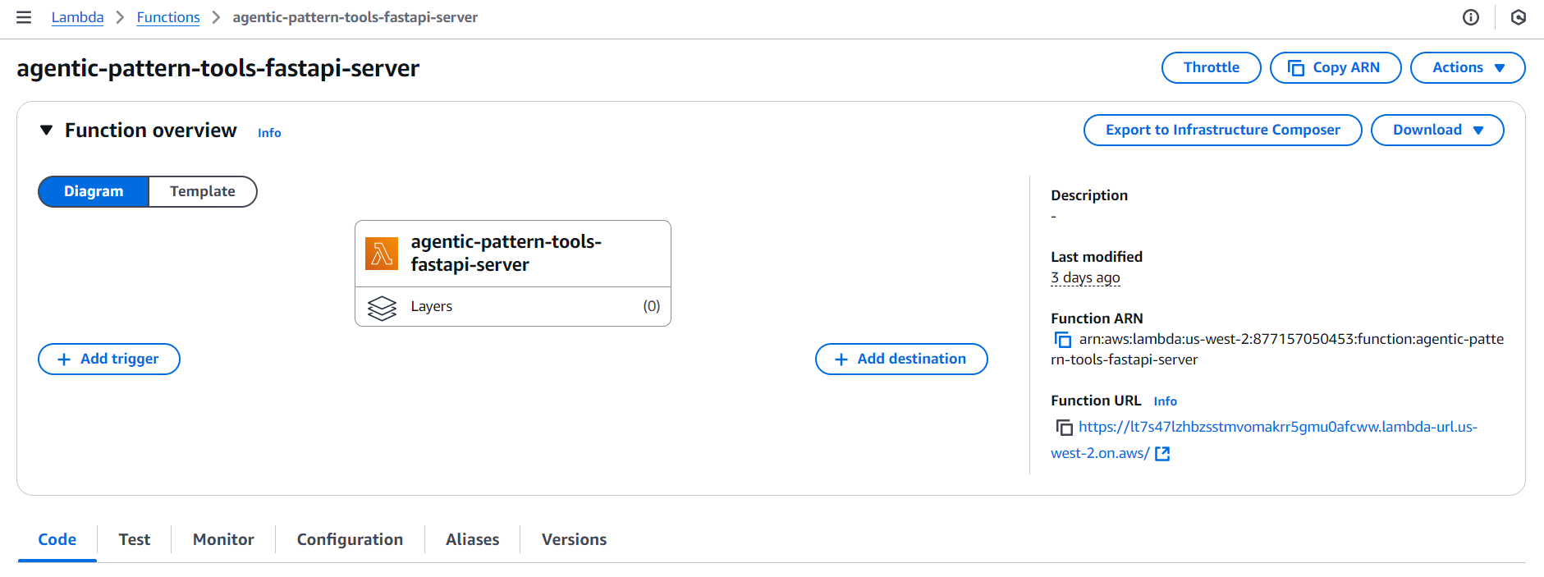
Case Study: FastAPI in Action
▸ Developed a FastAPI application for a global tech giant to host and deploy a proprietary LLM API.
▸ Implemented robust error tracking and integrated with AWS services for high availability.
▸ Conducted performance benchmarking to optimize resource usage and processing capacity.
6/8

Slide 7
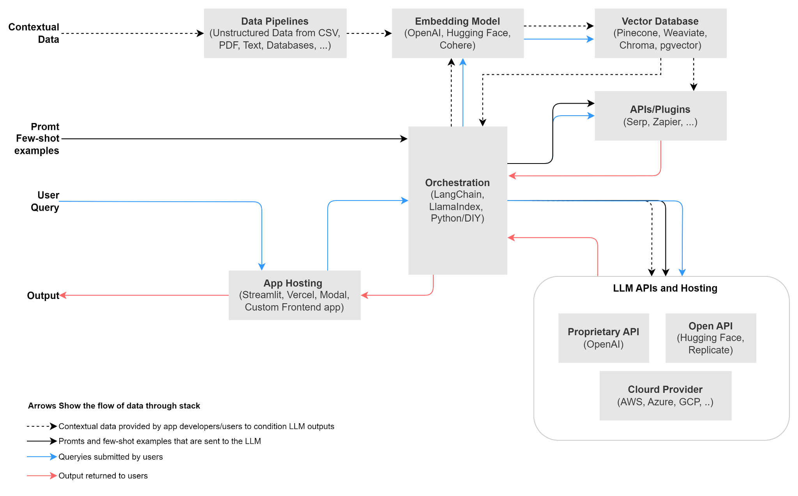
Practical Applications of FastAPI and GPU
▸ Supports various use cases including recommendation systems, fraud detection, and predictive analytics.
▸ Enables real-time data processing for applications in finance, healthcare, and manufacturing.
▸ Facilitates the development of scalable solutions that can adapt to evolving business needs.
7/8

Slide 8
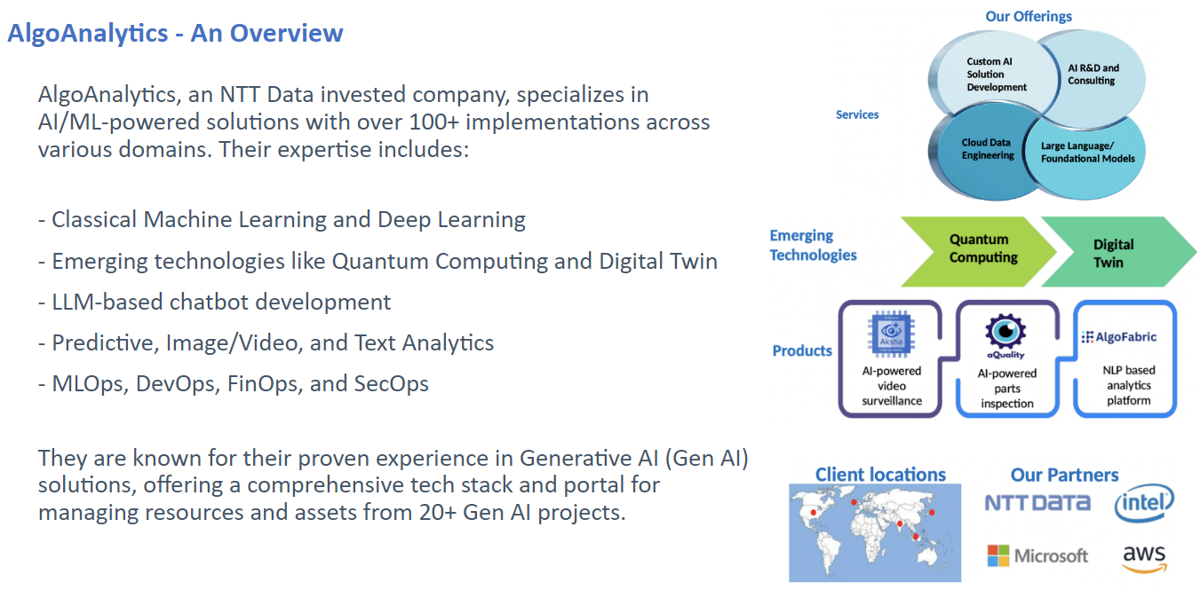
Conclusion and Future Outlook
▸ FastAPI, combined with GPU capabilities, positions organizations for success in a data-driven landscape.
▸ AlgoAnalytics provides the expertise and tools necessary to leverage these technologies effectively.
▸ Investing in these solutions will enhance efficiency, reduce costs, and drive innovation across industries.
8/8

