Slide 1
Intro to Autonomy of Cars and GPU Units
Advanced AI Solutions for Manufacturing Excellence

Slide 2
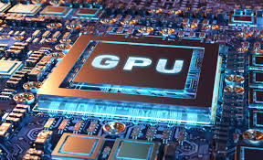
The Evolution of GPUs
• Transitioned from specialized graphics rendering to general-purpose parallel processing.
• Optimized architecture for massive parallelism enhances efficiency in data-intensive tasks.
• Core strength lies in thousands of smaller cores designed for throughput, unlike CPUs focused on latency.
2/8

Slide 3
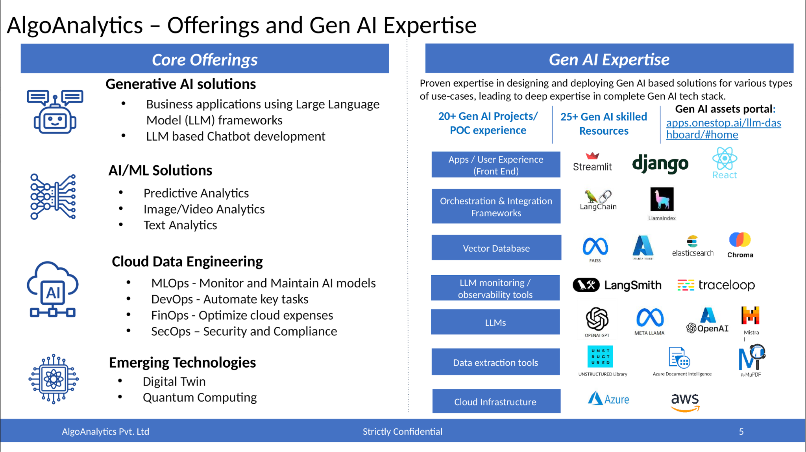
Business Value of GPUs in AI
• Accelerates time-to-discovery in complex computational science, enhancing accessibility.
• Provides energy-efficient performance critical for large-scale AI and deep learning applications.
• Essential for real-time data processing, driving technological innovation across sectors.
3/8

Slide 4
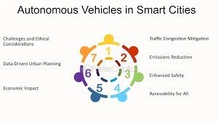
Autonomous Vehicles: A Disruptive Technology
• Promises reduced traffic congestion and optimized fuel efficiency through advanced algorithms.
• Significantly decreases accident rates by minimizing human error in driving.
• Challenges include navigating complex environments and addressing ethical and legal considerations.
4/8

Slide 5
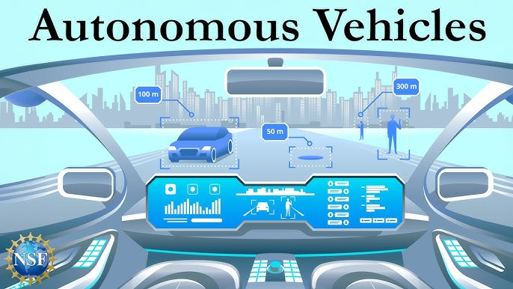
Sensor Fusion and Perception in AVs
• Foundation of self-driving systems relies on advanced sensors like LiDAR, radar, and cameras.
• Accurate environmental perception is critical for safe navigation and decision-making.
• Integration of sensor data enhances reliability and performance in varied driving conditions.
5/8

Slide 6
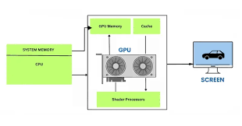
GPU Architecture and Deep Learning
• Modern GPUs include Tensor Cores optimized for low-precision matrix operations in deep learning.
• High core density and high-bandwidth memory support rapid model training and optimization.
• Critical for training large neural networks used in autonomous systems and AI applications.
6/8

Slide 7
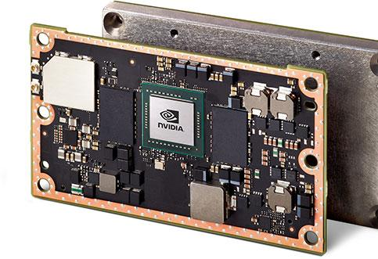
The Role of GPUs in High-Performance Computing
• Facilitates General-Purpose computing on Graphics Processing Units (GPGPU) for simulations.
• Enables modeling of complex phenomena across various scientific fields, enhancing research capabilities.
• Parallel architecture allows for unprecedented scales and resolutions in computational tasks.
7/8

Slide 8
Conclusion: The Future of Autonomous Vehicles and GPUs
• The synergy between GPUs and autonomous vehicle technology is pivotal for future advancements.
• Continued innovation in GPU architecture will support the evolving demands of AI and AVs.
• Strategic investment in these technologies is essential for maintaining competitive advantage in the market.
8/8

