Slide 1
Enhancing Welding Work Through Data-Driven Solutions
Advanced AI Solutions for Manufacturing Excellence

Slide 2
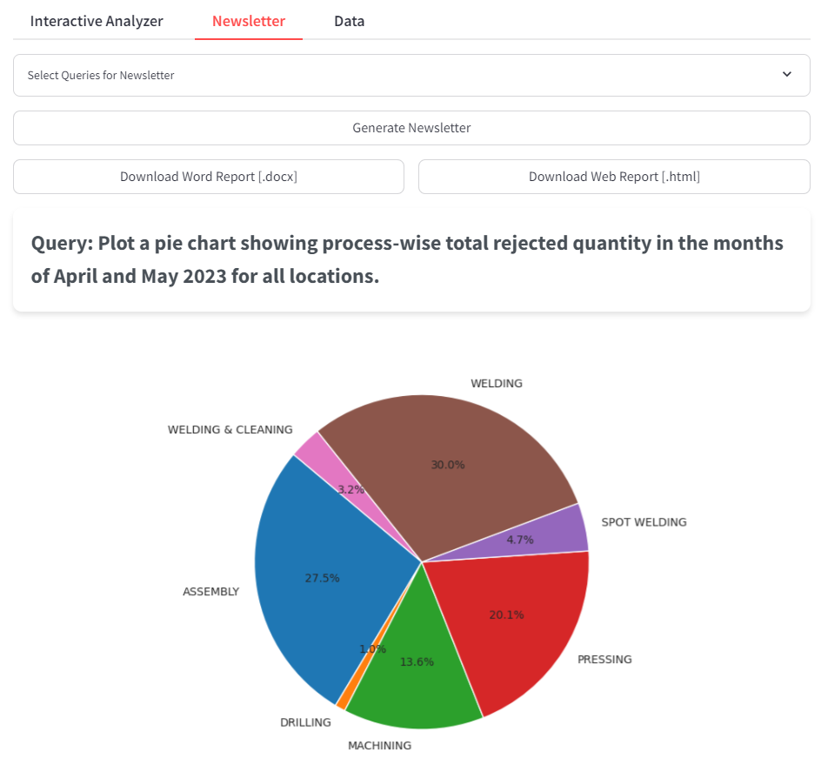
Overview of Welding Work
• Welding is a critical process in manufacturing, impacting product quality and durability.
• Data collection and analysis are essential for identifying defects and improving welding techniques.
• Utilizing advanced technologies like AI and sound analysis can enhance quality control.
2/6

Slide 3
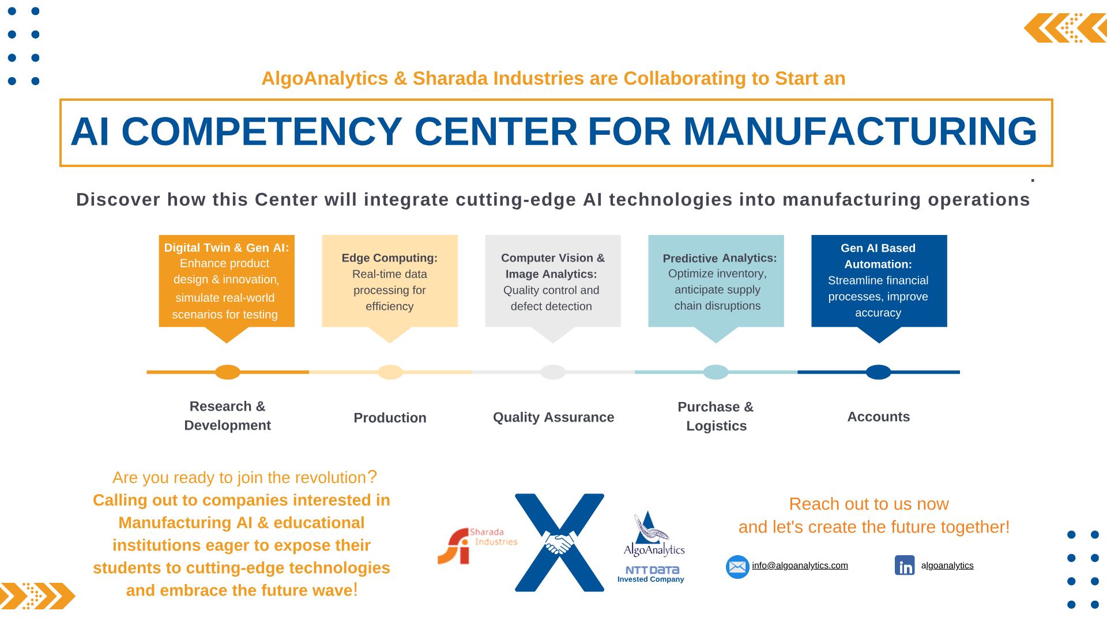
AI-Driven Quality Control
• Implementation of sound analysis models to classify weld quality in real-time.
• Detection of welding defects such as lack of penetration, porosity, and spatter.
• Automated data collection from multiple modalities (audio, video, sensor data) ensures comprehensive monitoring.
3/6

Slide 4
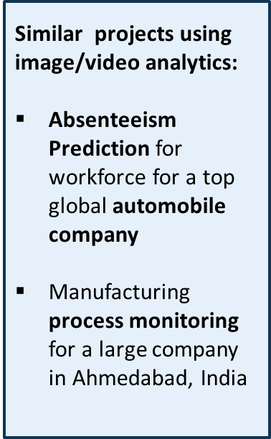
Case Study: Data Acquisition for Intel
• Collaborative project with a global semiconductor manufacturer to collect extensive welding data.
• Setup included robotic welding machines equipped with cameras and microphones for synchronized data logging.
• Focus on identifying and documenting various welding defects to improve manufacturing processes.
4/6

Slide 5
Benefits of Enhanced Welding Data Collection
• Improved defect detection leads to higher product quality and reduced rework costs.
• Data-driven insights enable proactive adjustments in welding processes, enhancing efficiency.
• Comprehensive datasets facilitate better training of AI models for future applications.
5/6

Slide 6
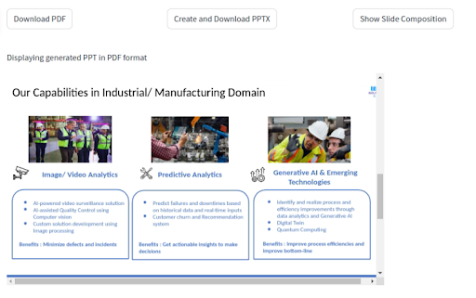
Future Directions in Welding Technology
• Continued integration of AI and machine learning for predictive maintenance and quality assurance.
• Expansion of data collection techniques to include additional sensor modalities for richer datasets.
• Collaboration with industry leaders to refine welding processes and set new quality standards.
6/6

