Slide 1

GenAI and LLM: Transforming Business Operations
AI-Powered Solution

Slide 2
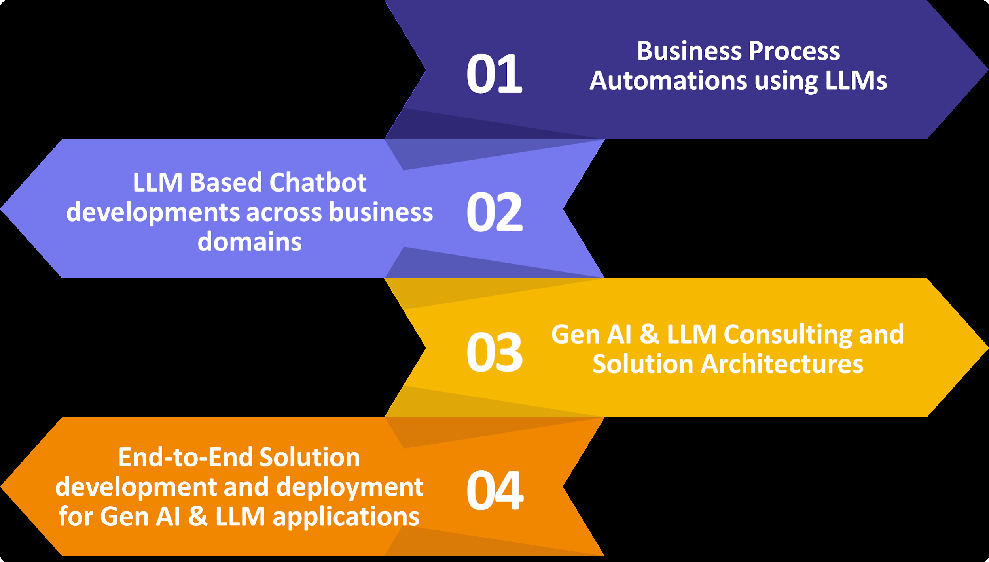
Overview of GenAI and LLM
• GenAI leverages Large Language Models (LLMs) to enhance business processes.
• LLMs provide capabilities such as document summarization, Q&A, and content generation.
• Cloud-based APIs enable seamless integration of proprietary LLMs into client systems.
AI Presentation
2

Slide 3
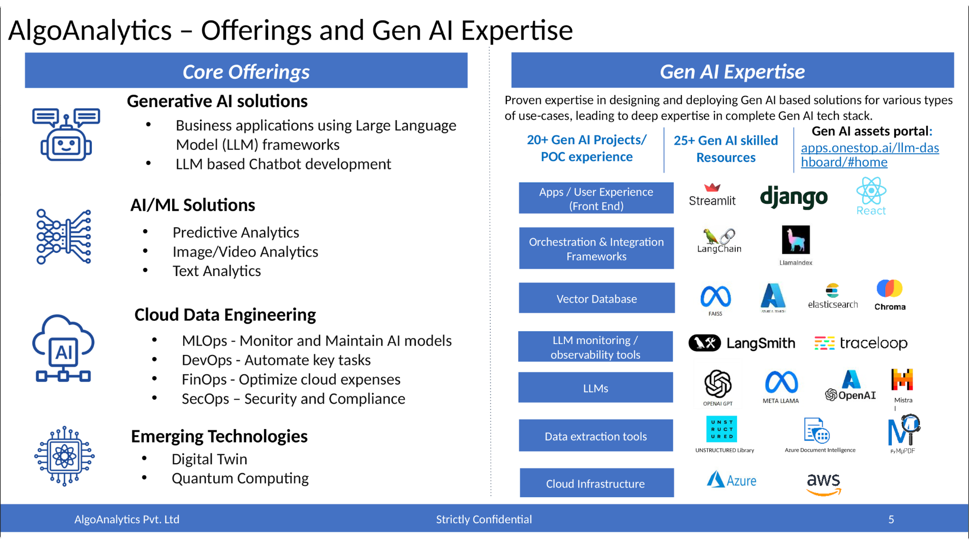
Core Offerings of GenAI
• Business Process Automation using LLMs streamlines operations and reduces costs.
• Development of LLM-based chatbots enhances customer engagement and service efficiency.
• Enterprise information extraction improves data retrieval and decision-making processes.
AI Presentation
3

Slide 4
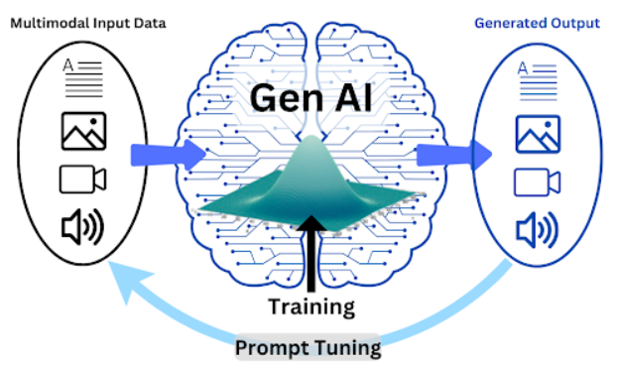
Recent Generative AI Projects
• Collaboration with NDIL on RAG Toolset Enhancement for improved data handling.
• Development of Llama-based applications showcased at GPAI Summit 2023.
• Implementation of AI-driven decision-making tools for financial services.
AI Presentation
4

Slide 5
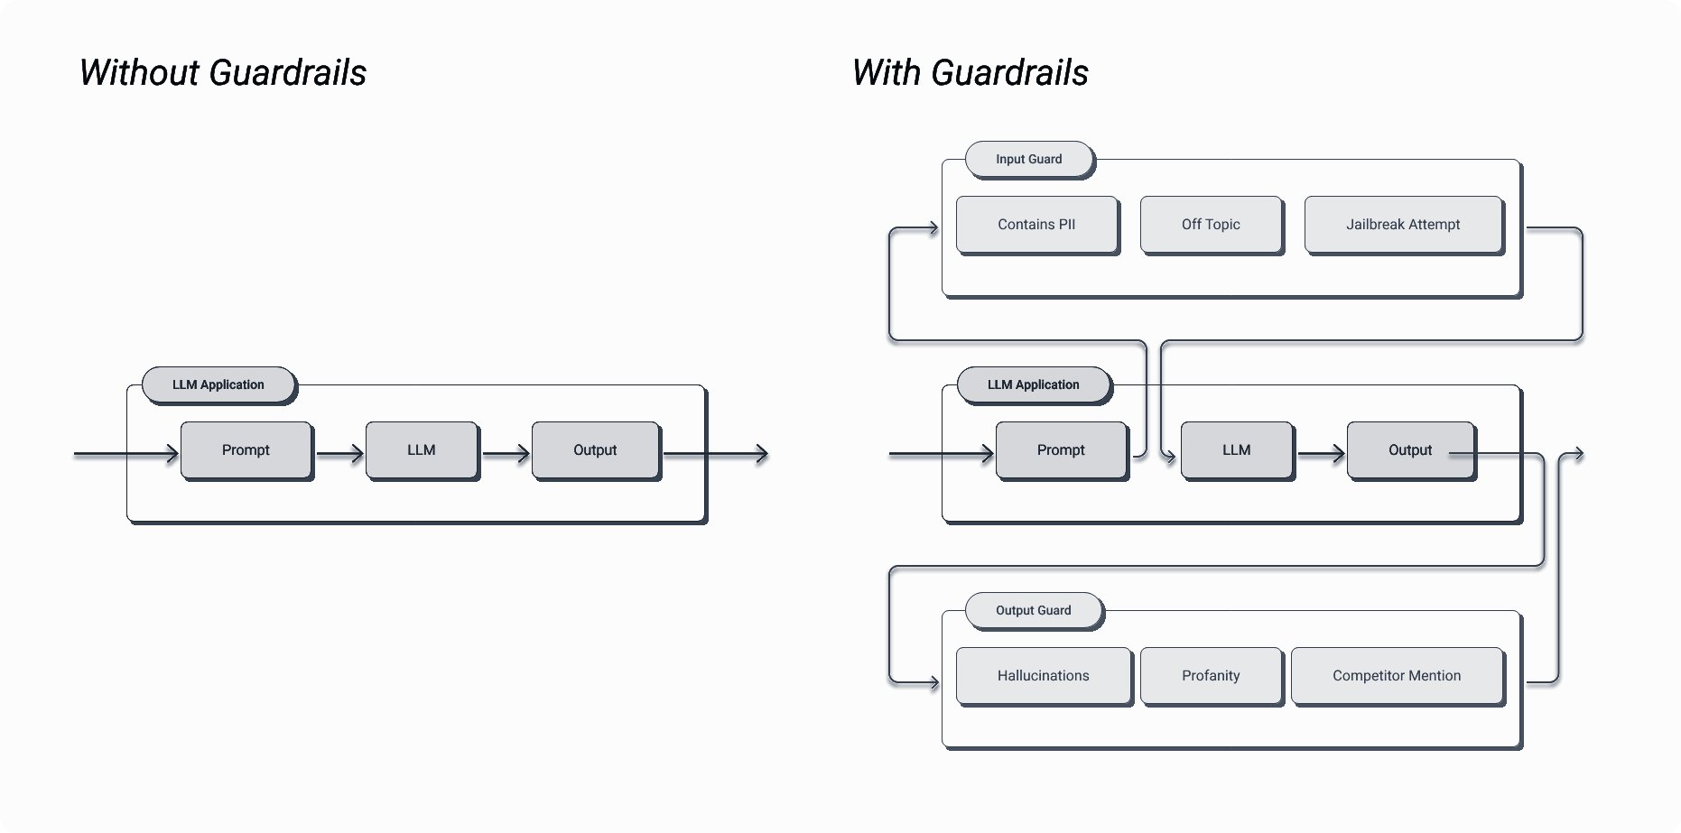
LLM Specialization and Efficiency
• Domain-specific LLMs enhance performance for targeted applications.
• Specialized models require less computational power, reducing operational costs.
• Balancing specificity and versatility is crucial for effective model management.
AI Presentation
5

Slide 6

Applications of LLMs in Various Industries
• LLMs are being utilized in FinTech for customer service and reporting.
• Legal advisors leverage LLMs for accurate information retrieval on motor laws.
• Healthcare applications benefit from specialized LLMs for patient data analysis.
AI Presentation
6

Slide 7

Advantages of Open Source LLMs
• Open-source models like Llama provide flexibility and transparency.
• Self-hosting options enhance data security and privacy for businesses.
• Cost-effective solutions allow for scalable implementation across various sectors.
AI Presentation
7

Slide 8
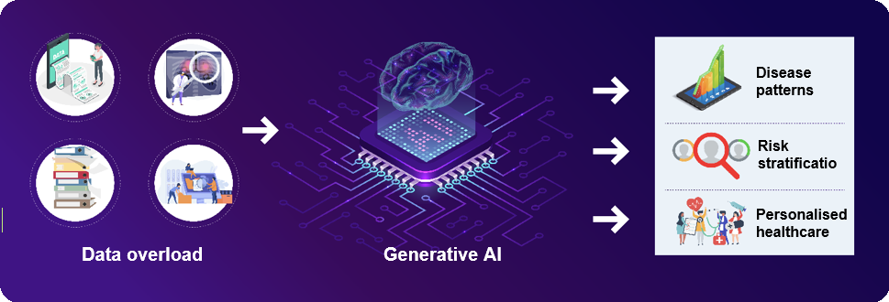
Future Trends in Generative AI
• Emergence of specialized models tailored for specific industry needs.
• Integration of multimodal capabilities for enhanced user experiences.
• Ethical considerations and data privacy will shape future LLM developments.
AI Presentation
8

Slide 9
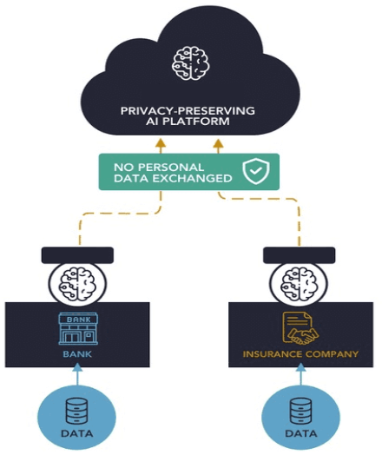
Challenges and Considerations
• Managing the complexity of model updates and maintenance is critical.
• Addressing ethical issues surrounding data usage and privacy is essential.
• Ensuring compliance with regulations through explainable AI (XAI) practices.
AI Presentation
9

Slide 10
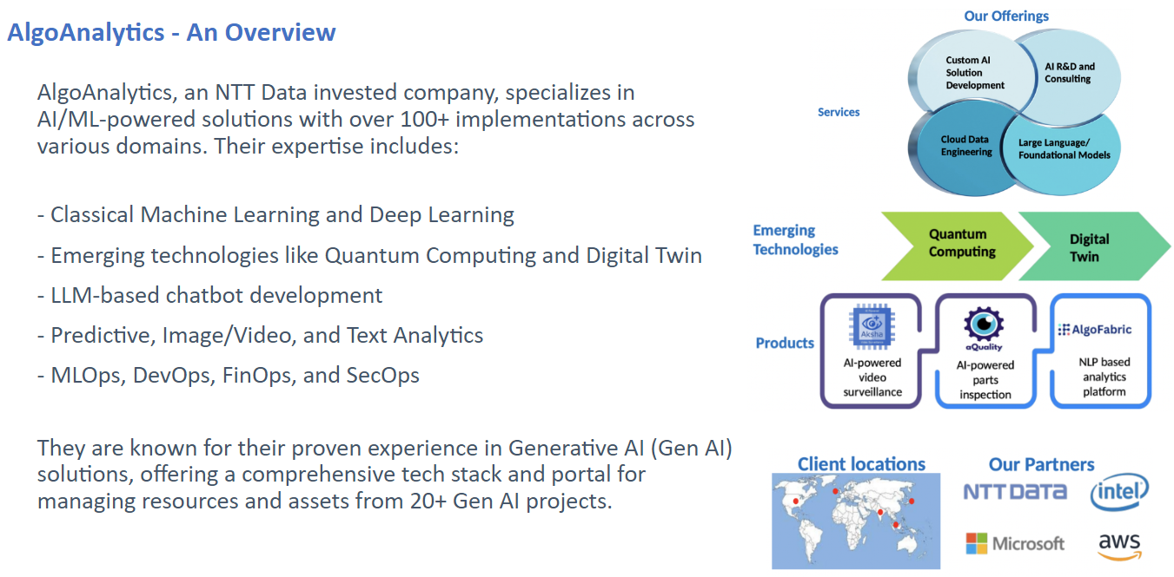
Conclusion and Next Steps
• Investing in LLM technology can significantly enhance business efficiency.
• Continuous exploration of specialized LLM applications is recommended.
• Engagement with GenAI experts can facilitate tailored solutions for unique business challenges.
AI Presentation
10

