Slide 1

Introduction to Aksha
AI-Powered Solution

Slide 2

What is Aksha?
• Aksha is an intelligent surveillance system designed for automated monitoring with minimal human intervention.
• Utilizes advanced technologies such as Computer Vision, Artificial Intelligence, and Generative AI for enhanced functionality.
• Capable of detecting objects and unusual situations, enabling proactive responses and analysis.
AI Presentation
2

Slide 3
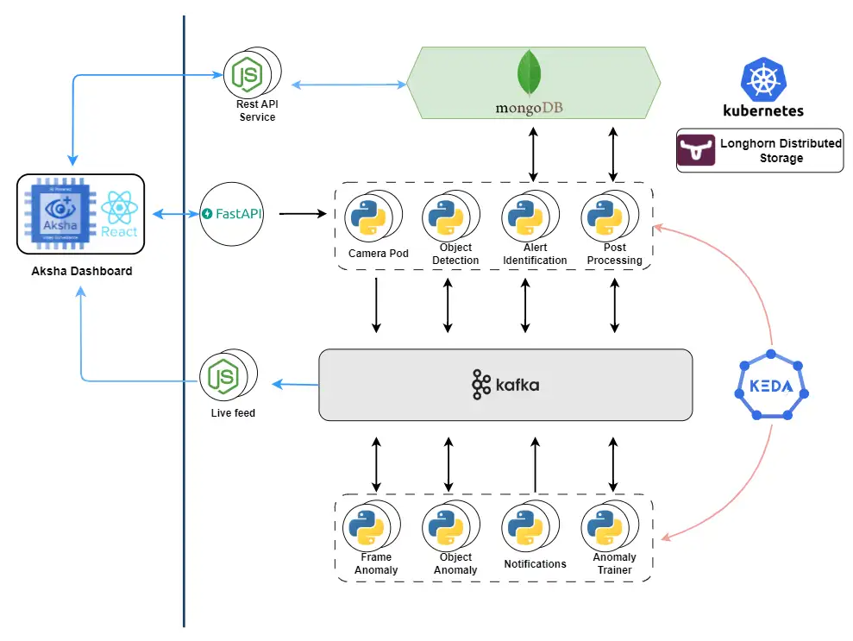
Architectural Approaches
• Offers multiple architectural configurations: On-Premise, Edge + Cloud, and Cloud-based UI with Edge Backend.
• Facilitates flexibility in deployment to meet diverse business needs and operational environments.
• Supports seamless integration with existing infrastructure for enhanced scalability and performance.
AI Presentation
3

Slide 4
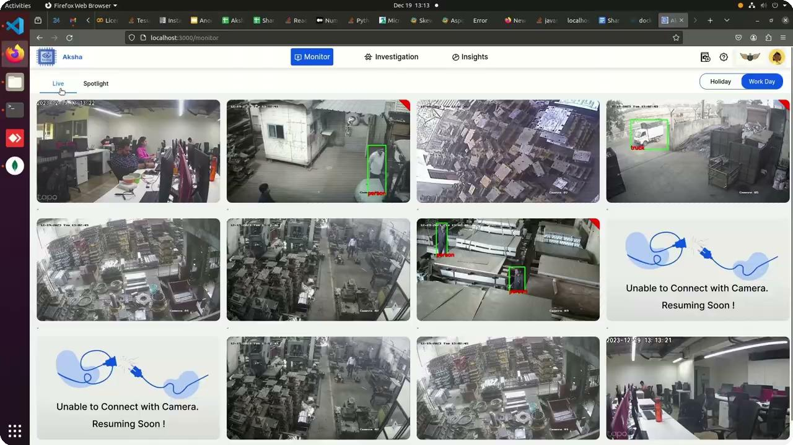
Key Features of Aksha
• Live data recording and processing with real-time object detection capabilities.
• Advanced image analysis powered by Generative AI, identifying various objects and anomalies.
• Customizable alert system that empowers users to set alerts tailored to their specific operational requirements.
AI Presentation
4

Slide 5
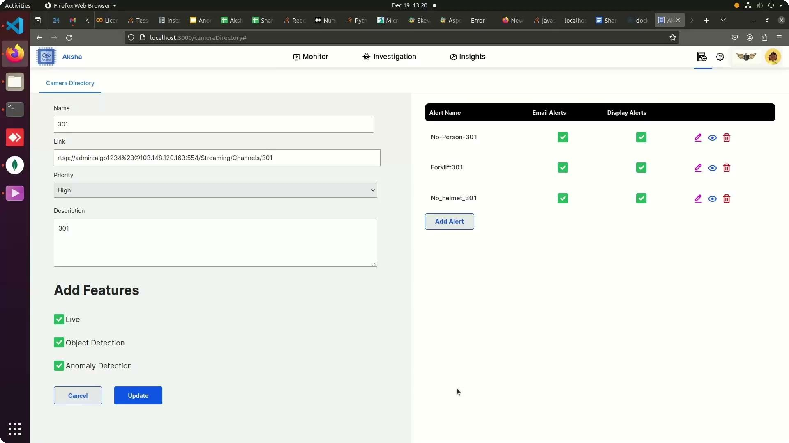
Customer Success Stories
• Clients report significant reductions in human monitoring efforts and enhanced CCTV utility.
• Positive feedback highlights the system's ability to detect abnormal events, improving safety and operational efficiency.
• Customers express eagerness for future updates and innovations, indicating strong trust in Aksha's capabilities.
AI Presentation
5

Slide 6
Scalability and Architecture Advantages
• Effortless scalability through microservices managed by Kubernetes, accommodating high message volumes with Kafka.
• Decoupled architecture enhances service development and deployment, improving fault tolerance.
• Real-time data processing ensures timely insights and actions, maintaining high availability and performance.
AI Presentation
6

Slide 7
Installation and Compatibility
• Installation requires access to the same network as the camera or RTSP links for integration.
• Compatible with any standard CCTV camera that provides RTSP links, ensuring broad applicability.
• Simple installation steps facilitate quick deployment and integration into existing surveillance systems.
AI Presentation
7

Slide 8
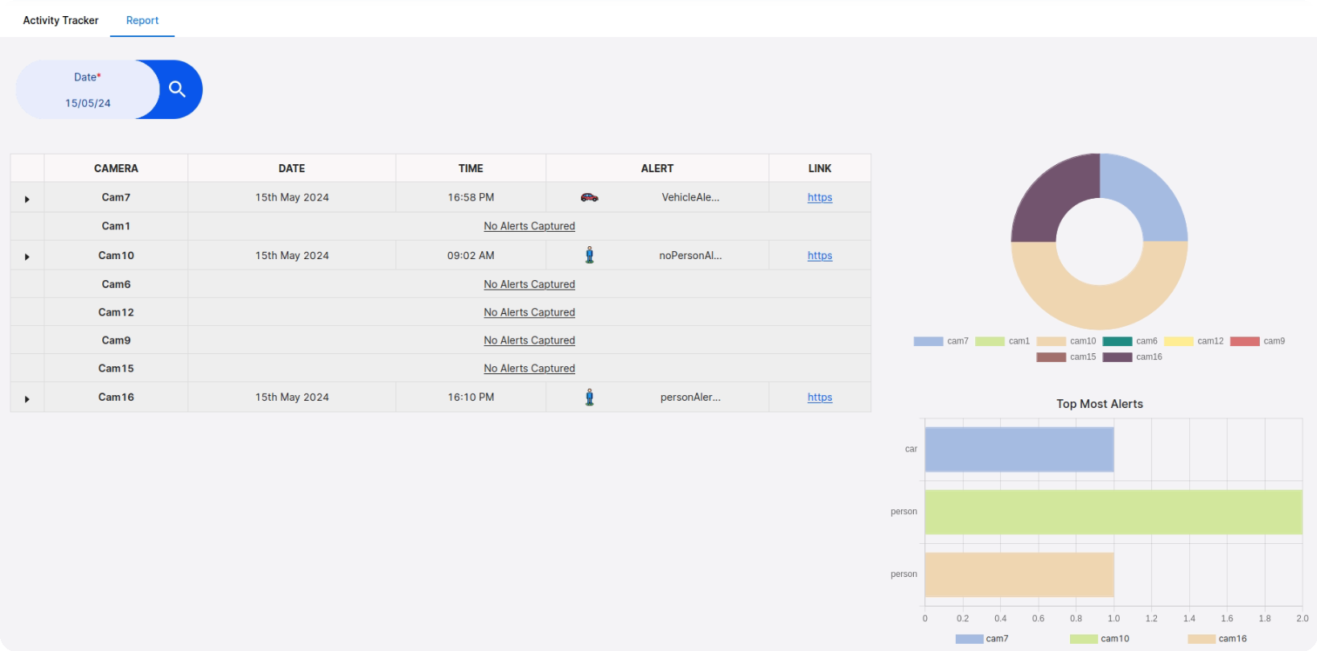
Contact and Further Information
• For more information, visit our website: https://aksha.algoanalytics.com/
• Contact us at: aksha@algoanalytics.com for inquiries or support.
• Visit our office at Alacrity India Innovation Centre, Pune for a personal demonstration.
AI Presentation
8

