Slide 1


Aksha
अक्ष
AI Powered Video Surveillance
https://aksha.algoanalytics.com
CONFIDENTIAL AND PROPRIETARY
Any use of this material without specific permission AlgoAnalytics is strictly prohibited

Slide 2
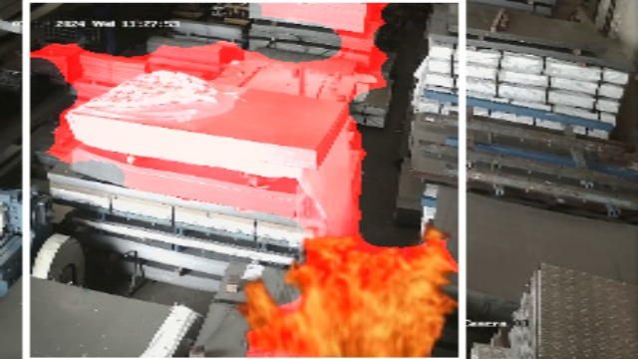
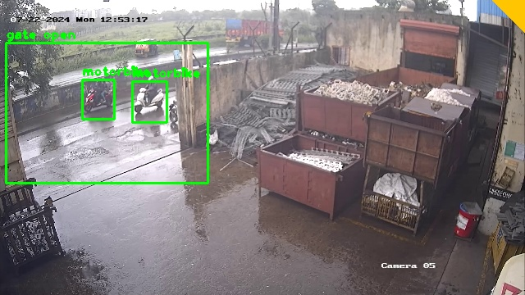
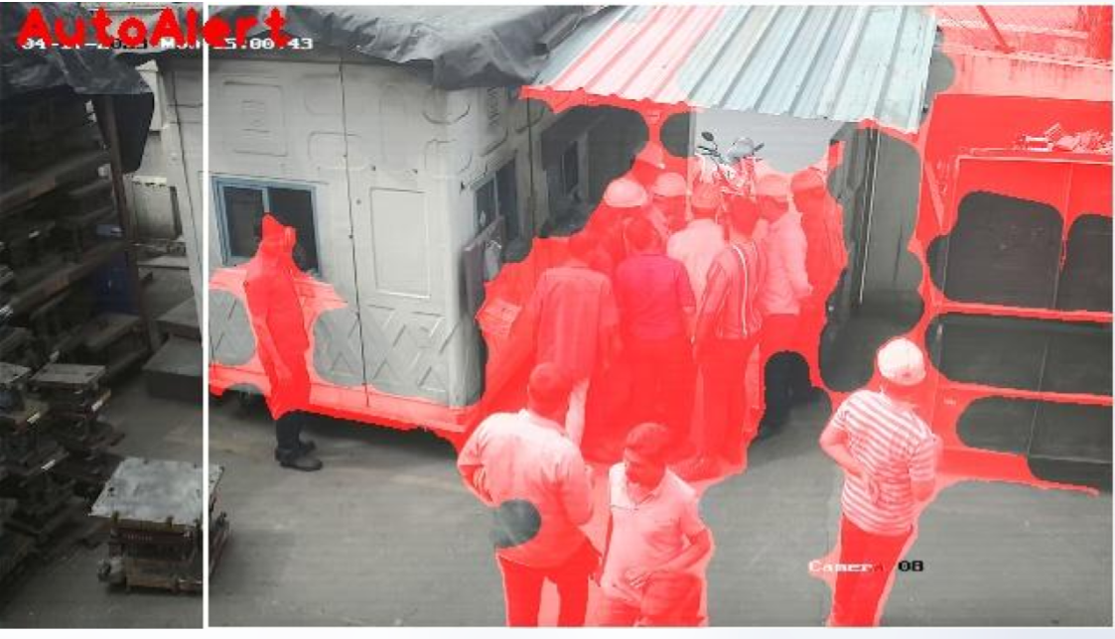
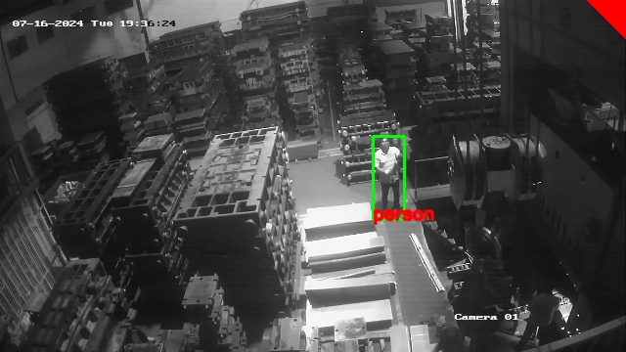
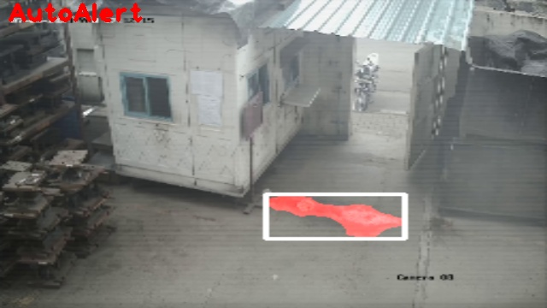
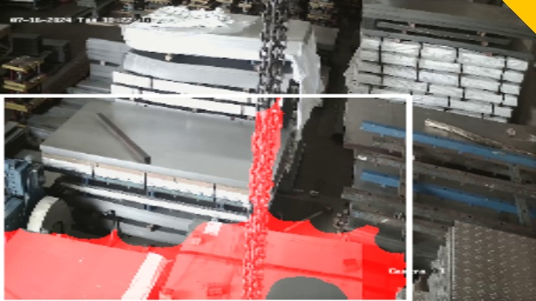
Still facing these issues ? We got intelligent CCTV for you...
Fire detection
Gate open detection
Crowd detection
Intrusion detection
Water leaks detection
Material shifting

Slide 3
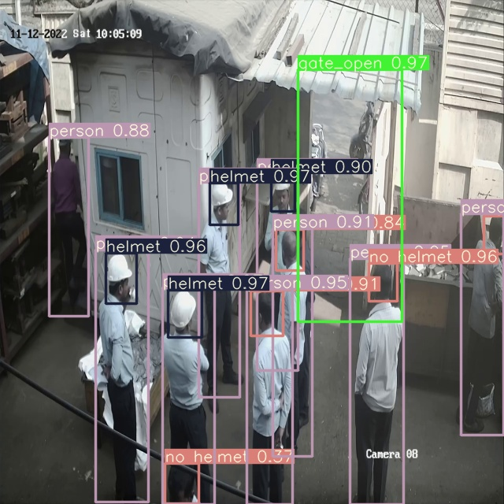
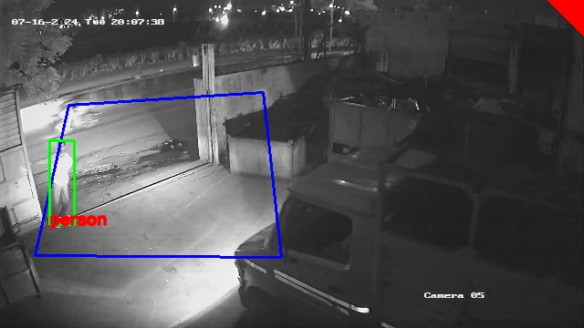
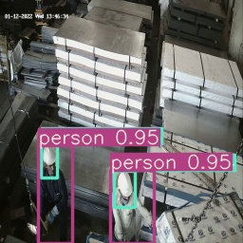
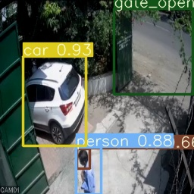
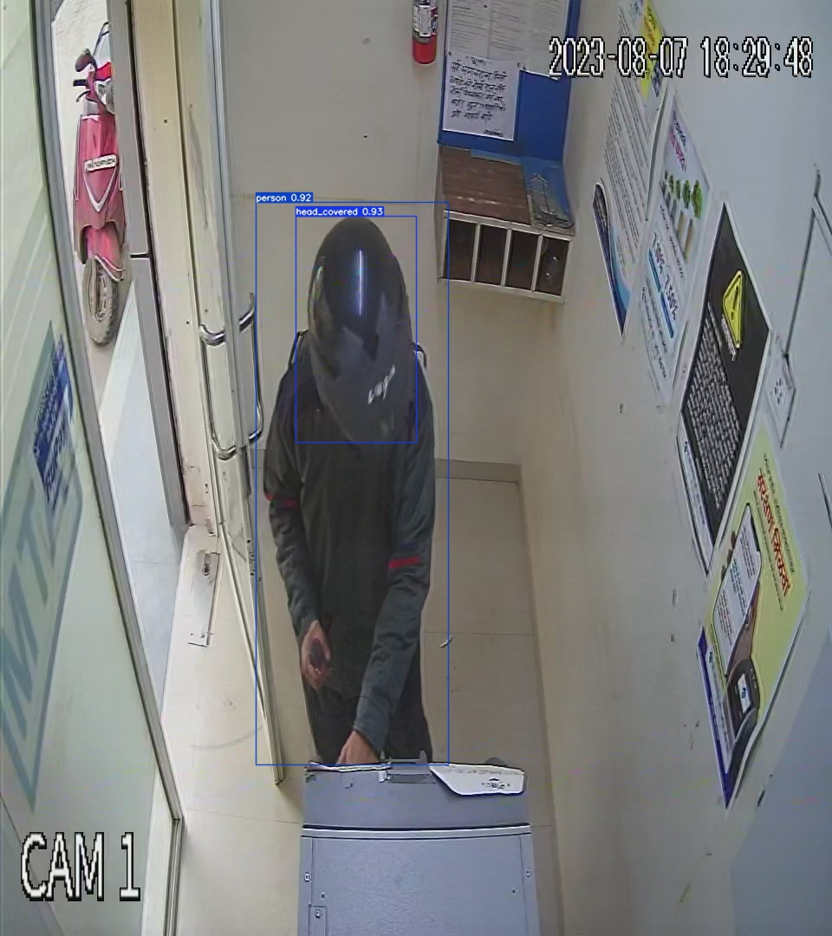
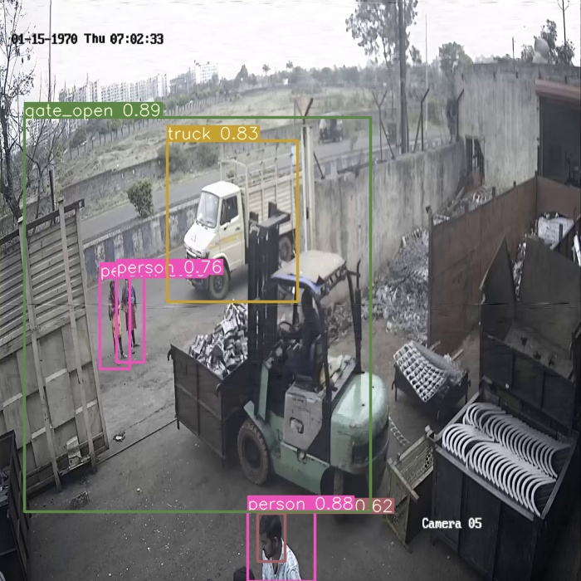
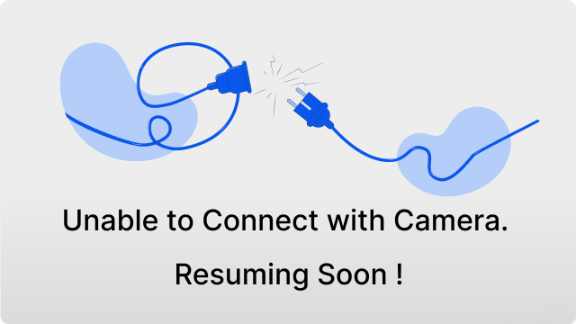
Perimeter breach
Helmet detection
Vehicle detection
Covered face detection
Camera connection lost detection

Slide 4
Introduction to Aksha
Aksha - Intelligent surveillance system is envisioned to automatically monitor the environment or premises with less or without human intervention.
Such monitoring tasks include automatically detecting objects, unusual situations and performing further analysis and actions.
Computer vision, Artificial Intelligence, and Gen AI play a very important role in developing such intelligent systems.

Slide 5
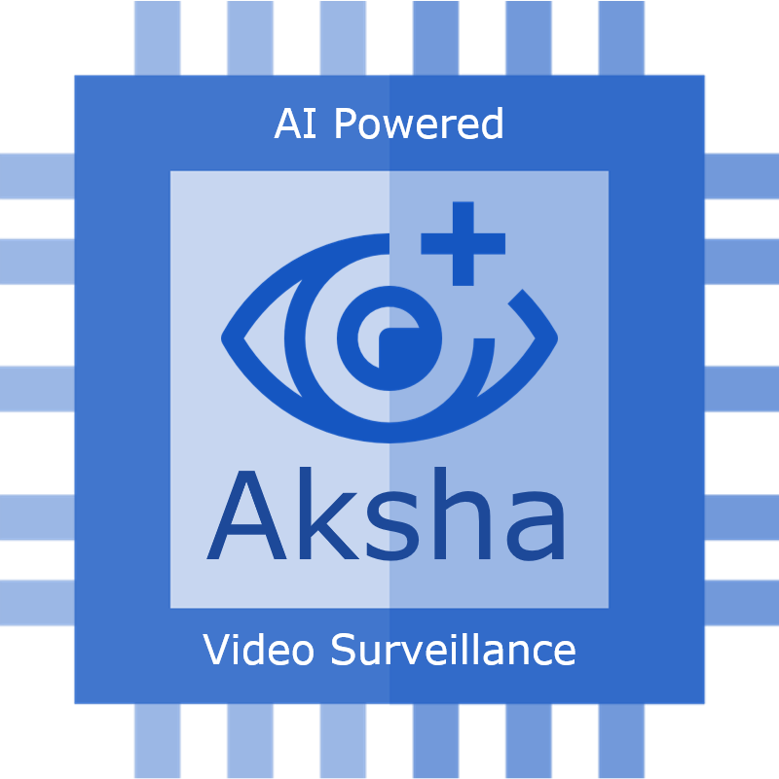




Aksha architectural approaches
We provide below mentioned architectural approaches
Aksha on Edge (On Premise)
Aksha UI & Backend on Edge
Aksha on Edge & Cloud
Aksha UI on Cloud & Backend on Edge
AlgoAnalytics Pvt. Ltd
Strictly Confidential
‹#›

Slide 6

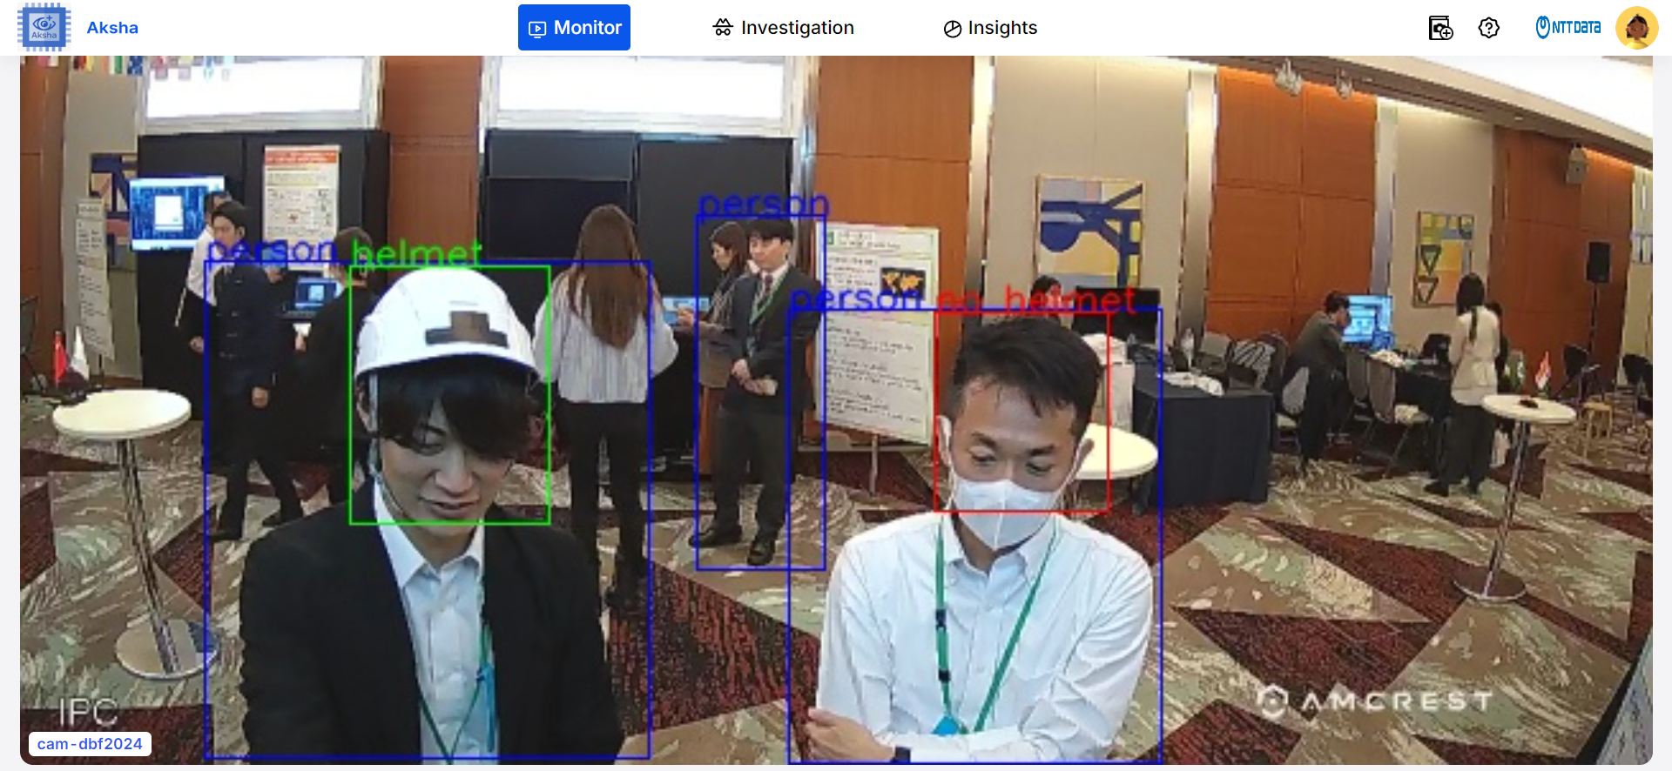
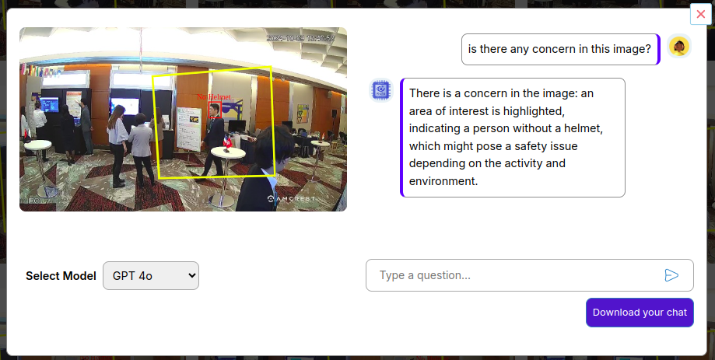
Aksha
Aksha, the smart surveillance system for the businesses that value employee safety. It is self learning system which detects object & anomalies using the power of Artificial Intelligence. It enables user to set customized alerts at fingertips.
Main features
Live recording and processing of data
Object detection
Image analysis using Gen AI
Unsupervised learning based Anomaly detection
Insight report generation & analysis Using Gen AI
Customized alert creation at fingertips
Objects: Person, supine person, no helmet, helmet, car, bicycle, truck, motorbike, backpack, handbag, gate open, gate closed, fork lift, crowd
Notes:
2

Slide 7
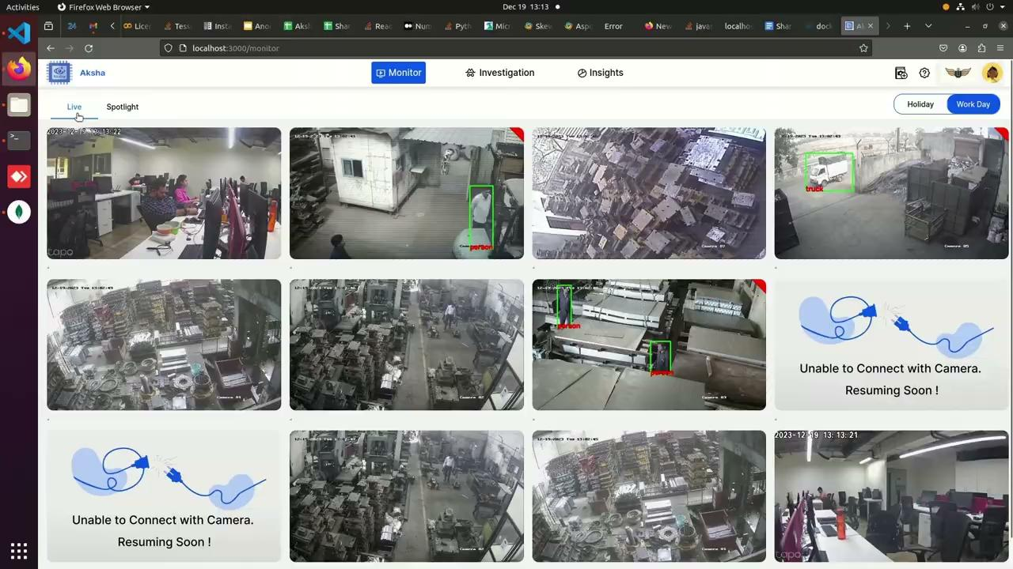
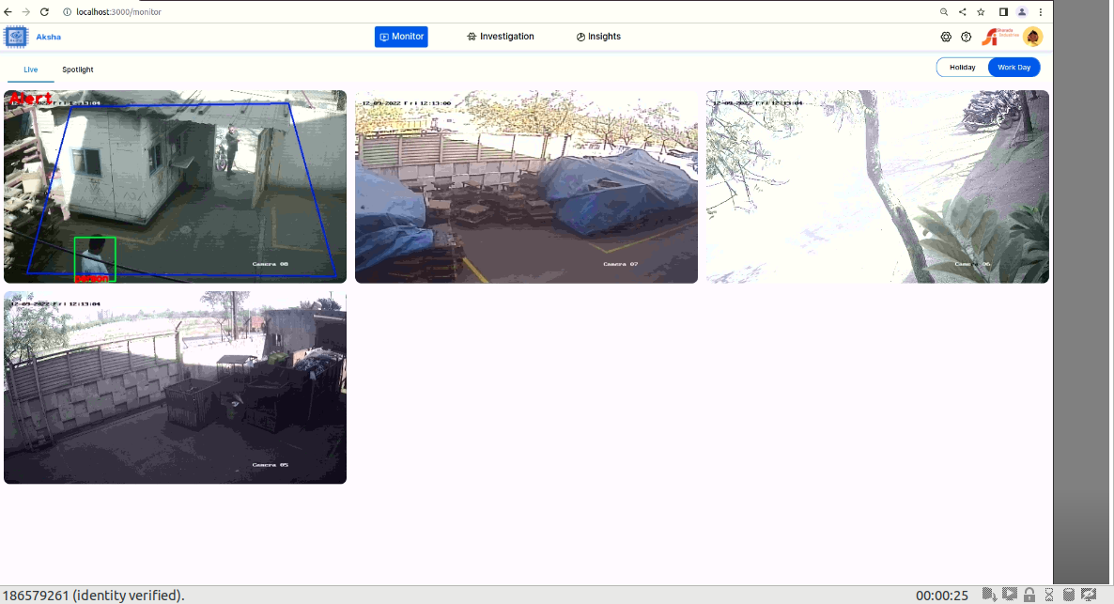
AKSHA : Live recording and processing of the data
Live view of AKSHA implementation at one of our client’s manufacturing factory outlet

Slide 8
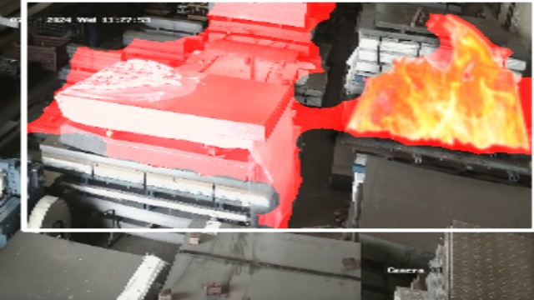
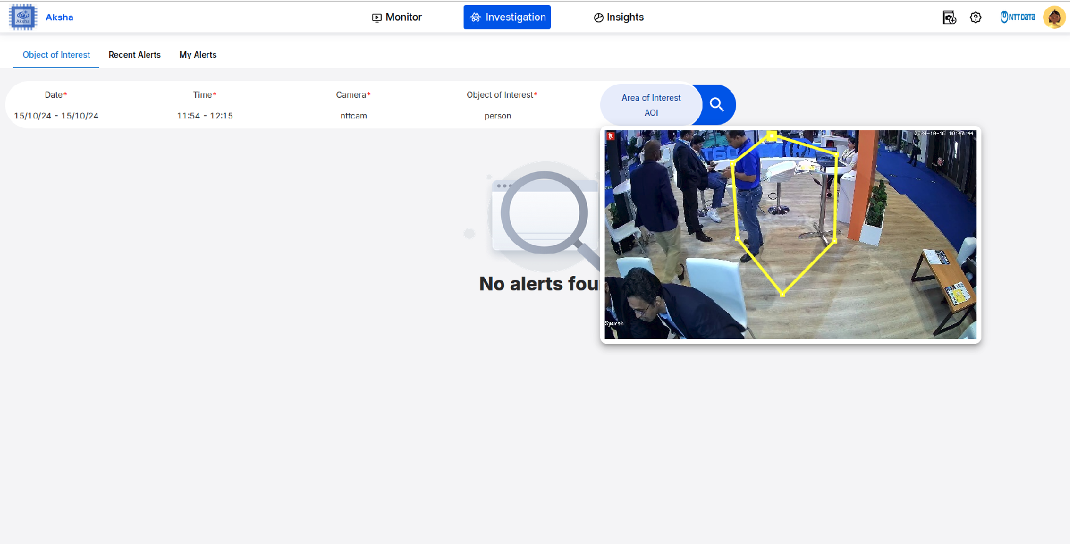
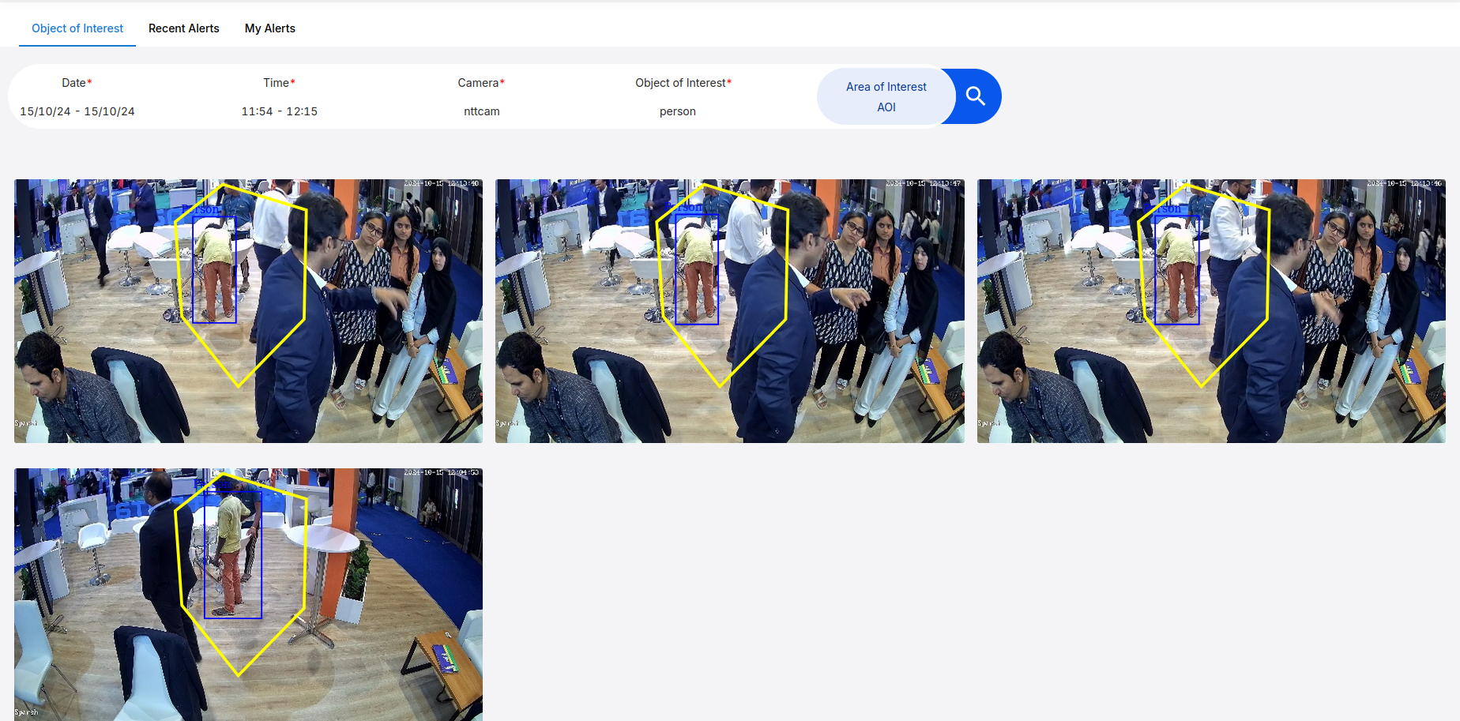
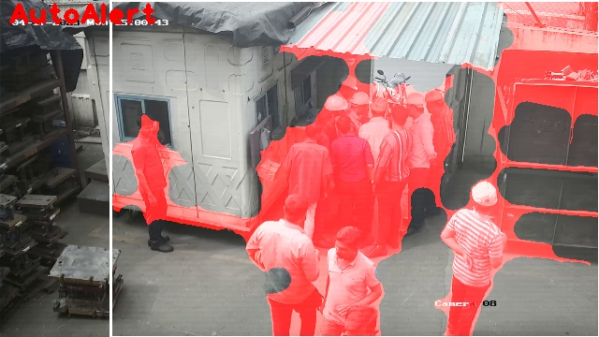
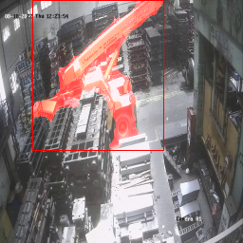
AKSHA : Anomalies and Object Detection
Anomalies (Unusual Situation)
Object Detection

Slide 9
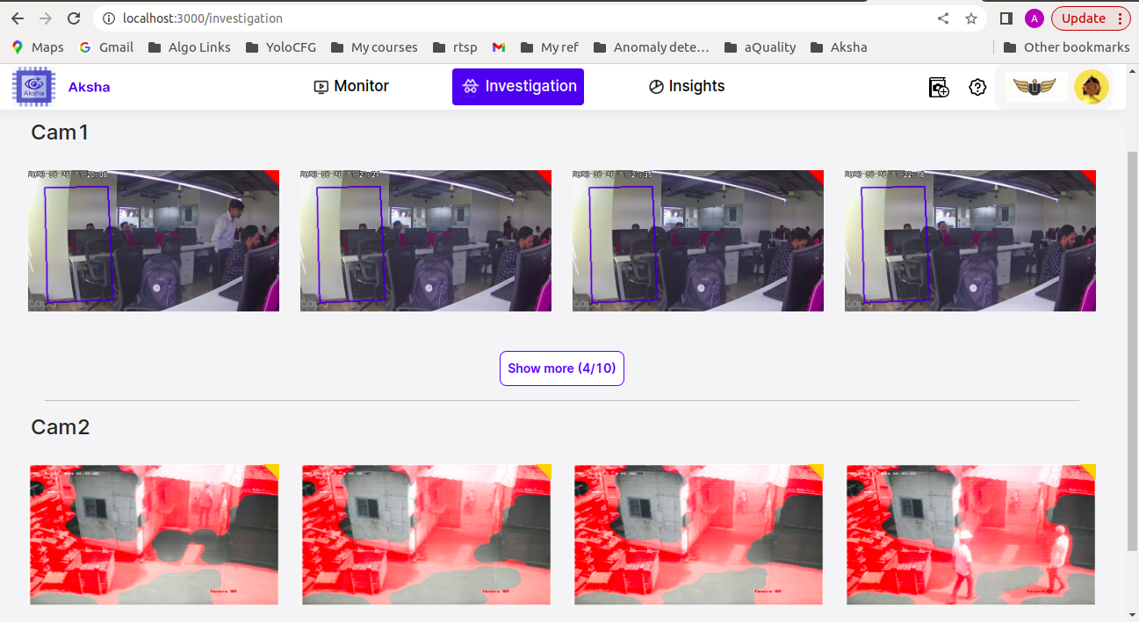
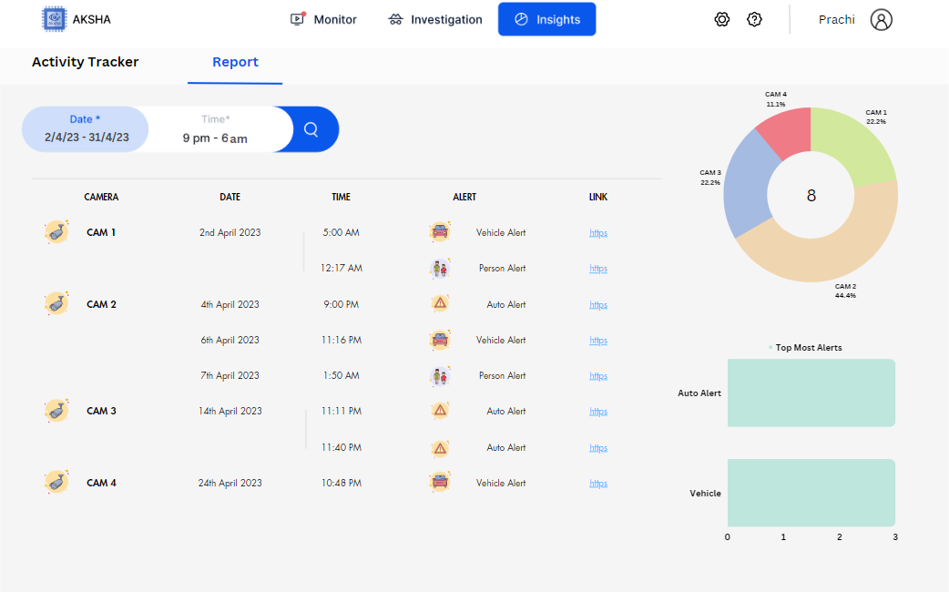
Recent Alert and Alert report

Slide 10
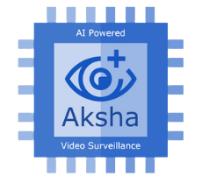

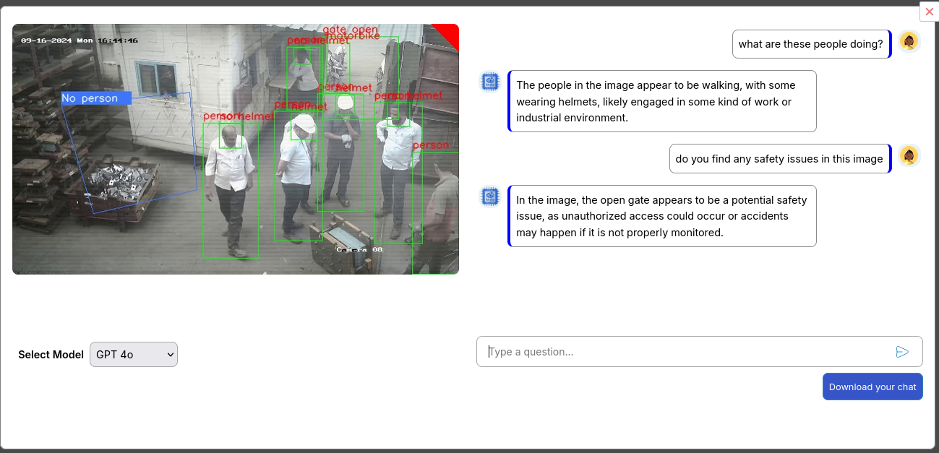
Image Analysis Using GenAI
To allow the user to ask any questions about the chosen image, a "User prompt" has been added to the "Investigate" tab.

Slide 11
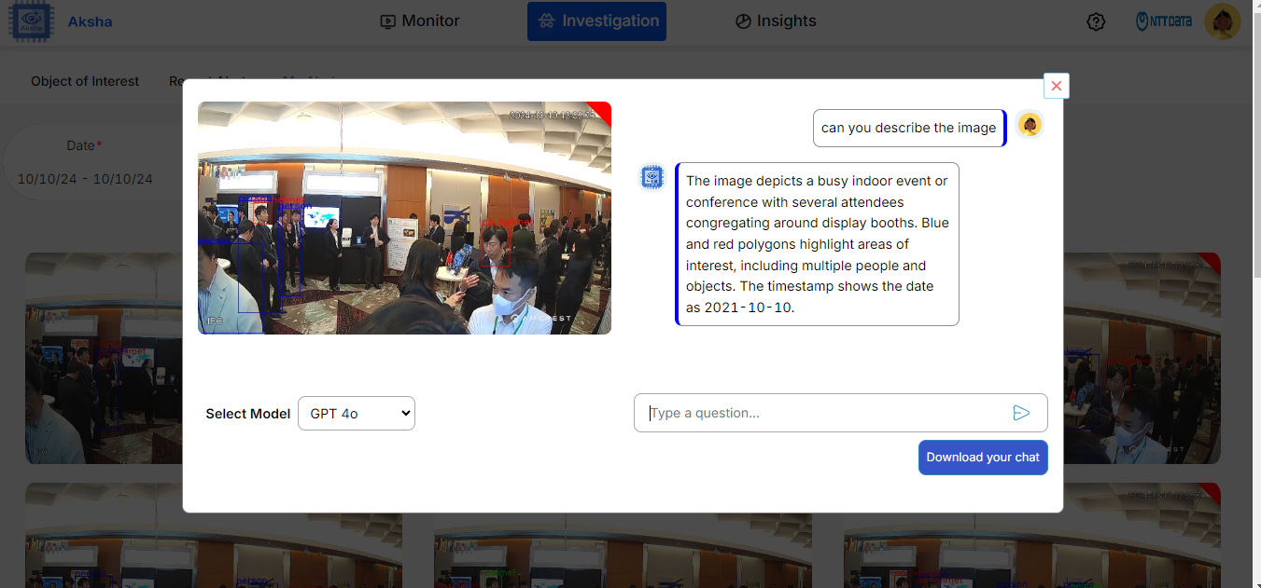
Contd..

Slide 12
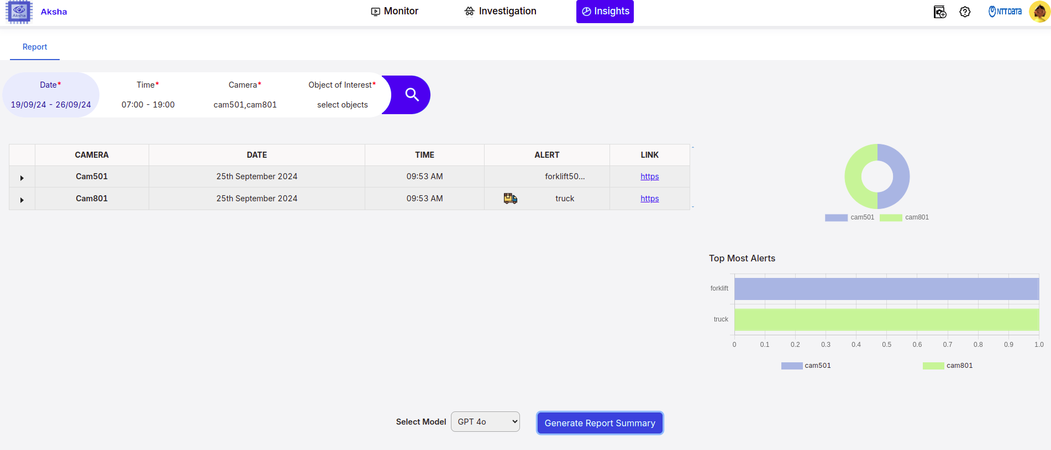
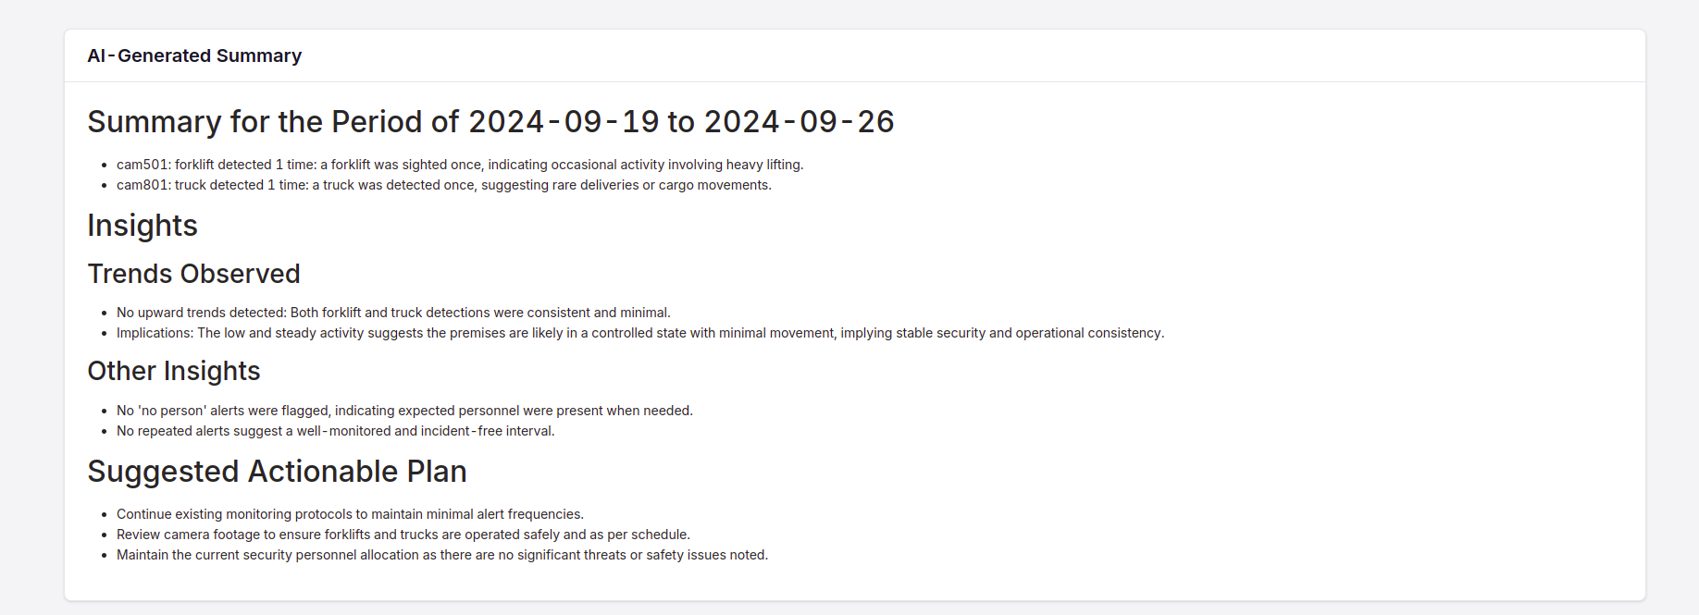
Customization and analysis of alert report content to identify trends and identify turning points.
Using Gen AI for alert report content customization and analysis
This feature will produce an extremely perceptive synopsis.
The admin's workload will undoubtedly be lessened.

Slide 13
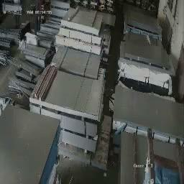
Activity Tracker
‹#›

Slide 14
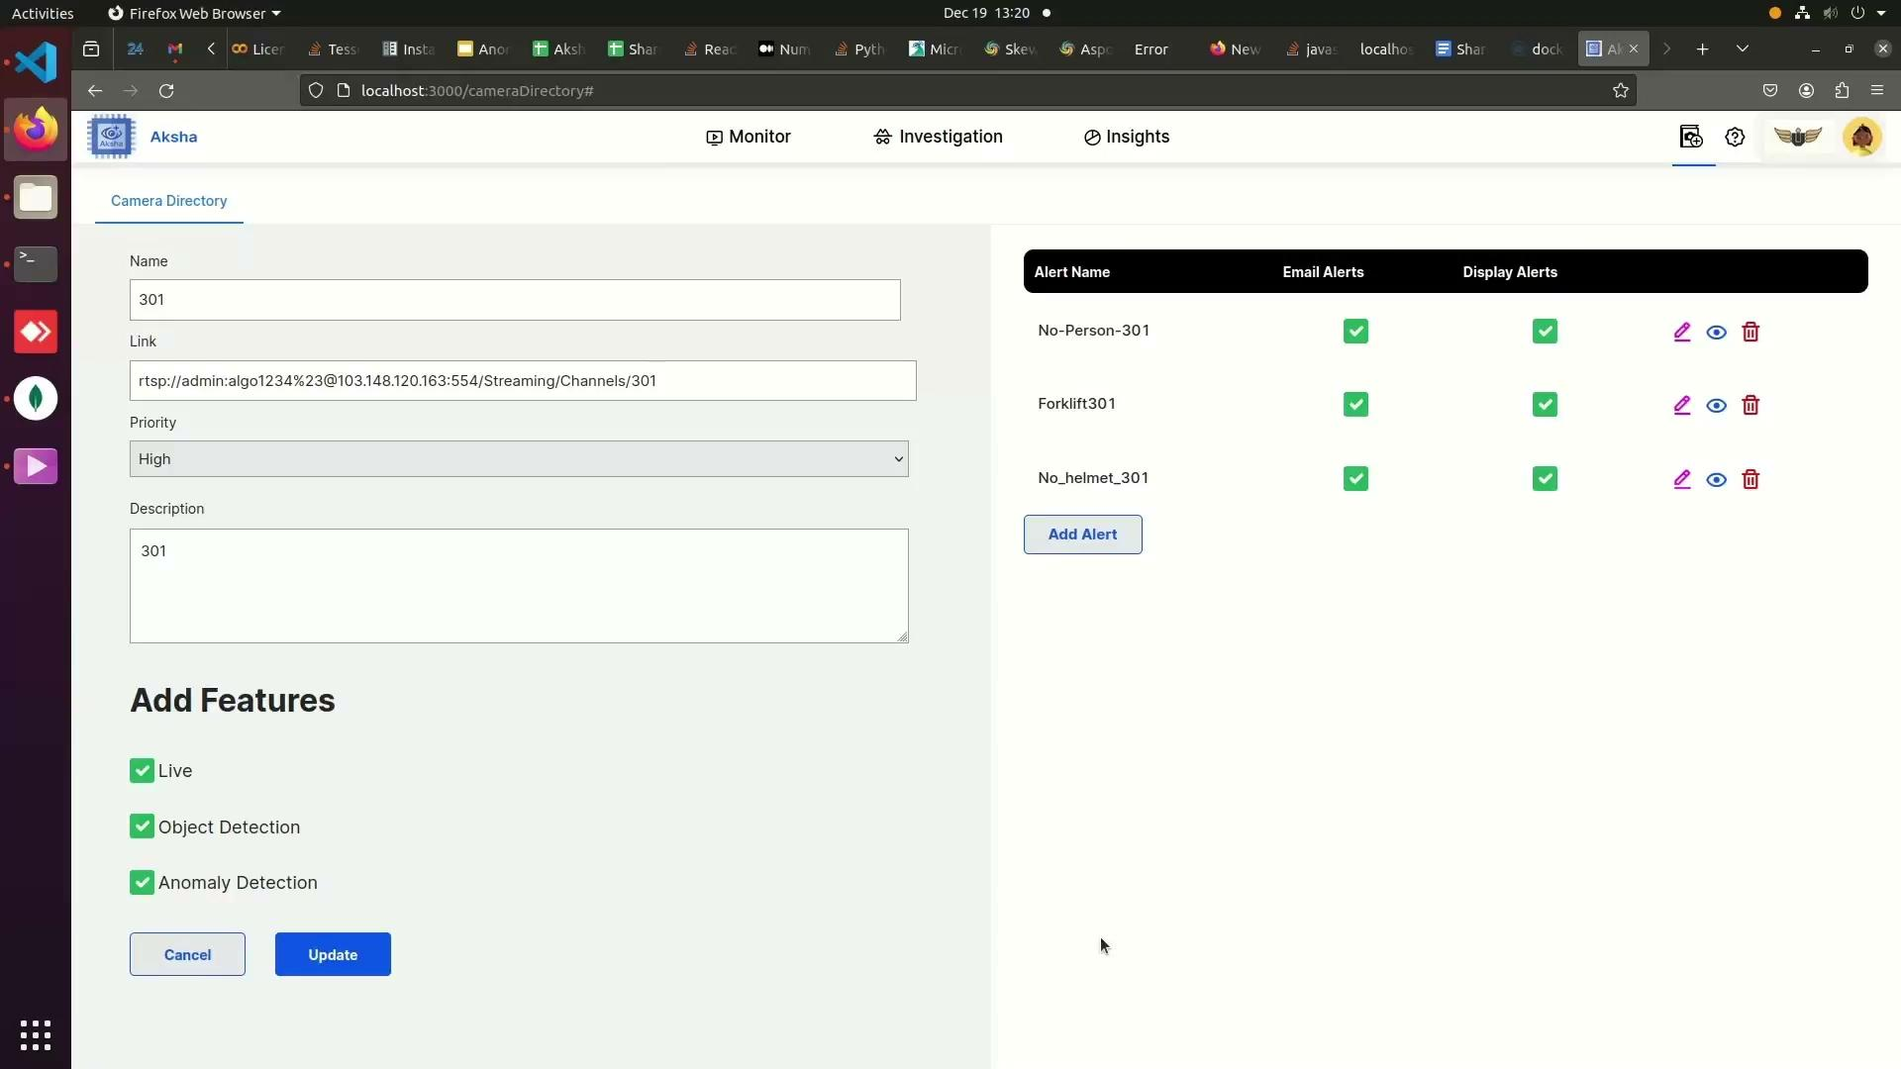
AKSHA : Customizable Alerts

Slide 15
AlgoAnalytics and NDIL collaboration
AlgoAnalytics customized “Aksha for workers safety” in collaboration with NDIL. This customized new Aksha version runs on “Edge + Cloud”.
Three stages of Aksha customization with NDIL have been successfully finished by AlgoAnalytics; in Phase III, we added Gen AI to enhance Aksha features.
Aksha Phase I
FY23 Q4
Aksha Phase II
FY24 Q1
Aksha Phase III
FY24 Q2
Aksha POC on Raspberry Pi 4B & Interfaced two wireless cameras with it.
Architectural changes to run Backend1 on Edge and UI on Azure
Continuous support to NDIL team to run Aksha on Raspberry Pi 4B with both OS support Linux and SPECTRA. Aksha code optimization to achieve better FPS and Notification
Enhanced Aksha features with Gen AI using Image prompt engineering. Improved Cloud architecture. Hardware mapping

Slide 16
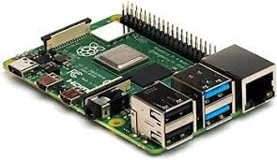

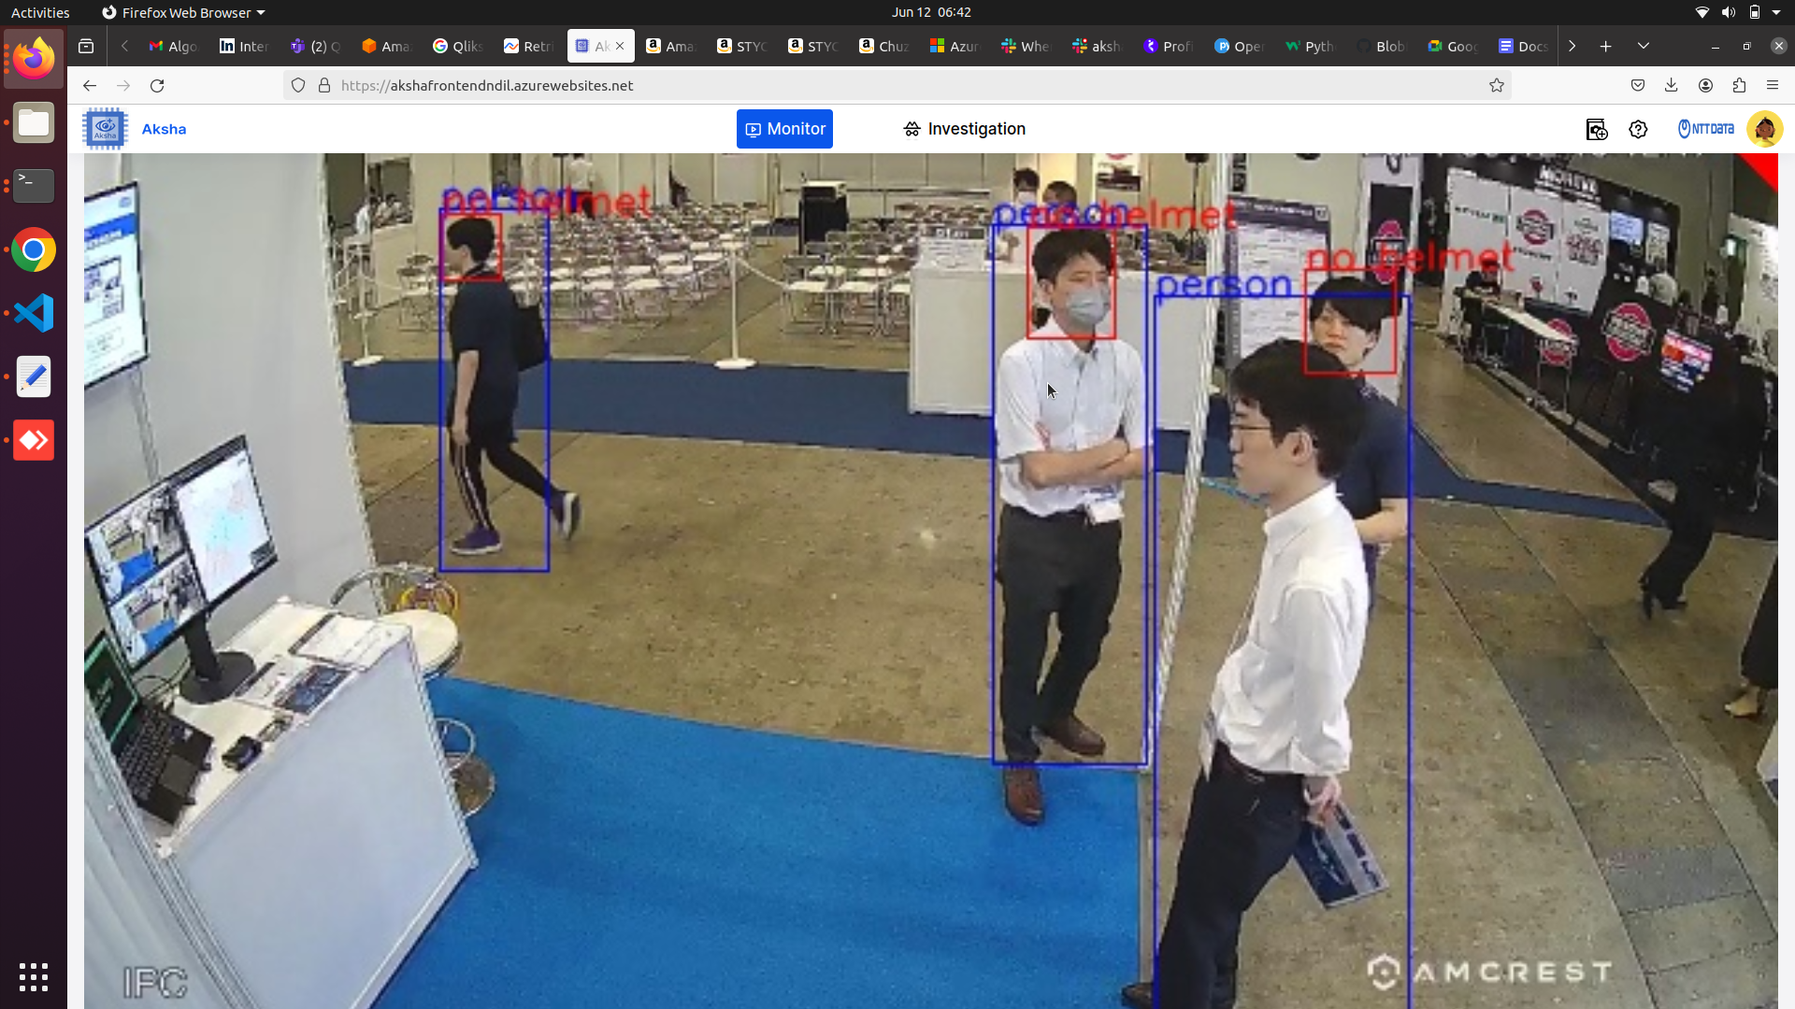
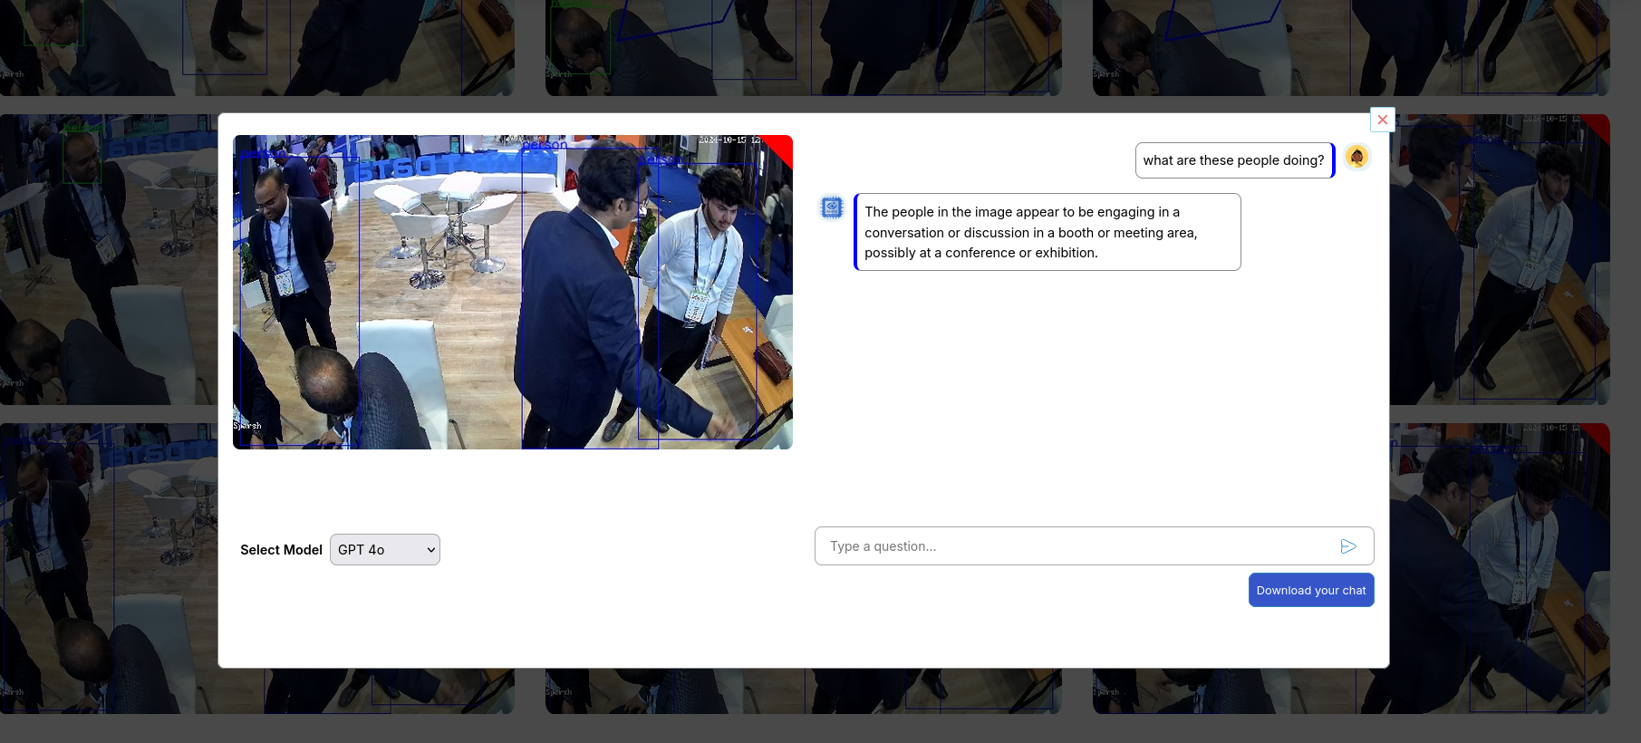
Exhibitions and Visibility
Docomo Business Forum
October 2024 (Japan)
Indian Mobile Congress (IMC) October 2024
(Delhi, India)

Slide 17

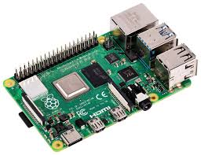
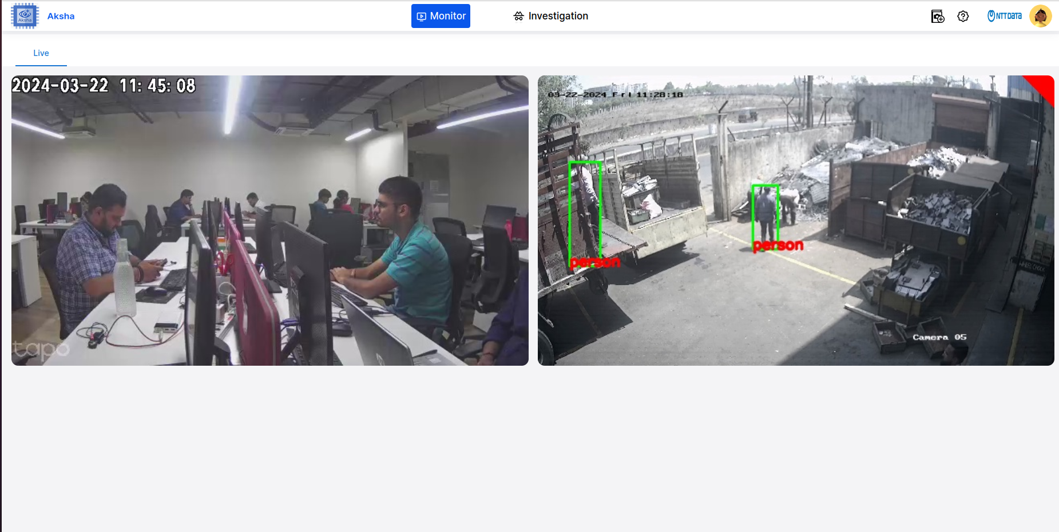





Current developments
Aksha on multi edge: Mapping between edge devices and cameras
The feed of all the cameras will be visible on the same GUI, whereas each camera will be running on a different hardware device, i.e. raspberry pi
All the cameras run on the same network.
Every camera communicates with the backend, which runs on the Azure app service. The feed is then sent to the front-end from the back-end
RTSP
VPN
RTSP
Local Network
Centralised GUI

Slide 18



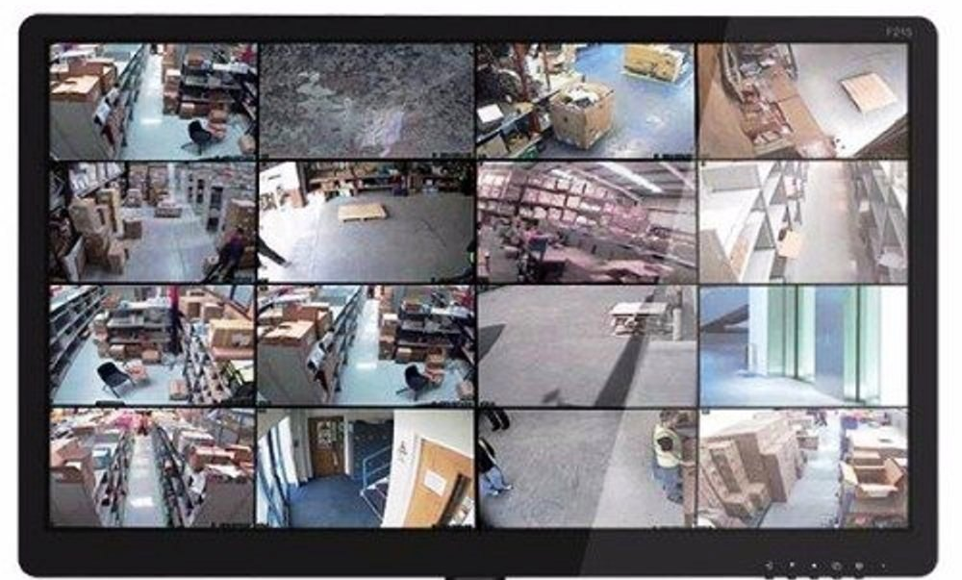
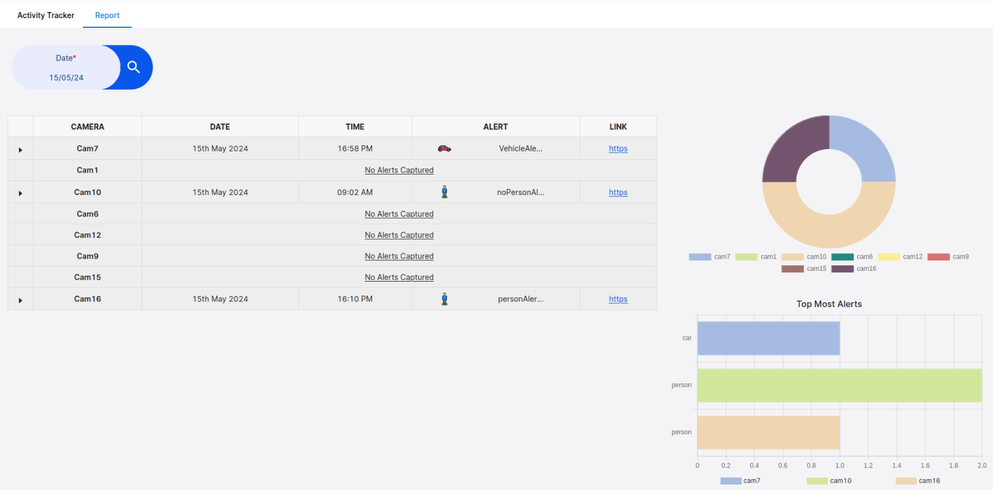
Enhancing Aksha’s Scalability: Using Kubernetes and Kafka
Location 1
Location 2
Location 3
Location N
Network Backbone
Central location

Slide 19
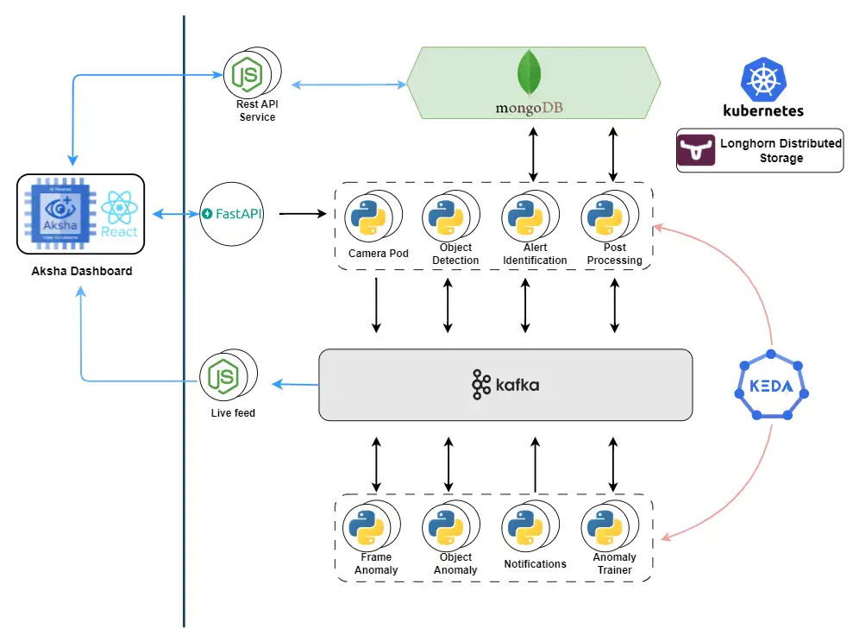
Enhancing Aksha’s Scalability: Architecture and Advantages
Effortless Scalability: Easily scale microservices with Kubernetes and manage high message volumes with Kafka.
Decoupled Architecture: Allows independent service development and deployment, improving fault tolerance and maintainability.
Real-time Data Processing: Facilitates real-time data streaming for timely insights and actions.
High Availability: Maintains reliable performance through Kubernetes orchestration and Kafka’s distributed messaging.

Slide 20
Aksha’s compatibility with the cameras
Aksha is compatible with any standard CCTV camera that provides RTSP link for connection. A few examples (but not limited to these) are:
Sr | Camera Make | Resolution
1 | HikVision | 2 MP, 4MP
2 | CPPlus | 2 MP, 4MP
3 | Dahua | 2 MP, 4MP
4 | Prama | 2 MP, 4MP
5 | Honeywell | 2 MP, 4MP
6 | T P Link | 2 MP, 4MP
7 | DLink | 2 MP, 4MP

Slide 21


What our customers have to say
Aksha has empowered our investments into the CCTV setup. Human monitoring efforts have reduced a lot. The ability to detect abnormal unforeseen events along with specific important entities without a lot of CAPEX is wonderful.
COO, Sharada Industries
Aksha has given us a different outlook into how CCTV can be used. The ability to detect abnormal events and then highlighting them has been really useful. It has also been eye opening w.r.t. what all scenarios can be highlighted and avoided. We are looking forward to the new updates and innovations in the pipeline from Aksha
Partner, United Toolkits

Slide 22
For more on AKSHA
(अक्ष)
Visit on below link
https://aksha.algoanalytics.com/
Contact Us on
aksha@algoanalytics.com
Visit our office at
Alacrity India Innovation Centre,
Ideas to Impacts Building,
Pallod Farm Lane 3, Baner Road,
Pune 411045
Landmark : Near Vijay Sales

Slide 23
Appendix

Slide 24
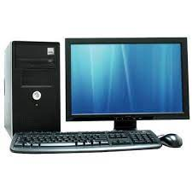
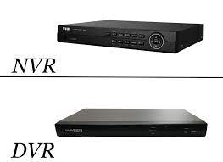
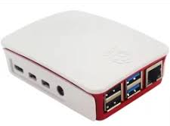
Aksha installation steps
Get the Camera RTSP links
2. Install Aksha on Edge device which is in the same network with DVR/NVR
In the same network
OR

