Slide 1

1. Choosing a Niche or Topic
1. Choosing a niche or topic is a crucial step in creating profitable digital products., 2. Having one specific niche is essential for success, as it helps differentiate your products from others., 3. To choose a profitable niche, you need to consider both forethought and research, including identifying problems people are experiencing and determining whether you can solve them., 4. Researching your competition and analyzing their strengths and weaknesses is also vital in choosing a niche.

Slide 2

1. Choosing a Niche or Topic
5. A niche with low-quality content or a lack of competition can be an opportunity for success.

Slide 3

2. Setting Up a YouTube Account
1. To create a YouTube account, you need to visit the YouTube website at https://www.youtube.com and click on the "Sign in" button, then select "Create account".
2. If you already have a Google account, you can automatically create a YouTube account by logging in with your Google credentials.
3. Children must be at least 13 years old to create a YouTube account, and you'll need to agree to Google's terms of service to create an account.

Slide 4

2. Setting Up a YouTube Account
4. When creating an account on mobile, you can tap the profile icon, then select "Add account" and follow the prompts to create a new account.
5. To create a strong password, it's recommended to use a mix of letters, numbers, and symbols to prevent hackers.
6. In addition to your password, you may also be asked to enter a recovery email and phone number. This is optional, but it can help you recover your account if you forget your password or need to verify your identity.

Slide 5

3. Creating High-Quality Content
1. High-quality content is defined as content that achieves its marketing goals.
2. Key characteristics of high-quality content include being comprehensive, useful, helpful, educational, and accurate.

Slide 6

3. Creating High-Quality Content
3. The success of content is measured by various key performance indicators (KPIs) such as ranking in the top three of Google for target keywords, increasing brand awareness, generating leads, and improving click-through rates.
4. Understanding search intent and call-to-action is crucial in creating high-quality content.
5. Proper formatting for readability is essential to make content easily digestible for both consumers and search engines.

Slide 7
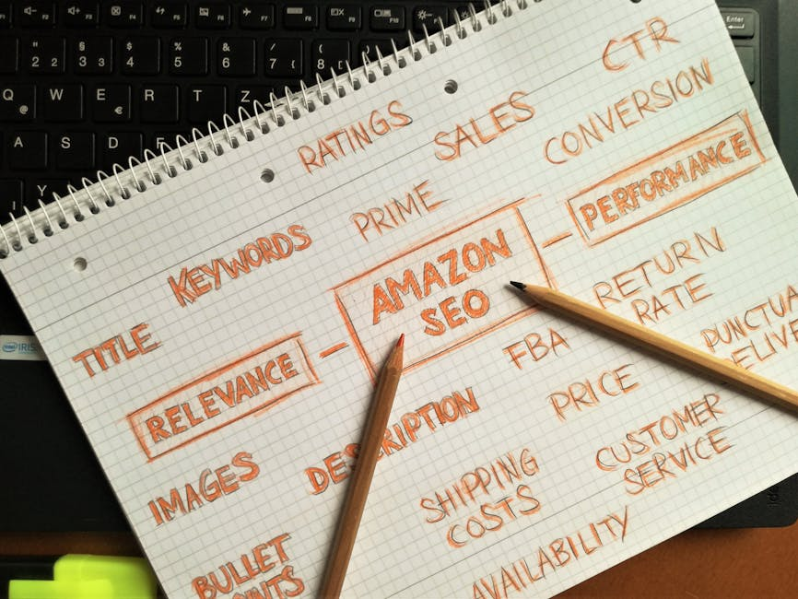
4. Optimizing Video Titles and Tags
1. Optimizing video titles should include relevant keywords early in the title to improve its visibility in search results.
2. Video descriptions should be comprehensive, include timestamps, links and CTAs, and relevant hashtags.
3. Strategic use of tags involves choosing specific and relevant keywords as tags, using a mix of broad and long-tail keywords.

Slide 8

4. Optimizing Video Titles and Tags
4. Consistency in using tags across related videos strengthens a channel's thematic relevance.
5. Regularly reviewing and refining titles, descriptions, and tags based on performance metrics and audience feedback is essential.

Slide 9

5. Building an Audience and Engagement
1. An engaged audience is critical to any brand's marketing success.
2. Experts recommend surveying your audience to understand their needs and preferences.

Slide 10

5. Building an Audience and Engagement
3. Using tools like journey maps, customer surveys, and marketing automation software can help businesses connect with their target audience.
4. Key metrics to track for audience engagement include page views, email opens, and Twitter interactions.
5. Businesses should align their engagement strategy with their company goals and image.

Slide 11

6. Monetizing Your Channel
1. You can monetize your YouTube channel without making videos by leveraging various monetization strategies.
2. To join the YouTube Partner Program, you need to reach milestones of 1,000 subscribers and 4,000 hours of watch time.

Slide 12

6. Monetizing Your Channel
3. Digital products, such as online courses, ebooks, and software, offer a significant opportunity for monetization through affiliate marketing.
4. Choosing the right niche is crucial for successful monetization, with key criteria including being evergreen, having high demand, and high CPM potential.
5. Platforms like ClickBank and Digistore24 offer a wide range of products to promote in various niches, facilitating affiliate marketing.

Slide 13
7. Promoting Your YouTube Channel
1. A YouTube channel can be promoted on various social media platforms, including Instagram, Facebook, TikTok, Pinterest, and Twitter.
2. Optimizing your YouTube content with search-friendly keywords can help your videos show up in YouTube search results and on Google.
3. Creating a community around your YouTube channel is essential for keeping viewers engaged and coming back for more.

Slide 14

7. Promoting Your YouTube Channel
4. Promoting your channel, not just your videos, can help increase your views and improve your return on investment (ROI).
5. Building a community and engaging with your audience can help you understand what works and do more of it to improve your YouTube strategy.

