Slide 1

1. Rate of Reaction
1. The rate of reaction refers to the speed at which reactants are converted into products.
2. The rate of reaction can be affected by various factors including the nature of the reaction, the physical state of reactants, concentration, pressure, temperature, and the presence of a solvent or electromagnetic radiation.
3. The rate of reaction can be increased by increasing the concentration of reactants, applying pressure, increasing temperature, and exposing the reactants to electromagnetic radiation.

Slide 2

1. Rate of Reaction
2. Concentration is another factor that affects the rate of reaction. According to the collision theory, the rate of reaction increases with the increase in concentration of the reactants.
3. Pressure also plays a role in the rate of reaction. When we increase the pressure of a gas, we increase the concentration of the gas molecules.
4. Temperature is another critical factor that affects the rate of reaction. According to the collision theory, a chemical reaction that takes place at a higher temperature generates more energy than a reaction at a lower temperature.
5. The properties of the solvent and its ionic strength can both affect the rate of reaction. For example, a solvent with a high dielectric constant can help to stabilize charged particles, leading to a faster reaction.
6. Finally, let's not forget about the order of reaction. This refers to how the reactant pressure or concentration affects the rate of reaction.

Slide 3

2. Reaction Mechanisms
1. In an addition-elimination reaction of tri-n-butyltin radical with a nitro compound, the first step is the addition of the radical to one of the oxygen atoms in the nitro group.

Slide 4

2. Reaction Mechanisms
2. The reaction mechanism for c-nitro compounds involves more varied possibilities after the initial addition, including breaking the C-N bond, cleaving an O-N bond to form a nitroso compound, or abstracting a hydrogen atom from an available donor. 3. Electron transfer between the tri-n-butyltin radical and a c-nitro compound is endothermic by at least 12 kcal/mol, making it inconsistent with the large rate constant observed for the reaction.

Slide 5

3. Catalysts and Inhibitors
1. A catalyst is a chemical compound that can increase the rate of a reaction without itself being consumed, and it can continue to act repeatedly.
2. A catalyst can reduce the activation energy of a reaction.

Slide 6
3. Catalysts and Inhibitors
3. Catalysts and inhibitors participate in chemical reactions but are not consumed, and they show opposite activity in biological and chemical systems.
2. An inhibitor is a chemical compound that can either stop or decrease the reaction rate of a chemical reaction, and it can reduce the activity of a catalyst as well.

Slide 7
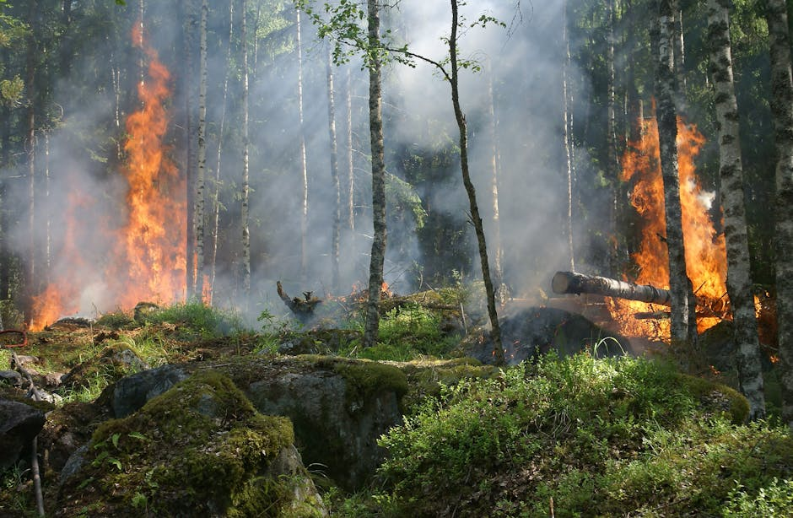
4. Temperature Effects
1. Rising temperatures are causing global warming, which is significantly affecting communities, health, and climate.
2. The Earth is experiencing a steady increase in thermometer readings since the industrial revolution, leading to extreme weather, longer wildfire seasons, and frequent heat waves.
3. The rise in sea levels and increased risk of coastal flooding are also consequences of rising temperatures.

Slide 8
4. Temperature Effects
BLANK_SLIDE

Slide 9

5. Activation Energy
1. Activation energy is the minimum amount of energy that must be provided for compounds to result in a chemical reaction.
2. Activation energy can be thought of as the magnitude of the potential barrier separating minima of the potential energy surface pertaining to the initial and final thermodynamic state.

Slide 10

5. Activation Energy
3. The Arrhenius equation gives the quantitative basis of the relationship between the activation energy and the rate at which a reaction proceeds.

Slide 11

6. Order of Reaction
1. The order of reaction refers to the relationship between the rate of a chemical reaction and the concentration of the species taking part in it.
2. The reaction order represents the number of species whose concentration directly affects the rate of reaction.
3. The order of reaction can have a value of zero, and it can be in the form of an integer or a fraction.

Slide 12

6. Order of Reaction
1. The reaction order represents the number of species whose concentration directly affects the rate of reaction.
2. The order of reaction can have a value of zero, and it can be in the form of an integer or a fraction.
3. The initial rates method involves measuring the initial rate of a reaction at different concentrations of each reactant.
4. The differential method is the easiest way to obtain the order of reaction.

Slide 13

7. Molecularity
1. Molecularity is the number of molecules that come together to react in an elementary reaction.
2. The kinetic order of an elementary reaction or reaction step is equal to its molecularity.

Slide 14

7. Molecularity
1. Molecularity is only useful to describe elementary reactions or steps.

