Slide 1
RevTrends

Slide 2
Project Overview
RevTrends is a Social Media Sentiment Analysis and Trend Tracking Platform designed to provide comprehensive insights into public sentiment across various social media platforms. It leverages real-time data streams to aggregate, analyze, and visualize sentiment trends, enabling users to make informed decisions and gain a competitive edge.

Slide 3
Tech-Stack
Python
SQL (MYSQL)
VS Code

Slide 4
Core Functional Requirements
CREATE
Add new Social Media Trend Data (topic, hashtags, date).
Register new users.
READ
View trending topics.
Display user profile information.

Slide 5
UPDATE
Edit user profile information.
Modify existing trend information.
DELETE
Delete user account.
Remove outdated trends.

Slide 6
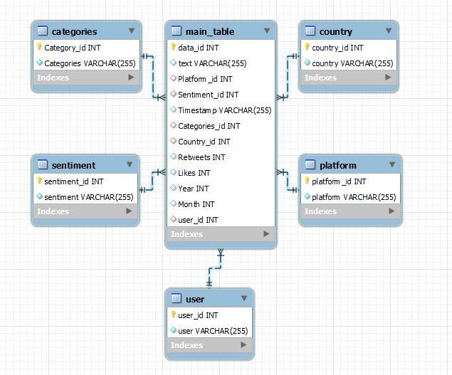
Database Schema

Slide 7
Architecture
BACKEND
Python for data manipulation.
MySQL for data storage.
Python for data storage.
DATABASE
MySQL for storing social media trend and user data.
FRONTEND
Command-line interface (CLI) for user interaction.

Slide 8
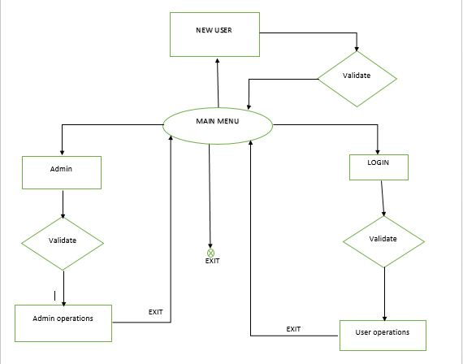
Flow Chart

Slide 9
Scope of Project
Difficulty in understanding public sentiment on social media due to vast and dynamic data.
so, RevTrends provides a trend tracking, enabling them to make informed decision based on public opinion.
This can be particularly valuable for business and individuals looking to understand how the public perceives their brand, products, or specific topics.

Slide 10
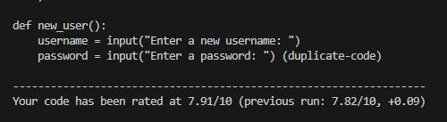
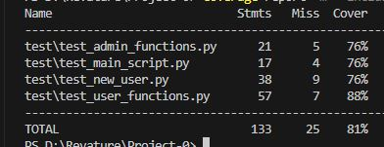
Test Results
Attained Pylint Score is 7.82
After doing unittest total coverage is 81%

Slide 11
Resources
Github Link:
https://github.com/NikhilSaiEppa/RevTrends_P0.git

Slide 12


