Slide 1

Portfolio
Shyam sharma (2002901550031/ CSE /IOT)
Nikhil saini (2002900100097/ CSE /b)

Slide 2


Slide 3
Objective
The primary objective of a portfolio is to showcase your skills, abilities, and accomplishments to potential clients, employers, or collaborators
Progressive record of student growth.
Document Progress over time.
It help to evaluate Strength and Weakness.
Artist accomplishments.

Slide 4
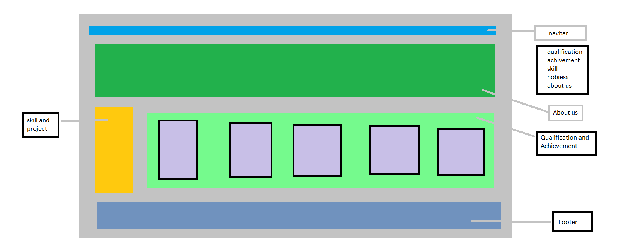
Layout

Slide 5
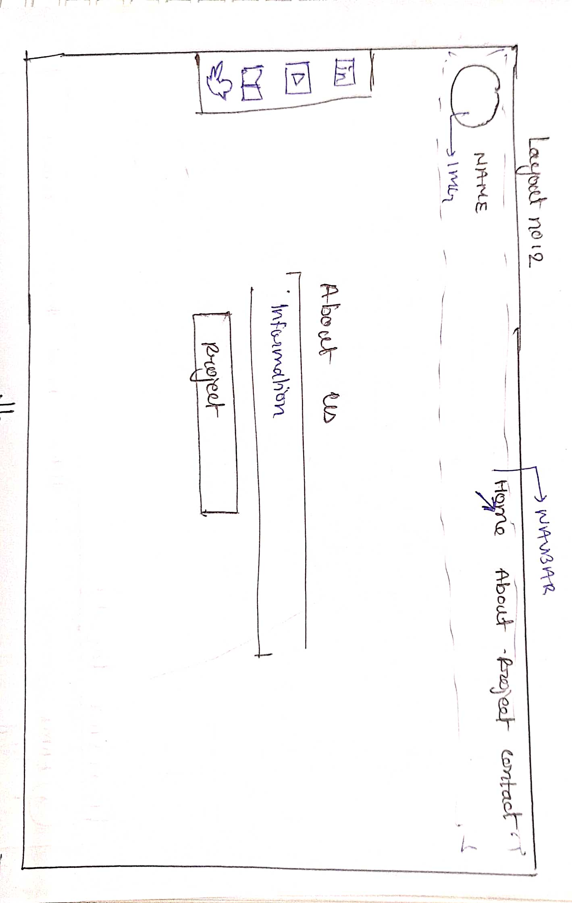
Layout

Slide 6
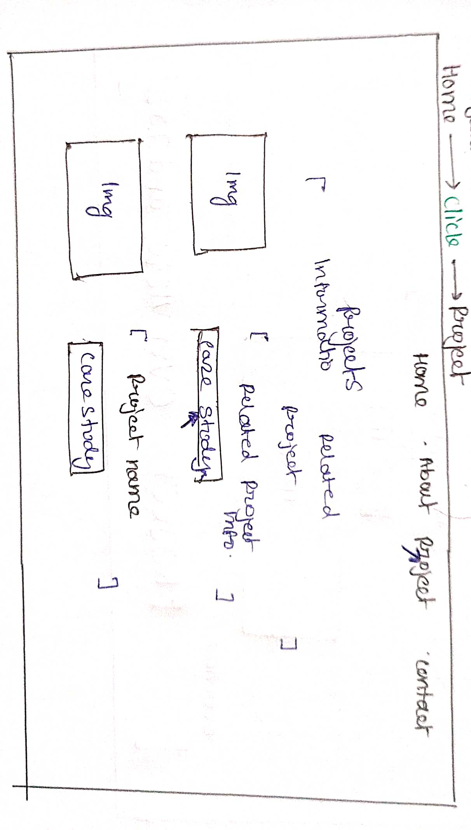
Layout

Slide 7
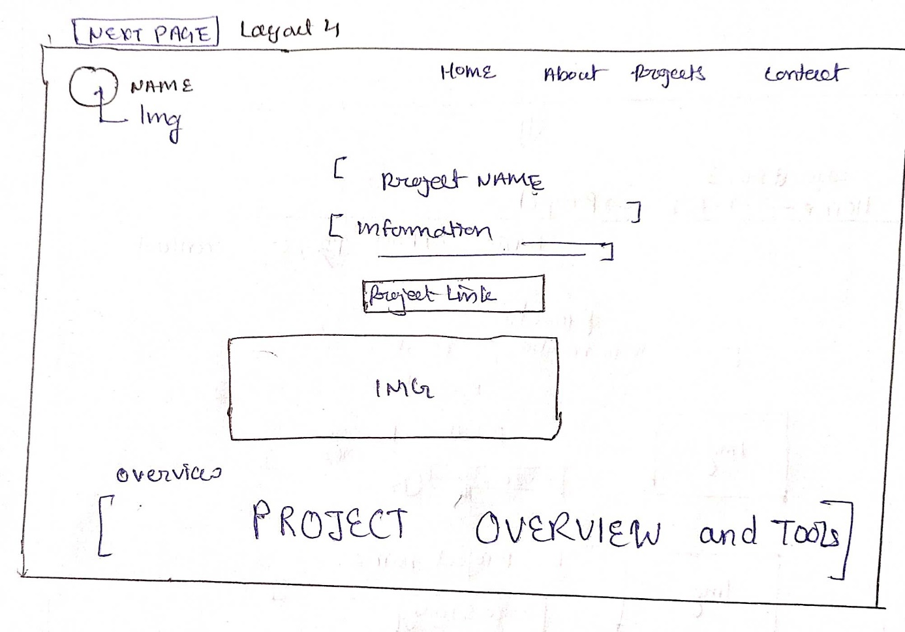
Layout

Slide 8
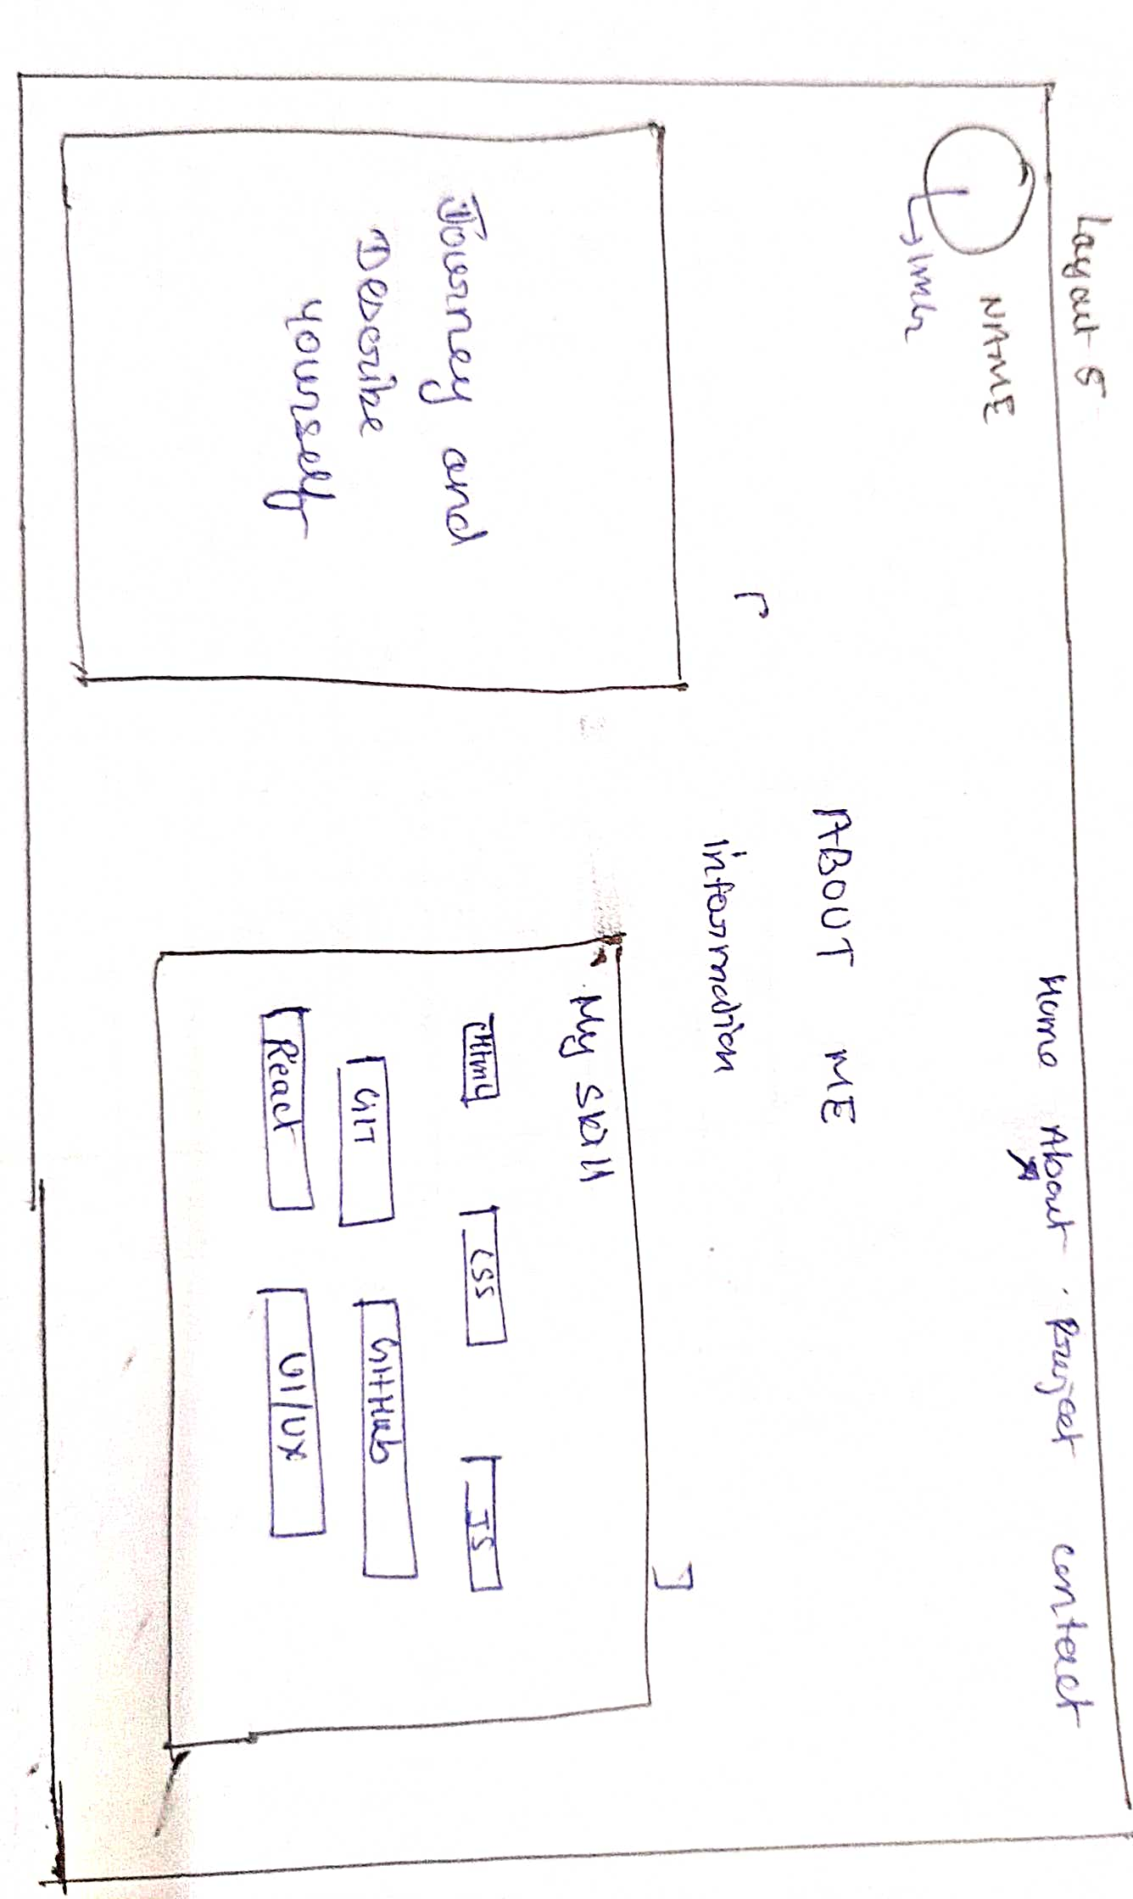
Layout

Slide 9
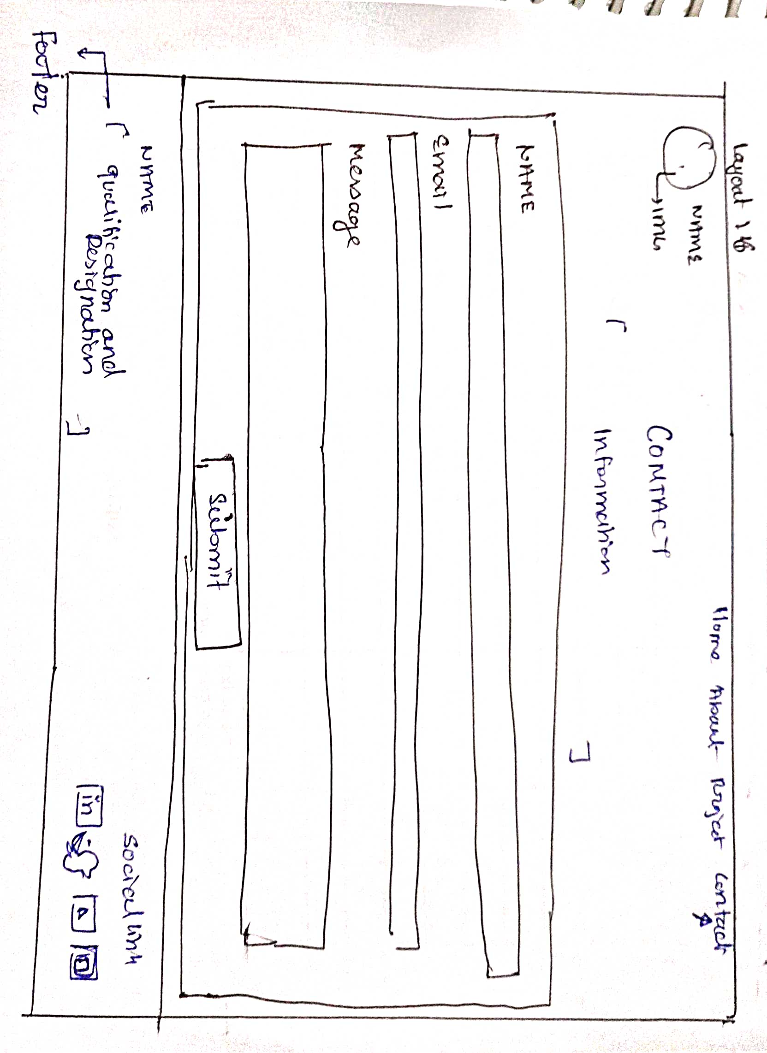
Layout

Slide 10
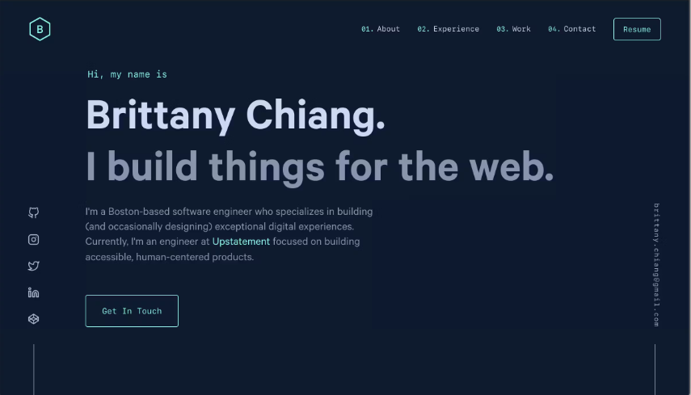
References

Slide 11
Component
Homepage: The homepage serves as an introduction to your portfolio and should provide a brief overview of who you are and what you do. It can include a short bio , your professional photo, and a summary of your skills and expertise.
About me: This section provides more detailed information about yourself, your background, and your experiences. You can include your education, certificates, and any other relevant details that showcase your qualifications and accomplishments.
Projects: Showcase your best work by highlighting the projects you have completed. Include descriptions , screenshots, or links to live demos or GitHub repositories.
Skills: Create a section where you list the specific skills you possess. This can include programming languages, frameworks, tools, or any other relevant skills that are important to your field.

Slide 12
Component
Recommendations: If you have received positive feedback from clients, employers, or colleagues, consider including testimonials or recommendations on your portfolio. These testimonials can add credibility and demonstrate the quality of your work.
Contact Information: Make it easy for visitors to get in touch with you by providing your contact information. Include your email address, phone number, and links to your professional social media profiles, such as LinkedIn or GitHub.

Slide 13


