Slide 1
Statistics
Study of data

Slide 2
Data Types
Continuous – Measurable
Height = {170,180……..}
Age
MRP
Salary
Distance
Money
Discrete – Countable
Name of stu ={ Akshat, Sameer…}
Days of week
Name of banks
Subject
No of cells
No of computers

Slide 3
Statistics
Descriptive Statistics – Description about the data
Measures of Central Tendency
Measures of Dispersion
Measures of Shape
Inferential Statistics

Slide 4
Measures of Central Tendency
Mean - average
Median – Middle value after arranging the data
Mode – Most repeated value
100,102,101,99,98,99,100

Slide 5
Height of stu 4 = 100,101,99,98,102
Mean – 100 cm
Median – 100 cm
Mean – Expected value without outlier for cont data
Median – Expected value with outlier for cont data
Height = 100,101,99,98,102,180
Mean – 113.3 cm
Median – 100.5 cm
Colour = {green, green, blue, Green, black}
Mode – Expected value for discrete data

Slide 6
Measures of dispersion
Standard Deviation
Variance
Range

Slide 7
HW: find mean median mode Variance SD for your +2/10 marks – Interpret from that

Slide 8
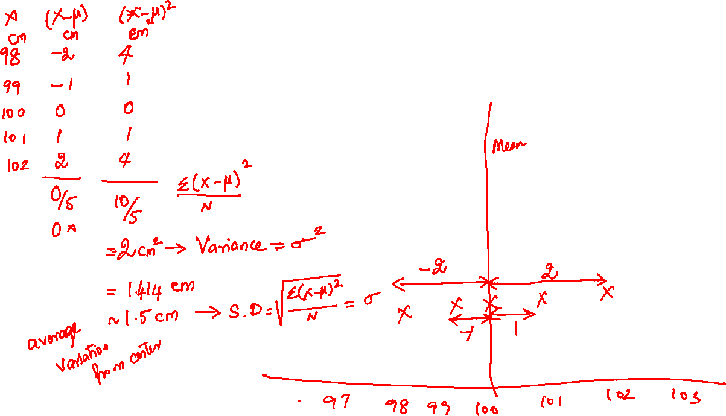

Slide 9
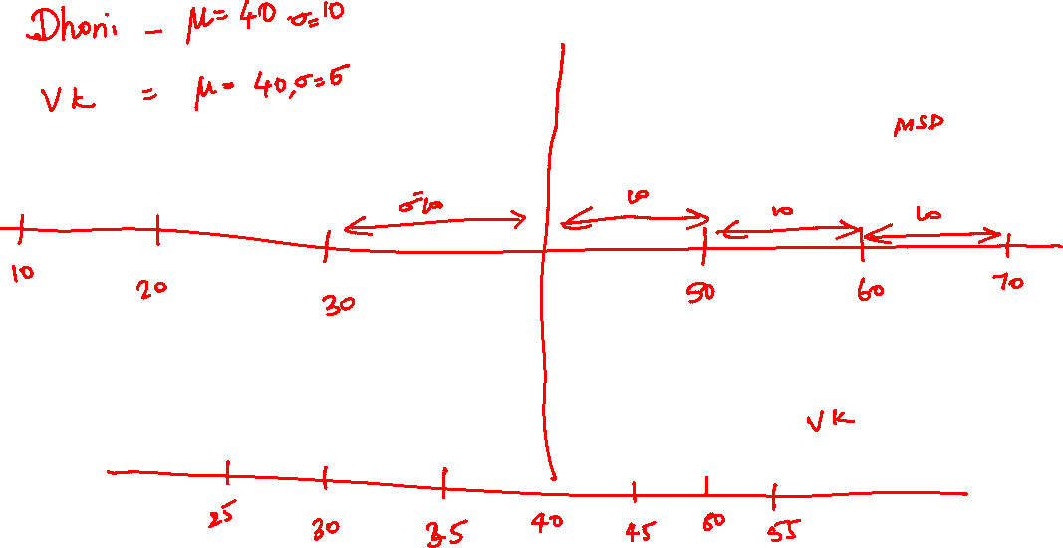

Slide 10
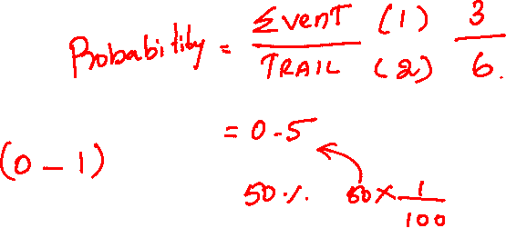
Range = Max - Min

Slide 11
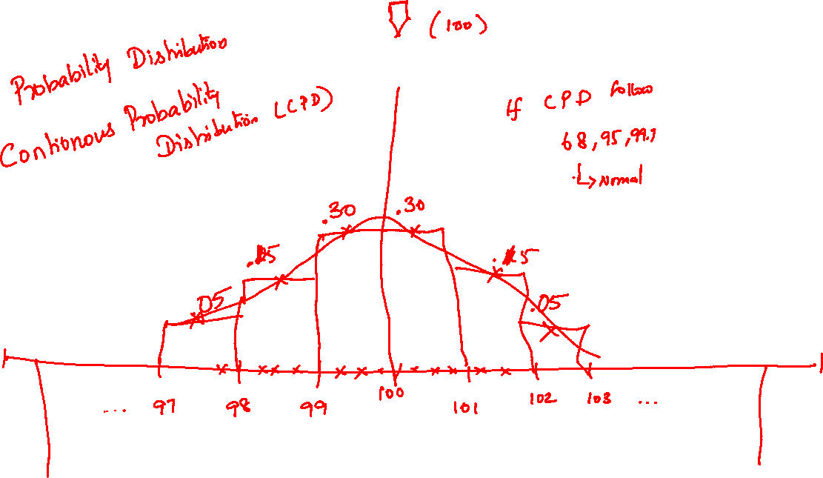

Slide 12
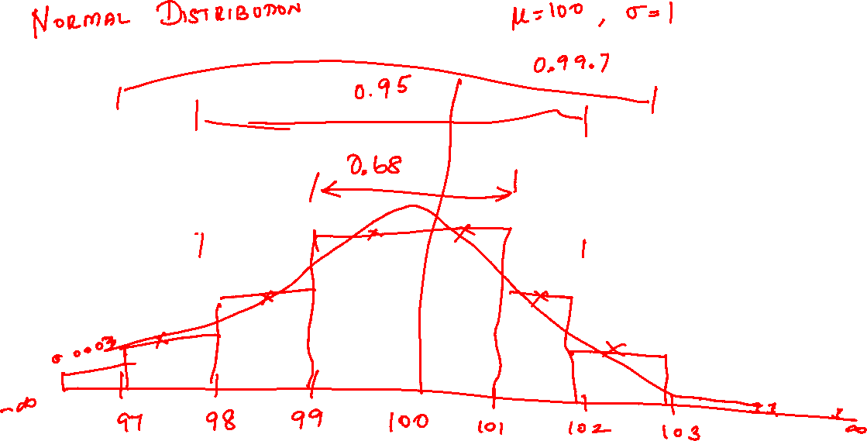
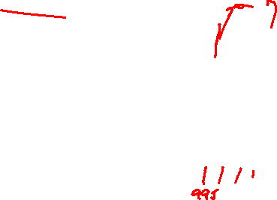

Slide 13
Properties of Normal Distribution
Between 1 sigma 68%
Between 2 sigma 95%
Between 3 sigma 99.7%
- ꚙ to +ꚙ
Probability of any particular event is zero
P(99 < X < 101 ) = 0.68
P(99.5) =0
P( 98 < X < 102 ) = 0.95
P( X < 100) = 0.5

Slide 14
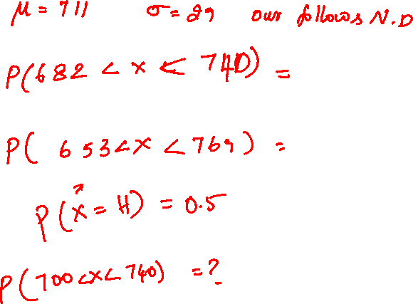

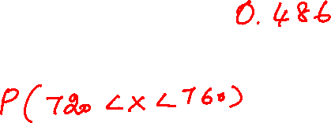

Slide 15
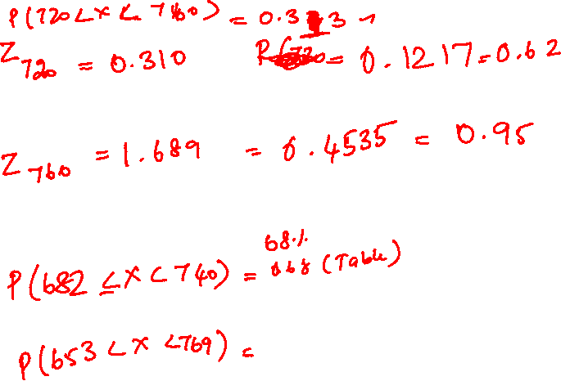

Slide 16
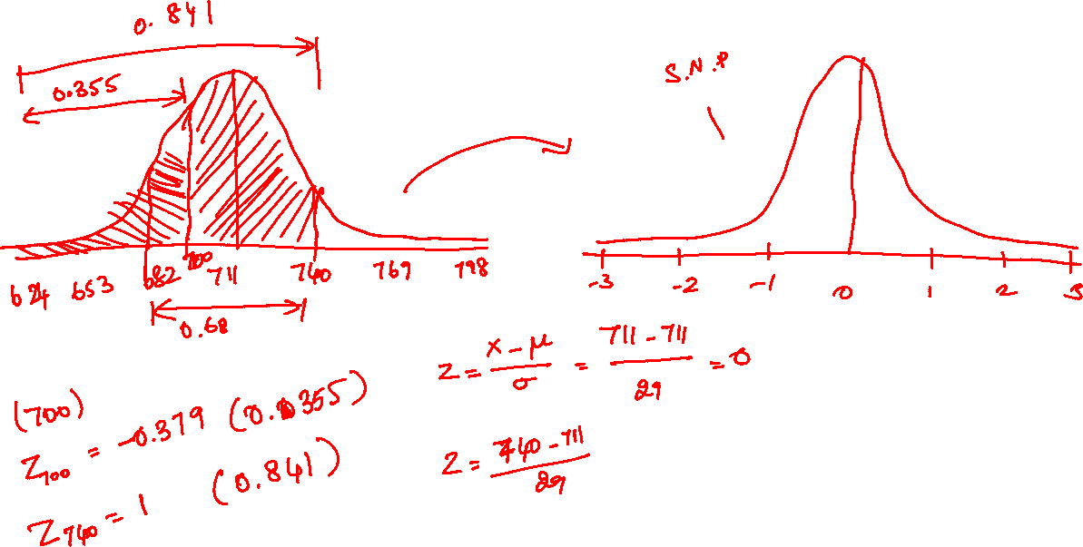

Slide 17
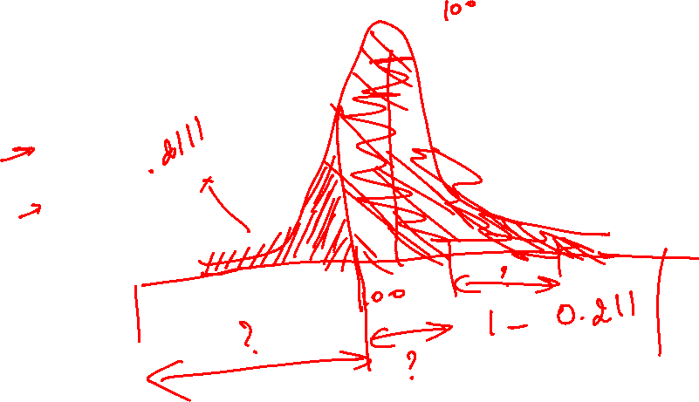
HW : mean = 100 sigma = 2.5
P( 98 < X < 102)
P( 102 < X < 106)
P( 101.5 < X < 105.6)
P( X =100.5)
P(X <98)
P(X> 98)
P(93.6 <x< 105.6)
P(96<x<107)

Slide 18
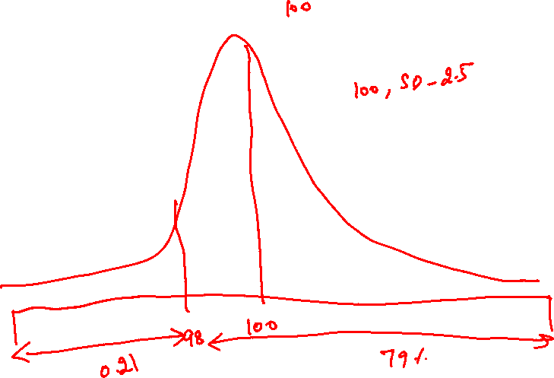
HW : mean = 55 sigma = 7
P(40 < X < 67)
P(45<X < 55)
P(60 < X < 68)
P(50< X < 67)
P(X = 60)
P(48 <x<53)
P(X<50)
P(X>50)

Slide 19
Measure of Shape
Skewness – Symmetry of Distribution
Kurtosis – peakedness of Distribution

Slide 20
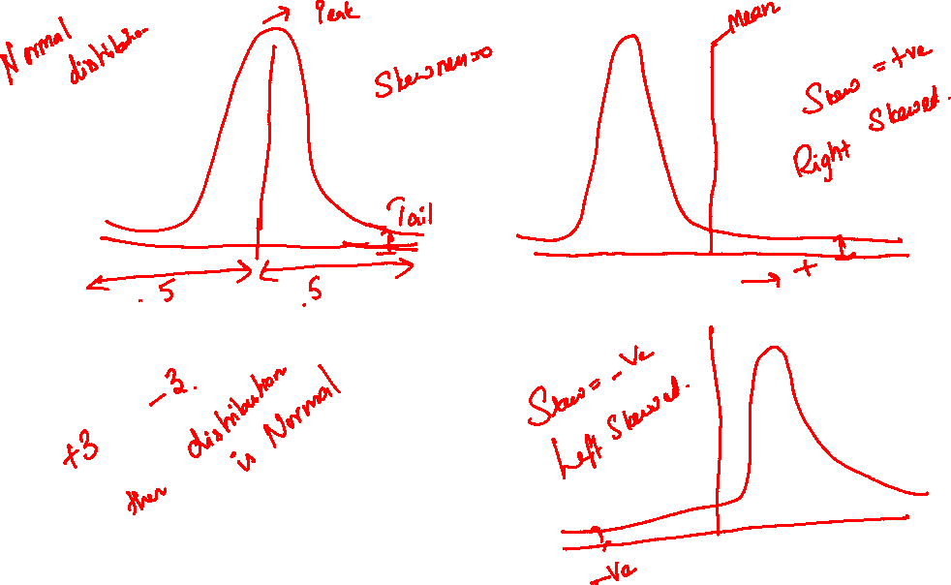

Slide 21
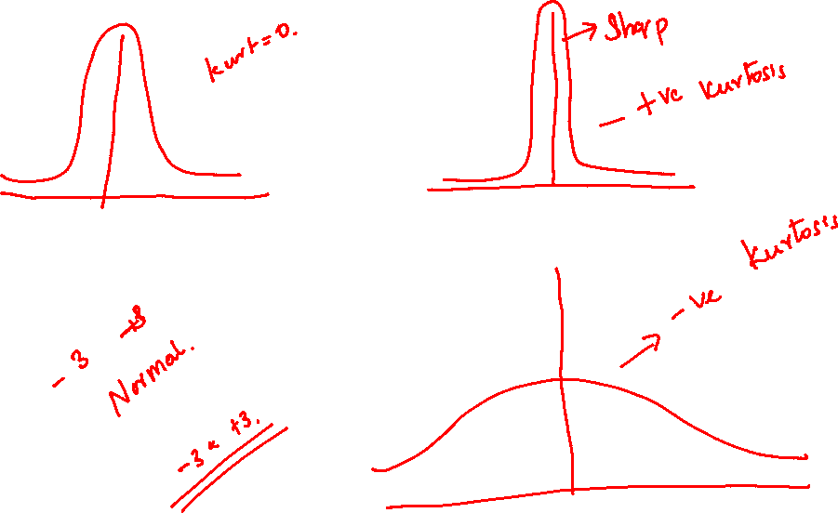

Slide 22
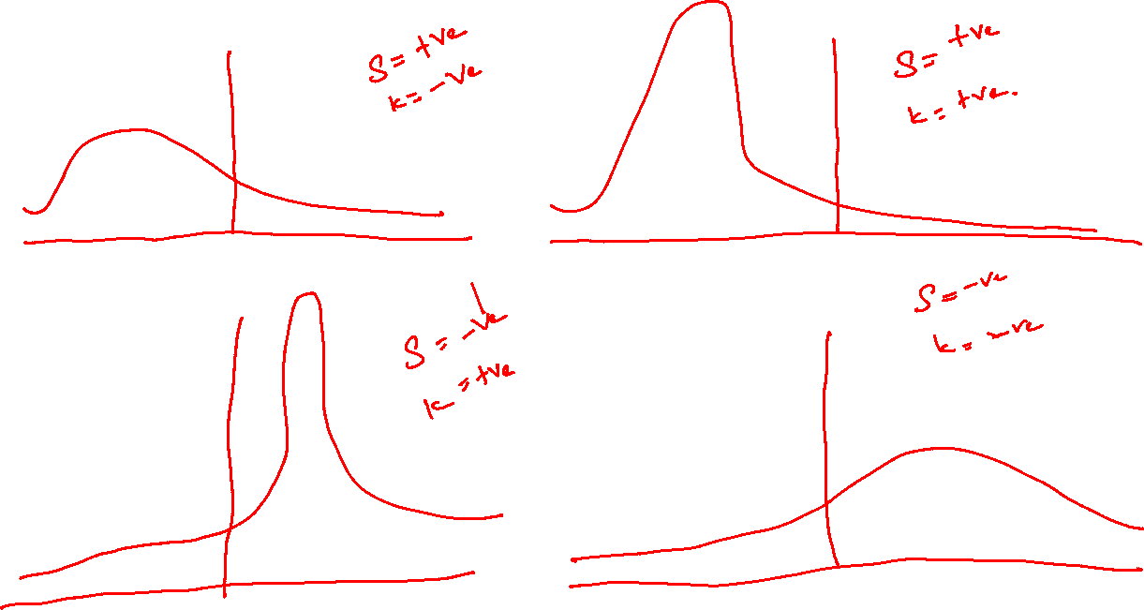

Slide 23
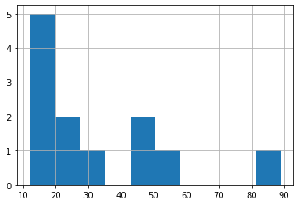
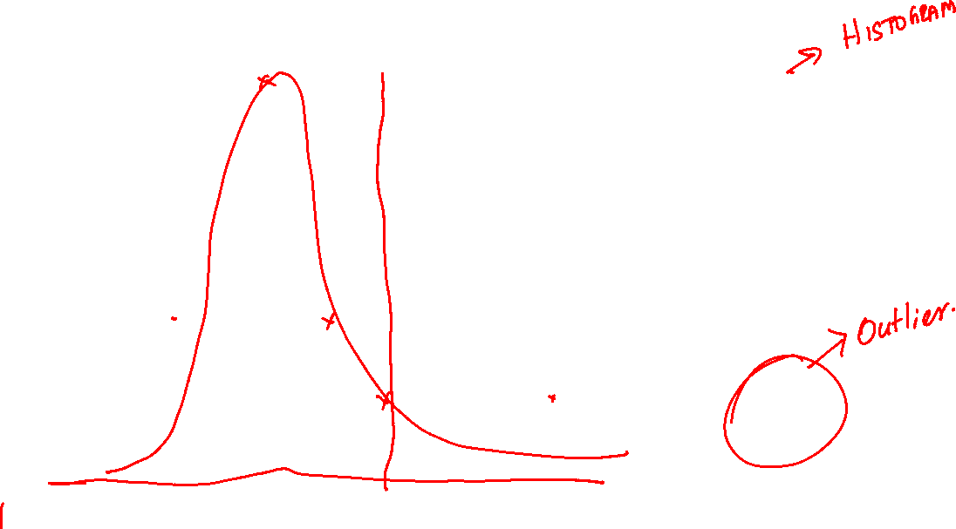

Slide 24
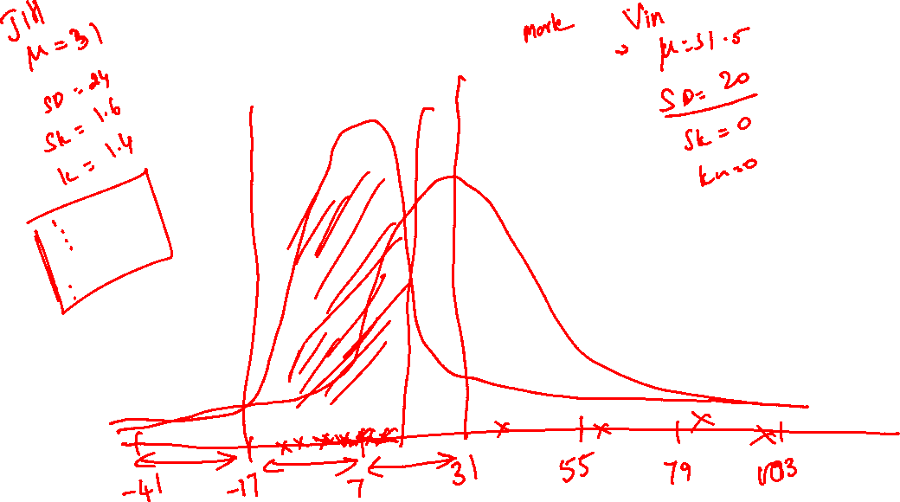

Slide 25
HW : Find any data and compare two varibles using Descriptive statistics
Expectation Graph with stats and interpretation

Slide 26
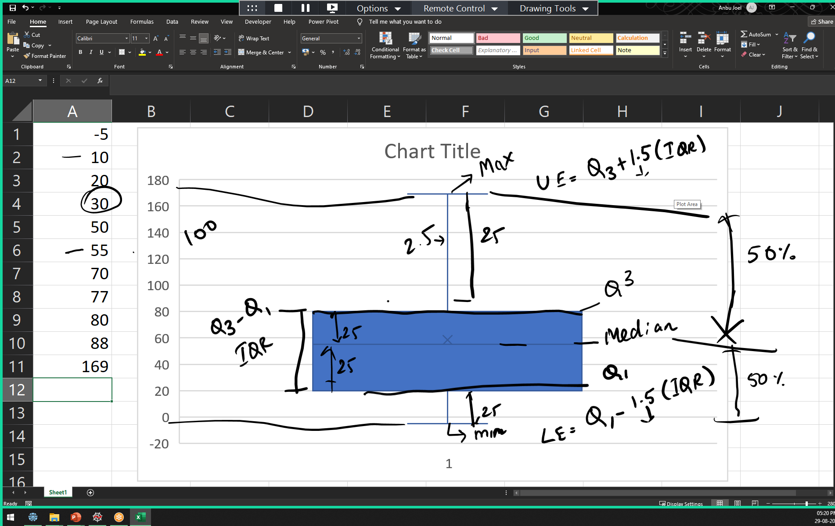

Slide 27
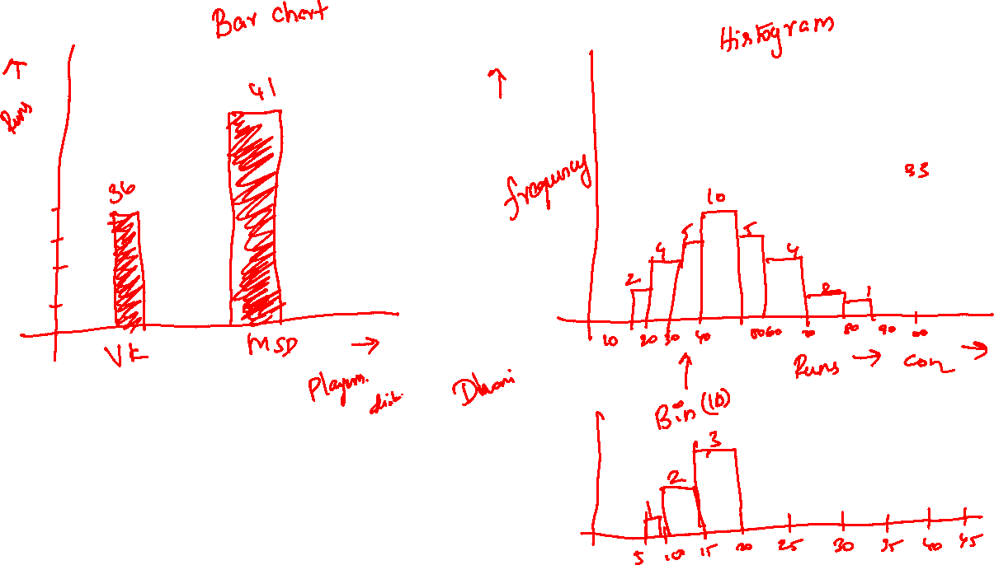

Slide 28
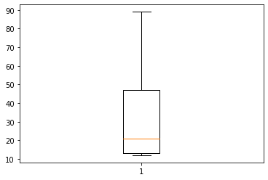
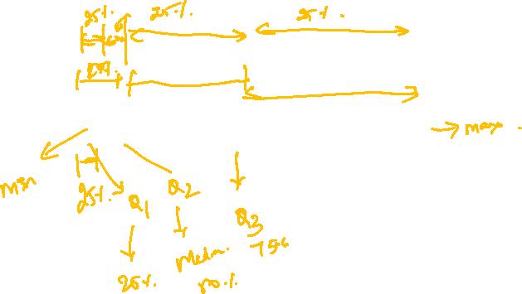

Slide 29
''' Create a subplots with 4 (2*2) different graphs with differnt colours and labels and title find code for changing the figure size of the graph '''

