Slide 1
Automated Gastric Cancer Diagnosis from Endoscopic Images
A cascaded spatio-temporal framework benchmarked on four public databases
Nikhil Sanjay (BL.EN.U4CSE23239) · Andrew Tom Mathew (BL.EN.U4CSE23269)
Guide: Dr. Tripty Singh · Department of CSE, Amrita School of Computing, Bengaluru
Notes:
Introduce the team and the one-line idea: a fast gate filters normal frames, a ResNet-50 + Bi-LSTM verifies suspicious frames over time, so the system stays accurate when individual frames are blurred or flashed.

Slide 2
Why automate endoscopic diagnosis?
1
Real-time throughput
2
Class imbalance
Heavy CNN ensembles and Transformers are accurate on still images but expensive per video frame.
Normal tissue dominates; cross-entropy is biased toward it, so rare early lesions are missed.
3
Black-box decisions
4
Transient artifacts
Grad-CAM maps are rarely checked against expert lesion masks.
Motion blur, light flashes and bubbles make single-frame classifiers fail in live video.
Notes:
Clinical motivation: early gastric lesions are subtle and detection depends on endoscopist skill and fatigue. False negatives cost lives; false positives cause unnecessary biopsies. Our literature review found four gaps; the first three come from published work, the fourth is the one our temporal design targets.

Slide 3
Proposed cascaded spatio-temporal pipeline
Video frame t
Stage 1 · MobileNetV2 gate
Stage 2 · ResNet-50
Stage 3 · Bi-LSTM
Diagnosis + Grad-CAM
buffer of last k = 5 frames
abnormality score s, averaged over the buffer
2048-d spatial feature per frame
temporal attention verifies lesion stability
class label and heat-map
s < τ : bypass with a normal-landmark label
Training: focal loss (γ = 2), AdamW, differential learning rate, cosine schedule. τ = 0.27 is chosen on validation as the largest threshold that keeps ≥ 99.5% of abnormal frames.
Notes:
Stage 1 is a cheap MobileNetV2 that scores how abnormal a frame looks. The score is averaged over the 5-frame buffer, so a single flashed frame cannot cause a bypass. Suspicious frames go to ResNet-50, whose features fill a buffer that a Bi-LSTM with attention reads. Grad-CAM explains the decision.

Slide 4
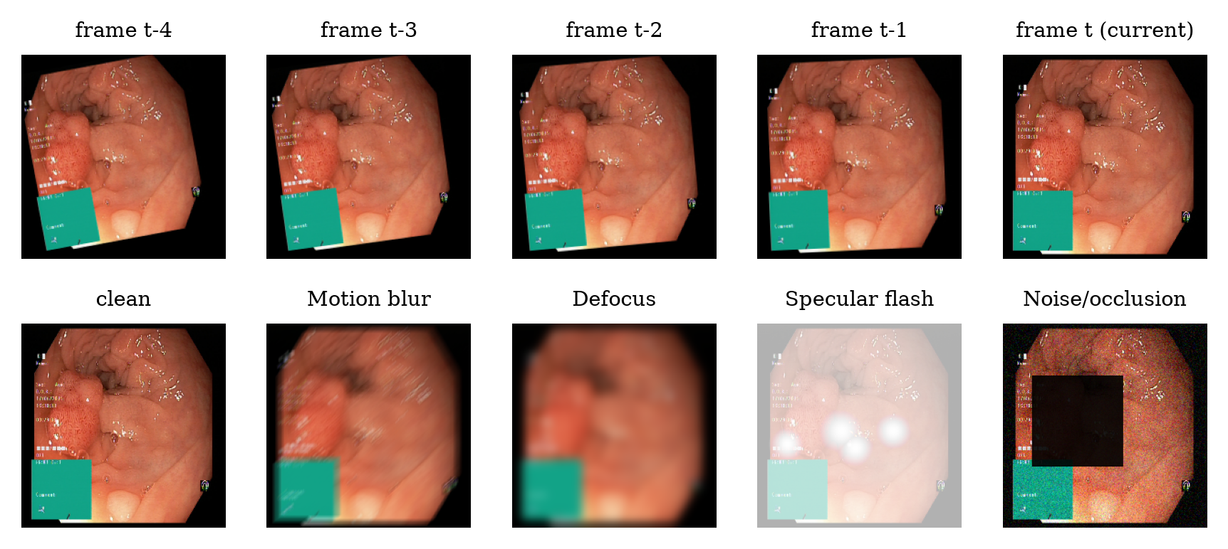
From still images to video: clips with simulated artifacts
Simulated camera motion
Each image becomes a 5-frame clip with drifting rotation, zoom and shift.
Four artifact families
Motion blur, defocus, specular flash, noise / occlusion.
Three test protocols
Clean · current frame corrupted (transient) · random stream with 30% corrupted frames.
Notes:
Public databases contain still images, so we synthesise short clips. The frames before the current one follow a smooth simulated camera trajectory, and any frame can be hit by one of four artifact types. This lets us test exactly the failure mode the temporal stage is designed for.

Slide 5
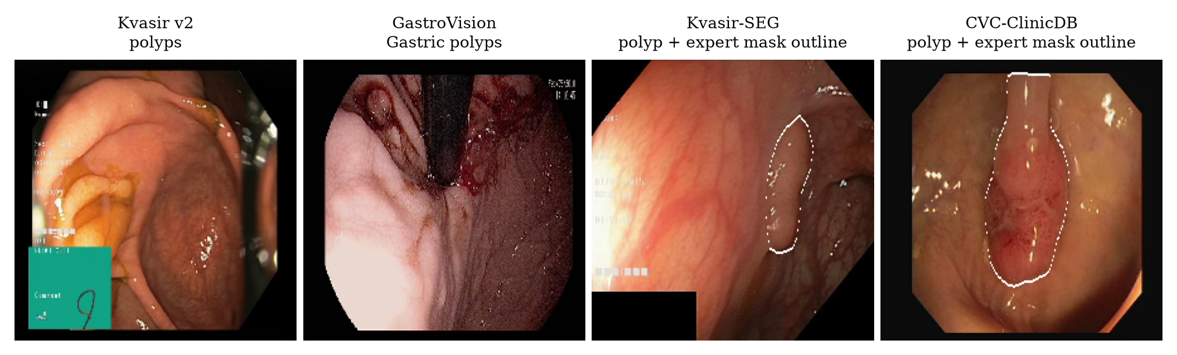
Four public databases
8,000
7,872
1,000
612
Kvasir v2
GastroVision
Kvasir-SEG
CVC-ClinicDB
8 classes · Primary 8-class benchmark
20 classes · Upper + lower GI, gastric findings
polyp masks · External polyp test + masks
polyp masks · Different hospital: domain shift
Notes:
Kvasir v2 is the primary benchmark. GastroVision tests generalisation on a larger, imbalanced database with gastric findings. Kvasir-SEG and CVC-ClinicDB have expert polyp masks and are never trained on: we use them for cross-database testing and to score Grad-CAM. All splits are stratified 70/15/15.

Slide 6
Nine baselines, ten performance evaluators
Baselines (same data, augmentation, optimiser, epochs)
Performance evaluators
Classical: SIFT bag-of-visual-words + HSV + LBP → RBF-SVM
Course CNNs: AlexNet, VGG-16, GoogLeNet
Deep CNNs: ResNet-50, DenseNet-121
Efficient CNNs: MobileNetV2, EfficientNet-B0
Transformer: ViT-B/16
Classification: Accuracy, Precision, Recall, F1, Specificity, Balanced accuracy, MCC, Cohen's κ, ROC-AUC
Efficiency: parameters, GMACs, batch-1 FPS on GPU and CPU
Robustness: accuracy under 4 artifact types and a random artifact stream
Explainability: Grad-CAM pointing game, energy-in-mask, IoU vs expert masks
Notes:
Every deep baseline is ImageNet-pretrained and fine-tuned with exactly the same pipeline, so differences come from the architecture. MCC is our headline metric because it stays informative under class imbalance.

Slide 7
Kvasir v2: within 1.7 points of the best model
91.9%
proposed accuracy on the Kvasir v2 test set (1,200 images)
90.8%
MCC; macro-F1 91.9%, AUC 99.2%
5 of 8
deep baselines statistically tied with ours (McNemar p ≥ 0.05); only ViT-B/16 is significantly better
Notes:
Hand-crafted SIFT features reach about 77.3%; deep networks reach about 88-93%. On clean, curated still images our cascade is level with its own ResNet-50 backbone and a little below the best model; with clean, near-identical frames the temporal stage has nothing extra to exploit. The advantage of the design shows on degraded frames, which is the next slide.

Slide 8
GastroVision: a harder, imbalanced database
Model | GastroVision Acc. | GastroVision Bal. acc. | GastroVision MCC
SIFT-BoVW+SVM | 64.9 | 42.2 | 60.4
AlexNet | 68.6 | 48.8 | 64.7
VGG-16 | 74.9 | 53.5 | 71.7
GoogLeNet | 76.3 | 56.3 | 73.4
ResNet-50 | 80.4 | 65.0 | 78.1
DenseNet-121 | 80.4 | 60.7 | 77.9
MobileNetV2 | 75.3 | 56.3 | 72.2
EfficientNet-B0 | 78.7 | 61.0 | 76.1
ViT-B/16 | 82.8 | 66.3 | 80.7
Proposed | 78.2 | 67.6 | 75.6
Balanced accuracy exposes rare-class failures that plain accuracy hides; the hand-crafted baseline collapses here. Bold = best per column.
Notes:
GastroVision has many more classes and strong imbalance, so balanced accuracy and MCC matter more than accuracy. Classes with fewer than 30 images were dropped because they cannot be split into train, validation and test.

Slide 9
Artifacts break single-frame models, not ours
91.8%
proposed accuracy when the current frame is corrupted (mean of 4 artifacts)
74.1%
most robust single-frame baseline (ViT-B/16)
Bi-LSTM attention: 0.03 on corrupted vs 0.27 on clean frames
Notes:
This is the key result. When only the current frame is blurred, flashed or occluded, every single-frame model loses a large share of its accuracy because it has nothing else to look at. The temporal model keeps its clean accuracy because the attention learns to ignore corrupted frames, with no frame-quality labels.

Slide 10
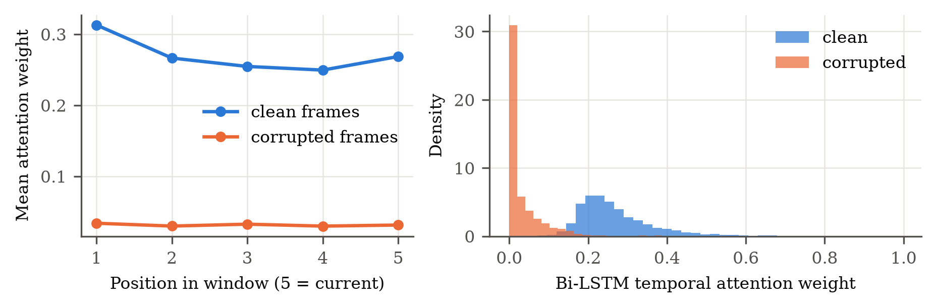
Why it works: attention ignores corrupted frames
Configuration (Kvasir) | Clean | Flash | Stream
ResNet-50 (focal), single frame | 91.4 | 41.2 | 81.8
+ temporal mean pooling | 92.3 | 92.4 | 91.8
+ Bi-LSTM (no gate) | 91.9 | 91.3 | 91.2
+ gate on current frame only | 91.8 | 85.8 | 90.4
Proposed cascade | 91.9 | 91.3 | 91.2
Gating on the current frame alone lets a flash push a lesion below τ; averaging the gate score over the 5-frame buffer removes that failure at no extra cost.
Notes:
Ablation: temporal aggregation removes most of the artifact sensitivity. On our synthetic clips, simple mean pooling is about as good as the Bi-LSTM because neighbouring frames are near-duplicates; the Bi-LSTM additionally tells us which frames it trusted. Gating on the current frame alone was a weak point; the smoothed gate fixes it.

Slide 11
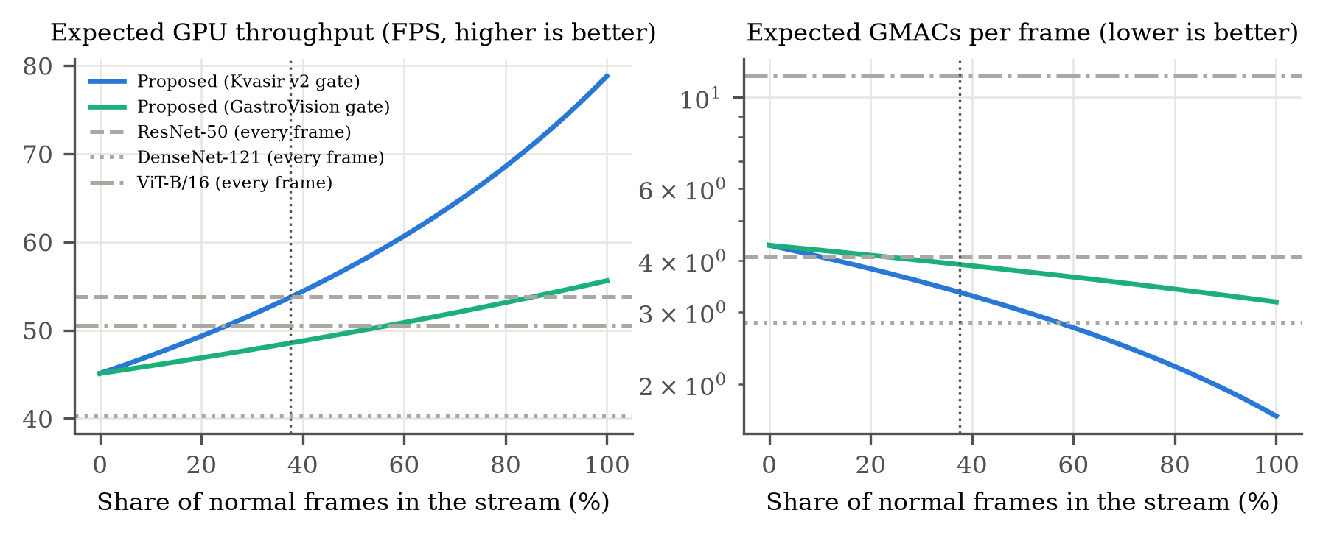
Efficiency: what the gate buys
99.3%
of abnormal test frames pass the gate (τ = 0.27)
3.35
GMACs per frame on Kvasir vs 4.09 for ResNet-50 on every frame
At Kvasir's balanced class mix the cascade only breaks even on the GPU (54 vs 54 FPS); the gain grows as normal frames dominate, as in real screening video. On this CPU, PyTorch's depthwise kernels are slow, so the gate does not pay off there.
73 FPS
expected GPU speed at 90% normal frames (ResNet-50 on every frame: 54 FPS)
Notes:
The gate keeps over 99% of abnormal frames. Kvasir is class-balanced, so only a quarter of frames are bypassed and the cascade merely breaks even with ResNet-50 on the GPU while adding temporal verification. Real screening video is mostly normal mucosa, where the saving is much larger (right panel: GMACs fall towards the MobileNetV2 cost). Be upfront that on the CPU MobileNetV2 is unexpectedly slow in PyTorch, so we do not claim a CPU speed-up.

Slide 12
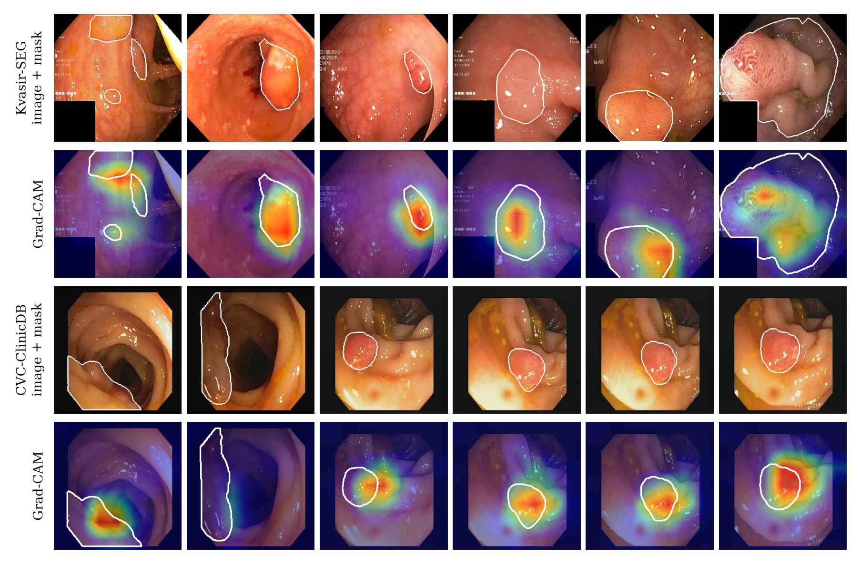
Unseen hospitals and explainability
93.5%
of CVC-ClinicDB polyp frames (different hospital and endoscope) flagged abnormal without retraining
81.3%
Grad-CAM pointing-game hits inside the expert polyp mask on Kvasir-SEG (random: 14.5%)
65.0%
pointing-game hits on CVC-ClinicDB (random: 8.5%)
Notes:
Without retraining, the Kvasir-trained cascade is applied to two databases it never saw. Grad-CAM is scored against expert masks: the pointing game asks whether the hottest pixel lies inside the polyp. Chance level is the mask area.

Slide 13
Conclusions and next steps
Accurate
91.9% accuracy and 90.8% MCC on Kvasir v2 (best baseline: ViT-B/16, 93.6%)
Robust
keeps its clean accuracy when frames are blurred, flashed or occluded; single-frame CNNs do not
Efficient
≥ 99% of abnormal frames pass the gate; normal frames skip ResNet-50 and the Bi-LSTM
Explainable
Grad-CAM validated against expert masks on two external databases
Next: validate on real endoscopic video (e.g. HyperKvasir videos), repeated-seed confidence intervals, rare gastric pathologies (early gastric cancer, ulcers).
Notes:
Close with the four properties and the limitations: the clips are synthetic, so real video validation is the most important next step. Rare gastric classes like ulcers had too few images to include. Then take questions.

