Slide 1
Multi-Agent Chess Arena
A Minimax Agent vs. an Alpha-Beta Pruning Agent with Heuristic Evaluation
23CSE401 Fundamentals of Artificial Intelligence · Case Study
Name: Nikhil Sanjay Roll No.: BL.EN.U4CSE23239

Slide 2
Problem Statement
• Two AI agents play full chess games against each other in an arena
  – Agent 1: Minimax, which looks at every move sequence up to depth d
  – Agent 2: Alpha-Beta, the same search but it skips branches that cannot matter
• Both use the SAME heuristic evaluation (material + piece-square tables)
• Each agent's goal: maximise its own outcome (win > draw > loss); one agent's gain is the other's loss
• Interaction: strictly alternating moves on a shared board; every move changes the opponent's options
• Questions: Do both agents choose equally good moves? How much work does pruning save? What does that saving buy in actual games?

Slide 3
PEAS and Environment Properties
PEAS | Chess arena
Performance | Win / draw / loss; material balance; nodes and time per move
Environment | 8×8 board, 32 pieces, the opponent agent, rules of chess (python-chess)
Actuators | Choose one legal move per turn (incl. castling, en passant, promotion)
Sensors | Full board state (FEN), side to move, legal moves, check / mate / draw status
Property | Value
Observable | Fully
Deterministic | Yes (no dice, no hidden cards)
Episodic? | Sequential
Static? | Static (turn-based)
Discrete? | Discrete
Agents | Multi-agent, competitive, zero-sum
Known? | Known rules

Slide 4
Type of Agent
• Utility-based, model-based agent with adversarial look-ahead
  – Model: the rules of chess predict the result of every move (transition model)
  – Utility: the heuristic evaluation estimates how good a position is for White
  – Goal-based alone is not enough: checkmate is usually too far away to see, so positions must be scored
• Competitive, zero-sum: White maximises the evaluation and Black minimises it
  – Each agent assumes the opponent plays its best reply, which is exactly what minimax models
• Why not a reflex agent? Grabbing material greedily walks into traps (E1, E2)
• Rational within bounded depth: only as good as its search horizon

Slide 5
Heuristic Evaluation Function
• eval(s) = Σ White (piece value + square bonus) − Σ Black (piece value + square bonus)
• Piece values (centipawns): P 100, N 320, B 330, R 500, Q 900
• Piece-square tables reward central knights, advanced pawns, a castled king, …
• Terminal positions are scored exactly:
  – Checkmate = ±(100000 − ply), so a faster mate scores higher
  – Stalemate and insufficient material = 0
• Same function for both agents, so any difference comes from the SEARCH alone

Slide 6
Search Techniques
Minimax (depth-limited)
Alpha-Beta pruning
• Depth-first over the game tree to depth d
• MAX (White) takes the max of its children and MIN (Black) the min
• Leaves are scored with the heuristic
• Visits every node: O(b^d) time, O(b·d) memory
• Carries α (best for MAX so far) and β (best for MIN so far)
• If α ≥ β, the opponent will never allow this line, so the remaining moves are skipped
• Returns EXACTLY the minimax value
• Move ordering (captures first, MVV-LVA) finds cut-offs early
• Best case O(b^(d/2)), worst case O(b^d)

Slide 7
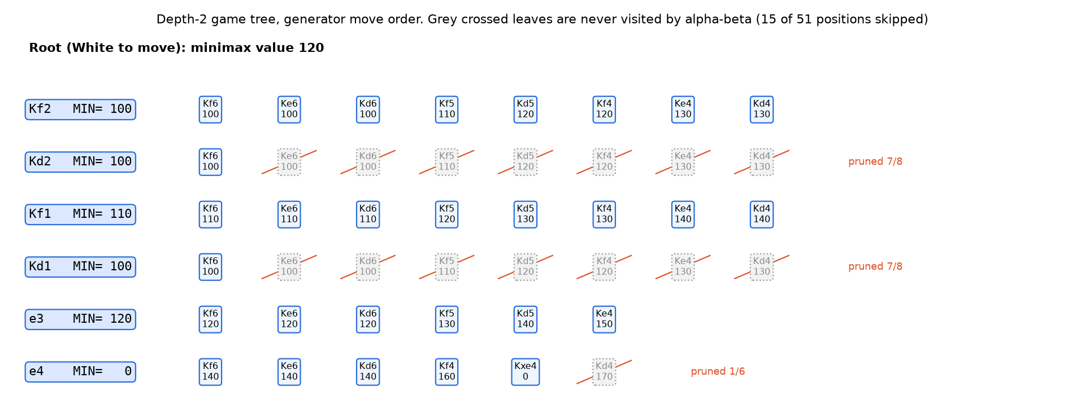
Search Tree: Where Pruning Happens
King+pawn endgame, depth 2, same move order for both searches
Minimax visits 51 positions; alpha-beta visits 36; both return value 120.

Slide 8
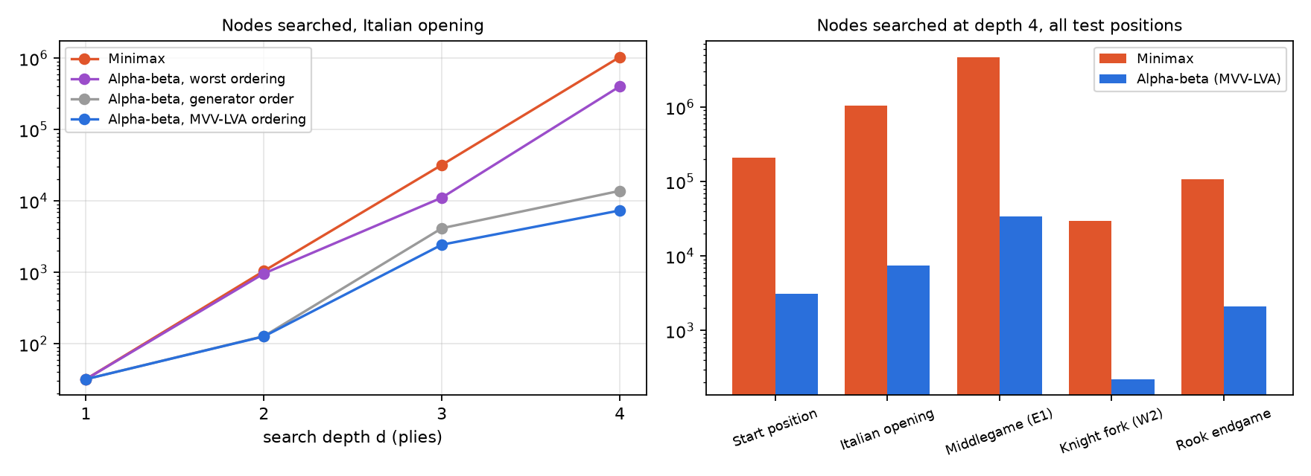
Nodes Searched vs. Depth
Alpha-beta always returned the same value as minimax (checked by assert)
Depth 4
Position | Minimax | Alpha-beta | Saved
Start position | 206,604 | 3,109 | 98.5%
Italian opening | 1,040,115 | 7,372 | 99.3%
Middlegame (E1) | 4,701,529 | 34,023 | 99.3%
Knight fork (W2) | 29,745 | 222 | 99.3%
Rook endgame | 108,368 | 2,124 | 98.0%

Slide 9
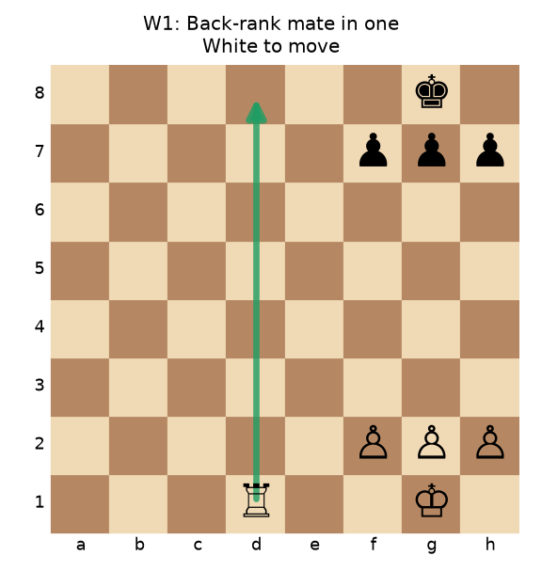
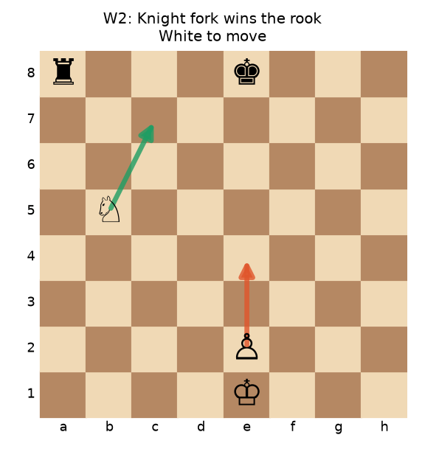
Working Cases
W1 Back-rank mate: both agents play Rd8# at every depth; the mate score is exact. At depth 3: 3,202 vs 419 nodes.
W2 Knight fork: at depth 1-2 the fork is invisible (the rook capture is on ply 3). At depth 3 both play Nc7+ (value +340). Nodes: 1,923 vs 112.

Slide 10
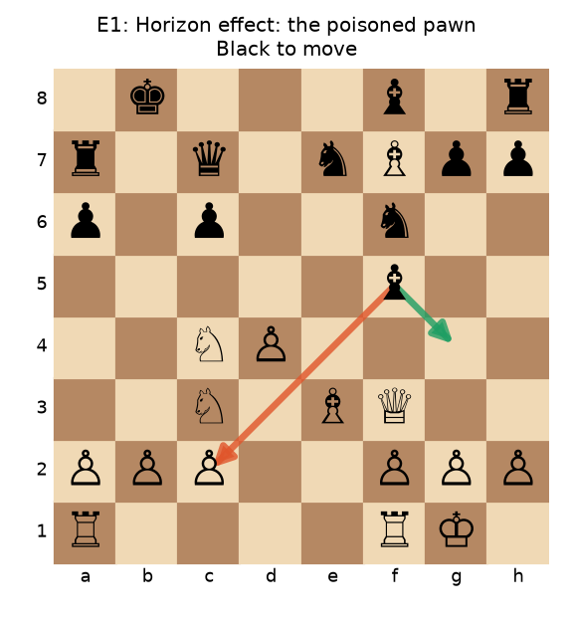
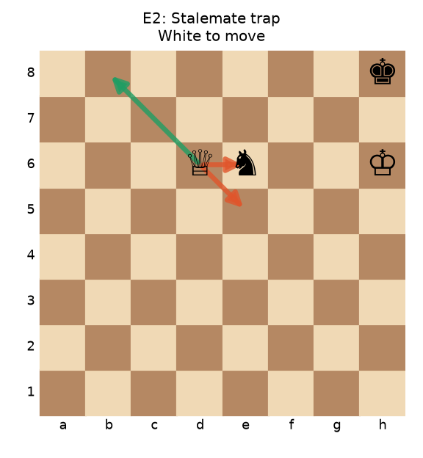
Edge Cases: Horizon Effect and Stalemate Trap
E1 (position from an agent game): at depth 1-2 Black grabs a pawn with Bxc2, but Bf4 then pins the queen to the king and wins it two plies later. At depth ≥ 3 the agent sees this and plays Bg4.
E2: Qxe6 wins a knight but is STALEMATE (value 0). A greedy material-counter plays Qxe6; both search agents play Qb8+ and find a forced mate.

Slide 11
Edge Case: Bad Move Ordering
Alpha-beta's saving depends on examining good moves first
Italian opening, depth 4 | Nodes | vs minimax
Minimax | 1,040,115 | 100%
Alpha-beta, reversed ordering (bad moves first) | 403,780 | 38.8%
Alpha-beta, generator order | 13,879 | 1.3%
Alpha-beta, MVV-LVA ordering | 7,372 | 0.7%
• Same value in every run: ordering changes only the work, never the answer
• With good moves first, one refutation is enough to prune the rest
• With bad moves first, cut-offs come late and alpha-beta approaches minimax, towards O(b^d)

Slide 12
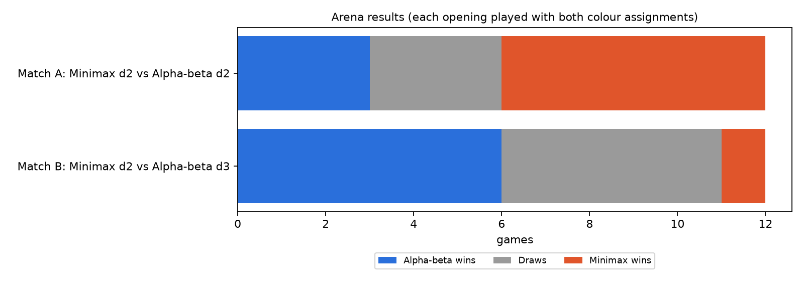
Arena Results
6 openings × both colours, 100-ply limit
Match | AB W-D-L | MM nodes/move | AB nodes/move
A: MM d2 vs AB d2 | 3-3-6 | 1,381 | 169
B: MM d2 vs AB d3 | 6-5-1 | 1,206 | 2,214
• Equal depth: in 636 replayed positions both agents' moves had the SAME value (100%) and were identical in 98.7%; the score comes only from tie-breaks
• Alpha-beta at depth 3 costs less than 2× minimax's nodes at depth 2, and the extra ply wins games

Slide 13
Complexity
 | Time | Space | Chess (b ≈ 35)
Minimax | O(b^d) | O(b·d) | d=4: ≈ 1.5 million leaves
Alpha-beta, best case | O(b^(d/2)) | O(b·d) | d=4: ≈ 2,450 leaves; twice the depth for the same work
Alpha-beta, worst case | O(b^d) | O(b·d) | no better than minimax
• Measured, start position (b = 20), depth 4: minimax 206,604 nodes, alpha-beta 3,109
• Each extra ply multiplies minimax's work by about b (20-40×), and alpha-beta's by about √b
• Full chess tree ≈ 10^120 nodes (Shannon), so any agent must cut off at depth d and use a heuristic

Slide 14
Comparison and Key Observations
 | Minimax | Alpha-Beta
Decision quality at equal depth | Optimal w.r.t. heuristic | Identical value
Nodes at depth 4 (avg of 5 positions) | 1,217,272 | 9,370
Sensitive to move ordering? | No | Yes (E3)
Horizon effect? | Yes | Yes, but it can search deeper and so push the horizon back
Practical depth in Python (~1 s/move) | ≈ 3 | ≈ 4-5
• Pruning is free accuracy-wise: it removes work, not information
• Depth matters more than anything else: the deeper agent avoids traps (E1) and finds tactics (W2)
• Limitations: horizon effect, a heuristic blind to king safety and mobility, exponential growth

Slide 15
Conclusion
• Chess is a fully observable, deterministic, sequential, competitive two-agent environment, which is ideal for adversarial search
• Minimax and alpha-beta agents with the same evaluation choose moves of the same value; alpha-beta does it with 1-2 orders of magnitude less work
• Good move ordering is what makes the pruning effective
• In the arena, the saved effort becomes extra depth, and extra depth becomes wins
• Next steps: iterative deepening, quiescence search (fixes the horizon effect), transposition tables

