Slide 1


1
A Multi-Agent Framework for Log Anomaly Detection
23CSE498 Project Phase 2 – Approval Presentation
Team ID: 23UG030 Panel No.: 17
S.No | Reg.No | Name of the Student | Branch
1 | BL.EN.U4CSE23209 | Atharva Anup Wasnik | CSE
2 | BL.EN.U4CSE23239 | Nikhil Sanjay | CSE
3 | BL.EN.U4CSE23257 | Vedhesh Dhinakaran | CSE
4 | BL.EN.U4CSE23269 | Andrew Tom Mathew | CSE
Project Guide: Dr. Ritesh Raj
Assistant Professor (Level 10), School of Artificial Intelligence, Amrita Vishwa Vidyapeetham, Bengaluru

Slide 2
2
Screenshot of your guides’ approval mail (to go ahead with the presentation)

Slide 3
Problem Definition
3
  Modern systems generate large volumes of heterogeneous log data, making manual analysis difficult and time-consuming.
  Existing approaches often address log anomaly detection, Root Cause Analysis (RCA), or AI-based insights as separate tasks.
  Recent research has introduced LLMs and AI agents for individual stages, but a unified system that autonomously coordinates the complete log-analysis workflow is still limited.
  There is a need for a system that can:
    Identify and classify incoming log data based on its log family.
    Develop an intelligent log analysis system that identifies log families and automatically performs preprocessing and data cleaning.
    Integrate and orchestrate specialized AI agents to perform anomaly detection and RCA using existing ML models and contextual evidence.
    Generate explainable and actionable insights using an SLM based on the detected anomalies and RCA results.
    Predict future system disruptions to prevent system downtimes and provide preventative counter-measures

Slide 4
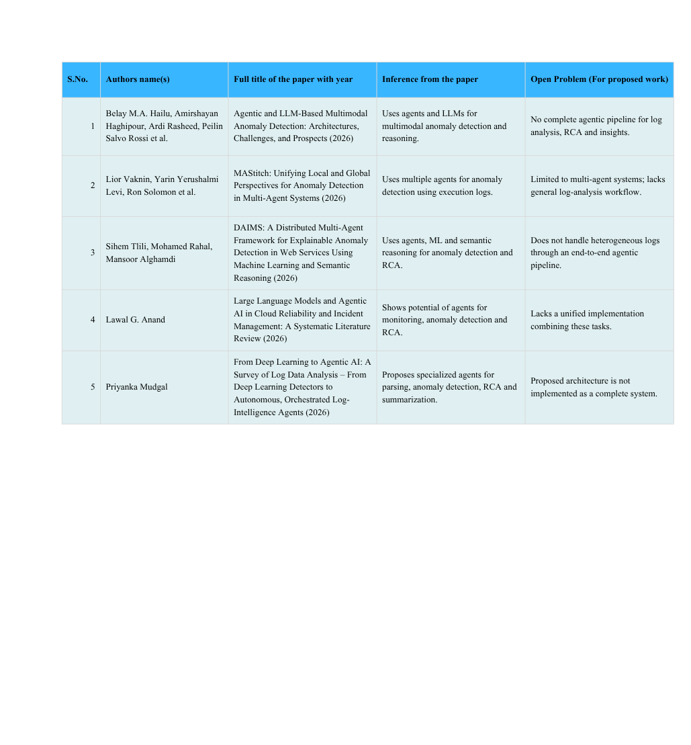
Literature Survey
4

Slide 5
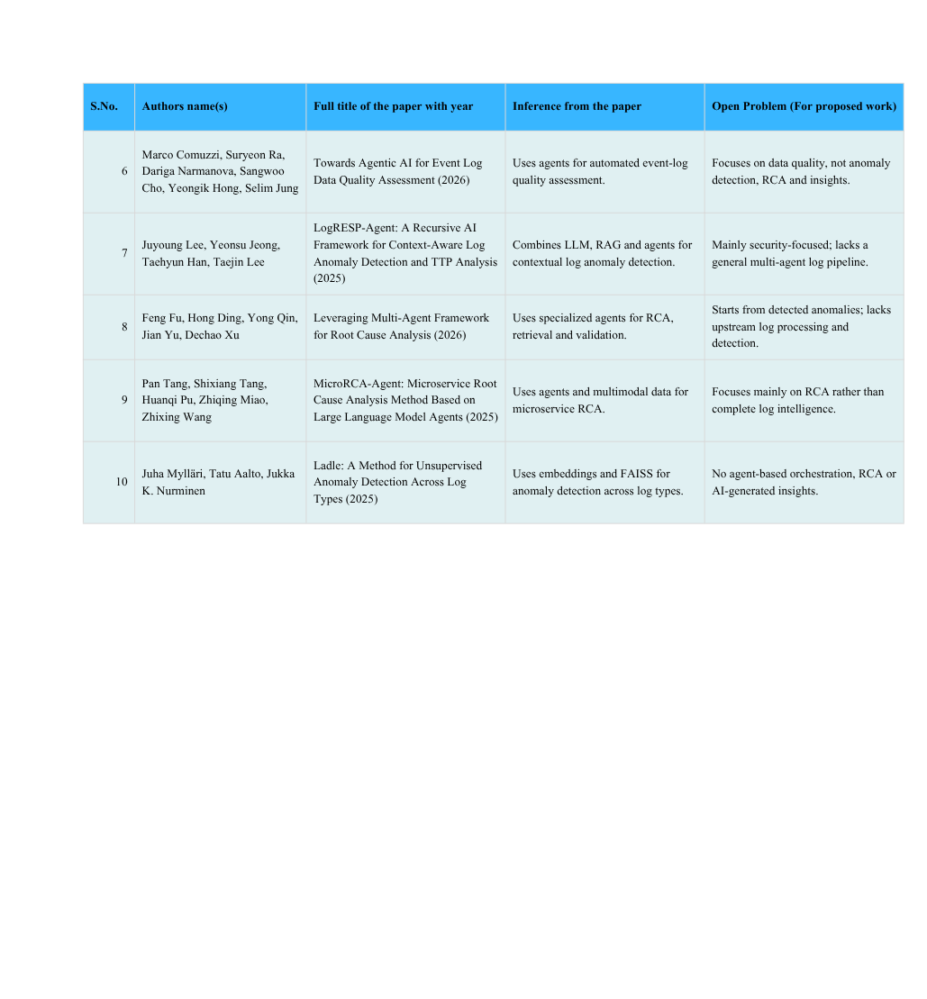
Literature Survey
5

Slide 6
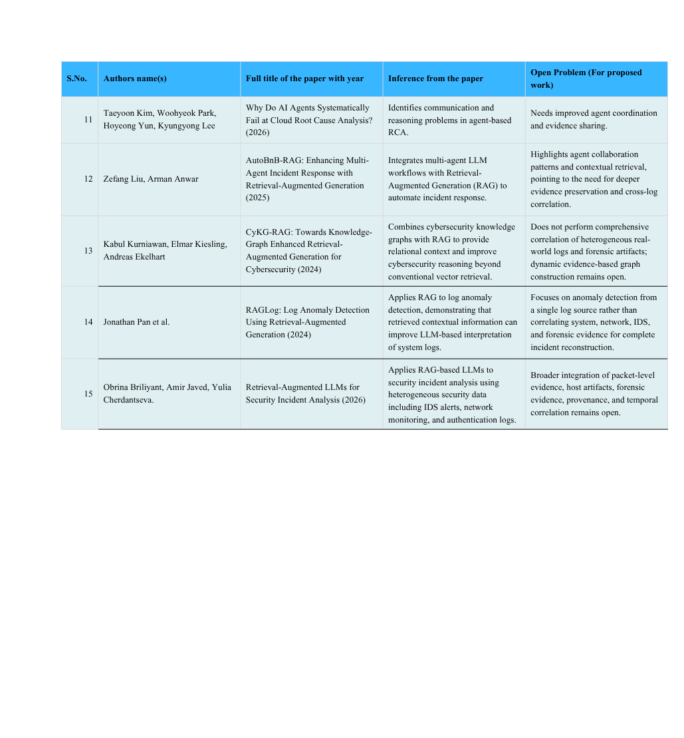
Literature Survey
6

Slide 7
Research Gaps Identified
7
  No complete end-to-end multi-agent log analysis system
  Limited automatic log-family classification
  Inadequate temporal synchronization across multimodal data
  Limited agent-based preprocessing and cleaning
  Weak integration between anomaly detection and RCA
  Limited orchestration of existing ML models using agents
  Limited SLM-based actionable insights
  Limited dynamic agent coordination and context sharing
  Limited integration of the complete workflow with Kubernetes logs
  Limited privacy-preserving agent architectures

Slide 8
Justification for the Proposed Problem
8
  Growing log volume and diversity make manual log analysis difficult and time-consuming.
  Existing research largely focuses on individual tasks such as anomaly detection, RCA, or log summarization.
  Recent LLM- and agent-based approaches show potential, but end-to-end coordination of these tasks is still limited.
  Different log families require different preprocessing and analysis strategies, creating a need for intelligent workflow selection.
  Existing ML models can perform accurate anomaly detection, but they are generally not autonomous in deciding when and how to use these models.
  An anomaly detection result alone does not explain why the anomaly occurred or what action should be taken.
  Combining specialized agents for preprocessing, anomaly detection, RCA, and SLM-based insights can provide a more complete analysis workflow.
  The architecture can initially work with manually uploaded logs and later be extended to real-time Kubernetes logs, making the system practical and scalable.

Slide 9
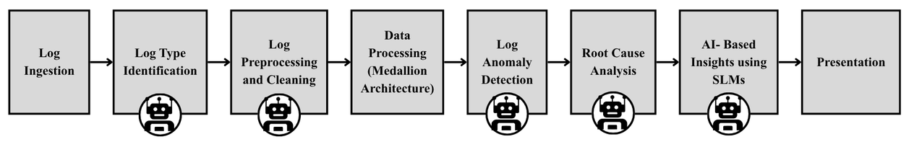
Pipeline of the Proposed System
9

Slide 10
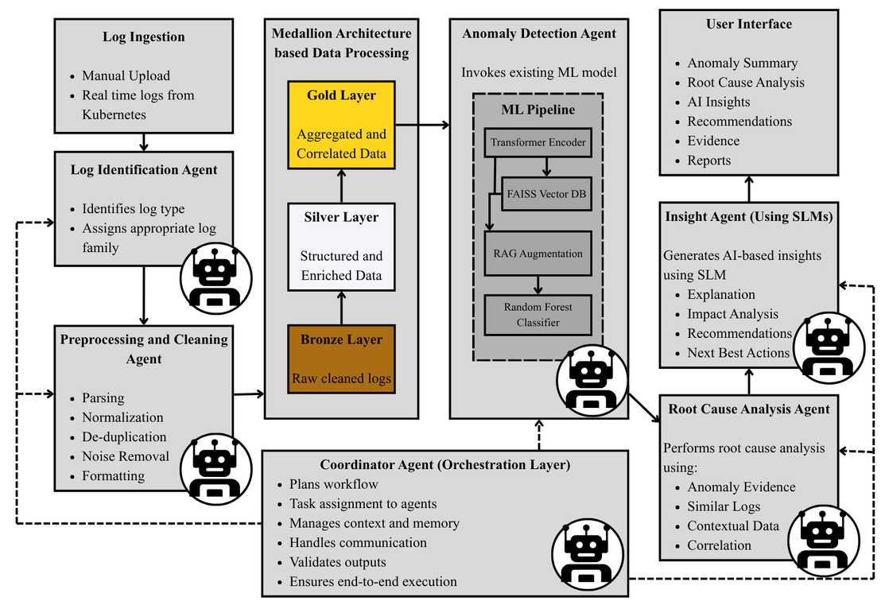
Architecture of the Proposed System
10

Slide 11
Architecture of the Proposed System
11
  Log Ingestion: The system initially accepts manually uploaded log files, with future support for real-time Kubernetes logs.
  Log Identification Agent: Identifies the incoming log type and assigns it to the appropriate log family/workflow.
  Preprocessing & Cleaning Agent: Performs parsing, normalization, de-duplication, noise removal, and formatting before analysis.
  Medallion-Based Data Processing: Organizes the processed logs into Bronze (raw cleaned logs), Silver (structured/enriched data), and Gold (aggregated/correlated data) layers.
  Anomaly Detection Agent: Invokes the existing ML pipeline consisting of Transformer embeddings → FAISS Vector DB → RAG augmentation → Random Forest classification to identify anomalies.
  Root Cause Analysis Agent: Uses anomaly evidence, similar logs, contextual data, and correlations to determine probable root causes.
  Insight Agent: Uses an SLM to generate explanations, impact analysis, recommendations, and next-best actions from the detected anomaly and RCA results.
  Coordinator Agent: Acts as the orchestration layer, managing workflow planning, task assignment, inter-agent communication, context/memory, output validation, and end-to-end execution.
  User Interface: Presents the final anomaly summary, RCA findings, AI-generated insights, recommendations, supporting evidence, and reports to the user.

Slide 12
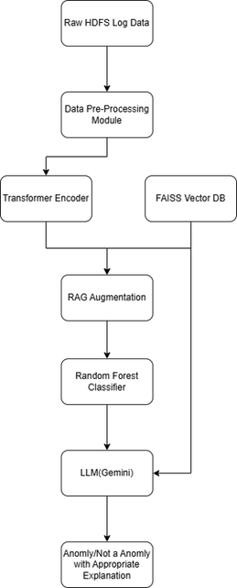
ML Pipeline - Project Phase I
12
Testing Architecture
•Data Ingestion: The workflow starts by collecting Raw HDFS Log Data.
•Preparation: The raw data is passed through a Data Pre-Processing Module to clean and format it for analysis.
•Encoding: The processed data is fed into a Transformer Encoder to create representations.
•Data Augmentation: The encoded output is merged with information retrieved from a FAISS Vector DB to perform RAG (Retrieval-Augmented Generation) Augmentation.
•Initial Classification: The augmented data is evaluated by a Random Forest Classifier.
•LLM Analysis: An LLM (Gemini) processes the output from the classifier, while also pulling direct contextual data from the FAISS Vector DB. Output is hence a explained prediction

Slide 13
Functionalities of the Proposed System
13
  Intelligent Log Classification – Input Agent identifies the log type and assigns it to the appropriate log family.
  Automated Preprocessing & Cleaning – Agents parse, normalize, clean, and prepare logs for analysis.
  Medallion-Based Data Processing – Organizes data through Bronze → Silver → Gold layers.
  AI-Based Anomaly Detection – Anomaly Detection Agent invokes the existing Transformer encoder + Embeddings + FAISS + RAG Augmentation + Random Forest Classifier.
  Automated Root Cause Analysis – RCA Agent analyzes anomalous events and relevant contextual evidence to identify probable causes.
  SLM-Based Insights – Insight Agent generates explanations, impact analysis, and actionable recommendations.
  Multi-Agent Orchestration – Coordinator Agent manages communication, context sharing, and execution between specialized agents.
  Manual-to-Live Data Ingestion – Initially supports manual log uploads, with future integration for real-time Kubernetes logs.
  Unified Incident View – Presents anomaly, RCA findings, evidence, and AI-generated insights through the application interface.
Core Functionality
Identify → Preprocess → Clean → Detect → Diagnose → Explain → Recommend → Orchestrate

Slide 14
Software/Tools Requirements
14
Software Tools
  Python – Core development and ML pipeline
  PyTorch / Scikit-learn – Deep learning and Random Forest models
  Sentence Transformers – Log embedding generation
  FAISS – Similarity search and retrieval
  LangGraph / LangChain – Multi-agent orchestration
  SLM / LLM – RCA, reasoning and AI-based insights
  Pandas & NumPy – Data preprocessing and cleaning
  Streamlit – User interface and visualization
  Git & GitHub – Version control and collaboration
  Kubernetes – Future real-time log ingestion and testing
System Requirements
  Processor: Intel i5 / AMD Ryzen 5 or higher
  RAM: Minimum 8 GB, 16 GB recommended
  Storage: Minimum 10 GB available
  GPU: NVIDIA GPU recommended for faster model inference; optional for initial development
  OS: Windows / Linux

Slide 15
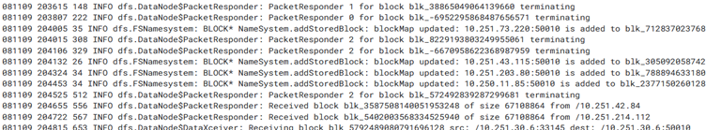
Dataset Description
15
Static Benchmark Dataset: HDFS (Hadoop Distributed File System)
Description & Scale: Standard academic benchmark dataset comprising over 11.17 million log records generated across 200+ Amazon EC2 nodes.
Ground Truth & Labeling: Features block-level trace IDs () labeled as normal execution sequences or anomalous system failures.
Role in Pipeline: Serves as the ground truth baseline to train the Transformer Encoder and Random Forest Classifier, as well as validate Log Identification and Preprocessing agents.

Slide 16
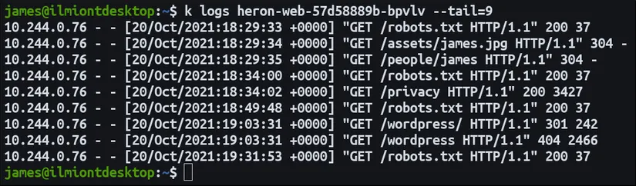
Dataset Description
16
Dynamic Real-Time Dataset: Kubernetes Cluster Logs
Deployment & Workloads: Multi-service containerized microservice architectures deployed across Kubernetes clusters.
Fault Injection & Anomaly Simulation: Controlled chaos engineering experiments (via Chaos Mesh / LitmusChaos) to inject realistic, real-time anomalies:
Resource Exhaustion: Memory leaks, CPU throttling, and thread exhaustion.
Network Faults: Packet corruption, dynamic latency spikes, and DNS resolution failures.
Lifecycle & State Errors: Pod crash loops, image pull errors, and failed volume mounts.
Log Family Diversity: Heterogeneous log types including application logs (JSON/plain text), ingress controller logs, and Kubernetes system events .

Slide 17
Timeline
17
Abstract Submission
    16th July, 2026
Literature Survey
    12th August, 2026
Design [Front End, Back End]
    20th September, 2026
Implementation
    5th October, 2026
Testing
    30th October, 2026
Document Submission
    15th November, 2026

Slide 18
Conclusion
18
Research Gaps Identified
  Lack of a complete end-to-end multi-agent log analysis workflow integrating preprocessing, anomaly detection, RCA, and insights.
  Limited dynamic orchestration of specialized agents and existing ML models across heterogeneous log families.
  Limited explainability and actionable insights, with weak integration between anomaly detection, RCA, and SLM-based reasoning.
  Limited support for heterogeneous and real-time logs, particularly Kubernetes-based environments.
Deliverables
  Multi-Agent Log Analysis Framework with specialized agents for log identification, preprocessing, anomaly detection, RCA, and insights.
  Integration of the existing ML pipeline — Transformer + Embeddings/FAISS + RAG + Random Forest — for anomaly detection.
  SLM-Based Insight Generation providing anomaly explanations, impact analysis, recommendations, and next-best actions.
  Coordinator Agent for dynamic workflow orchestration, communication, and context sharing.

Slide 19
References
19
[1] Belay MA, Haghipour A, Rasheed A, Salvo Rossi P. Agentic and LLM-Based Multimodal Anomaly Detection: Architectures, Challenges, and Prospects. Sensors (Basel). 2026 Apr 9;26(8):2330. doi: 10.3390/s26082330. PMID: 42076439; PMCID: PMC13119914.
[2] Lior Waknin, Yarin Yerushalmi Levi, Ron Solomon, Jaidip Kotak, Amit Giloni, Chiara Picardi, Roman Vainshtein, Yuval Elovici, and Asaf Shabtai. 2026. MAStitch: Unifying Local and Global Perspectives for Anomaly Detection in Multi-Agent Systems. In Proceedings of the 25th International Conference on Autonomous Agents and Multiagent Systems (AAMAS '26). International Foundation for Autonomous Agents and Multiagent Systems, Richland, SC, 1874–1882. https://doi.org/10.65109/BMJZ4532
[3] Tlili, S., Rahal, M. & Alghamdi, M. DAIMS: a distributed multi-agent framework for explainable anomaly detection in web services using machine learning and semantic reasoning. World Wide Web 29, 37 (2026). https://doi.org/10.1007/s11280-026-01425-8
[4] Anand, Lawal G. "Large Language Models and Agentic AI in Cloud Reliability and Incident Management: A Systematic Literature Review." (2026).
[5] Mudgal, Priyanka. "From Deep Learning to Agentic AI: A Survey of Log Data Analysis."
[6] Comuzzi, Marco, Suryeon Ra, Dariga Narmanova, Sangwoo Cho, Yeongik Hong, and Selim Jung. "Towards Agentic AI for Event Log Data Quality Assessment." In International Conference on Advanced Information Systems Engineering, pp. 405-422. Springer, Cham, 2026.
[7] Lee, Juyoung, Yeonsu Jeong, Taehyun Han, and Taejin Lee. 2025. "LogRESP-Agent: A Recursive AI Framework for Context-Aware Log Anomaly Detection and TTP Analysis" Applied Sciences 15, no. 13: 7237. https://doi.org/10.3390/app15137237
[8] Fu, F., Ding, H., Qin, Y. et al. Leveraging multi-agent framework for root cause analysis. Complex Intell. Syst. 12, 4 (2026). https://doi.org/10.1007/s40747-025-02096-0

Slide 20
References
20
[9] Tang, Pan, Shixiang Tang, Huanqi Pu, Zhiqing Miao, and Zhixing Wang. "MicroRCA-Agent: Microservice root cause analysis method based on large language model agents." arXiv preprint arXiv:2509.15635 (2025).
[10] Mylläri, Juha, Tatu Aalto, and Jukka K. Nurminen. "Ladle: a method for unsupervised anomaly detection across log types." Automated Software Engineering 32, no. 2 (2025): 34.
[11] Kim, Taeyoon, Woohyeok Park, Hoyeong Yun, and Kyungyong Lee. "Why do AI agents systematically fail at cloud root cause analysis?." arXiv preprint arXiv:2602.09937 (2026).
[12] Z. Liu and A. Anwar, "AutoBnB-RAG: Enhancing Multi-Agent Incident Response with Retrieval-Augmented Generation," arXiv:2508.13118, 2025, doi: 10.48550/arxiv.2508.13118.
[13] Kurniawan, K., Kiesling, E., & Ekelhart, A. (2024). CyKG-RAG: Towards knowledge-graph enhanced retrieval augmented generation for cybersecurity. CEUR Workshop Proceedings, 3950.
[14] Pan, J., Wong, S. L., & Yuan, Y. (2024). RAGLog: Log anomaly detection using retrieval-augmented generation. IEEE WFPST 2024.
[15] Briliyant, O., Javed, A., & Cherdantseva, Y. (2025). Enhancing cybersecurity log analysis through retrieval-augmented generation. IEEE FLLM 2025, 990–995

Slide 21
21
THANK YOU

