Slide 1

Scalable Data Processing and Analytics using Apache Spark
Mining of Massive Datasets (23CSE355), Assignment 2
Spark analysis of 1.39 million Lichess chess games
Team_No: [Team No]
Project Advisor: [Advisor Name]
Sl. No. | Reg. No. | Name of the student
1 | BL.EN.U4CSE23239 | Nikhil Sanjay
2 | BL.EN.U4CSE23246 | Ravva Siddhartha
3 | BL.EN.U4CSE23269 | Andrew Tom Mathew
Notes:
Good morning. We are presenting Assignment 2 for Mining of Massive Datasets. The topic is scalable data processing and analytics with Apache Spark. We used the Lichess open database of chess games, about 1.39 million rated games, and processed it with RDDs, DataFrames, Spark SQL and Spark Streaming.

Slide 2
Abstract
We built a scalable data processing pipeline in Apache Spark (PySpark 3.5.3) over 1,389,994 rated chess games from the Lichess open database, covering 31 December 2013 to 28 February 2014, 93.3 million moves and 36,666 players.
We parsed the raw PGN files into a flat table, loaded it as RDDs (map, filter, flatMap, reduceByKey), cleaned and analysed it with DataFrames and Spark SQL, chained both into one timed RDD to DataFrame workflow, and replayed 200,000 games as a live feed through Spark's micro-batch streaming engine.
The results show white scoring about 52.5%, an underdog win rate that falls from 44% for equal players to 10% for rating gaps over 400, and draws becoming more than twice as common between the 1000 and 2200 rating bands. Structured Streaming could not run on our Windows machine, so the streaming results come from the DStream API.
Notes:
Here is the whole project in one slide. We took about 1.39 million real chess games and processed them with every part of Spark the assignment asks for. The headline results are the small first-move advantage for white, the upset rates that follow the Elo model, and more draws among stronger players. We will also be upfront that the streaming part used the DStream API, and we explain why later.

Slide 3
Introduction
Assignment 1 asked us to look at a large dataset through the course concepts: how it would be stored, whether MapReduce style processing would suit it, and how it behaves as a stream. In Assignment 2 we actually run that processing in Apache Spark.
Our data is the Lichess open database of rated chess games for January and February 2014. One game is only a few hundred bytes, but there are 1,389,994 of them, and the questions we care about are counts, averages and group-bys. That is exactly the kind of work Spark splits across partitions.
We set up PySpark on a laptop, loaded the games as RDDs, cleaned and queried them with DataFrames and Spark SQL, chained both into one pipeline, and finally replayed 200,000 games as a live feed through Spark's micro-batch streaming engine.
Notes:
This assignment carries on from Assignment 1, where we only discussed the data conceptually. Here we actually ran the processing in Spark. Our dataset is chess games from Lichess, almost 1.4 million of them over two months. Each game is small, but the count is what makes it a big data problem. We covered all parts, from RDDs up to streaming.

Slide 4
Dataset Overview
Item | Details
Source | Lichess Open Database (database.lichess.org), standard rated games, CC0 licence
Period | 31 Dec 2013 to 28 Feb 2014, two monthly PGN files (111 MB and 113 MB compressed)
Records | 1,389,994 games (698k + 692k), merged and de-duplicated on game id
Attributes | 16 columns: game_id, white, black, result, white_elo, black_elo, white_diff, black_diff, eco, opening, time_control, termination, utc_date, utc_time, num_moves, moves
Type of data | Multi-dimensional records with one text field (the move list, 93.3M tokens) and an implicit player to player graph
Players | 36,666 distinct accounts
Streaming use | 200,000 games replayed as a feed in bursts of 10,000 (requirement was 10k)
Notes:
Here is the dataset in one table. The raw files are PGN, which is a multi-line text format, so we first converted them to a CSV with one row per game and 16 columns. After merging the two months we have 1,389,994 games from 36,666 players. The move list column is basically a text document per game, which we use later for a word count.

Slide 5
Spark Architecture
Driver Program
SparkSession / SparkContext
builds the DAG, schedules tasks
1. request resources
Cluster Manager
local scheduler in our runs
(YARN / Kubernetes / Standalone)
3. send tasks
2. launch executors
Executor 1
tasks + cached partitions
Executor 2
tasks + cached partitions
Executor n
tasks + cached partitions
Storage: lichess_games.csv (local disk here; HDFS or S3 on a cluster)
In our setup everything runs inside one JVM on a laptop (local[*]): the driver and executors are threads and the cluster manager is Spark's built-in local scheduler. The same code would run on a real cluster unchanged.
Notes:
This is the standard Spark architecture. The driver holds our SparkSession, turns our code into a DAG and splits it into tasks. It asks the cluster manager for resources, the cluster manager starts executors, and the executors run the tasks on partitions of the data and cache them in memory. In our case all of this was inside one JVM on a laptop in local mode, but the code is the same as on a cluster.

Slide 6
Application Workflow and Environment
Environment we used
Python 3.11, PySpark 3.5.3, OpenJDK 17 on Windows 11
Local mode, local[*] on 24 logical cores
spark.driver.memory = 6g, spark.sql.shuffle.partitions = 16
The CSV was read as 24 partitions
APIs used
RDD API for loading and parsing (Part B)
DataFrames and Spark SQL with the Catalyst optimiser (Parts C, D)
Spark Streaming micro-batches (Part E)
Action
count(), takeOrdered(), collect()
Job
one per action
Stages
split at shuffles (reduceByKey, groupBy)
Tasks
one per partition, 24 in our runs
Our Part D pipeline triggered 7 jobs in total.
Notes:
On the left is our setup: PySpark 3.5.3 with Java 17, running in local mode with all 24 cores and 6 GB for the driver. On the right is how a Spark application actually runs. Transformations like map and filter are lazy. Only when we call an action, like count, does Spark start a job. The job is cut into stages wherever data has to be shuffled, and each stage runs one task per partition.

Slide 7
RDD Creation, filter() and map()
We created the RDD with sc.textFile and asked for 24 partitions. filter() drops the header line and map() turns each line into a list of 16 fields. We used Python's csv module instead of split(",") because some opening names contain commas.
part_b_rdd.py
lines = sc.textFile(DATA, minPartitions=24)
out["num_partitions"] = lines.getNumPartitions()
out["total_lines_incl_header"] = lines.count()
# map(): parse each CSV line into a list of fields
rows = (lines.filter(lambda l: not l.startswith(HEADER_PREFIX))
.map(lambda l: next(csv.reader([l]))))
rows.cache()
out["num_games"] = rows.count()
output: results/part_b_rdd.json
{
"num_partitions": 24,
"total_lines_incl_header":
1389995,
"num_games": 1389994,
...
}
We cache the parsed RDD because six more analyses reuse it.
Notes:
This is where the RDD is created. textFile reads the CSV into 24 partitions. Then filter removes the header and map parses every line into its 16 fields. We got 1,389,995 lines, which is 1,389,994 games plus the header. We cached the parsed RDD because all the next analyses reuse it.

Slide 8
flatMap() and reduceByKey()
For transaction data the usual example is product frequency. For chess the same idea is opening frequency: map every game to (opening, 1) and let reduceByKey add them up. flatMap splits each move list into tokens, which gives a word count over 93,334,516 moves.
part_b_rdd.py
opening_freq = (rows.map(lambda r: (r[9], 1))
.reduceByKey(lambda a, b: a + b))
top = opening_freq.takeOrdered(15, key=lambda kv: -kv[1])
# word count over the move text
move_freq = (rows.flatMap(lambda r: r[15].split())
.map(lambda m: (m.rstrip("+#"), 1))
.reduceByKey(lambda a, b: a + b))
Opening (2,636 distinct) | Games
Van't Kruijs Opening | 41,190
Horwitz Defense | 27,499
Modern Defense | 27,203
Owen Defense | 23,675
Scandinavian: Mieses-Kotroc | 22,997
Top move tokens: O-O 1,707,127, Nf3 1,349,797, e4 1,299,386, d4 1,218,674.
Notes:
Our version of the product frequency example is opening frequency. Each game becomes a pair of opening and 1, and reduceByKey sums them. The Van't Kruijs Opening, which is just 1.e3, is the most common with 41,190 games. We also used flatMap to split the move text into words, so this is a word count over 93 million moves. Castling is the single most common move.

Slide 9
More RDD Analyses
We used filter() to keep only decisive games with a rating gap of 300 or more. In 165,249 such games the lower-rated player still won 23,018 times, which is 13.9%.
Analysis | RDD operations | Output
First move | filter, map, reduceByKey | e4 823,698 (59.3%), d4 334,633 (24.1%), e3 46,150
Most active players | flatMap (both colours), reduceByKey | ZMAJ 5,697, ribarisah 5,438, 147a 4,380 (36,666 players)
Results | map, reduceByKey, collectAsMap | 1-0: 707,167 (50.9%), 0-1: 638,037 (45.9%), draw: 44,790 (3.2%)
Termination | map, reduceByKey, collectAsMap | Normal 931,572, Time forfeit 458,266, Rules infraction 156
Upsets, gap of 300+ | map, filter, count | 165,249 games, underdog won 23,018 (13.9%)
1.e4 is played about 2.5 times as often as 1.d4, and white wins 5 points more often than black.
Notes:
These are the other RDD jobs we ran on the same cached RDD. flatMap was useful for players, because each game emits two records, one for white and one for black. White wins 50.9 percent of games against 45.9 percent for black, so the first move advantage is real. And with filter we found that even with a 300 point rating gap, the weaker player wins about one game in seven.

Slide 10
DataFrame Creation and Cleaning
We gave spark.read.csv an explicit schema with 16 string columns, then cast the numeric and time columns and removed bad rows. The cleaning removed 4,585 rows, only 0.33% of the data.
part_c_dataframe.py
schema = StructType([StructField(n, StringType(), True) for n in [
"game_id", "white", "black", "result", ..., "moves"]])
raw = spark.read.csv(DATA, header=True, schema=schema,
quote='"', escape='"')
clean = (df.dropna(subset=["white_elo", "black_elo",
"ts", "base", "inc"])
.filter(F.col("result").isin("1-0", "0-1", "1/2-1/2"))
.filter(F.col("num_moves") > 0)
.filter(F.col("white_elo").between(600, 3000)
& F.col("black_elo").between(600, 3000))
.dropDuplicates(["game_id"]))
Step | Rows
Raw rows | 1,389,994
Missing white_elo | 105
Missing black_elo | 108
No time control | 4,391
Clean rows | 1,385,409
Removed | 4,585
The 4,391 rows without a clock are correspondence games (time control "-").
Notes:
For DataFrames we defined the schema ourselves instead of letting Spark infer it, which avoids an extra pass over the data. Then we cast the ratings and move counts to integers and dropped rows with missing ratings, illegal results, zero moves or ratings outside 600 to 3000. Most of the removed rows were correspondence games that have no clock. We also added derived columns like the time control category, a 200 point rating band, day and hour.

Slide 11
groupBy, Aggregation and Sorting
We grouped the clean games by time-control category. The category comes from the estimated length, base + 40 × increment seconds: Bullet under 180, Blitz under 480, Rapid under 1500, otherwise Classical.
part_c_dataframe.py
by_cat = (clean.groupBy("category")
.agg(F.count("*").alias("games"), F.round(F.avg("avg_elo"), 1).alias("avg_rating"),
F.round(F.avg("plies"), 1).alias("avg_plies"),
F.round(F.avg("white_score"), 4).alias("white_score"))
.orderBy(F.desc("games")))
Category | Games | Avg rating | Avg plies | White score
Blitz | 525,324 | 1615.5 | 69.9 | 0.528
Rapid | 450,210 | 1571.2 | 67.0 | 0.524
Bullet | 372,522 | 1672.7 | 64.2 | 0.522
Classical | 37,353 | 1492.8 | 61.5 | 0.523
Blitz is the most played category.
Bullet players have the highest average rating (1672.7) but play the shortest games.
Notes:
This is the DataFrame API doing groupBy, aggregation and sorting in one chain. Blitz is the most popular with 525 thousand games. Interestingly bullet players are the strongest on average but their games are the shortest. White's score is between 52 and 53 percent in every category.

Slide 12
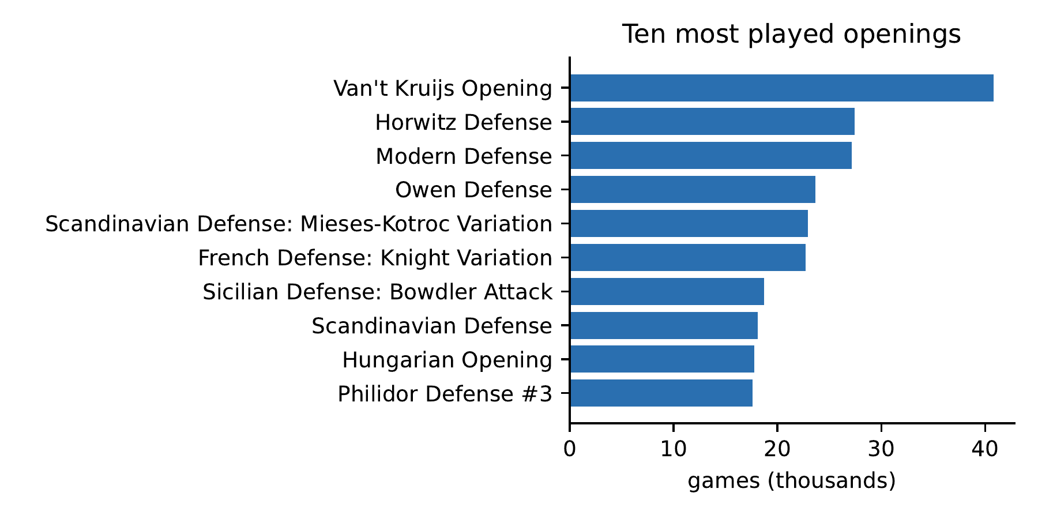
Top Openings and Most Active Players
Our 'top products' query is the most played openings, and 'top customers' is the most active players. Both use groupBy, count and orderBy on the clean DataFrame.
Player | Games | Score | Avg rating
ZMAJ | 5,697 | 0.485 | 1919
ribarisah | 5,438 | 0.505 | 2034
147a | 4,380 | 0.391 | 1979
speedyG | 4,338 | 0.559 | 1899
amir51 | 3,948 | 0.467 | 1839
One account, houdjini, scores 85.5% over 3,594 games at an average rating of 2231.
Notes:
On the left are the ten most played openings after cleaning. The counts are slightly lower than the RDD version, for example 40,808 instead of 41,190 for Van't Kruijs, because these are after cleaning. On the right are the most active players. ZMAJ alone played 5,697 games in two months. One player, houdjini, wins 85 percent of games, which stands out.

Slide 13
Spark SQL: Results by Rating Band
We registered the clean DataFrame as a temporary view called games and wrote the remaining queries in SQL. This one groups games by the average rating of the two players.
part_c_dataframe.py
spark.sql("""
SELECT elo_band, COUNT(*) AS games,
ROUND(AVG(white_score), 4) AS white_score,
ROUND(AVG(CASE WHEN result = '1/2-1/2'
THEN 1.0 ELSE 0.0 END), 4) AS draw_rate,
ROUND(AVG(plies), 1) AS avg_plies
FROM games GROUP BY elo_band ORDER BY elo_band""")
Band | Games | Draw rate | Avg plies
1000 | 24,333 | 2.8% | 50.7
1200 | 183,385 | 2.6% | 58.3
1400 | 461,779 | 2.7% | 64.3
1600 | 464,907 | 3.5% | 70.8
1800 | 201,868 | 4.2% | 73.6
2000 | 43,473 | 4.4% | 75.3
2200 | 4,398 | 6.3% | 83.6
Stronger players play longer games and draw more than twice as often (2.8% at 1000 against 6.3% at 2200).
Notes:
Here we switched to Spark SQL on a temporary view. The query groups games into 200 point rating bands. As the rating goes up, games get longer, from about 51 to 84 half moves, and draws become more common. We left out the bands with fewer than 1,000 games so the numbers are not noisy.

Slide 14
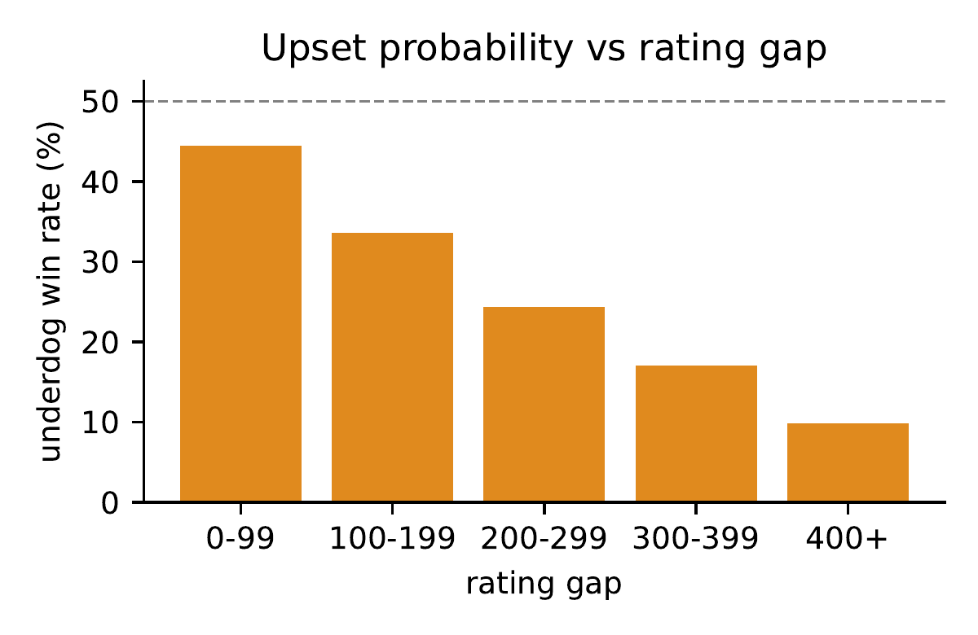
Spark SQL: Upsets and How Games End
The first query asks how often the lower-rated player wins a decisive game. The second uses a window function, SUM(COUNT(*)) OVER (PARTITION BY category), to get the share of each ending.
Category | Normal | Time forfeit | Rules infr.
Bullet | 42.7% | 57.3% | 0.01%
Blitz | 68.8% | 31.2% | 0.01%
Rapid | 83.3% | 16.7% | 0.02%
Classical | 84.6% | 15.3% | 0.07%
The underdog win rate falls from 44.4% (gap under 100) to 9.9% (gap over 400), as the Elo model predicts.
In bullet, more games are lost on the clock than finished normally.
Notes:
The chart on the left is the upset query. With almost equal ratings the weaker player still wins 44 percent of decisive games, and with a 400 point gap it drops to about 10 percent. That is what the Elo rating model predicts, so it is a good sanity check of our pipeline. The table shows how games end. In bullet 57 percent of games end on time, compared to around 16 percent in rapid and classical.

Slide 15
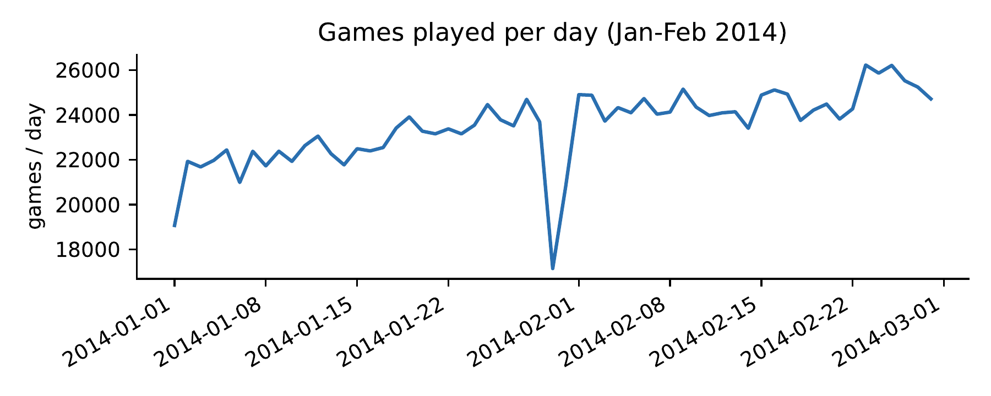
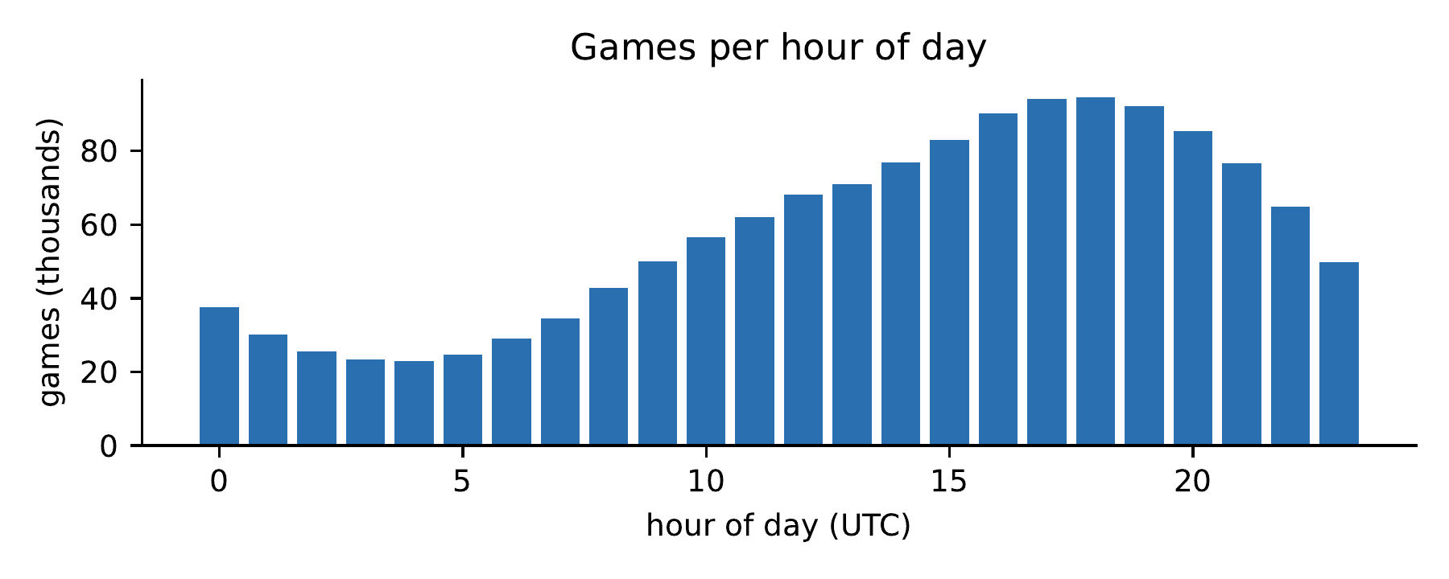
Daily and Hourly Trends
For the trend query we grouped by day and by hour of day (UTC). Traffic peaks at 18:00 with 94,447 games and is lowest at 04:00 with 22,998, about a 4 times swing.
Apart from 30 January (17,146), every full day had between 19,070 and 26,226 games.
Weekends are only slightly busier than weekdays.
Notes:
This is the monthly trend part of the assignment. The daily count is fairly flat, between about 19 and 26 thousand games a day, with a slow rise into February. The hourly chart is much more interesting. Activity is highest around 6 pm UTC and lowest around 4 am. A platform could use this to plan server capacity.

Slide 16
End-to-End Analytics Workflow
part_d_pipeline.py chains the two APIs in the order the assignment asks for. We timed every stage on the same laptop.
Input Data
lichess_games.csv
1,389,994 rows
count: 14.3 s
RDD Processing
textFile, filter,
map(parse + validate)
cache: 27.8 s
DataFrame
createDataFrame
with schema, cache
2.6 s + 15.5 s
Analytical Output
groupBy, agg,
orderBy, to CSV
3.0 s
1,385,456 rows survive RDD validation (4,538 dropped), 24 partitions, 7 Spark jobs in total.
Pipeline output: category, opening (500+ games) | Games | White score | Avg rating
Blitz, Barnes Defense | 583 | 0.851 | 1328.2
Bullet, King's Knight Opening | 554 | 0.734 | 1479.8
Rapid, Russian Game: Damiano Variation | 597 | 0.717 | 1446.6
Notes:
This is the Part D workflow: input, RDD processing, DataFrame processing and the analytical output. The RDD stage was the slowest at 27.8 seconds because the parsing runs in Python row by row. Once the data was a DataFrame, the final aggregation over 1.39 million rows took only 3 seconds, since it runs in the JVM with Catalyst. The output is the openings with the best score for white in each time control, and these are mostly played at lower ratings.

Slide 17
Streaming: Source and Processing
To simulate a live feed, a producer thread listens on localhost:9999 and pushes a burst of 10,000 tab-separated games every 3 seconds, 20 bursts in total (200,000 games). Spark cuts the feed into 3-second micro-batches. For every batch we count the records and the wins, draws and mean rating, keep running totals per termination type, and keep a sliding 9-second window count.
part_e_streaming.py
ssc = StreamingContext(sc, INTERVAL) # 3-second micro-batches
events = (ssc.socketTextStream(HOST, PORT)
.filter(lambda l: l.count("\t") >= 11).map(parse))
events.foreachRDD(per_batch) # count + summary per batch
(events.map(lambda r: (r[1], 1))
.reduceByKeyAndWindow(add, None, 3 * INTERVAL, INTERVAL)
.foreachRDD(per_window)) # 9 s sliding window
We also wrote a Structured Streaming version (readStream + foreachBatch), but it could not run on our Windows machine, so these results come from the DStream API.
Notes:
For streaming we needed a source, so we wrote a small producer that sends 10,000 games every 3 seconds over a socket. Spark reads the socket and forms a micro-batch every 3 seconds. For each batch we count the records and summarise results, keep running totals, and also compute a 9 second sliding window. We have to be honest that the Structured Streaming script did not run on Windows, which we explain in the challenges slide.

Slide 18
Streaming: Batch Output
This is the console output of our run. Each BATCH line is one micro-batch with its record count and summary; the running totals grow batch by batch.
results/part_e_run.log (excerpt)
[producer] sent burst 0 (10000 games)
[producer] sent burst 1 (10000 games)
[producer] sent burst 2 (10000 games)
[producer] sent burst 3 (10000 games)
BATCH {'batch_id': 1, 'time': '21:30:48', 'records': 10000, 'white_wins': 5199, 'black_wins': 4482,
'draws': 319, 'avg_rating': 1628.0} | running: {'Time forfeit': 3448, 'Normal': 6552}
[producer] sent burst 4 (10000 games)
[producer] sent burst 5 (10000 games)
WINDOW(9s) {'Normal': 6552, 'Time forfeit': 3448}
[producer] sent burst 6 (10000 games)
BATCH {'batch_id': 2, 'time': '21:30:58', 'records': 10000, 'white_wins': 5072, 'black_wins': 4599,
'draws': 329, 'avg_rating': 1628.5} | running: {'Time forfeit': 6418, 'Normal': 13582}
...
BATCH {'batch_id': 19, 'time': '21:33:52', 'records': 10000, 'white_wins': 5132, 'black_wins': 4585,
'draws': 283, 'avg_rating': 1615.1} | running: {'Time forfeit': 64968, 'Normal': 134978, 'Rules infraction': 54}
Notes:
Here is the actual console output from our streaming run. You can see the producer sending bursts and Spark printing one BATCH line per micro-batch, with the count of records, wins, draws and the average rating. The running totals at the end of each line keep growing. By the last batch the totals are 134,978 normal endings, 64,968 time forfeits and 54 rule infractions, which adds up to all 200,000 games.

Slide 19
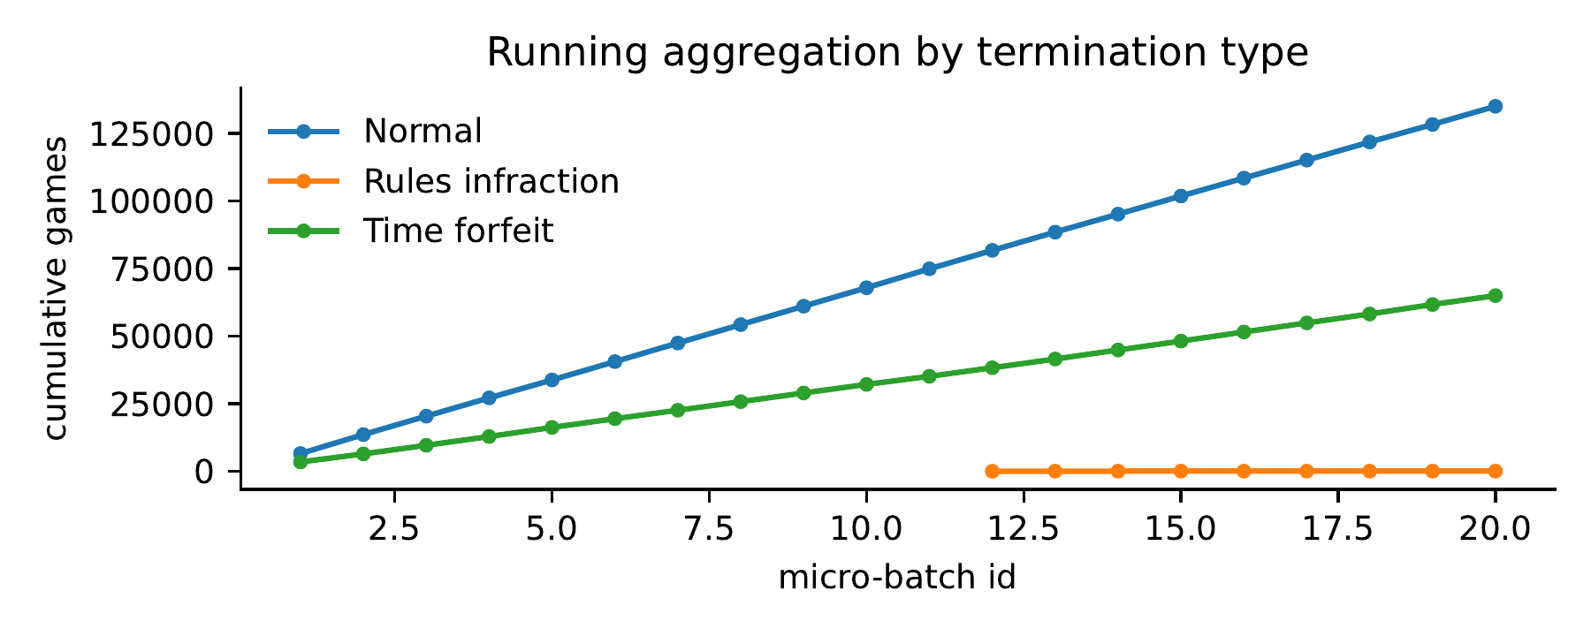
Streaming: Results
Batch | Records | White | Black | Draws
1 | 10,000 | 5,199 | 4,482 | 319
2 | 10,000 | 5,072 | 4,599 | 329
9 | 10,000 | 5,169 | 4,536 | 295
18 | 20,000 | 10,222 | 9,210 | 568
19 | 10,000 | 5,132 | 4,585 | 283
All 200,000 records were processed in 19 non-empty batches and none were lost.
The running mix settles at 67.5% Normal and 32.5% Time forfeit, very close to 67.0% and 33.0% on the full 1.39M games.
Batches finished about 10 s apart instead of 3 s. Processing was slower than the interval on local[4], so bursts queued up and batch 18 got two of them (20,000 records).
Notes:
The chart shows the running totals per termination type after each batch, and the table shows a few of the batches. Every batch had 10,000 records except batch 18, which got two bursts because our processing was slower than the 3 second interval. That is back-pressure, and more executors would fix it. The nice thing is that the stream sample gives almost the same termination split as the full dataset.

Slide 20
Results and Observations
White has a small but real edge: 50.9% wins for white against 45.9% for black over 1,389,994 games.
Time control changes how games end. 57.3% of bullet games are lost on time, but only 16.7% of rapid games.
Stronger players blunder less: games grow from 50.7 to 83.6 plies and draws from 2.8% to 6.3% between the 1000 and 2200 bands.
Upset rates fall from 44.4% to 9.9% as the rating gap grows, which matches the Elo model.
Only 0.33% of the rows needed cleaning.
On the same machine the RDD parsing stage took 27.8 s while the DataFrame aggregation took 3.0 s. Python lambdas run row by row; DataFrame plans run in the JVM.
A 200,000-game stream gave almost the same termination mix as the full data.
Notes:
To sum up the results. White wins about 5 points more often than black. The time control decides how games end, with bullet games mostly lost on the clock. Higher rated players play longer games and draw more, and the upset rates follow the Elo model, which also tells us our pipeline is correct. On the Spark side, DataFrames were clearly faster than our Python RDD code for the same amount of data.

Slide 21
Challenges Faced
1. PGN is not one record per line. Spark cannot split it, so we wrote parse_pgn.py to stream the compressed .zst file and write one CSV row per game.
2. Commas inside opening names. A plain split(",") broke rows like "King's Gambit Accepted, King's Knight Gambit", so we parse with the csv module inside map().
3. Structured Streaming on Windows. Its checkpoints need Hadoop's winutils.exe and hadoop.dll. We built a small winutils stand-in, but hadoop.dll was still missing, so we ran the DStream version and kept the Structured Streaming script for Linux, WSL or Docker.
4. first() crashed the Python worker on Windows. We skip the header with a filter on the "game_id," prefix instead.
5. Back-pressure in the stream. With one of four threads used by the receiver, batches took about 10 s instead of 3 s.
Notes:
These are the main problems we ran into. The biggest one was Structured Streaming. It needs Hadoop native libraries on Windows for checkpointing, and we could only fake one of the two files. So we used the older DStream API, which works on the same micro-batch idea. Smaller issues were parsing PGN files, commas inside opening names, and a Windows crash when calling first().

Slide 22
Conclusion and Future Scope
Conclusion
We built and ran a full Spark pipeline over 1.39 million real chess games: RDD transformations and actions, DataFrame cleaning and Spark SQL, a timed RDD to DataFrame workflow, and a 200,000-record micro-batch stream. The analysis found known chess patterns from the data alone, which also tells us the pipeline works.
Future scope
Run the Structured Streaming script on Linux or Docker and compare it with the DStream results.
Run on a multi-node cluster to measure the actual speed-up; so far we only used local mode.
For the end-semester project, add more months of data and build on the clean DataFrame, for example with Spark MLlib.
Notes:
In conclusion, we covered every part of the assignment on real data. The results match what chess players already know, which gives us confidence in the pipeline. The two open items are running Structured Streaming on a platform that supports it and testing on a real cluster. For the end-semester project we would like to extend this with more data and some MLlib work.

Slide 23
References
[1] Lichess.org Open Database. https://database.lichess.org (CC0).
[2] M. Zaharia et al., "Resilient Distributed Datasets: A Fault-Tolerant Abstraction for In-Memory Cluster Computing," NSDI, 2012.
[3] M. Armbrust et al., "Spark SQL: Relational Data Processing in Spark," SIGMOD, 2015.
[4] M. Armbrust et al., "Structured Streaming: A Declarative API for Real-Time Applications in Apache Spark," SIGMOD, 2018.
[5] M. Zaharia et al., "Discretized Streams: Fault-Tolerant Streaming Computation at Scale," SOSP, 2013.
[6] J. Dean and S. Ghemawat, "MapReduce: Simplified Data Processing on Large Clusters," OSDI, 2004.
[7] A. Elo, The Rating of Chessplayers, Past and Present. Arco, 1978.
[8] Apache Spark documentation, version 3.5. https://spark.apache.org/docs/3.5.3/
Notes:
These are the references we used. The dataset is from the Lichess open database. The Spark papers cover RDDs, Spark SQL, Structured Streaming and the DStream model we ended up using. The Elo reference is for the rating model we compared our upset results against.

Slide 24
THANK YOU
Notes:
Thank you for listening. We are happy to take any questions, and we can show the code or the output files if needed.

