Slide 1
Simple Compiler for Arithmetic Operations using LLVM
23CSE314 Compiler Design
Team_No: 2
Project Advisor:
Ms. Neera Chaudhary
Asst. Prof. (OC), CSE Dept.
Ms. Kavitha C.R.
Asst. Prof.(Sr.Gr.) CSE Dept.
S.No | Reg.No | Name of the Student | Section
1 | BL.EN.U4CSE23239 | Nikhil Sanjay | CSE C
2 | BL.EN.U4CSE23263 | Kandrakunta Amith | CSE C
3 | BL.EN.U4CSE23269 | Andrew Tom Mathew | CSE C

Slide 2
Problem Definition
To design and implement a simple compiler that supports variable assignment, arithmetic operations, and print statements, and translates them into LLVM IR for execution.

Slide 3
Literature Survey
S.No | Author Name(s) | Full Title of the Paper with Year | Inference from the Paper (Methodology/Technology) | Open Problem (for your proposed work)
1 | Zhao et al. | Formalizing the LLVM Intermediate Representation for Verified Program Transformations (2012) | Introduces formal semantics for LLVM IR, enabling correctness verification of compiler transformations and improving reliability of optimization passes | Need for lightweight and scalable formal verification techniques suitable for small-level compilers
2 | Liu et al. | Efficient Compiler Optimization by Modeling Passes Dependence (2024) | Proposes modeling dependencies between optimization passes to improve efficiency and effectiveness of compiler optimizations | Lack of automated pass selection strategies for domain-specific or simplified programming languages
3 | A. Nötzli and F. Brown | LifeJacket: verifying precise floating-point optimizations in LLVM(2016) | Proposes using SMT solvers to automate verification of precise floating-point peephole optimizations in LLVM. | Supports only a subset of IEEE-754 features: it omits vector types and 80/128-bit floats, assumes a fixed (round-to-nearest-even) rounding mode, and does not model exceptions or imprecise transforms

Slide 4
Literature Survey
S.No | Author Name(s) | Full Title of the Paper with Year | Inference from the Paper (Methodology/Technology) | Open Problem (for your proposed work)
4 | Hashimoto & Ishiura | Detecting Arithmetic Optimization Opportunities for C Compilers by Randomly Generated Equivalent Programs (2016) | Uses random program generation to identify optimization opportunities in arithmetic expressions | No direct mechanism to incorporate such optimization detection into beginner-level compiler systems
5 | Ziyodov | Arithmetic Expression Compiler using Python and LLVM (2025) | Demonstrates LLVM-based backend for compiling arithmetic expressions with a simple pipeline | Limited support for full programming constructs like control flow, variables scope, and error handling
6 | Lopes & Regehr | Alive2: Bounded Translation Validation for LLVM (2021) | Provides translation validation tool to verify correctness of LLVM optimizations | High complexity makes it difficult to integrate into lightweight or student-level compilers

Slide 5
Literature Survey
7 | Lammich | Refinement of Parallel Algorithms Down to LLVM (2024) | Shows transformation of high-level parallel algorithms into efficient LLVM IR | Focus is on parallel algorithms; lacks applicability for simple sequential compiler design
8 | Zou | A Code Generator for Energy-Efficient Wavefront Parallelization (2018) | Proposes LLVM-based code generation for energy-efficient parallel computations | Not suitable for basic arithmetic compilers or educational compiler frameworks
9 | Kang et al. | Crellvm: Verified Credible Compilation for LLVM (2018) | Introduces verified compilation ensuring correctness between source and target code | High overhead and complexity unsuitable for small compiler implementations
10 | Huang et al. | Embedding Recursive Fork-Join Parallelism into LLVM’s IR (2019) | Extends LLVM IR to support parallel constructs like fork-join models | Does not address simple sequential language compilation or beginner-friendly compiler design

Slide 6
Software/Tools Requirements
Front End S/W: Flex (lexical analyzer), Bison (parser), C language implementation
Back End S/W: LLVM (IR generation), llc, clang, shell scripting for build/run
H/W Requirements: Intel i3 / AMD equivalent, minimum 4 GB RAM, minimum 10 GB free storage
OS: Ubuntu / Windows 11

Slide 7
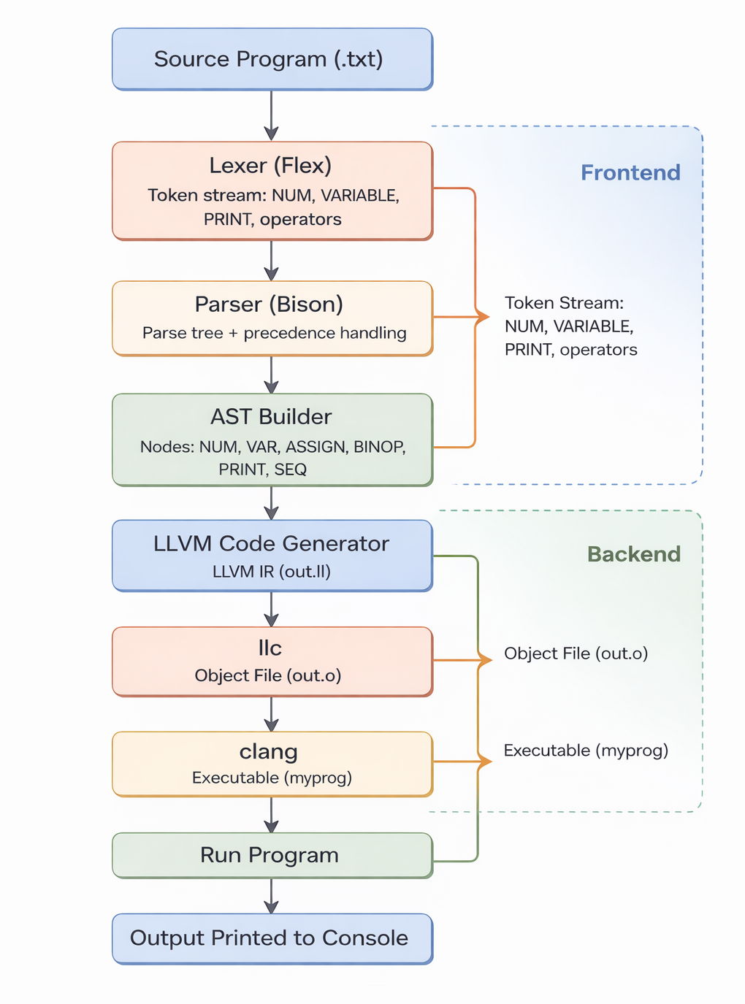
Architecture / Design

Slide 8
Data Set
Source of dataset: Self-created input programs (no external dataset required)
Sample dataset:
x = 10;
y = 32;
x = x + y;
print x;
Justification: Compiler validation requires controlled test programs that cover tokenization, grammar correctness, precedence, variable assignment, and output behavior.

Slide 9
Implementation
Implemented lexer rules for numbers, identifiers, keywords (print), operators, delimiters.
Implemented parser grammar for statements and expressions.
Enforced precedence and associativity (*,/ higher than +,-).
Built AST during parsing to represent program structure.
Supported statement list sequencing for multi-line programs.

Slide 10
Implementation
Implemented LLVM IR generation by traversing AST.
Added symbol table for variable allocation/loading/storing.
Generated IR for arithmetic operations: add, sub, mul, div.
Linked print statements to printf in generated IR.
Output IR written to out.ll, then compiled to native executable.

Slide 11
Testing
TC1: x = 42; print x; -> Output: 42
TC2: x = 1 + 5 * 27; print x; -> Output: 136
TC3: x = (1 + 5) * 27; print x; -> Output: 162
TC4: x = 10; y = 32; x = x + y; print x; -> Output: 42
TC5: Invalid token input -> Lexer/Parser reports error behavior
Validation focus: correctness of precedence, assignment, and printing

Slide 12
Result and Analysis
Successfully compiles simple arithmetic programs to LLVM IR.
Correctly handles operator precedence and parentheses.
Supports multiple assignments and variable reuse.
Produces runnable native binary via llc + clang.
Current scope is intentionally minimal and suitable for compiler fundamentals learning.

Slide 13
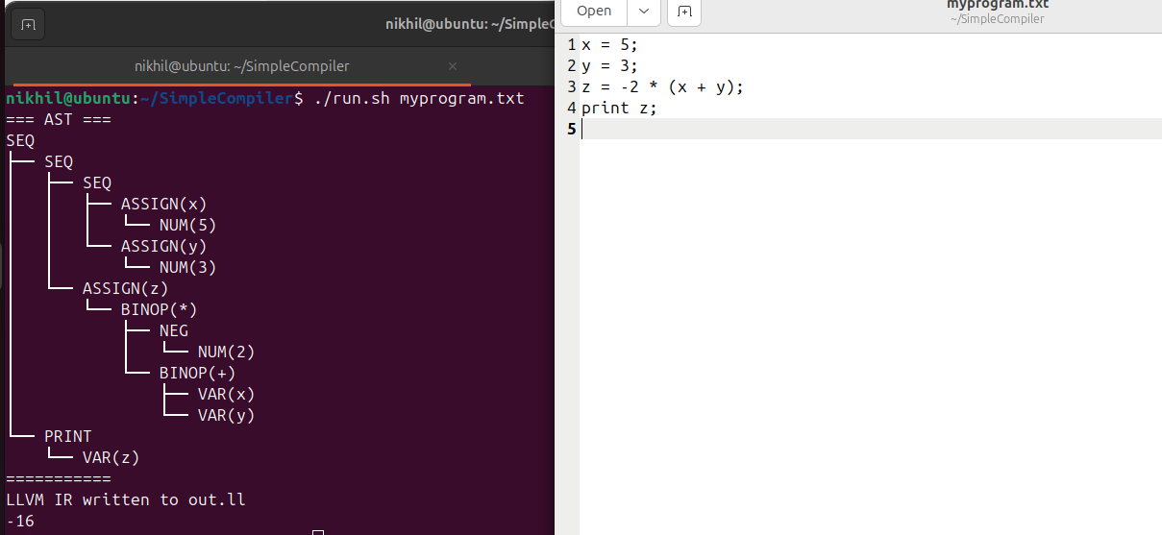
Demonstration
Simple Implementation for a basic program variable assignment using brackets and negative numbers

Slide 14
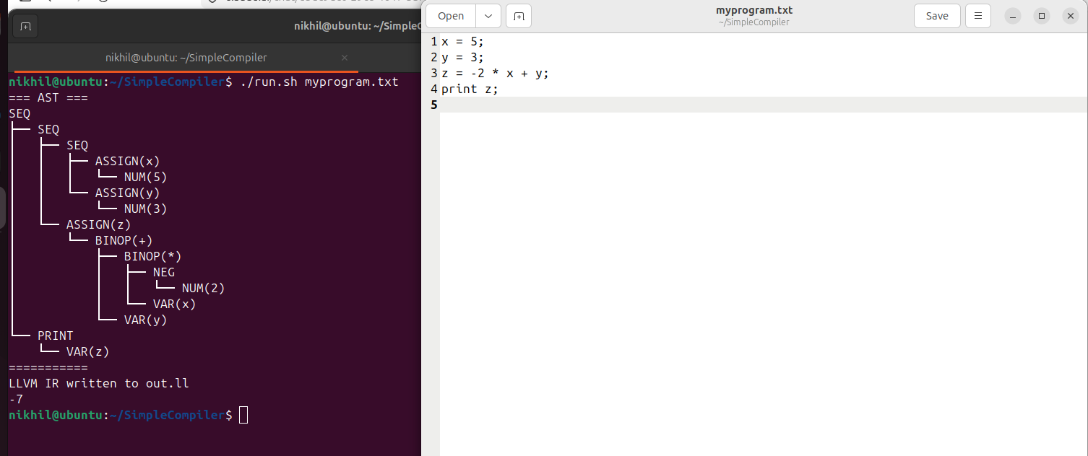
Demonstration
Simple Implementation for a basic program using multiple variables
Simple Implementation for a basic program using multiple variables and slightly complex operations

Slide 15
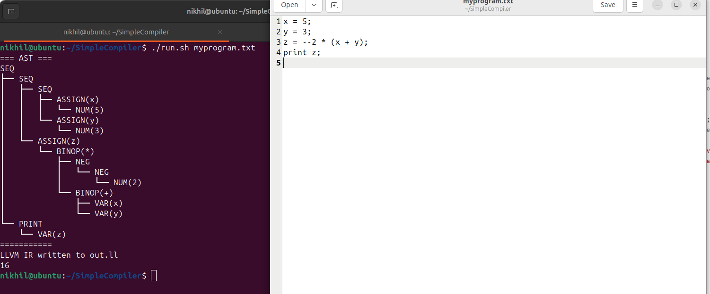
Demonstration
Simple Implementation for a basic program with 2 operators such as (--)

Slide 16
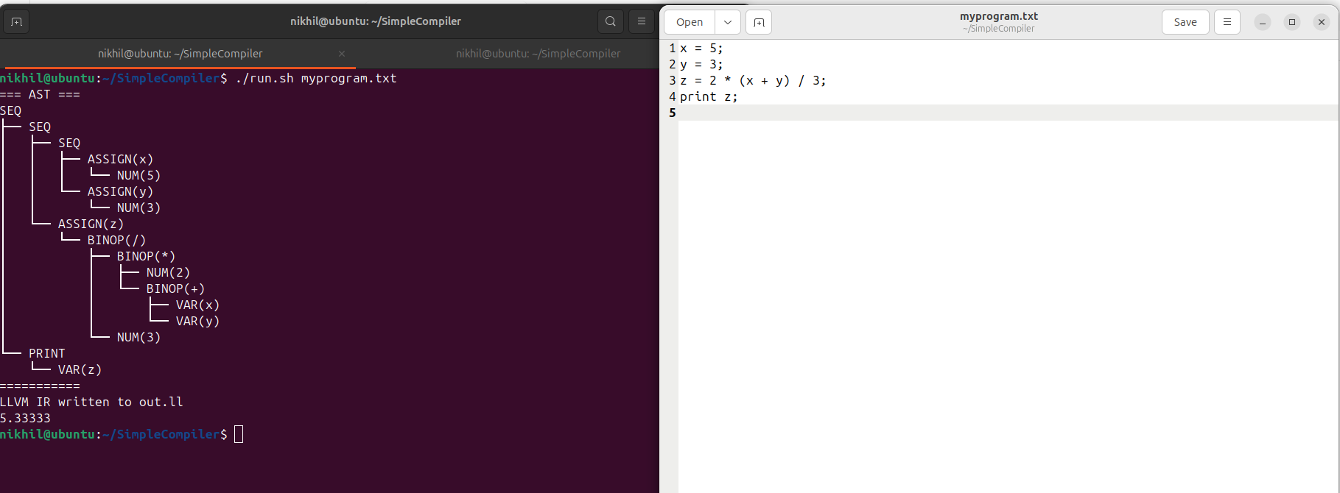
Demonstration
Floating point numbers showcase

Slide 17
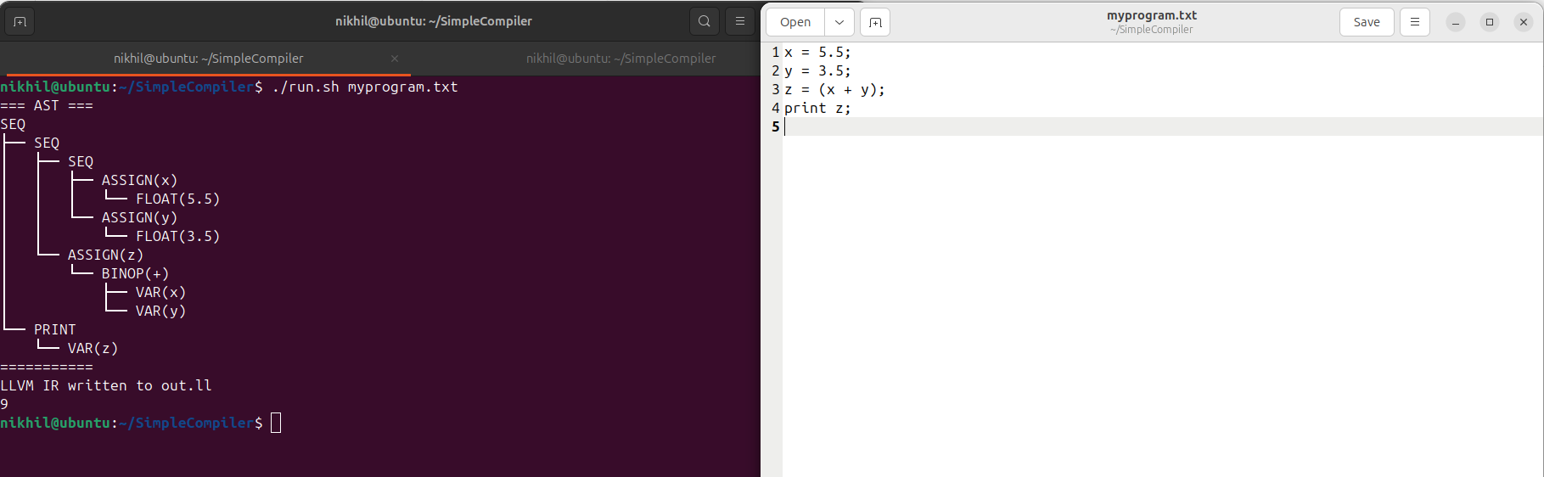
Demonstration
Type conversion of 2 floats to a integer

Slide 18
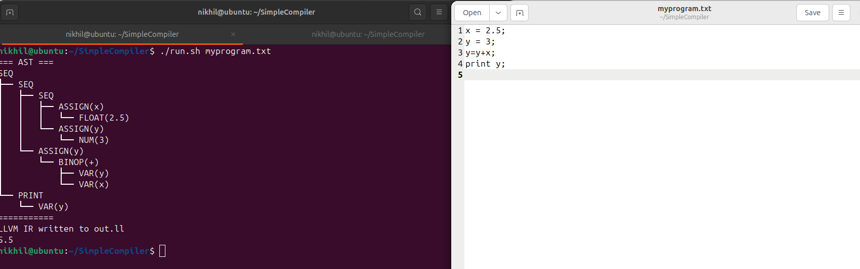
Demonstration
Type conversion a variable from integer to float

Slide 19
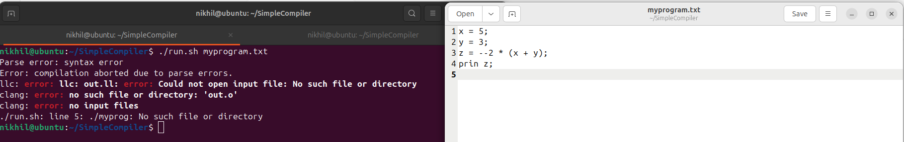
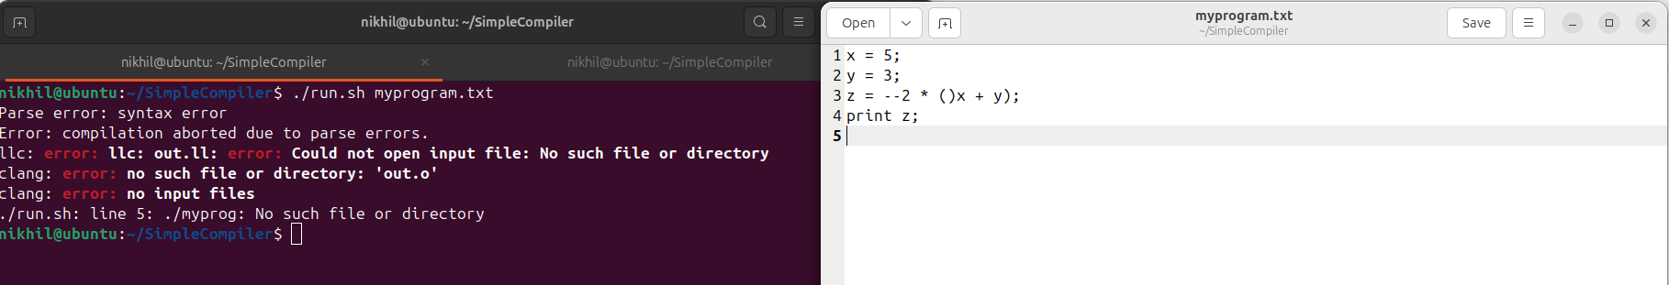
Demonstration
Simple Implementation for a basic program with error in print statement
Simple Implementation for a basic program which has incorrect brackets matching

Slide 20
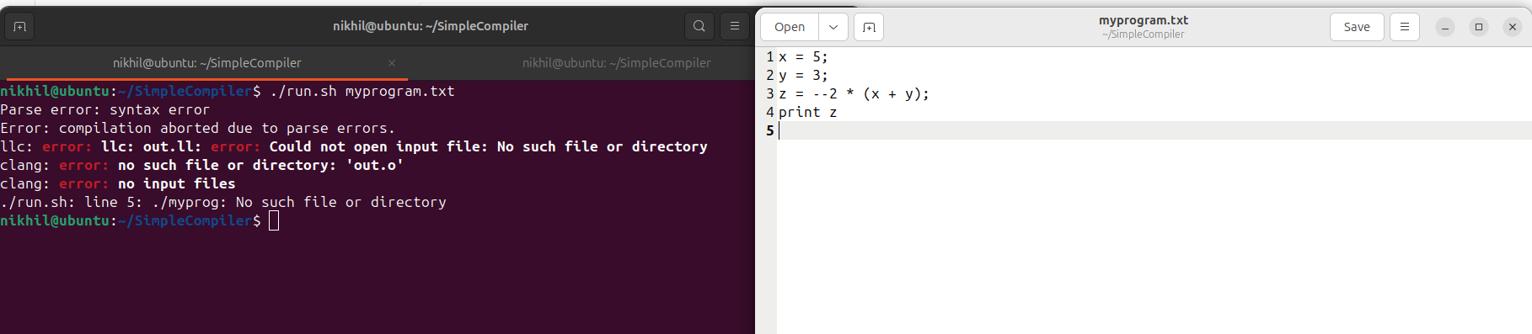
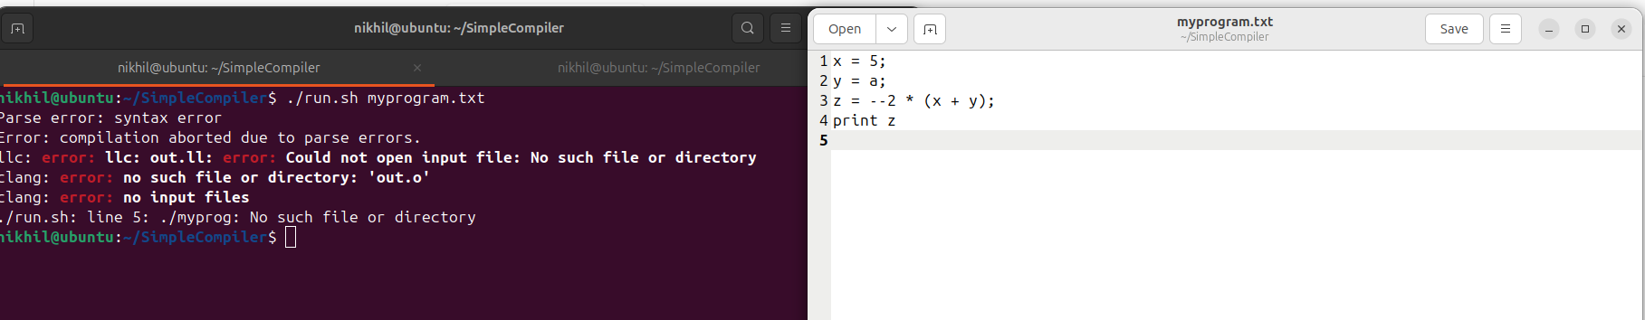
Demonstration
Simple Implementation for a basic program with missing semicolon
Simple Implementation for a basic program which has incorrect variable assignment with string

Slide 21
Timeline
Literature Survey
Design [Front End, Back End]
Implementation
Testing
Document Submission
March-5th
March-20th
April-10th
April-15th
Abstract Submission
March-5th

Slide 22
Conclusion and Future Enhancements
Built a working mini-compiler pipeline from source code to executable using Flex, Bison, and LLVM.
Achieved correct arithmetic evaluation with precedence, assignment, and print support.
Future enhancement: add if/while control flow, functions, and type checking.
Future enhancement: improve diagnostics, undeclared-variable handling, and optimization passes.

Slide 23
References
[1] J. Zhao, S. Nagarakatte, M. M. K. Martin, and S. Zdancewic, “Formalizing the LLVM intermediate representation for verified program transformations,” ACM SIGPLAN Notices, vol. 47, no. 1, pp. 427-439, Jan. 2012, doi:10.1145/2103621.2103709.
[2] J. Liu, J. Fang, Z. Wang, and J. Xie, “Efficient compiler optimization by modeling passes dependence,” CCF Transactions on High Performance Computing, vol. 6, pp. 588-607, Dec. 2024, doi:10.1007/s42514-024-00197-9.
[3] A. Notzli and F. Brown, “LifeJacket: Verifying precise floating-point optimizations in LLVM,” in Proc. 5th ACM SIGPLAN Int. Workshop on State of the Art in Program Analysis (SOAP), 2016, pp. 24-29, doi:10.1145/2931021.2931024.
[4] Hashimoto and N. Ishiura, “Detecting arithmetic optimization opportunities for C compilers by randomly generated equivalent programs,” IPSJ Transactions on Systems, vol. 9, pp. 21-29, 2016, doi:10.2197/ipsjtsldm.9.21.
[5] Ziyodov, “Arithmetic expression compiler using Python and LLVM,” American Journal of Applied Science and Technology, vol. 5, no. 10, pp. 100-108, Oct. 2025.
[6] N. P. Lopes and J. Regehr, “Alive2: Bounded translation validation for LLVM,” Proc. ACM Program. Lang., vol. 5, no. OOPSLA, pp. 1-28, Oct. 2021, doi:10.1145/3485497.
[7] P. Lammich, “Refinement of parallel algorithms down to LLVM: Applied to practically efficient parallel sorting,” Journal of Automated Reasoning, vol. 68, Art. no. 14, Jun. 2024, doi:10.1007/s10817-024-09701-w.
[8] Y. Zou, “A code generator for energy-efficient wavefront parallelization of uniform dependence computations,” IEEE Transactions on Dependable and Secure Computing, vol. 15, no. 9, pp. 1335-1347, Sep. 2018.
[9] J. Kang et al., “Crellvm: Verified credible compilation for LLVM,” ACM SIGPLAN Notices, vol. 53, no. 4, pp. 631-645, Jun. 2018, doi:10.1145/3192366.3192377.
[10] Q. Huang, W. Moses, and C. E. Leiserson, “Embedding recursive fork-join parallelism into LLVM’s intermediate representation,” ACM Transactions on Parallel Computing, vol. 6, no. 4, Art. 19, Dec. 2019.

Slide 24
Contribution of the Team Members
Sl. No. | Reg. No. | Name | Contribution Description
1 | BL.EN.U4CSE23239 | Nikhil Sanjay | Parser grammar design, AST,LLVM IR code generation , design, and system integration
2 | BL.EN.U4CSE23263 | Kandrakunta Amith | Testing, and debugging
3 | BL.EN.U4CSE23269 | Andrew Tom Matthew | Lexer implementation, Documentation, and demo preparation

Slide 25
THANK YOU

