Slide 1



Hate Tweet Sentiment Analysis
Team Member
Nikhil Saraogi [21MCA1080]
Lakshya [21MCA1056]
Under the Guidance of
Prof. Monica

Slide 2


Agenda
Background
Business Proposal
Approach
Data Sources
Methodology
Analysis
Random Forest
Logistic Regression
Next Steps

Slide 3
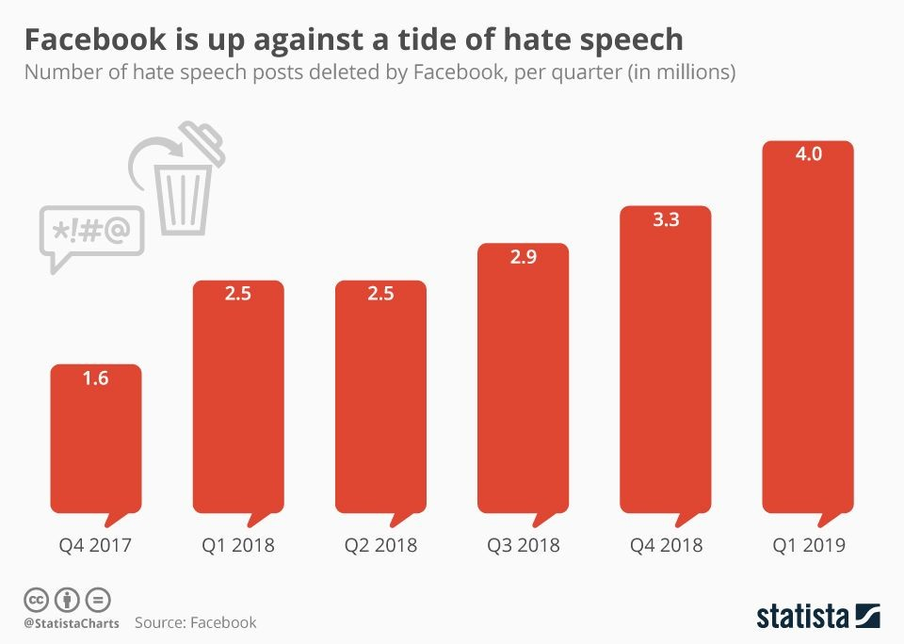
Background
What is Hate versus Oﬀensive Speech?
Hate Speech:
any form of expression intending to vilify humiliate, or incite hatred against group orindividual on basis of race, religion, skin color, sexual or gender identity, ethnicity, disability, or national origin
Key takeaway: incite violence and promote hatred
Forms of Content Moderation:
Human Moderation (Facebook)
Community Moderation (Reddit)
Algorithmic Moderation (Twitter, YouTube)
Multiple Tier (Algorithmic and Human or Community)

Slide 4
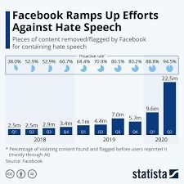
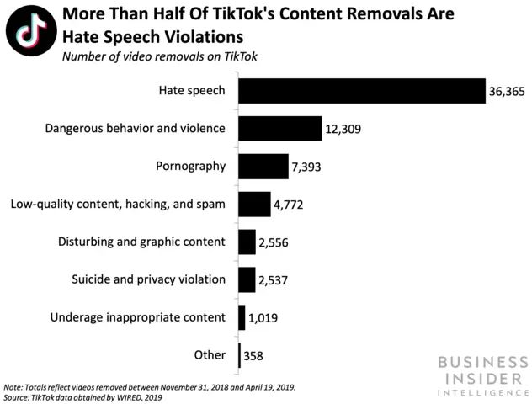
Business Proposal
Company invest in an automated hate speech detection system?
Community: Establish leadership presence in setting precedent in industry
Business Partners: Negative press can aﬀect willingness of businesses to engage or individuals from investing
Employee: Promotes sense of stability and well-being among your employees
Customer: Appeal to larger customer base in urban areas that lean more to the left

Slide 5

Approach Based on Cross Industry Standard Process for Data Mining (CRISP-DM)
Look at the big picture.
Get the data.
Discover and visualize the data to gain insights.
Prepare the data for Machine Learning algorithms.
Select a model and train it.
Fine-tune your model.
Present your solution.
Launch, monitor, and maintain system.

Slide 6
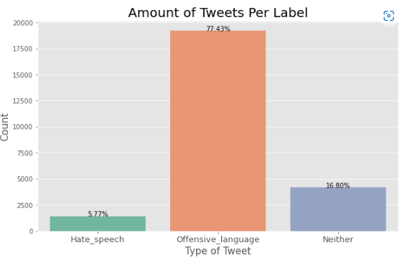
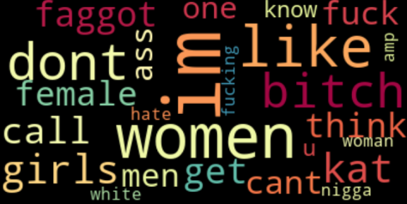
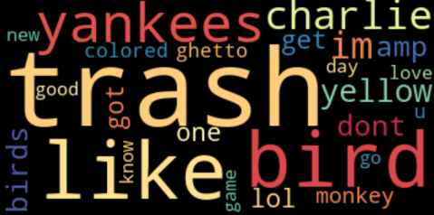
Data Sources
Analysis and Challenges
Cornell University Study:
Dataset biased towards racism and homophobic tweets
Easier to label, misogynistic terms more ambiguous, human classiﬁers more biased against misogyny
Huge class imbalance:
Aristotle University Study:
Dataset included Sexism and Racism labeled tweets
Acquire more hate-labelled tweets through API using Tweet ID lookup from datasets
Challenge:
Diﬀerentiating between hate versus oﬀensive tweets

Slide 7
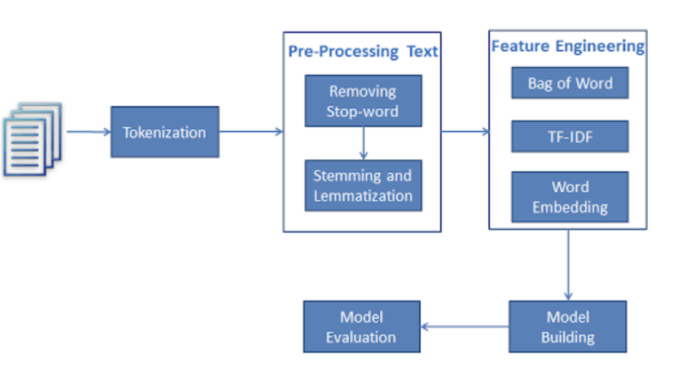
Methodology
With NLP, computers are taught to understand human language, its meaning and sentiments.
In order to translate complex natural human language into systematic constructed features, we need to follow some major steps shown on the next graph.

Slide 8
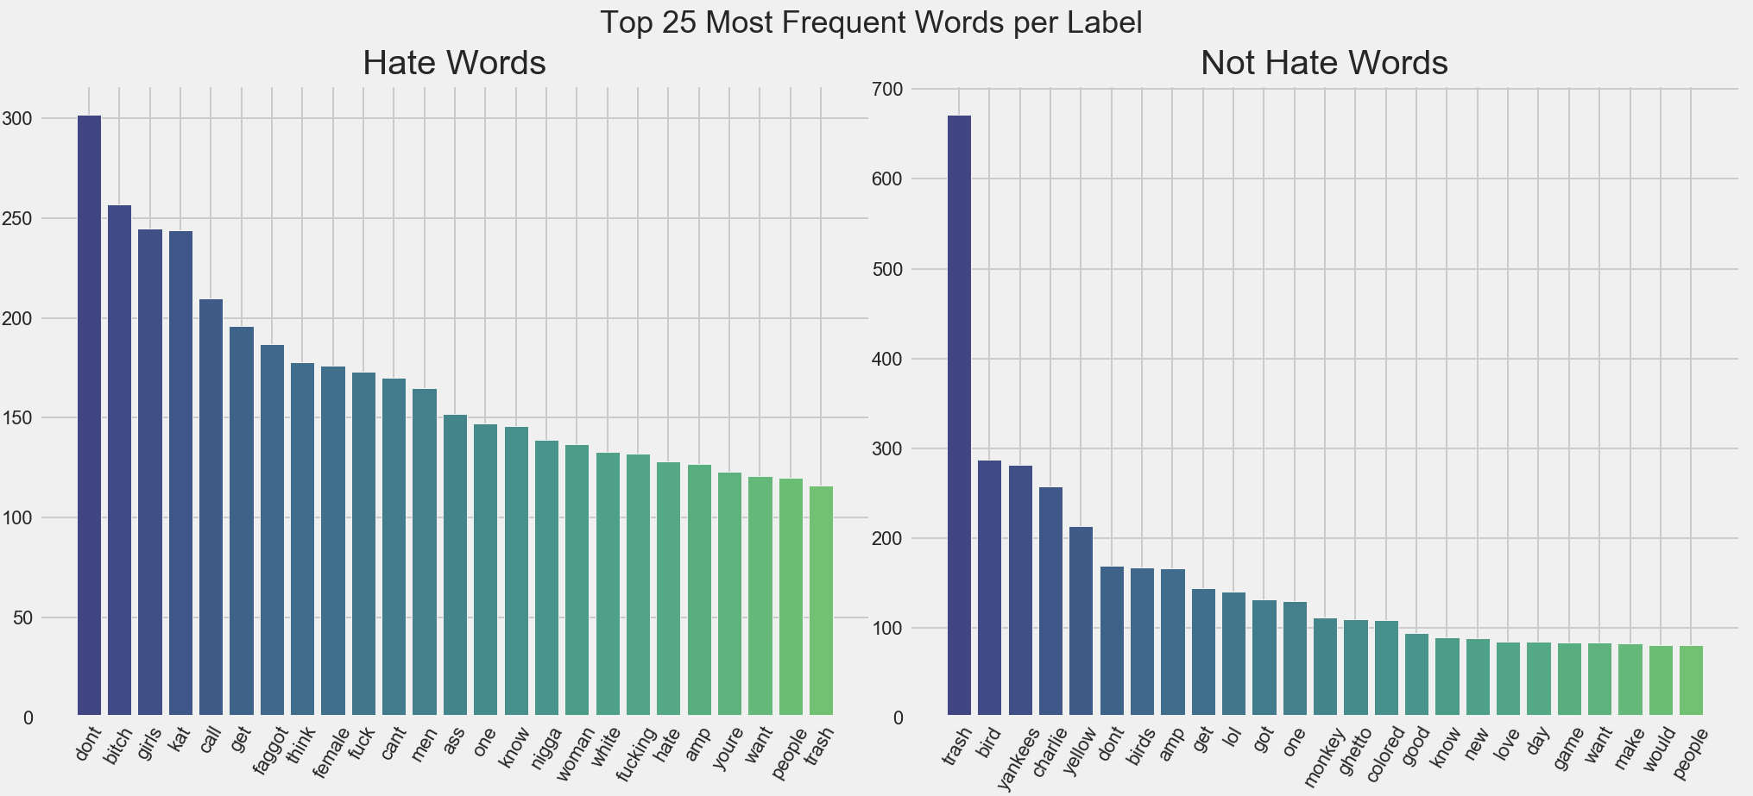
Analysis
Frequency distribution of words within the whole corpus.

Slide 9
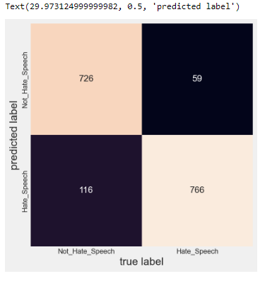
Random Forest
Random Forest with Lemmatization Features: Precision: 0.8685
Recall: 0.9285
Testing Accuracy: 0.895
F1 Score: 0.8975

Slide 10
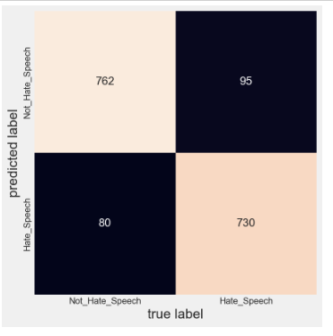
Logistic Regression
Logistic Regression with Lemmatization Features: Precision: 0.9012
Recall: 0.8848
Testing Accuracy: 0.895
F1 Score: 0.893

Slide 11
Final Review
Naive Bayes
Comparison
Tuning Model
Class Imbalance
Random Under Sampler
SMOTE-ENN
Performance Comparison
Future Work

Slide 12
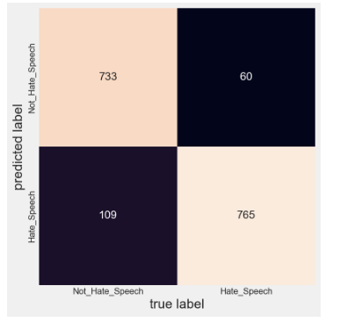
Naive Bayes
Naïve Bayes with Lemmatization Features: Precision: 0.8753
Recall: 0.9273
Testing Accuracy: 0.8986
F1 Score: 0.9005

Slide 13
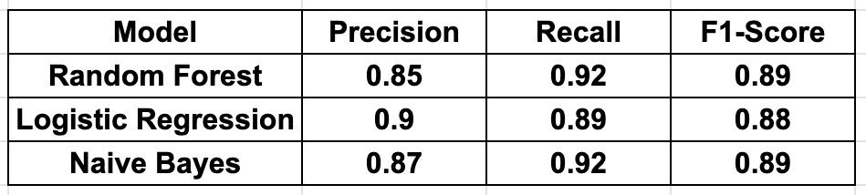
Modeling
As our major evaluation metrics will be Recall and F1 score, based on models performance - best results was achieved with random forest.

Slide 14
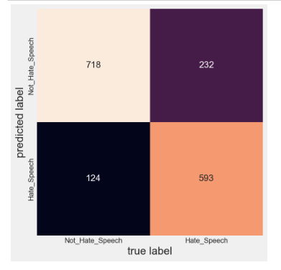
Random Forest with Hyper Parameters selected with Grid-Search:
Random Forest with Hyper Parameters selected with Grid-Search let us create final model with following results on testing data:
Precision: 0.8753
Recall: 0.7195
Testing Accuracy: 0.8077
F1 Score: 0.7898

Slide 15
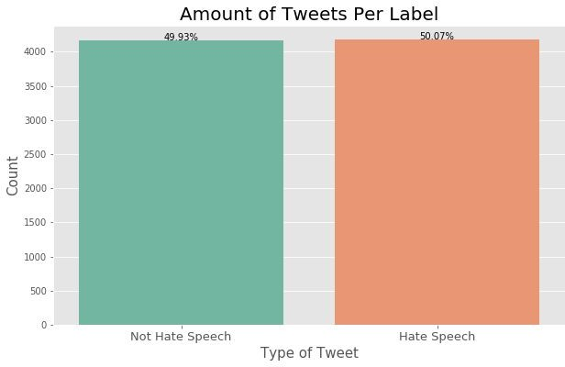
Class Imbalance
During EDA, we discovered that data from Cornell University appears to be unbalanced with minority class as hate speech and represented on the top graph.
Undersampling Methods:
RandomUnderSampler
ClosestNearestNeighbours
SMOTE-ENN (Oversampling and Undersampling)
With API requests using labeled as hate speech tweets ids we were able to bring more data to our project and balance it. Bottom graph shows balanced data.

Slide 16
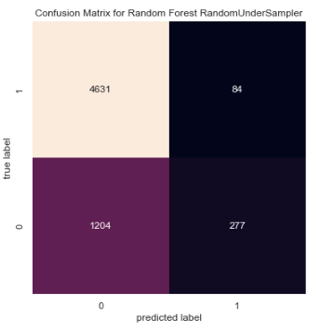
Random Under Sampler
Logistic Regression Random Under Sampling
Precision Score: 0.07659
Average precision-recall score: 0.2526
F1 score: 0.14179
Recall score: 0.95290
Naive Bayes Random Under Sampling
Precision Score: 0.05858
Average precision-recall score: 0.198121
F1 score: 0.11066
Recall score: 0.99722
Random Forest Random Under Sampling
Precision Score: 0.092003
Average precision-recall score: 0.22667
F1 score: 0.16555
Recall score: 0.97719

Slide 17
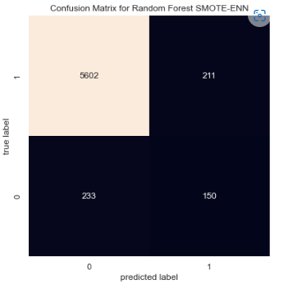
SMOTE-ENN
Logistic Regression SMOTE
Precision Score: 0.185
Average precision-recall score: 0.31117
F1 score: 0.287
Recall score: 0.640
Naive Bayes SMOTE
Precision Score: 0.1848
Average precision-recall score: 0.28254
F1 score: 0.28677
Recall score: 0.63988
Random Forest SMOTE
Precision Score: 0.3714
Average precision-recall score: 0.29630
F1 score: 0.3914
Recall score: 0.40443

Slide 18
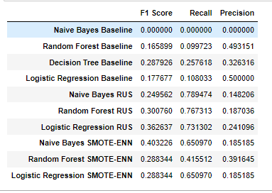
Performance Comparison

Slide 19
What are our future goals with the project?
Future Work
Multi-class Classiﬁcation: Developing a model that can differentiate between the different nuances based on business needs
Neural Network Integration: Allow for use of embeddings and better semantic understanding of the text analyzed
Preparing for Deployment: Testing on unseen data to demonstrate generalizability of developed model

Slide 20



