Slide 1
CONTRACT MONTHLY CLAIM SYSTEM
Contract Monthly Claim System (CMCS)
ASP.NET MVC Application with Automation Features
Nikhil Saroop, ST10040092, PROG6212, and 21 November.

Slide 2
GITHUB LINK : https://github.com/NikhilSaroop21/ST10040092_Nikhil_POE_Part2_PROG6212.git
VIDEO LINK :
https://drive.google.com/file/d/19zBKVnmF93dUEZT0AIJijWKTibK68t-q/view?usp=sharing

Slide 3
Table of Contents
Title | Content
Introduction | Overview of the Contract Monthly Claim System (CMCS)
Home Page Overview | Key features and role-specific access
Role-Based Access Control | Ensuring secure and focused functionality for each role
Features for Lecturers | Submission, tracking, and document upload functionalities
Features for Programme Co-ordinators/Academic Managers | Claim review, approval, and rejection workflow
Features for HR | Generate invoices or reports
Automation Features | Auto-calculation, real-time updates, and document validation
Tools and Technologies Used | ASP.NET MVC, jQuery, AJAX, SignalR, and Entity Framework .How these tools enhance functionality and performance
Benefits of cmcs | 4 BENEFITS
Conclusion | Summarizing the impact of CMCS on efficiency and user experience

Slide 4




Introduction
Purpose:
To create a web-based application to streamline claim submissions, approvals, and tracking for lecturers and program coordinators/managers.
Simplifies workflows with a focus on automation and user-friendly design.
Key Objectives:
Enable lecturers to submit and track claims efficiently.
Provide a seamless approval process for Programme coordinators/managers.
Implement automation to reduce errors and enhance efficiency.
Secure the system using role-based access control.
Built Using:
Framework: ASP.NET MVC for modularity and scalability.
Tools: Entity Framework, jQuery, and SQL Server for robust functionality.
(“ASP.NET Core | Open-source web framework for .NET,” n.d.)

Slide 5
Home Page

Slide 6
Home Page - Centralized Entry Point
Purpose:
Serves as the main entry point for all users (Lecturers,HR, Programme Co-ordinators, and Academic Managers).
Provides secure access to role-specific dashboards.
Key Features:
Welcome Message: Outlines the purpose of the system (Contract Monthly Claim System).
Login Section: Allows users to log in based on their roles:
Lecturers: Redirected to the submission and tracking dashboard.
Programme Co-ordinators/Managers: Redirected to the claim's approval dashboard.
Navigation Menu:
Links to login, contact support, and help pages.
Clear instructions for accessing features.
Role-Based Access:
Ensures users only see features relevant to their roles (security-focused design).
(“Homepage Design,” n.d.)

Slide 7

Home page view

Slide 8
Role-Based Access Control
(“Role-Based Access Control (RBAC),” n.d.)

Slide 9
Role-Based Access Control Features
Secure Authentication
Role-Specific Dashboards
Restricted Access
(“Role-Based Access Control (RBAC),” n.d.)

Slide 10
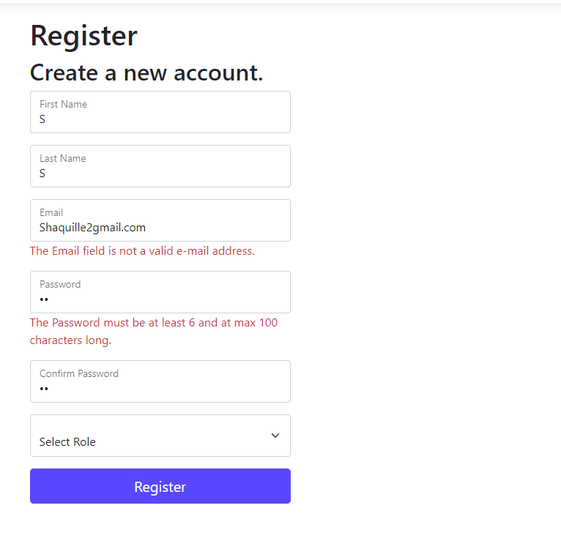
Secure Authentication
Role-based authentication is implemented using ASP.NET Identity, ensuring that only authorized users can access the system.
Credentials are validated securely, and users are assigned specific roles upon login (Lecturer, Programme coordinator, Academic Manager, or HR).
(“Authentication Tools for Secure Sign In - Google Safety Center,” n.d.)

Slide 11
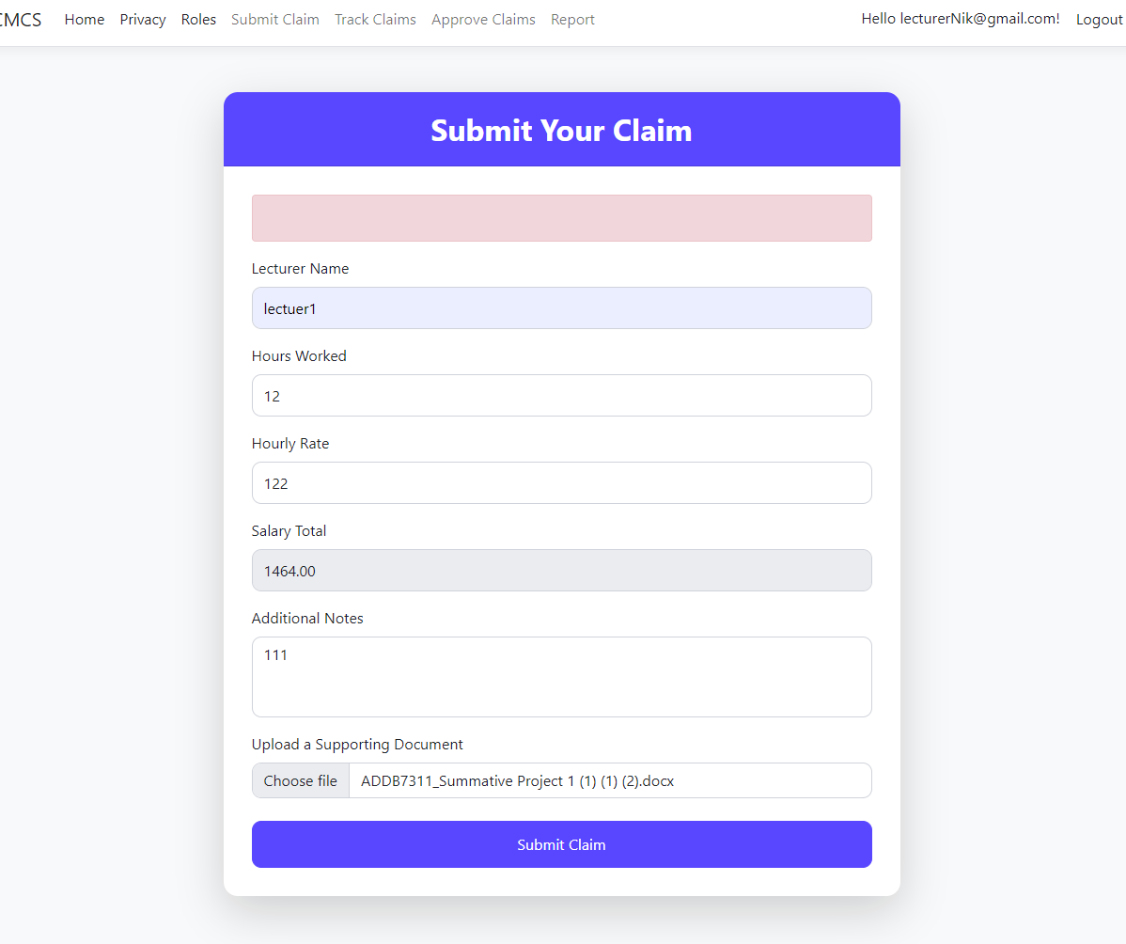
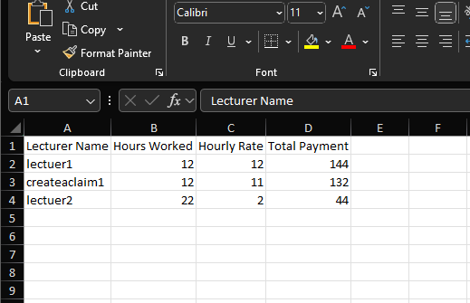
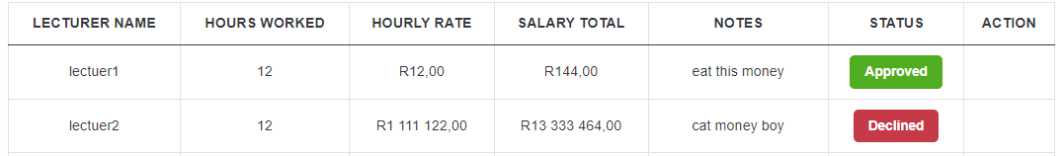
Role-Specific Dashboards
Each role has access to a unique dashboard tailored to their tasks: Lecturers: Submit claims, track claim statuses, and upload documents.
Programme Co-ordinators/Academic Managers: Review, approve, or reject claims.
HR Personnel: Manage lecturer data and generate payment reports.
(“How to set dashboards by role | Salesforce Trailblazer Community,” n.d.)

Slide 12
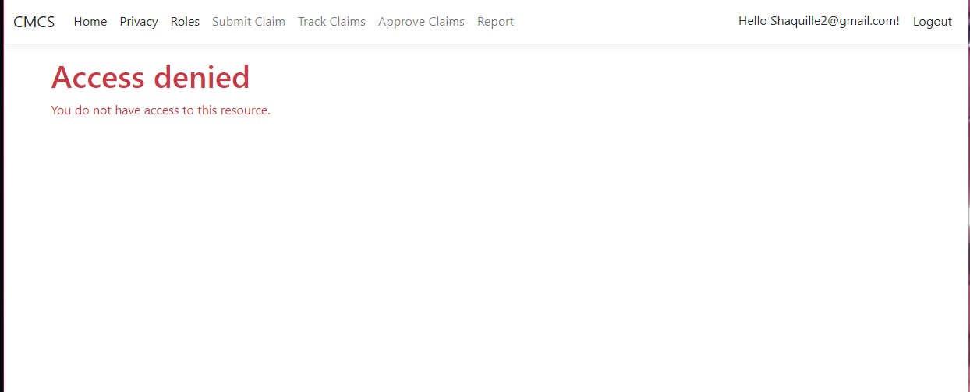
Restricted Access
Restricted Access
Users are limited to features relevant to their roles, ensuring that sensitive data is protected.
Lecturers cannot view or modify other users' claims, and Programme Co-ordinators/Managers cannot submit claims.
Even a admin has no access to creating a claim or tracking one , they can only approve it
Lecturers cannot approve or view the reports of all claims
HR can only see Reports or invoices
(“The Definitive Guide to Role-Based Access Control (RBAC) | StrongDM,” n.d.)

Slide 13
Role-Based Access Control
Purpose of Role-Based Access Control
Why Role-Based Access Control?
Ensures security: Protects sensitive claim data by restricting access to authorized users.
Promotes focused functionality: Users only see features relevant to their role, reducing complexity and preventing errors.
Facilitates efficiency: Streamlines workflows by tailoring dashboards and actions to specific roles (Lecturer or Manager).
Benefits:
Privacy: Lecturers cannot access other lecturers' claims or administrative tools.
Accountability: Managers are accountable for claim approvals, with restricted access to other roles’ features.
Usability: Simplifies user interaction by decluttering irrelevant options.
(“The Definitive Guide to Role-Based Access Control (RBAC) | StrongDM,” n.d.)

Slide 14
vALIDATION
Example: Registration validation
The user must follow the correct format when registering
Refers to ensuring that data meets specific criteria before it is accepted, processed, or stored. Validation can occur in different layers of the MVC pattern, depending on the application's requirements:
(tdykstra, 2024)

Slide 15
Workflow
1. Lecturers
2. HR
3. Programme Co-ordinators/Academic Managers

Slide 16
Lecturers

Slide 17
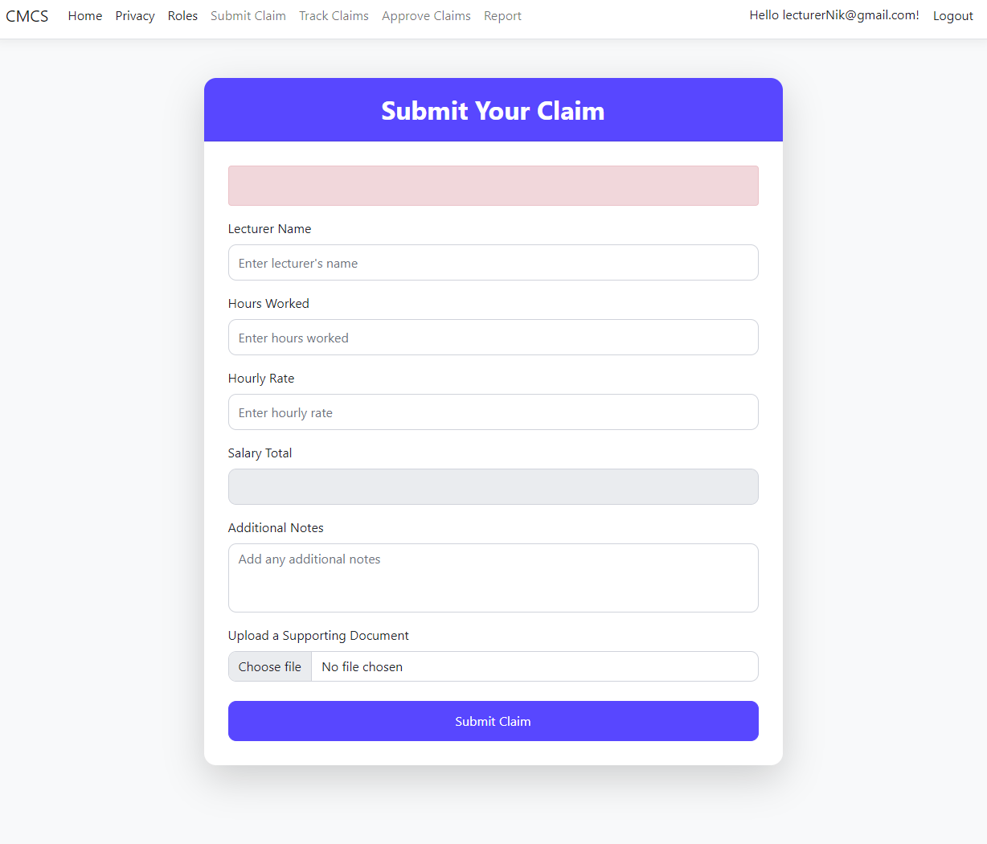
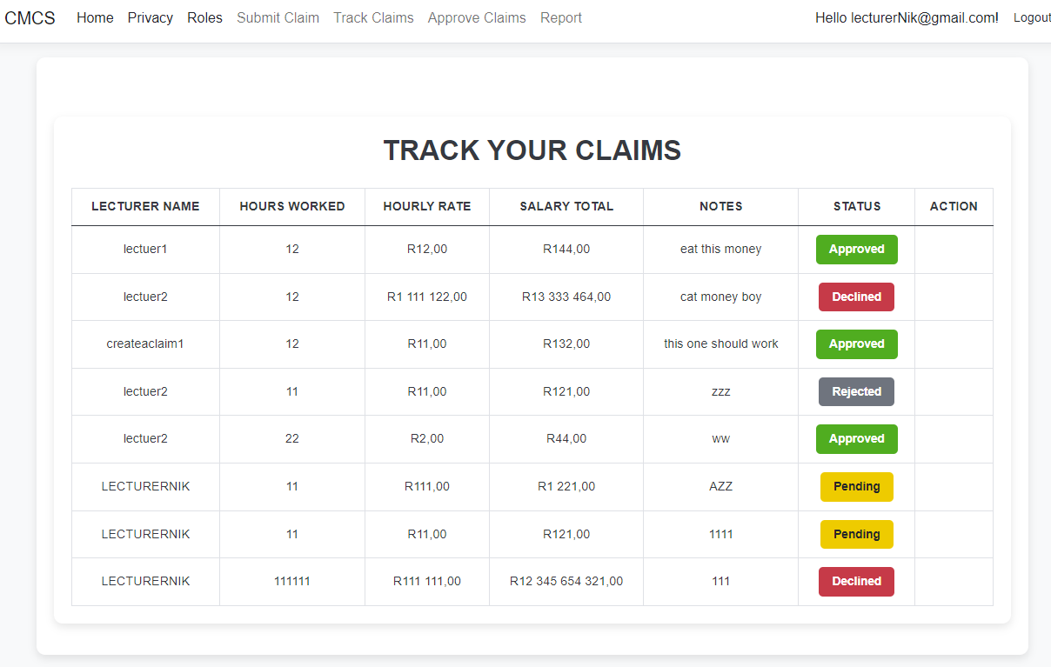
Lecturer Pages

Slide 18
Lecturer Role
Lecturer’s Role in the System
Content:
Features Available:
Submit Claims:
Use an intuitive form to input hours worked and hourly rate.
Auto-calculation feature computes the total claim.
Upload supporting documents.
Track Claim Status:
View real-time status updates:
Pending (submitted but not reviewed).
Approved (verified and accepted).
Rejected (declined with possible feedback).
Access Restrictions:
Cannot view other lecturers' claims.
Cannot access approval workflows or administrative features.

Slide 19
Lecturer login process

Slide 20
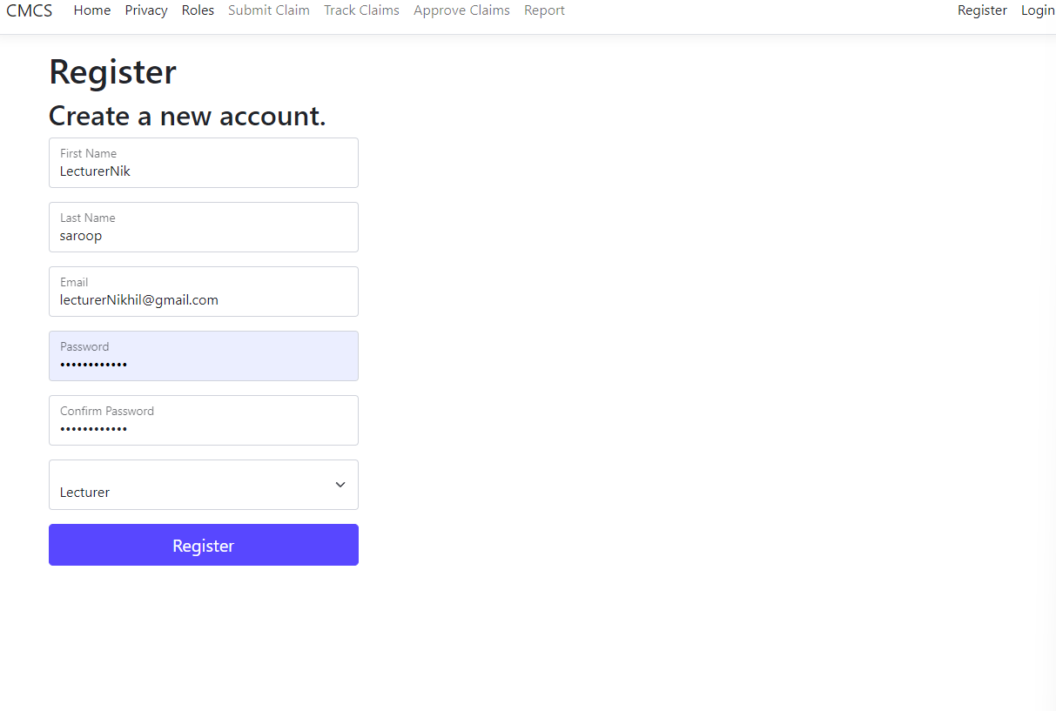
Lecturer SIGN UP
Lecturers must input their Name and surname, a valid email with an @, and a password they will remember.
This is saved and will be used to log in.
They press the submit button to continue

Slide 21
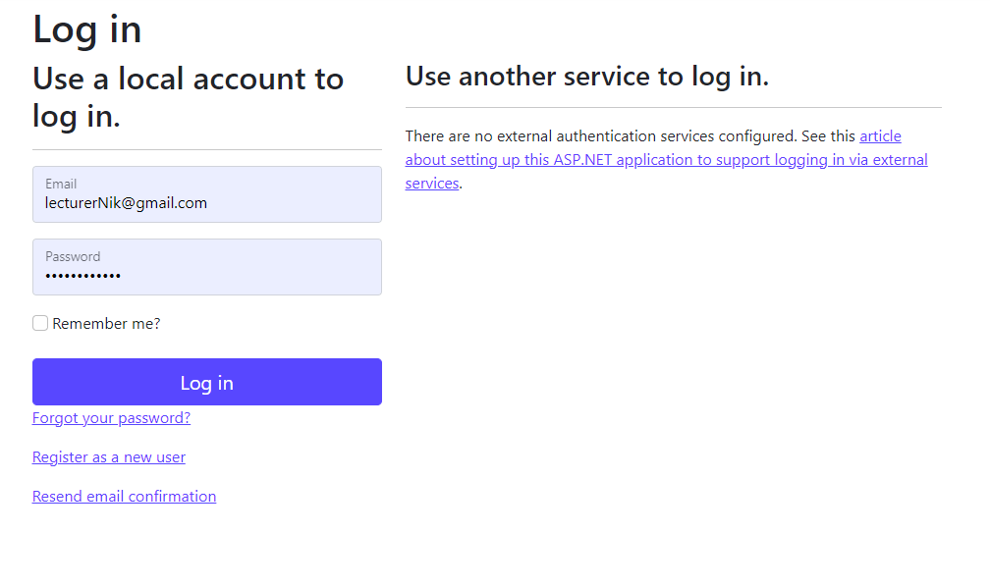
Lecturer LOG IN
Lecturers must login with their chosen password and email
They press the Log in button to continue

Slide 22
Lecturer Features
Claim Submission:
Fields Included:
Lecturer Name.
Hours Worked.
Hourly Rate.
Auto-calculated Total Claim.
Document Upload:
Upload supporting files with validation for size and type (e.g., .pdf, .docx, .xlsx).
Submit Button:
Prominently displayed for easy access.
Claim Tracking:
Real-time status updates:
Pending: Submitted but awaiting review.
Approved: Verified and accepted by Programme Co-ordinators/Managers.
Rejected: Declined with possible feedback from approvers.
User-Friendly Interface:
Simple navigation and clear layout to improve user experience.

Slide 23
Showcasing features of lecturers

Slide 24
Create new claim
A lecturer can submit a new claim.
They must input their name, hours worked, and hourly rate, which will then be automated in calculating salary total.
It will also be testing the conditions whether a user is declined earlier
Additional notes so a user can give their own personal messages
They can also upload a file to support their claim

Slide 25
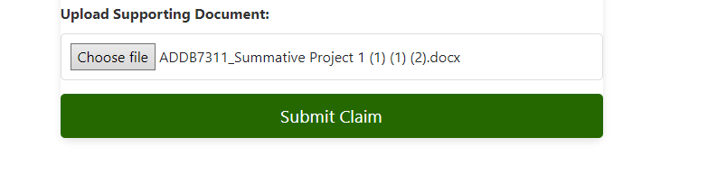
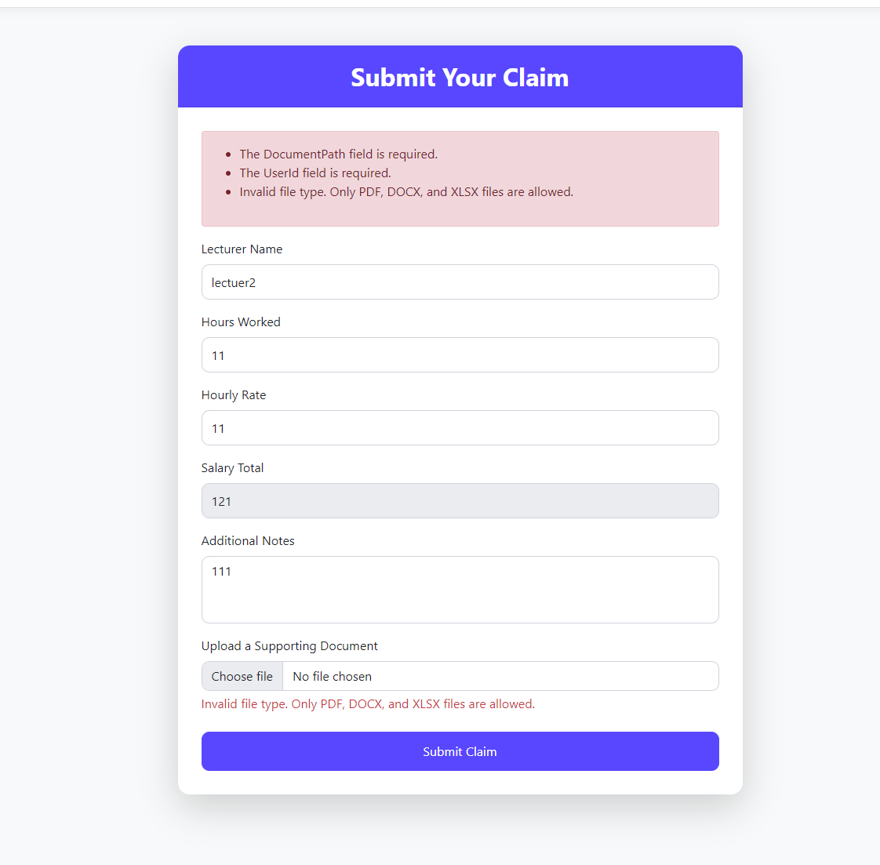
Upload claim
The claim has an upload which must a particular criteria.
The upload criteria is as follows below
Validation asking for a PDF,DOCX, OR XLDX file only.
Once the criteria is met the user can only submit the claim with the claim button to submit

Slide 26
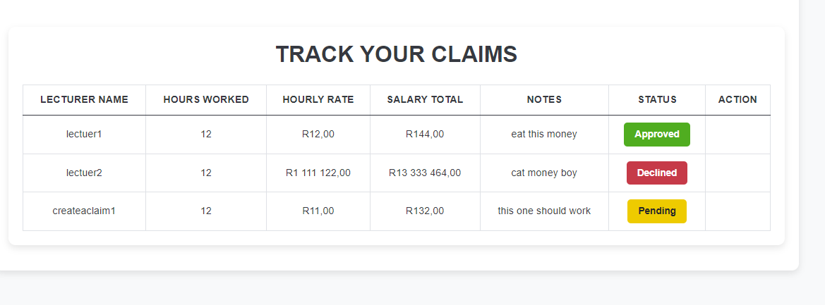
Track claim
A lecturer has three views they either see a Approve green label, Yellow pending label or a Declined red label.
Red means their claim was not accepted.
Green means their claim was approved .
Yellow means it is pending.
A claim won’t always be pending if the submission of the claim does not meet the criteria in the values entered for Hourly rate or Hours worked the claim is instantly rejected as a automated feature.

Slide 27
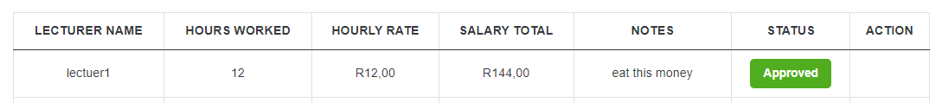
Accepted claim
Hr can start the process of payment soon

Slide 28
Declined claim
Declined means they didn’t mean the criteria for the automation or was rejected through management
A claim is instantly rejected if the value of either the hours worked or the hourly rate did not meet the business criteria
Hourly Rate cannot be more than 500 and Hours worked cannot be more than 200.
If so it is declined

Slide 29
Pending claim
Wait for Managerial personal to approve it

Slide 30
Programme Co-ordinators/Academic Managers

Slide 31
Program Co-ordinators and Academic Managers login process

Slide 32
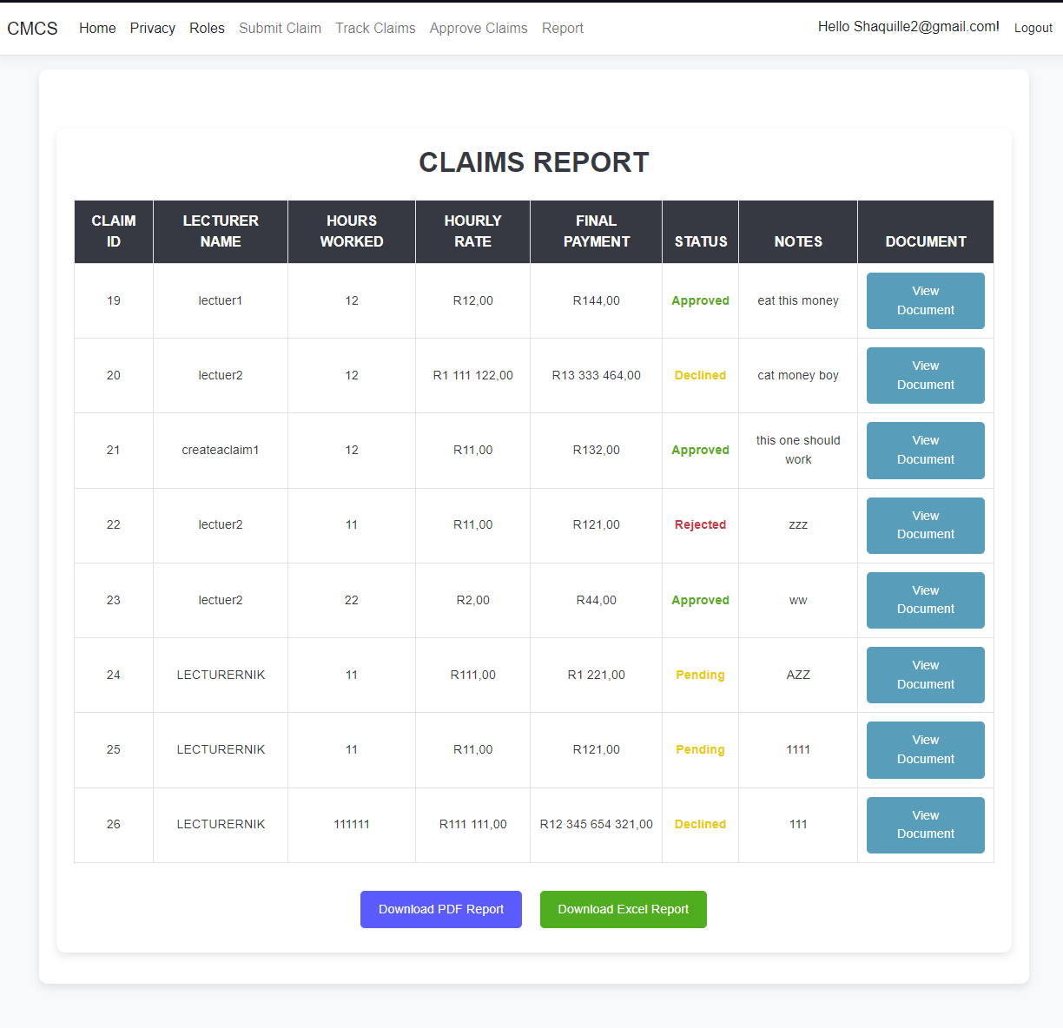
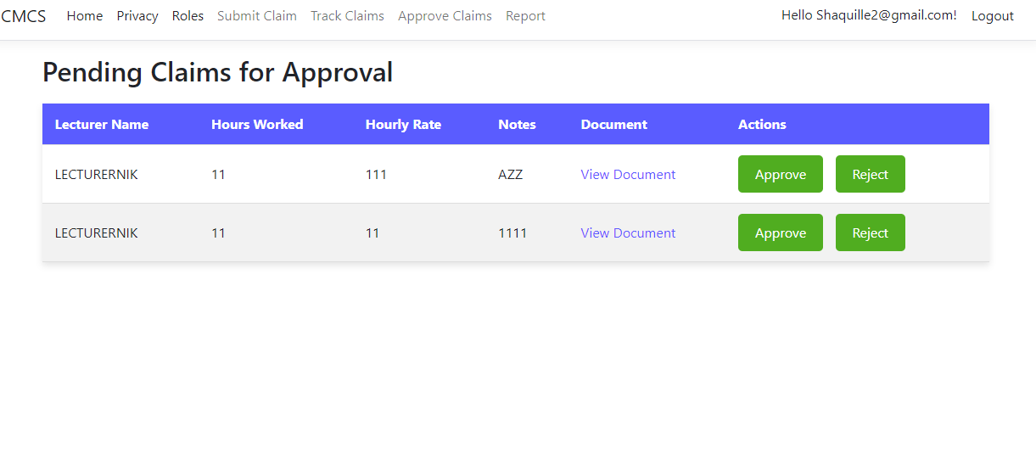
Program Co-ordinators and Academic Managers Pages

Slide 33
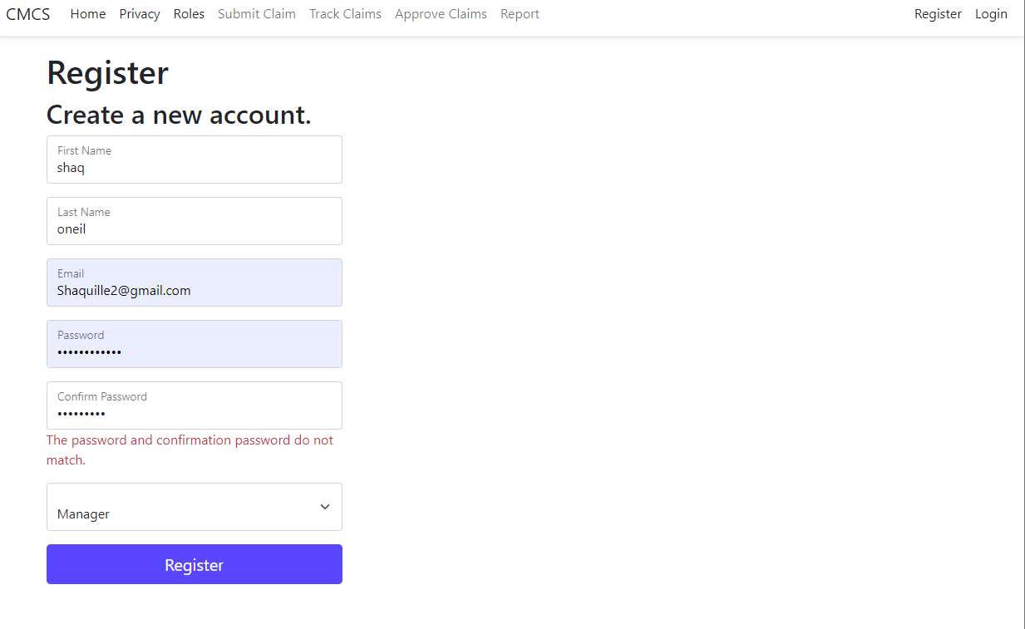
Program Co-ordinators and Academic Managers Lecturer SIGN UP
Must choose the manager role when registering and follow the criteria for creating an account to access their dashboard

Slide 34
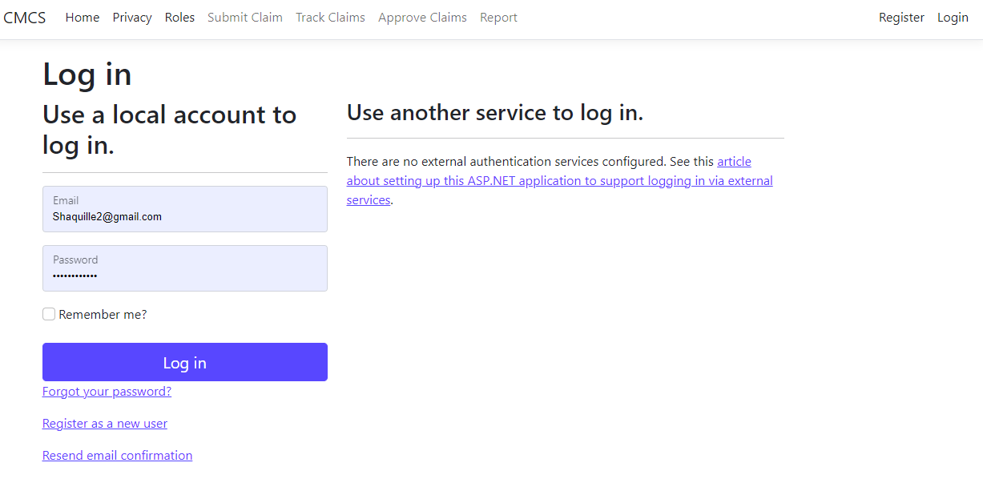
Program Co-ordinators and Academic Managers Lecturer LOGIN

Slide 35
Programme Co-ordinators/Academic Managers Role
Programme Co-ordinator/Academic Manager Role in the System
Features Available:
View Submitted Claims:
Access a dashboard displaying all pending claims.
Approve or Reject Claims:
Review claims with detailed information provided by the lecturer.
Approve or reject claims with a single click.
Optionally provide feedback for rejected claims.
Access Restrictions:
Cannot submit claims.
No access to track claim statuses.
(tdykstra, 2024)

Slide 36
Programme Co-ordinator/Manager Features
Dashboard for Claim Management:
View all pending claims submitted by lecturers.
Access detailed claim information, including hours worked, hourly rate, and supporting documents.
Approval Workflow:
Approve Claims:
Marks claims as approved, immediately updating the lecturer's dashboard.
Reject Claims:
Provide a reason for rejection or feedback (optional).
Updates the lecturer's dashboard with a rejected status.
Simplified Role:
Focus solely on reviewing and approving/rejecting claims.
Eliminates distractions with no access to claim submissions or other tasks.

Slide 37
Programme Co-ordinators/Academic Managers Showcasing features

Slide 38
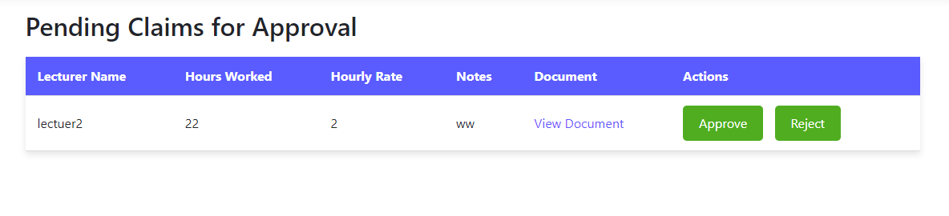
Programme Co-ordinators/Academic Managers Approval
Programme Co-ordinators/Academic Managers must approve or decline the pending claim

Slide 39
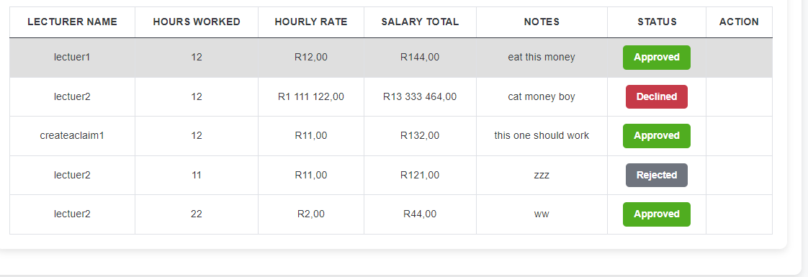
Accepted and rejected claims

Slide 40
hr

Slide 41
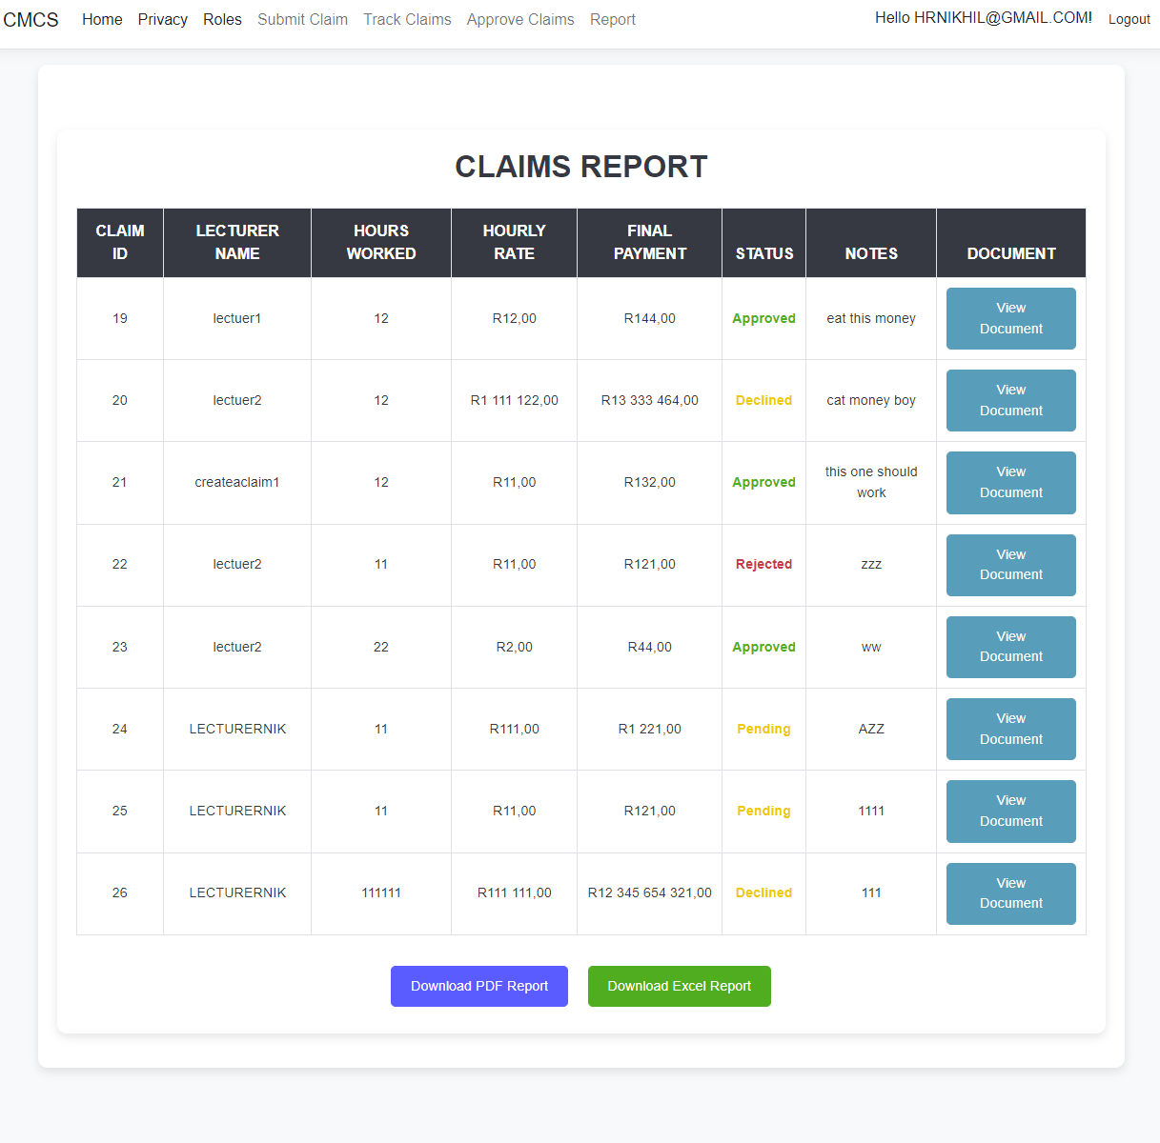
HR PAGES

Slide 42
Hr login process

Slide 43
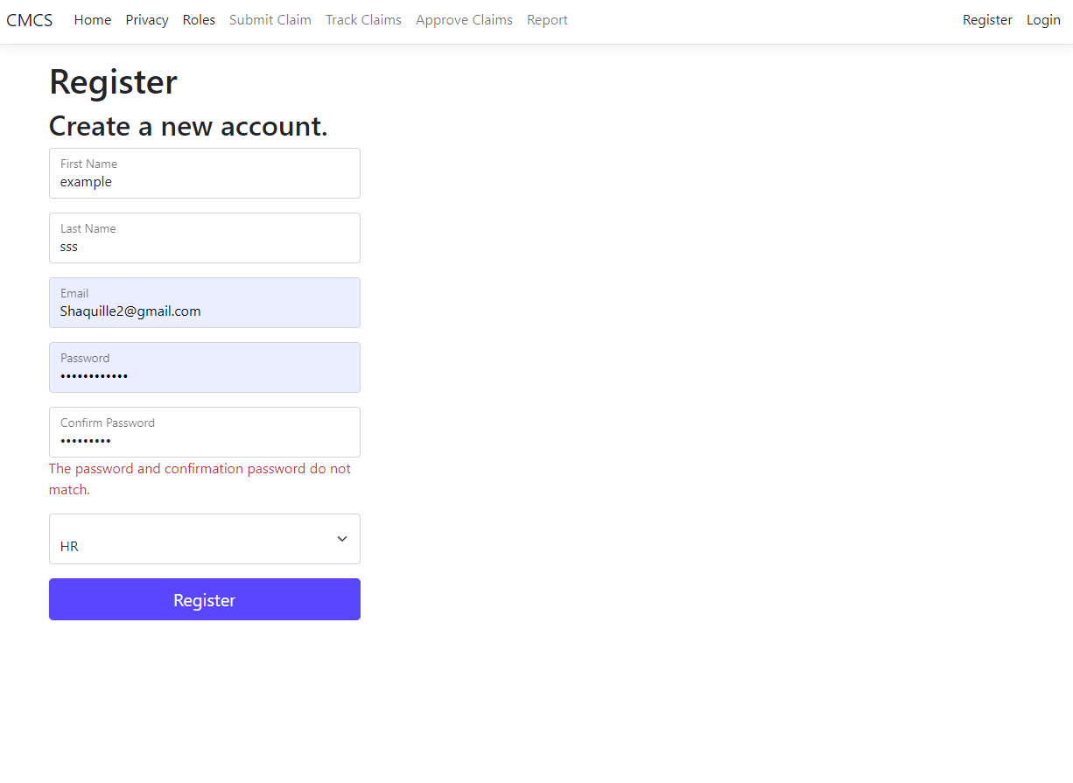
Hr Sign up
HR must follow the criteria when registering
They must choose the HR role
Submit by pressing the register button

Slide 44
Hr login
Login with the details created through the registration processes

Slide 45
AUTOMATION

Slide 46
1. Lecturer Auto-calculator for claims 2. Hr invoice generator 3. Programme Co-ordinators/Academic Managers Automation in Claim Verification and Approval process
Automation features found in app

Slide 47
1. Lecturer
Auto-calculator for claims

Slide 48
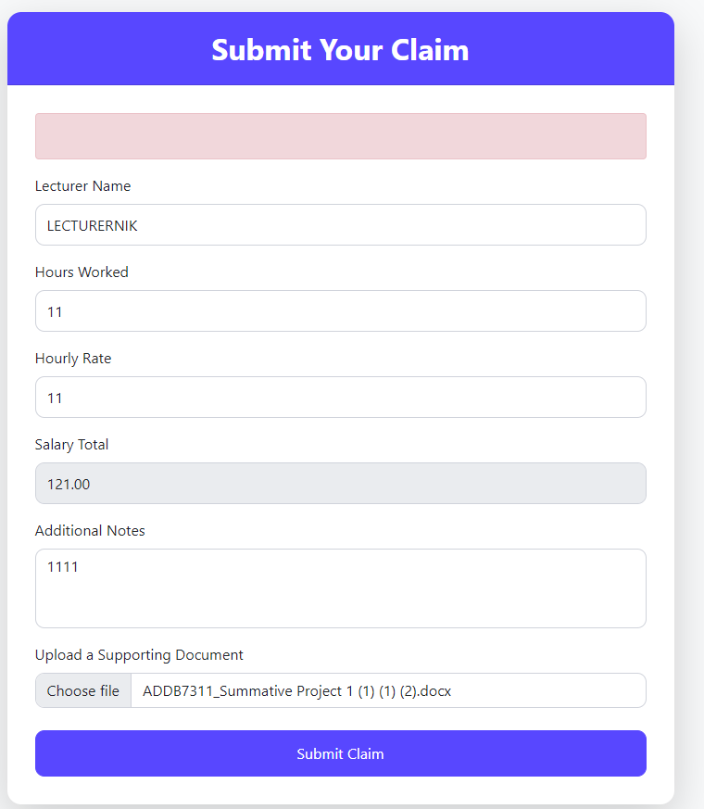
Example of claim calculator automatically
The automation for the claim calculator streamlines the approval process by automatically denying claims where the hourly rate exceeds $500 or the total hours worked surpass 200.
This ensures compliance with predefined thresholds, reduces manual intervention, and speeds up claim processing.

Slide 49
2. Hr invoice generator

Slide 50
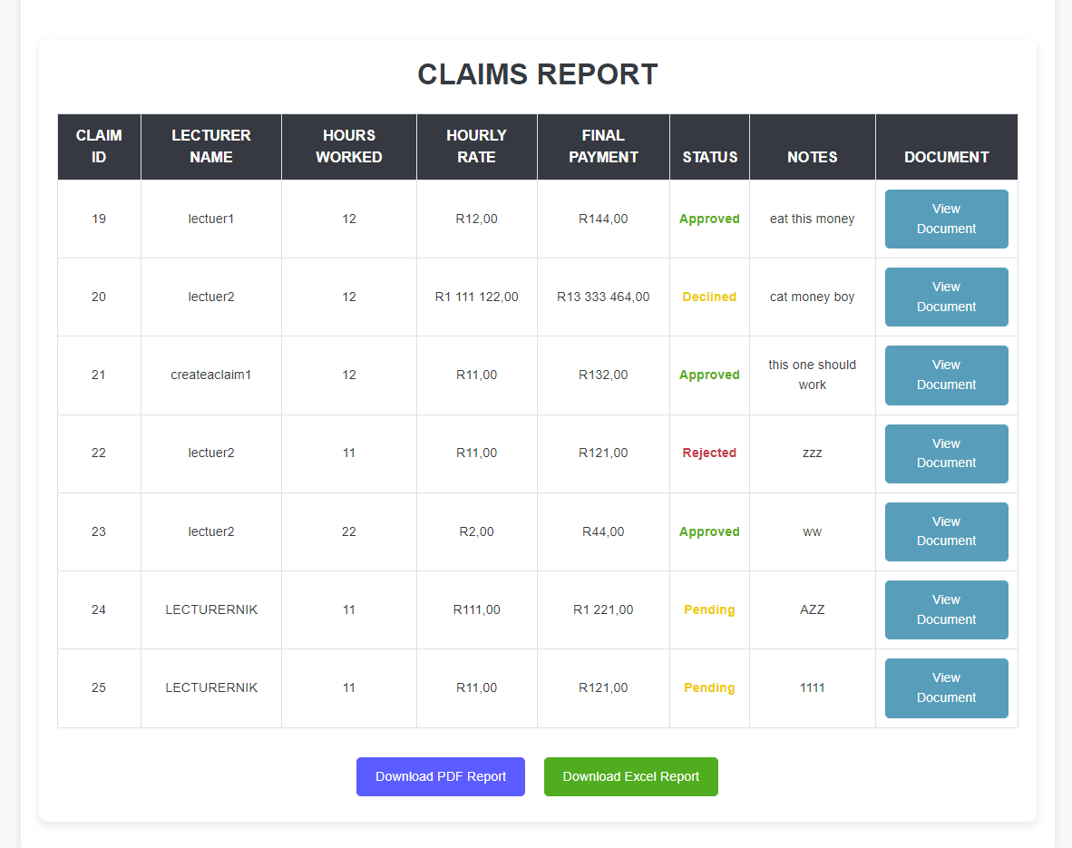
Example of generated report
A HR personnel can download a pdf or Excel to view the report
The just press the download PDF REPORT OR DOWNLOAD EXCEL REPORT
It will generate a invoice for all the given claims

Slide 51
3. Programme Co-ordinators/Academic Managers Automation in the Claim Verification and Approval process

Slide 52
Hourly rate >500 or hours worked >200 then it is automatically declined in the system

Slide 53
Meet criteria to claim example
All approved in green

Slide 54
DID NOT MEET CRITERIA TO CLAIM EXAMPLE
All Rejected in red

Slide 55
ASP.NET Core MVC Framework
A lightweight, cross-platform framework for building dynamic, data-driven web applications. It follows the Model-View-Controller pattern, which separates concerns, making the application more modular and easier to maintain
Entity Framework Core
An ORM (Object-Relational Mapper) that simplifies database interactions by allowing developers to work with database data using C# objects. It eliminates the need to write raw SQL queries for most database operations.
Tools and Technologies Used
ASP.NET Identity
A robust system for managing user authentication and authorization. It allows features like user registration, login, password recovery, and role-based access control, ensuring secure access to application features.
JavaScript, XML, and jQuery
JavaScript: Adds interactivity and dynamic functionality to web pages, such as real-time updates and form validation.
XML: A markup language used for data storage and transfer, often for structured data between systems.
Query: A JavaScript library that simplifies DOM manipulation, AJAX calls, and event handling.
(“javascript - jQuery and XML : Select by ID - Stack Overflow,” n.d.)

Slide 56
Benefits of cmcs
Streamlined Processes and Increased Efficiency
Enhanced User Experience
Robust Security through Role-Based Access Control (RBAC)
Reliability and Scalability

Slide 57
Streamlined Processes and Increased Efficiency
CMCS automates key tasks such as claim calculations, real-time status updates, and document validation. These automation features reduce manual effort and speed up workflows, allowing lecturers to submit claims and Programme Co-ordinators/Managers to approve or reject them efficiently. (spelluru, 2024)

Slide 58
Enhanced User Experience
The system’s role-based access ensures that each user interacts with a tailored interface, improving usability. Features like auto-calculation of claims, real-time notifications, and progress indicators make the platform intuitive and user-friendly, minimizing errors and saving time for all stakeholders.
(“Enhance User Experience,” n.d.)

Slide 59
Robust Security through Role-Based Access Control (RBAC)
By implementing RBAC, CMCS restricts access to specific features based on user roles, ensuring data privacy and integrity. Lecturers can only access their own claims, while Programme Co-ordinators and HR personnel are limited to their respective responsibilities. This isolation of tasks protects sensitive information and prevents unauthorize(“Role-Based Access Control (RBAC),” n.d.)
d access.

Slide 60
Reliability and Scalability
Built with secure authentication mechanisms like ASP.NET Identity, CMCS ensures safe login and data protection. Additionally, the system is scalable, allowing for future enhancements such as analytics, new roles, or additional automated workflows without compromising its current stability.
(“Role-Based Access Control (RBAC),” n.d.)

Slide 61
Conclusion
In conclusion, this project highlights the importance of leveraging technology and strategic planning to achieve our goals. By focusing on innovation, efficiency, and user-centric solutions, we have demonstrated a clear path to addressing key challenges.
The outcomes not only meet the initial objectives but also pave the way for future enhancements and scalability. Collaboration, continuous improvement, and a commitment to excellence remain at the heart of this solution.
Thank you for your time and attention. I look forward to your feedback and future discussions.
(tdykstra, 2024)

Slide 62
bibliography
ajcvickers, 2024. Overview of Entity Framework Core - EF Core [WWW Document]. URL https://learn.microsoft.com/en-us/ef/core/
(20 November 2024)
ASP.NET Core | Open-source web framework for .NET [WWW Document], n.d. . Microsoft. URL https://dotnet.microsoft.com/en-us/apps/aspnet
(20 November 2024)
Authentication Tools for Secure Sign In - Google Safety Center [WWW Document], n.d. URL https://safety.google/authentication/
(20 November 2024)
Enhance User Experience: 14 Proven Strategies to Boost Your UX [WWW Document], n.d. URL https://contentsquare.com/guides/ux/
(20 November 2024)
Homepage Design: 5 Fundamental Principles [WWW Document], n.d. . Nielsen Norman Group. URL https://www.nngroup.com/articles/homepage-design-principles/
(20 November 2024)
How to set dashboards by role | Salesforce Trailblazer Community [WWW Document], n.d. . Trailhead. URL https://trailhead.salesforce.com/trailblazer-community/feed/0D54S00000A8nINSAZ
(20 November 2024)
javascript - jQuery and XML : Select by ID - Stack Overflow [WWW Document], n.d. URL https://stackoverflow.com/questions/27185505/jquery-and-xml-select-by-id
(20 November 2024)
Rick-Anderson, 2024. Introduction to Identity on ASP.NET Core [WWW Document]. URL https://learn.microsoft.com/en-us/aspnet/core/security/authentication/identity?view=aspnetcore-9.0
(20 November 2024)
Role-Based Access Control (RBAC) [WWW Document], n.d. URL https://www.datasunrise.com/knowledge-center/role-based-access-control-rbac/
(20 November 2024)
spelluru, 2024. Azure Event Hubs: Data streaming platform with Kafka support - Azure Event Hubs [WWW Document]. URL https://learn.microsoft.com/en-us/azure/event-hubs/event-hubs-about
(20 November 2024)
tdykstra, 2024. Overview of ASP.NET Core [WWW Document]. URL https://learn.microsoft.com/en-us/aspnet/core/introduction-to-aspnet-core?view=aspnetcore-9.0(20 November 2024)
The Definitive Guide to Role-Based Access Control (RBAC) | StrongDM [WWW Document], n.d. URL https://www.strongdm.com/rbac (20 November 2024)
What Is Role-Based Access Control (RBAC)? A Complete Guide [WWW Document], n.d. . Frontegg. URL https://frontegg.com/guides/rbac
(20 November 2024)

