Slide 1
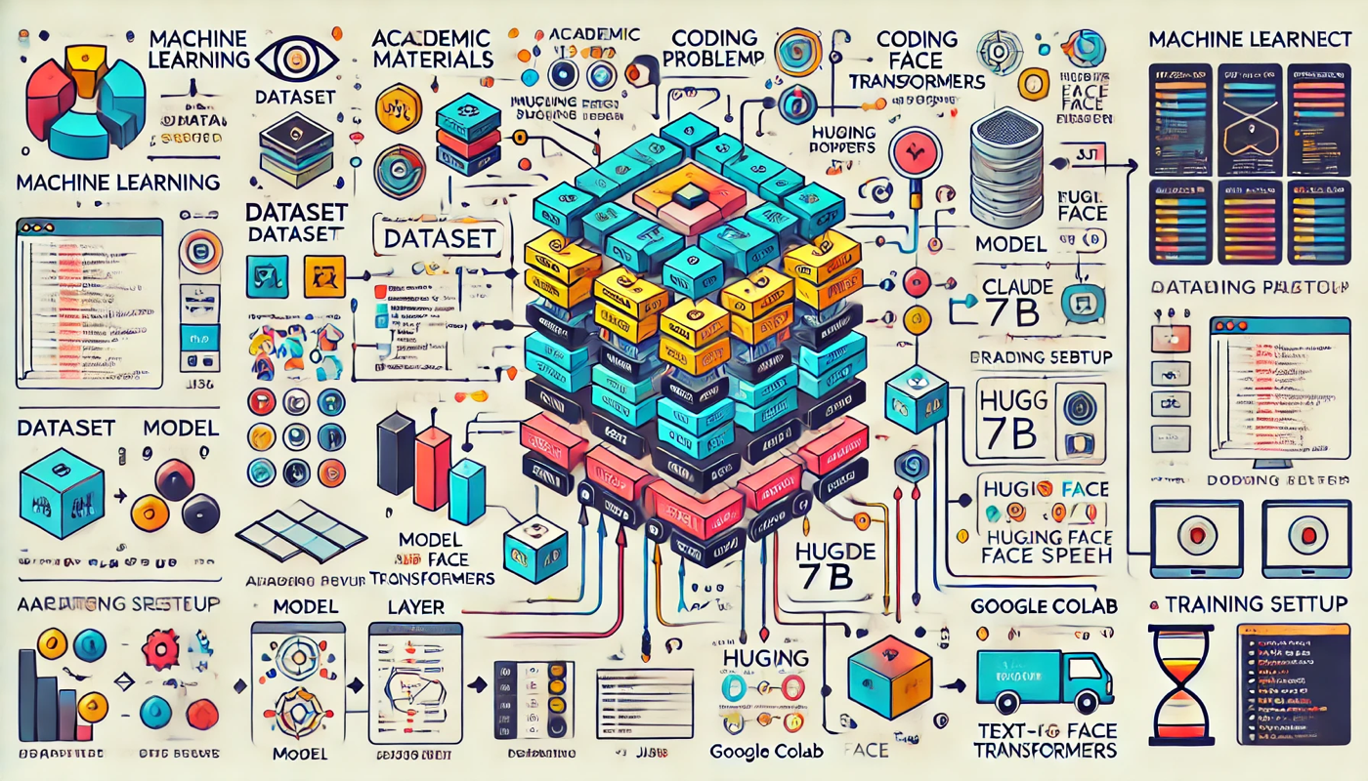
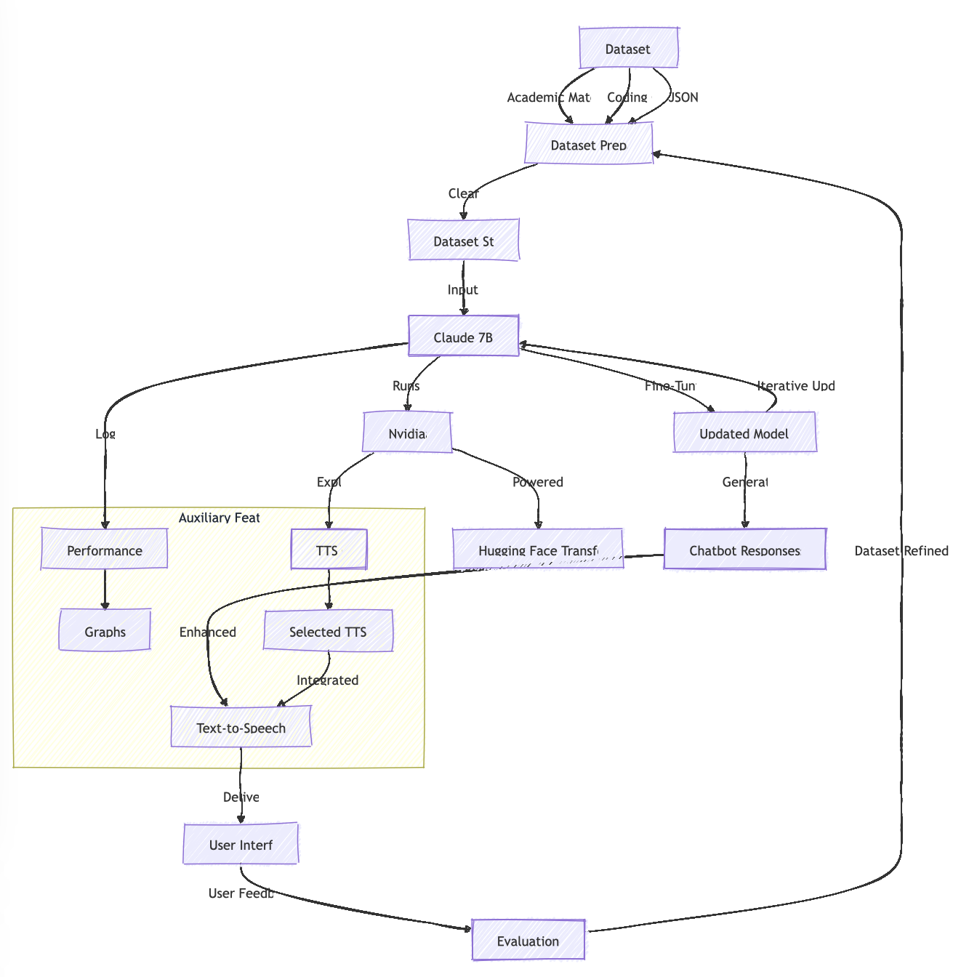
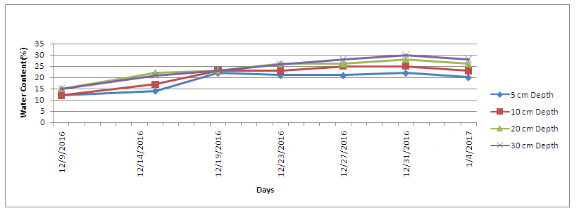
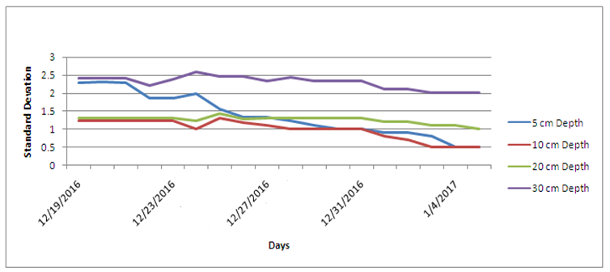
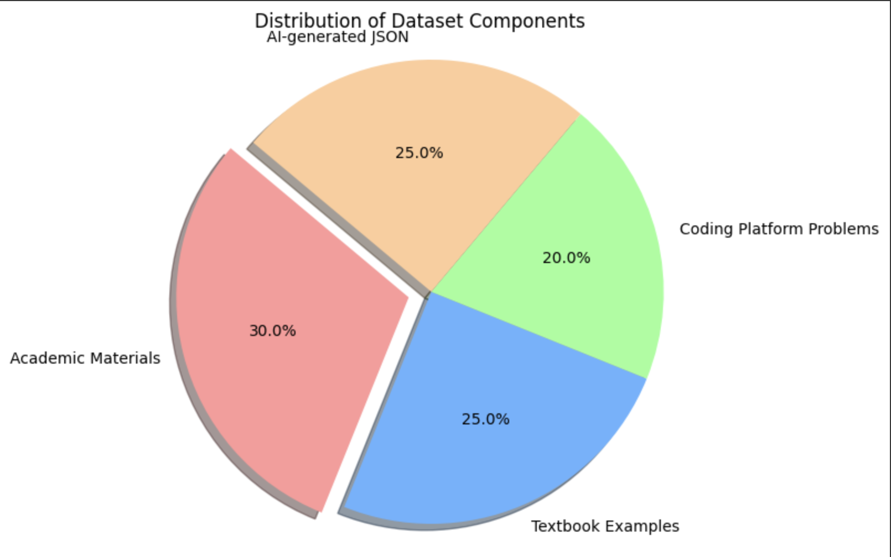
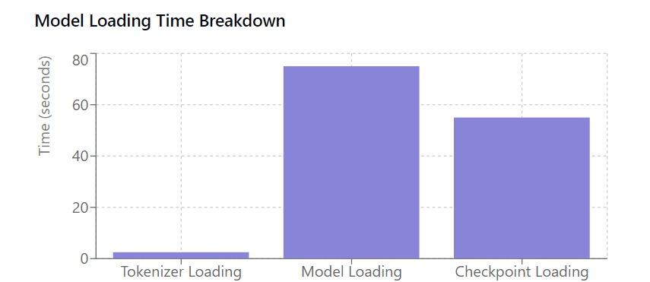
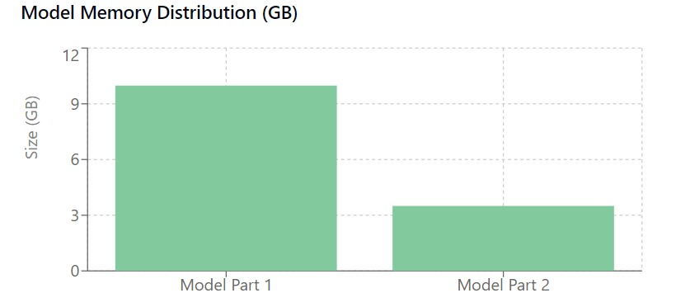
SRMTutor: An LLM based Application for Engineering Subjects
PI : Dr. Subalalitha C.N , Dr. Akilandeswari , Dr.Kayalvizhi R ; Co-PIs : Bhupesh S , Hirithik R , Sukanya K , Luvish Arora , Nikhil Sharma , Yash Srivastava , Gaurish Aradhy , SRM Institute of Science and Technology
OVERVIEW
SYSTEMATIC PROCESS
POTENTIAL BENEFICIARIES
The Humanoid project is an innovative initiative aimed at creating an intelligent and interactive chatbot specializing in data structures (DS) and algorithms (Algo). Built on the Claude 7B model using Hugging Face’s Transformers library, the project focuses on developing a dynamic learning model through continuous updates to its dataset, which includes academic materials, textbook examples, coding challenges, and AI-generated content. The chatbot undergoes iterative training and testing to improve its understanding of DS-Algo concepts. A key feature under development is the integration of text-to-speech (TTS) capabilities, enabling more human-like and accessible interactions. By combining advanced machine learning techniques with real-world problem-solving applications, the project seeks to bridge the gap between education and technology, offering a valuable resource for students, developers, and educators.
.
The Humanoid project has the potential to benefit a diverse audience, including students, educators, developers, and organizations. For students, it provides an interactive humanoid to learn and practice data structures and algorithms, while educators can use it as a supplementary teaching tool to explain complex concepts. Developers and programmers can rely on the humanoid for debugging and solving challenges, with competitive programmers leveraging it to enhance their preparation and master advanced scenarios. Organizations can deploy the model for employee training or technical interviews, and technology platforms, such as online learning or coding practice websites, can integrate it to offer engaging and automated assistance.
Fig. 2 Illustrative process visualization
TESTING RESULTS
PROPOSED ARCHITECTURE
Evaluation and Testing
1. Basic Problem Testing:
• Evaluate the chatbot’s responses to simple DS-Algo problems.
2. Advanced Scenarios:
• Test edge cases and complex algorithmic challenges to identify areas for improvement.
3. Feedback Incorporation:
• Collect user and team feedback to refine the model.
Integration
1. Text-to-Speech (TTS):
• Evaluate TTS options such as Google’s TTS API, Coqui TTS, and Hugging Face TTS models.
• Integrate the best TTS model for generating human-like audio responses.
2. System Testing:
• Test the integration of chatbot and TTS for end-to-end functionality.
Iterative Improvement
1. Dataset Expansion:
• Add more advanced and diverse DS-Algo topics to the dataset.
2. Model Refinement:
• Incorporate new data and feedback into subsequent training iterations.
3. Feature Enhancements:
• Explore additional features, such as natural language understanding for better context handling.
Variance of Soil Moisture content at different depths
During the preliminary findings, the overall water content at various depths was recorded as follows: 5 cm depth (12% to 23%), 10 cm depth (12% to 25%), 20 cm depth (15% to 28%) and 30 cm depth (15% to 30%). After irrigation there was an increase in soil moisture content at various depths.
.
Date of Irrigation
Fig 4. Variance of Soil Moisture at different depth
Fig.1 A detailed system architecture illustrating the workflow of the chatbot, including dataset input, model training, and TTS integration.
Standard Deviation of Soil Moisture content at different depths
WORKING ALGORITHM
In a 0.82 acre of land, after irrigation the field observations of soil moisture at 5 cm depth there was the standard deviation up to 2 to 2.5, after 4 to 5 days the standard deviation decreases gradually and was close to one. At 10 cm and 20 cm depth there was the constant change in the standard deviation moisture content between 0.5 to 1.2. At 30 cm depth there was variance between 2 to 2.5 over the entire period of time.
Step 1: Dataset Preparation
1. Data Collection:
• Collect data from diverse sources such as academic materials, textbook examples, coding challenges, and JSON files generated by AI tools.
2. Data Cleaning and Annotation:
• Remove duplicates, incomplete entries, and irrelevant data.
• Annotate datasets to match specific DS-Algo topics and problems for better focus.
3. Data Structuring:
• Organize data into training, validation, and test sets to ensure robust model performance.
Step 2: Model Setup
1. Select Base Model:
• Use Claude 7B, a pre-trained transformer model from Hugging Face, as the base model.
2. Environment Setup:
• Configure the environment on Nvidia Jetson to enable compatible workflow with the humanoid.
• Install dependencies such as the Hugging Face Transformers library.
3. Initialization:
• Load the base model and tokenizer for preprocessing input and generating outputs.
Step 3: Model Training
1. Fine-Tuning:
• Train the model on the prepared dataset using supervised learning.
• Optimize parameters to improve the chatbot’s understanding of DS-Algo concepts.
GRAPH VISUALIZATION
The pie chart visualizes the distribution of various components in the dataset used for the humanoid project, which focuses on data structures and algorithms (DS-Algo).
Date of Irrigation
Fig 5. Standard Deviation of Soil Moisture at Different Depth
PUBLICATION
Fig 3. Pie Chart
ACKNOWLEDGEMENT
Fig . Model loading time breakdown / model memory distribution

