Slide 1
IMPACT OF CUSTOMER PREFERENCES ON REVENUE FOR AIRBNB

Slide 2
AGENDA
Objective
Background
Key findings
Recommendations
Appendix:
Data sources
Data methodology
Data model assumptions

Slide 3
OBJECTIVE
Improve our shared understanding about the market conditions
Improve our shared understanding about our customers
Provide early recommendations to our marketing and operations teams.

Slide 4
BACKGROUND
Manhattan and Brooklyn contributes around 90% of the revenue collected.
Staten island gets lowest count on reviews with just 1% of the total.
Availability of rooms is the lowest for Brooklyn .

Slide 5
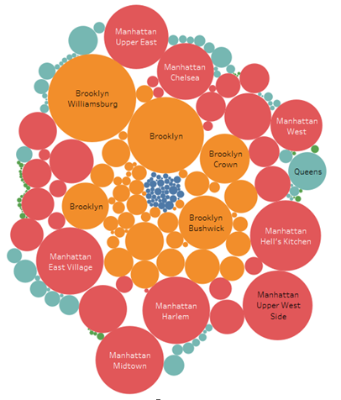
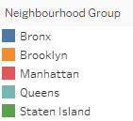
LESSER REVENUE FROM SMALLER CITIES IS IMPACTING THE OVERALL GROWTH.
The below bubble chart shows prices area wise:
The top 2 cities(Manhattan and Brooklyn) are contributing 90% as compared to rest.
On an average 142 is charged per night at different listings.
About 72% revenue is from entire home or an apartment followed by private room with 27%.

Slide 6
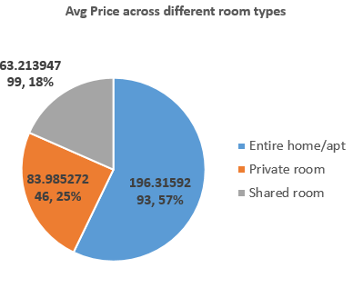
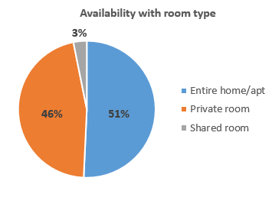
ROOM TYPE CAN HELP YOU TARGET PARTICULAR CUSTOMERS
The availability of Shared room is just 1% of the 3 categories.
About 97% of the rooms available are Entire home and Private room.
The average price across the category is the most with about 57%.

Slide 7
AREAS OF IMPROVEMENT
Target more on the small cities.
Increase the reviews for the lesser known areas.
Increase the availability.

Slide 8
APPENDIX - DATA METHODOLOGY
The following are the sources of our data
The excel sheet provided with various listings their name, location, availability in the NYC.
The reviews data such as review count, reviews per month.
The team gathered information through online sources.

Slide 9
APPENDIX - DATA METHODOLOGY
The analysis on the Airbnb dataset included:
Cleaning the data set using Jupyter notebook.
Using pivot table to compare.
Using tableau to create bubble graph and pie charts.

Slide 10
APPENDIX - DATA ASSUMPTIONS
There were certain gaps due to missing data
The last review date has been considered for date timeline.
The latitude and longitude column is clubbed to get a location.
The 20% of the null values were deleted.

